Slide 1
CAPSTONE PROJECT
Group Name:
Prakash Dakshina

Slide 2
Objective
CredX is a leading credit card provider that gets thousands of credit card applications every year. But in the past few years, it has experienced an increase in credit loss. The CEO believes that the best strategy to mitigate credit risk is to acquire the right customers.
In this project, our task is to help CredX identify the right customers using predictive models. Using past data of the bank’s applicants, we need to determine the factors affecting credit risk, create strategies to mitigate the acquisition risk and assess the financial benefit of your project.

Slide 3
Steps to Problem Solving
Understand the underlying problem and the domain for the problem.
Understand the dataset provided (both Demographic and Credit Bureau) and inspect each attribute of both.
Perform data cleaning on both the data sets. For input dataset of IV analysis, imputing values needs to be ignored.
Choose each data-set individually and perform Exploratory Data Analysis to anticipate the significant variables.
Work of Evidence (WoE) and Information Value (IV) analysis and preparing WoE transformed dataset.
Take Demographic data-set and perform WoE transformation and also obtain significant variables based on IV.
Merge Demographic data-set with Credit Bureau dataset and do WoE transformation and get significant variables.
Use both the original clean data-set and WoE transformed data set of demographics separately to prepare data models. For this bi-logit problem model preparation, begin with simple models like Logistic Regression model with RFE and step by step move on to relatively complex models like Logistic Regression with Regularization, Decision Tree, Random Forest etc. Following steps needs to be considered in each model building process :
Initially the dataset needs to be divided into Test and Train dataset.
There is a class imbalance in the dataset. This needs to be handled using balanced class during each model preparation.
Cross Validation needs to be done for each model.
Additional validation of data should be done on the dataset on the rejected applications (performance tag null) ignored for model building.
Hyperparameters for each type of models need to be optimized properly using GridSearch and model coming with optimized parameter should be chosen.

Slide 4
Steps to Problem Solving (continued …)
The above step also needs to be carried out for merged data set of demographic and Credit Bureau.
Evaluate all the models based on the following parameters :
Confusion matrix should be prepared for each model.
Sensitivity, specificity, accuracy curve for each model with different cut-offs.
AUC-ROC curve for the model using cut-off values for each model.
Precision and Recall curve for cut-off should be generated.
Gini-Index needs to be evaluated for Tree based models like decision tree and random forest.
Within each model type evaluation using GridSerach based on recall values should be done to get models with optimized hyperparameters.
For evaluation among models, the dataset for rejected applications (with performance tag missing), which were assumed as potentially defaulters should be considered for evaluations. Ideally, the output for all these applications should be defaulters.
The apt two stable and optimized models (with stable characteristics) - one for demographics and second for combined data needs to be chosen.
On the basis of the chosen model and significant variables in the model, two application scorecard should be prepared for the two models.
Access the financial benefits of the project by checking the underlying matrices that get optimized.
Present all the results obtained in all the above steps to the management.

Slide 5
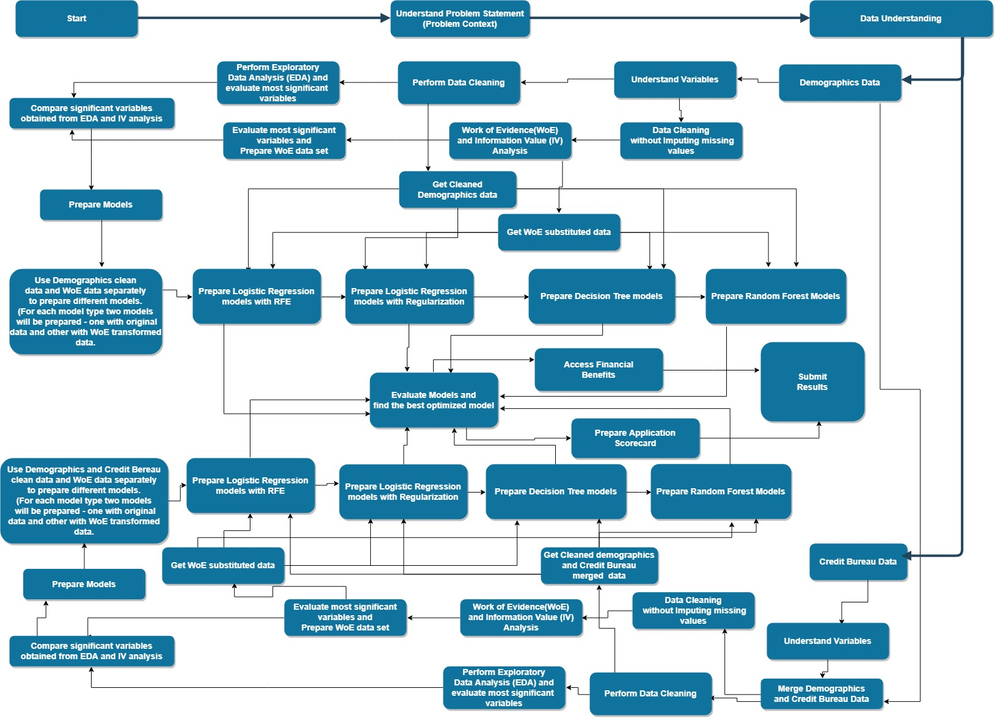
Problem Solving Methodology

Slide 6
Data Understanding
There are two data sets in this project: Demographic and Credit bureau data.
Demographic/application data: This is obtained from the information provided by the applicants at the time of credit card application. It contains customer-level information on age, gender, income, marital status, etc.
Credit bureau data: This is taken from the credit bureau and contains variables such as 'number of times 30 DPD or worse in last 3/6/12 months', 'outstanding balance', 'number of trades', etc.
Both files contain a performance tag, which indicates whether the applicant has gone 90 days past due (DPD) or worse in the past 12 months (i.e. defaulted) after getting a credit card.
In some cases, it is observed that all the variables in the credit bureau data are zero and credit card utilization is missing. These represent cases in which there is a no-hit in the credit bureau. The cases with missing credit card utilization are also observed. These are the cases in which the applicant does not have any other credit card.

Slide 7
Data Understanding and Handling Data Issues for Demographic Data
Variable Name | Description | Data Issues and their handling
Application Id | Unique Ids of the customer | 3 non-unique Application Id values (6 records) were found. On manual check, it was found that the underlying customers with both records were different. All the 6 records, being less in number were removed considering them as junk data.
Age | Age of customer | One customer had negative age (age was -3). 19 customers had age as 0. 45 customers had age less than 18 (assuming a person with age less than 18 is not eligible for applying the card). The age for all the above record was set as 18.
Gender | Gender of Customer | Gender was missing for 2 customers. These were imputed as ‘M’ based on maximum value counts (mode).
Marital Status | Marital status of customer (at the time of application) | Marital Status was missing for 6 customers. Missing values were imputed as ‘Married’ based on maximum value counts (mode).
Income | Income of customers | Income was negative for 81 customers. This negative count was imputed with median value.

Slide 8
Data Understanding and Handling Data Issues for Demographic Data (continued …)
Variable Name | Description | Data Issues and their handling
No. of Dependents | No. of children of customers | No. of children were missing for 3 customers. All these 3 customers had Marital status ‘Married’. So, the values were imputed with value 3 based on maximum occurring value.
Education | Education of customers | Education was missing for 119 customers. Missing values were imputed with value ‘UNKNOWN’.
Profession | Profession of customers | Profession was missing for 14 customers. Missing values were imputed with 'SAL’ based on maximum occurring values.
Type of Residence | Type of residence of customers | Residence type was missing for 8 customers. Missing values were imputed with 'Rented’ based on maximum occurring values.
No. of months in current residence | No of months in current residence of customers
No of months in current company | No of months in current company of customers
Performance Tag | Status of customer performance (" 1 represents "Default") | Performance Tag was missing for 1425 customers. All these customers were removed from the data set as Credit Card was never issued to these customers.

Slide 9
Data Understanding and Handling Data Issues for Credit Bureau Data
Variable Name | Description | Data Issues and their handling
Application Id | Customer application ID | 3 non-unique Application Id values (6 records) were found. On manual check, it was found that the underlying customers with both records were different. All the 6 records, being less in number were removed considering them as junk data.
No of times 90 DPD or worse in last 6 months | Number of times customer has not payed dues since 90 days in last 6 months
No of times 60 DPD or worse in last 6 months | Number of times customer has not payed dues since 60 days in last 6 months
No of times 30 DPD or worse in last 6 months | Number of times customer has not payed dues since 30 days in last 6 months
No of times 90 DPD or worse in last 12 months | Number of times customer has not payed dues since 90 days in last 12 months
No of times 60 DPD or worse in last 12 months | Number of times customer has not payed dues since 60 days in last 12 months

Slide 10
Data Understanding and Handling Data Issues for Credit Bureau Data (continued …)
Variable Name | Description | Data Issues and their handling
No of times 30 DPD or worse in last 12 months | Number of times customer has not payed dues since 30 days in last 12 months
Avgas CC Utilization in last 12 months | Average utilization of credit card by customer | This was missing for 1058 customers. This missing values were imputed by median value except for the values where Outstanding Balance was missing (in that scenario it was imputed with 0).
No of trades opened in last 6 months | Number of times the customer has done the trades in last 6 months | This was missing for 1 customer. Missing value was imputed with the maximum occurring value.
No of trades opened in last 12 months | Number of times the customer has done the trades in last 12 months
No of PL trades opened in last 6 months | No of PL trades in last 6 month of customer
No of PL trades opened in last 12 months | No of PL trades in last 12 month of customer
No of Inquiries in last 6 months (excluding home & auto loans) | Number of times the customers has inquired in last 6 months

Slide 11
Data Understanding and Manipulation for Credit Bureau Data (continued …)
Variable Name | Description | Data Issues and their handling
No of Inquiries in last 12 months (excluding home & auto loans) | Number of times the customers has inquired in last 12 months
Presence of open home loan | If the customer has home loan (1 represents "Yes") | This was missing for 272 customers. This was assumed that these haven’t taken home loan so imputed with 0.
Outstanding Balance | Outstanding balance of customer | This was missing for 272 customers. This was assumed that these haven’t taken/applied any credit card yet so imputed with 0.
Total No of Trades | Number of times the customer has done total trades
Presence of open auto loan | If the customer has auto loan (1 represents "Yes")
Performance Tag | Status of customer performance (" 1 represents "Default") | Performance Tag was missing for 1425 customers. All these customers were removed from the data set as Credit Card was never issued to them.

Slide 12
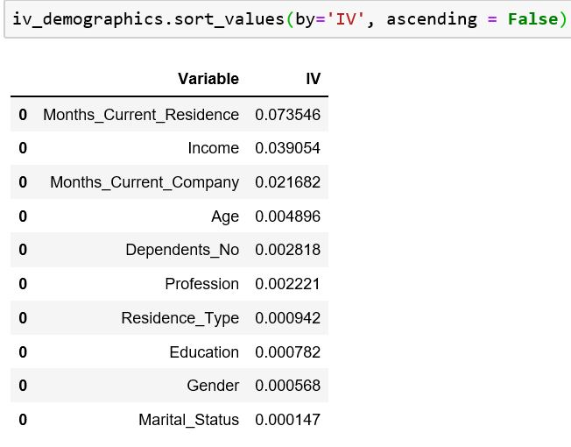
EDA and WoE / IV Analysis for Demographic Data
Following predictor variables were obtained as part of EDA and WoE Analysis for Demographic data
(top five based on IV values).
Months_Current_Residence
Income
Months_Current_Company
Age
Dependents_No
The overall information value of the data set was 0.1467.

Slide 13
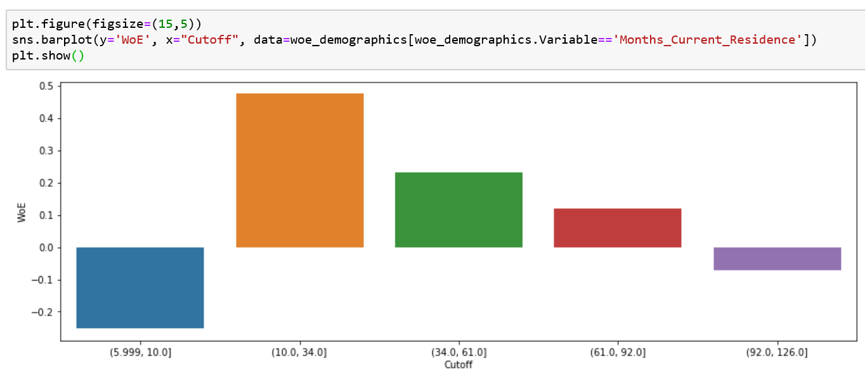
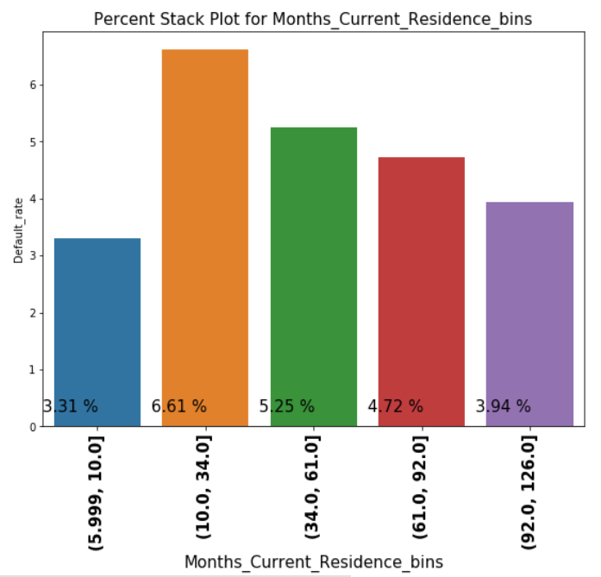
Understanding Months_Current_Residence as predictor demographic variable
The WoE values across rising in bins show monotonic decrease in WoE as months of current residence increase across bins (except the lowest value bin).
Similar trend of monotonic decrease is also observed in the bar plot for the bins created for Number of months in current residence.

Slide 14
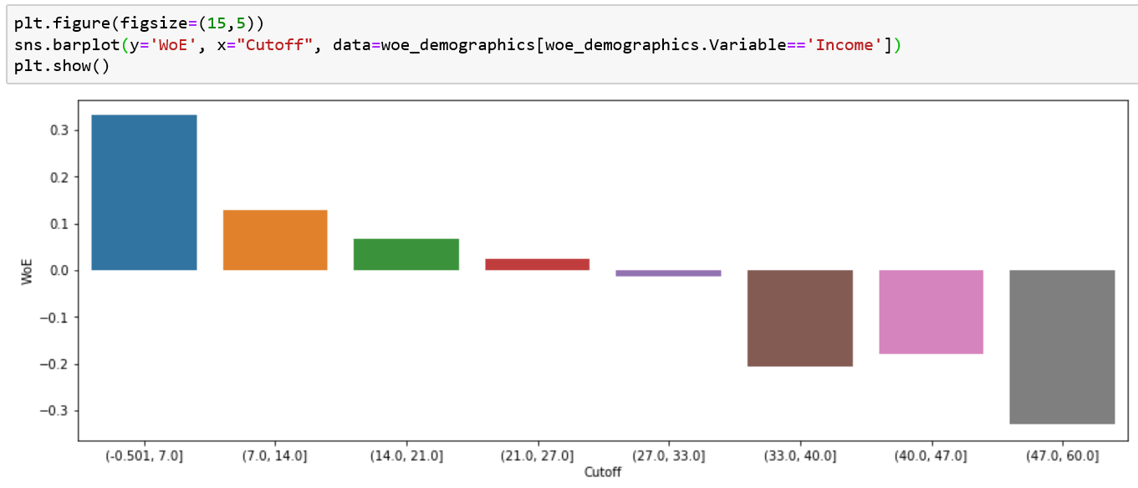
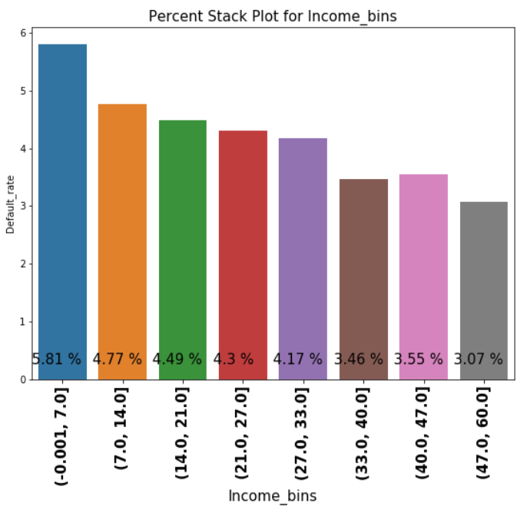
Understanding Income as predictor demographic variable
The WoE and bins plot chart shows monotonic decrease in default rate as income increase across bins.
Similar trend is observed across Income bins plotted along the bar plot which shows decrease in percentage of defaulters across income bins.

Slide 15
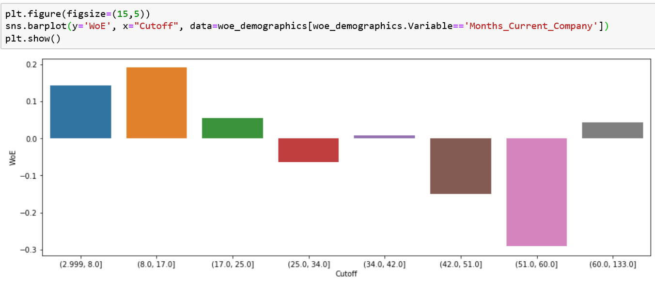
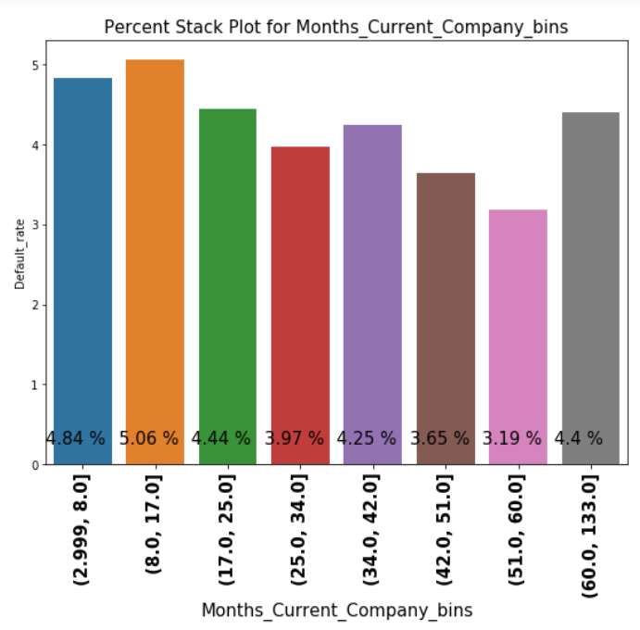
Understanding Months_Current_Company as predictor demographic variable
The WoE and bins plot chart shows monotonic decrease in default rate as Months_Current_Company increase across bins (with some exceptions).
Similar trend is observed across Months_Current_Company bins plotted along the bar plot which shows decrease in percentage of defaulters across bins.

Slide 16
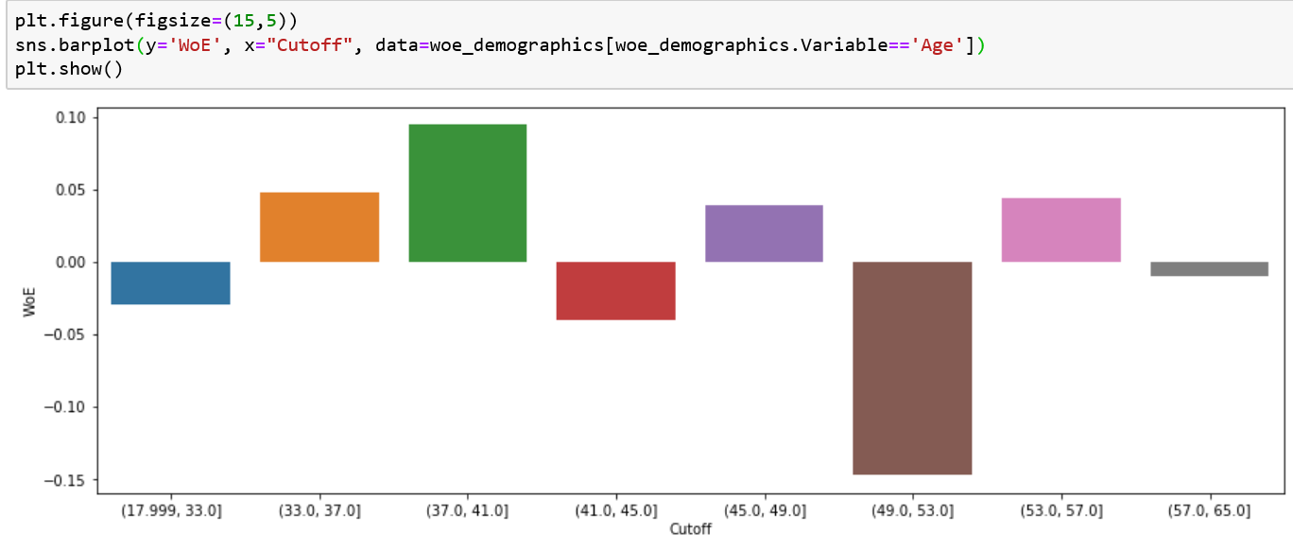
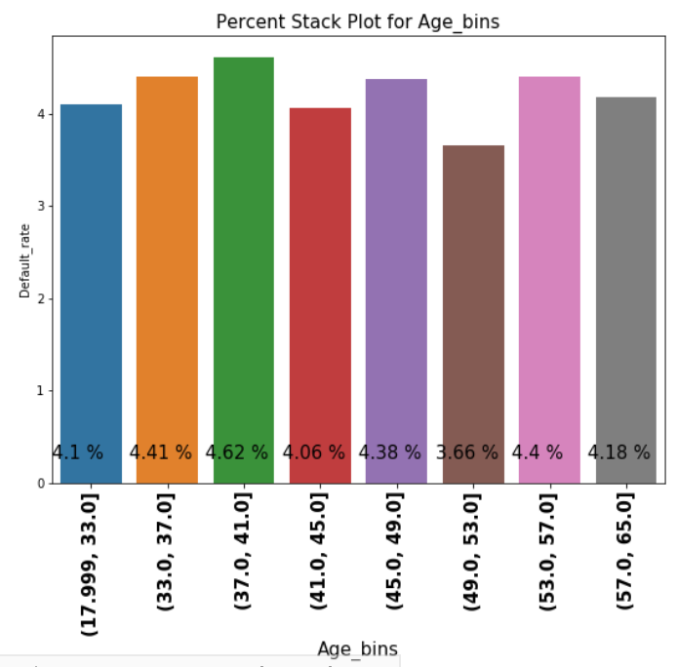
Understanding Age as predictor demographic variable
The WoE and bins plot chart shows variations across Age group bins.
Similar kind of variations are also observed in bar plot for Age bins created.

Slide 17
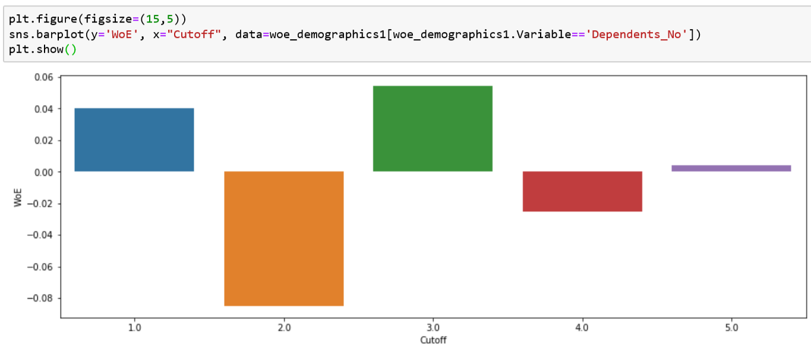
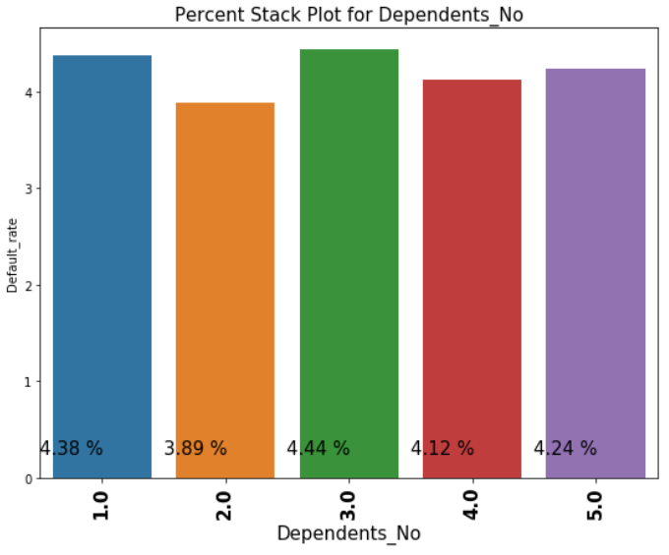
Understanding Dependent No. as predictor demographic variable
The Dependent No. is the fifth significant variable as per IV analysis and there is a big fall in the Information value as comparison to fourth significant variable.
Although this variable is significant as per IV value, the bar plot is unable to convey much to be classified as trend.

Slide 18
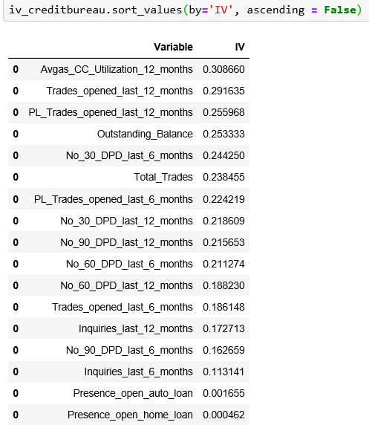
EDA and WoE / IV Analysis for Credit Bureau Data
Following predictor variables were obtained as part of EDA and WoE Analysis for Credit Bureau data
(top five based on IV values).
Avgas_CC_Utilization_12_months
Trades_opened_last_12_months
PL_Trades_opened_last_12_months
Outstanding_Balance
Inquiries_last_12_months
The overall information value of the data set was 3.287.

Slide 19
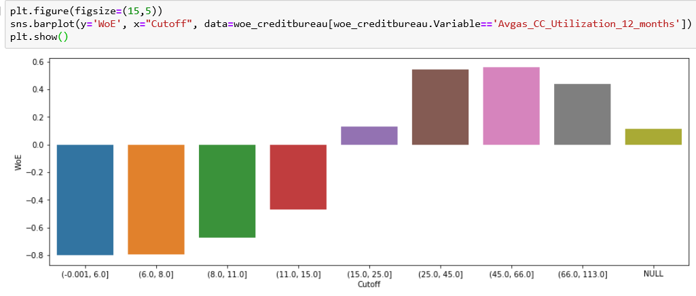
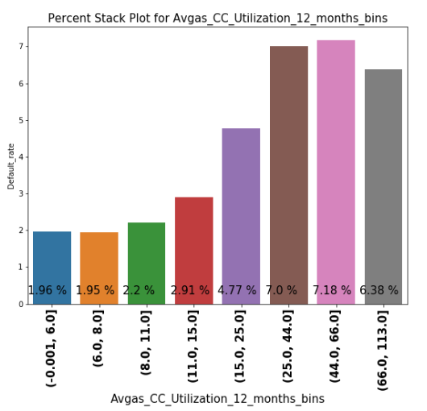
Understanding Avgas_CC_Utilization_12_months as predictor Credit Bureau variable
The WoE values across rising in bins show monotonic increase in WoE as Avgas_CC_Utilization_12_months increase across bins (except highest values bin).
Similar trend of monotonic increase in defaulter's percent is also observed in the bar plot for the bins created for Avgas_CC_Utilization_12_months.

Slide 20
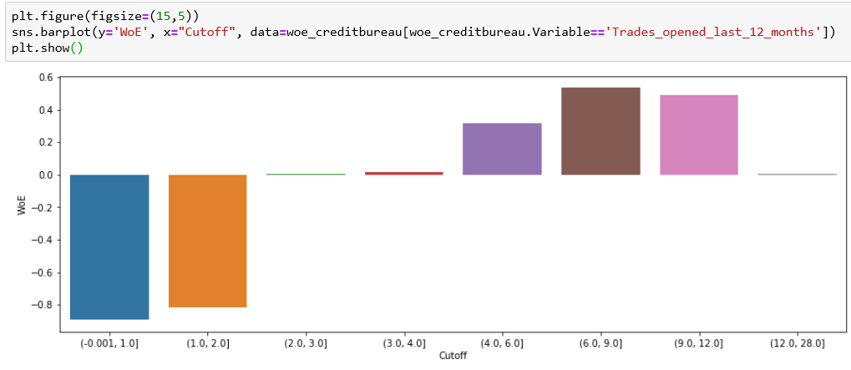
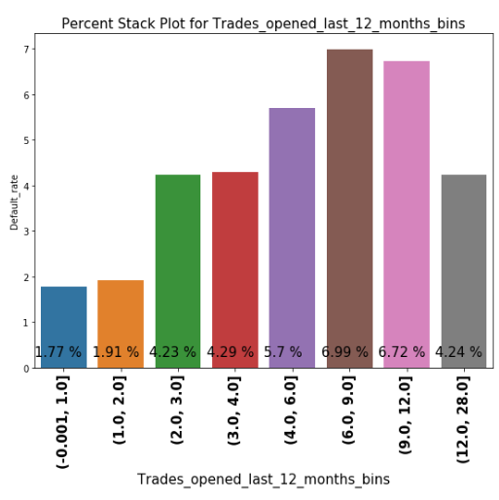
Understanding Trades_opened_last_12_months as predictor Credit Bureau variable
The WoE values across rising in bins show monotonic increase in WoE as Trades_opened_last_12_months increase across bins (except the highest value bins).
Similar trend of monotonic increase in default percent is also visible in the bar plot for the bins created for Trades_opened_last_12_months.

Slide 21
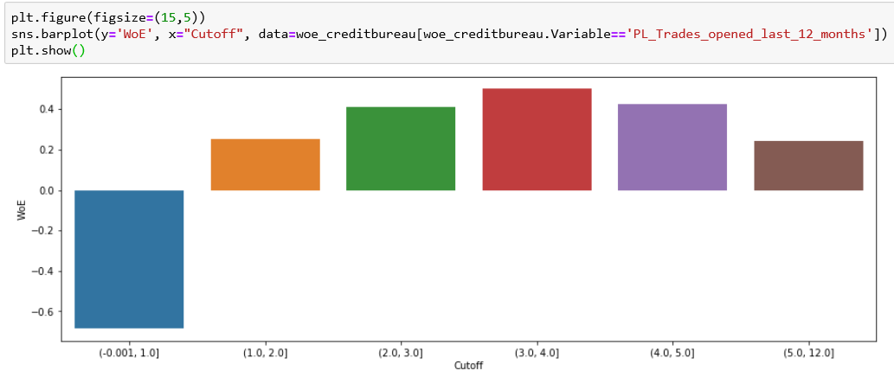
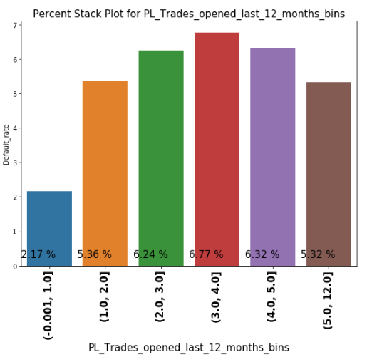
Understanding PL_Trades_opened_last_12_months as predictor Credit Bureau variable
The WoE values across rising in bins show monotonic increase and then monotonous decrease as PL_Trades_opened_last_12_months increase across bins.
Similar trend of monotonic increase and decrease in default percent is also observed in the bar plot for the bins created for PL_Trades_opened_last_12_months.

Slide 22
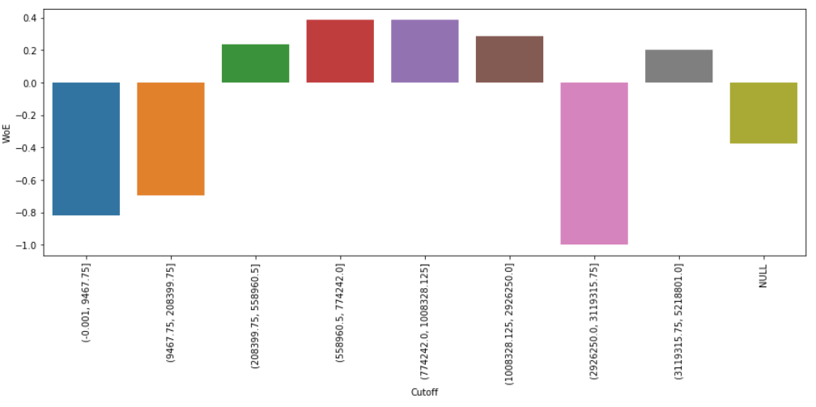
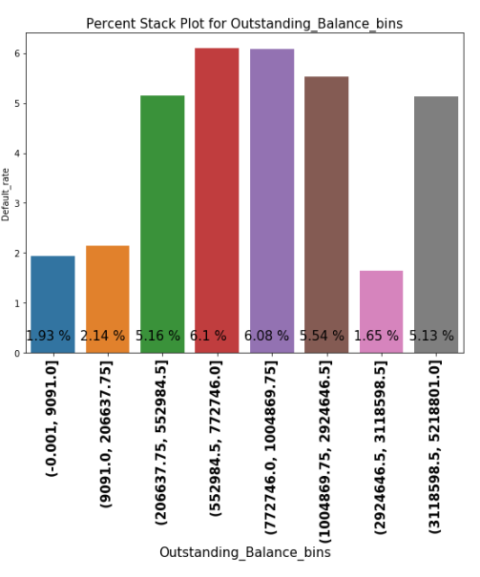
Understanding Outstanding_Balance as predictor Credit Bureau variable
The WoE values across rising in bins show monotonic increase in WoE and then monotonous decrease as Outstanding_Balance increase across bins.
Similar trend of monotonic increase and decrease in default percent is also observed in the bar plot for the bins created for Outstanding_Balance.

Slide 23
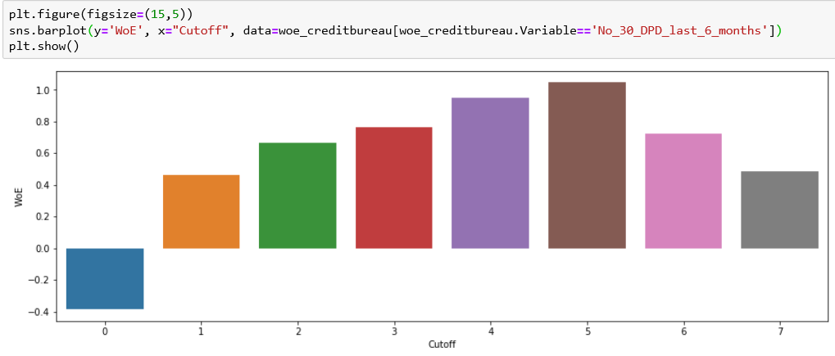
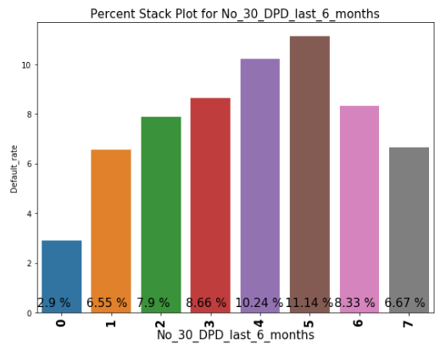
Understanding No_30_DPD_last_6_months as predictor Credit Bureau variable
The WoE values across rising in bins show monotonic increase and then monotonous decrease as No_30_DPD_last_6_months increase across bins.
Similar trend of monotonic increase and decrease in default percent is also observed in the bar plot for the bins created for No_30_DPD_last_6_months.

Slide 24
Model Building
Data Sets chosen for model
Demographics data set
Demographics WoE transformed data set
Combined (Demographics and Credit Bureau) data set
Combined (Demographics and Credit Bureau) WoE transformed data set
4 models for each data set
Logistic regression with RFE
Logistic regression with regularization
Decision tree
Random forest
Total 16 models

Slide 25
Model Building Results for Demographics Dataset
Model | Accuracy (Test data) | Precision (Test data) | Recall (Test data) | Precision (Rejected app. data) | Recall (Rejected app. data)
Logistic Regression | 78% | 5.46% | 26% | 100% | 58%
Logistic Regression with Regularization | 54.16% | 5.1% | 56.06% | 100% | 66.31%
Decision Tree | 56.35% | 5.18% | 54.13% | 100% | 51%
Random Forest | 62.20% | 6.17% | 56.06% | 100% | 30%
Hyperparameters chosen to tune the model:
Logistic Regression with Regularization
C : 0.1
Penalty : L1
Random Forest
max_depth : 4
min_samples_leaf : 350
min_samples_split : 400
n_estimators : 1000
max_features : 10
Logistic Regression
AUC: 0.57
Cut off point: 0.05
Decision tree
max_depth : 5
min_samples_leaf : 100
min_samples_split : 50
Criterion : gini

Slide 26
Model Building Results for Demographics-WoE transformed Dataset
Model | Accuracy (Test data) | Precision (Test data) | Recall (Test data) | Precision (Rejected app. data) | Recall (Rejected app. data)
Logistic Regression | 73% | 6.32% | 39.42% | 100% | 58.31%
Logistic Regression with Regularization | 59.89% | 5.85% | 57.03% | 100% | 77.26%
Decision Tree | 62.48% | 5.80% | 52.46% | 100% | 57.68%
Random Forest | 63.41% | 5.96% | 52.57% | 100% | 73.47%
Hyperparameters chosen to tune the model:
Logistic Regression with Regularization
C : 0.1
Penalty : L1
Random Forest
max_depth : 4
min_samples_leaf : 300
min_samples_split : 450
n_estimators : 1000
max_features : 2
Logistic Regression
AUC: 0.60
Cut off point: 0.05
Decision tree
max_depth : 5
min_samples_leaf : 200
min_samples_split : 50
Criterion : gini

Slide 27
Model Building Results for Combined (Demographics and Credit Bureau) data set
Model | Accuracy (Test data) | Precision (Test data) | Recall (Test data) | Precision (Rejected app. data) | Recall (Rejected app. data)
Logistic Regression | 68% | 7% | 51% | 100% | 93.96%
Logistic Regression with Regularization | 58% | 6.45% | 66.70% | 100% | 99.36%
Decision Tree | 53.90% | 6.52% | 74.63% | 100% | 95.29%
Random Forest | 57% | 6.79% | 72.36% | 100% | 99.92%
Hyperparameters chosen to tune the model:
Logistic Regression with Regularization
C : 0.01
Penalty : L1
Random Forest
max_depth : 4
min_samples_leaf : 350
min_samples_split : 400
n_estimators : 900
max_features : 15
Logistic Regression
AUC: 0.67
Cut off point: 0.05
Decision tree
max_depth : 5
min_samples_leaf : 50
min_samples_split : 200
Criterion : gini

Slide 28
Model Building Results for Combined (Demographics and Credit Bureau)-WoE dataset
Model | Accuracy (Test data) | Precision (Test data) | Recall (Test data) | Precision (Rejected app. data) | Recall (Rejected app. data)
Logistic Regression | 65% | 7.15% | 61.03% | 100% | 97.89%
Logistic Regression with Regularization | 58.43% | 6.78% | 68.75% | 100% | 97.54%
Decision Tree | 53.87% | 6.49% | 73.34% | 100% | 99.78%
Random Forest | 57.28% | 6.75% | 70.54% | 100% | 99.85%
Hyperparameters chosen to tune the model:
Logistic Regression with Regularization
C : 0.01
Penalty : L1
Random Forest
max_depth : 4
min_samples_leaf : 350
min_samples_split : 400
n_estimators : 900
max_features : 10
Logistic Regression
AUC: 0.67
Cut off point: 0.05
Decision tree
max_depth : 5
min_samples_leaf : 200
min_samples_split : 50
Criterion : entropy

Slide 29
Model Evaluation Techniques
Basis of Evaluation To Get Optimal Model for each type:
The objective of the model is to optimize Sensitivity / Recall .
Confusion matrix prepared for each model.
Sensitivity, specificity, accuracy curve for Logistic Regression models.
AUC-ROC curve for the Logistic Regression models using cut-off values for each model.
Choice of Regularization (L1 or L2) for Regularization Model.
Plots showing optimized values for Regularization hyperparameter.
Use of GridSearchCV and plotting its results for all models.
Gini-Index needs to be evaluated for Tree based models like decision tree and random forest.
Within each model type evaluation using GridSerach based on recall values should be done to get models with optimized hyperparameters.
For evaluation among models, the dataset for rejected applications (with performance tag missing), which were assumed as potentially defaulters should be considered for evaluations. Ideally, the output for all these applications should be defaulters.

Slide 30
Model Evaluation
Final Model chosen : Random Forest model on WoE transformed Combined data set.
Reasons for Choosing this Model :
The model gave good recall values on Test data (which is our objective).
The model was able to reject almost all the manually rejected applications (work like humans).
It is an ensemble model which means it aggregates various diverse models adding almost all available information across the data.
The mode of operation of this model is very complex. Hence, guessing the prediction logic to forge data will not be possible both by staff members or deliberate defaulters.
The model is very stable. The use of WoE values and multiple decision trees provide this stability. The WoE values are bound to show less variance making the model stable.
The model is expected to have comparatively long life over others and is expected to have less modifications with time.
It requires no outlier treatment.
The model is expected not to overfit on any data.

Slide 31
Application Scorecard
Model chosen : Logistic regression with Lasso regularization on WOE transformed Combined data set
Scorecard Evaluation variables and formulae :
target_score = 400
target_odds = 10
pts_double_odds = 20
factor = pts_double_odds / log10(2)
offset = target_score - factor × log10(target_odds)
scorecard['logit’] = ∑ (β×WoE) + α
(where β — logistic regression coefficient and α — logistic regression intercept)
Finally, scorecard['score'] = offset - factor × scorecard['logit']

Slide 32
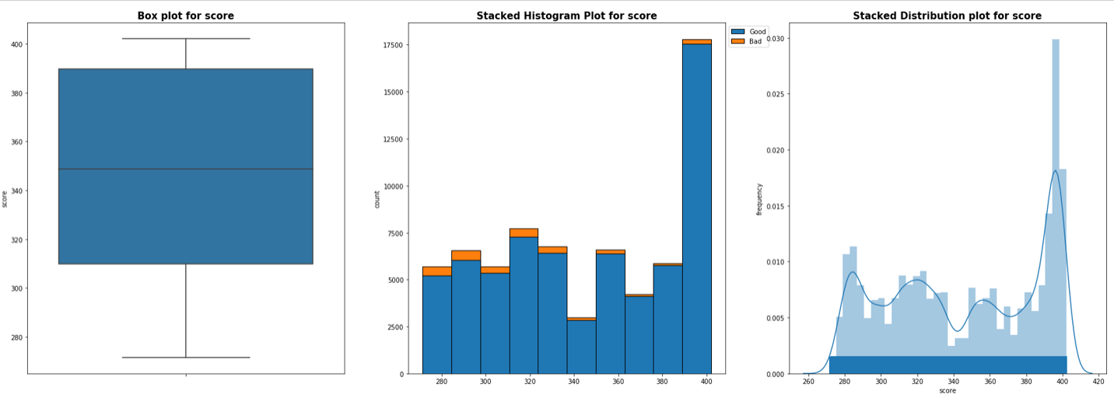
Application Scorecard Variation Plots
Overall Scorecard Variation Plots

Slide 33
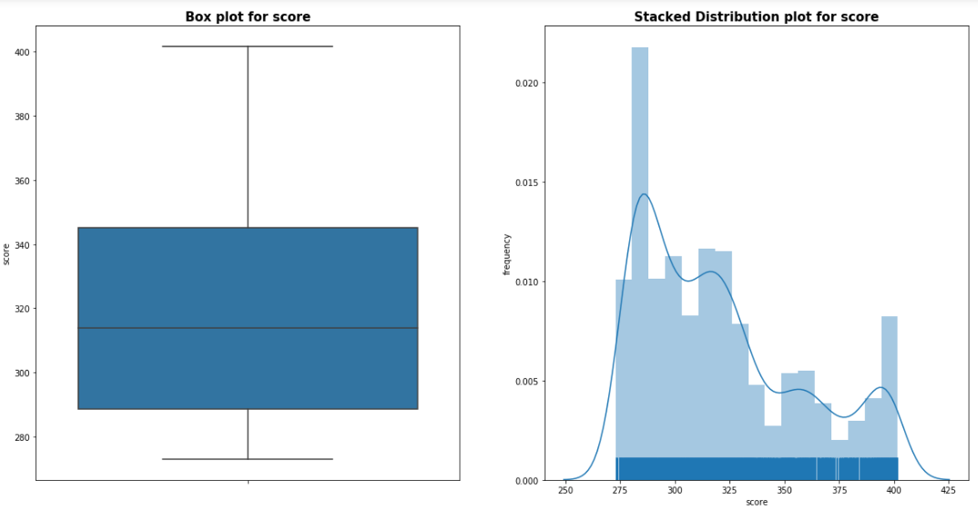
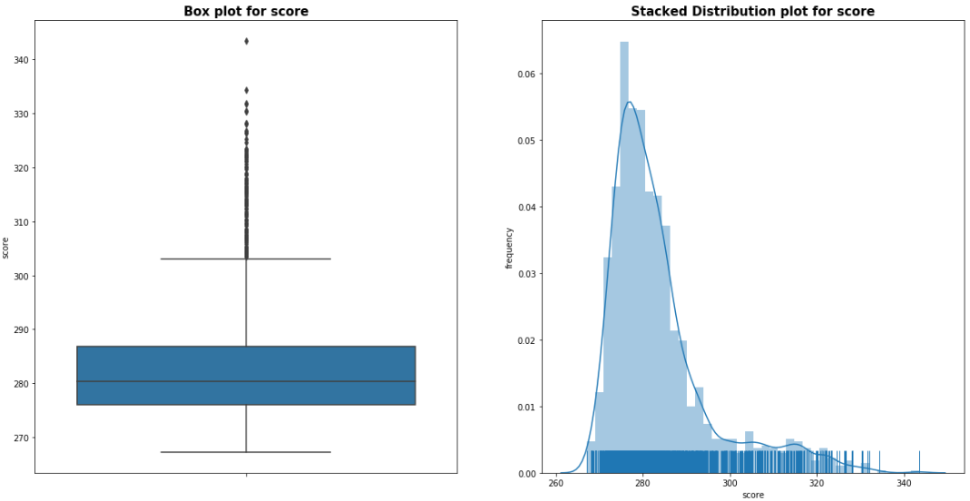
Application Scorecard Variation Plots continued …
Defaulters Scorecard Plots
Rejected Population Scorecard Plots

Slide 34
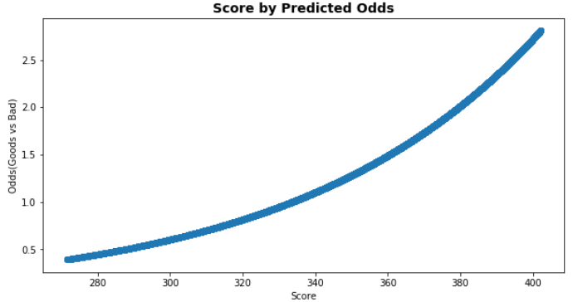
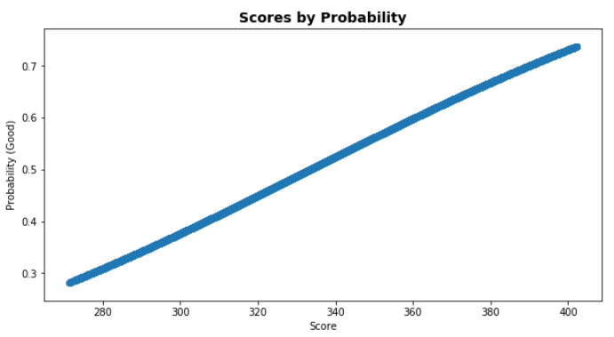
Application Scorecard
Cut-Off : 330
Reason for Choosing this Cut-Off
Recommended Strategy “Acquire the right customers” (a bit conservative owing to previous losses)
Caters almost all the rejected population
Prevents two-third of the default cases.
Impacts one-third of the approved cases.
A less cut-off would dilute the purpose of the model.
A higher cut-off will impact the business of the bank.
Discussions and recommendations by CredX Operations and Strategy team may change this cut-off.

Slide 35
Benefits of ML model
Our objective is to minimize “Net Credit Loss’’ from Profit & Loss perspective.
With ML model we get good discriminatory power over pre-identifying risky costumers.
Reduces the cost spent on Underwriters which rejects the application by reviewing manually.
Reduces time for processing of application requests as Underwriters are not involved and the process is automated.
Prevents manual error made by Underwriters.
Any kind of bias can be easily removed which creeps in due to sex, race or religion.
Scorecard and cut-off provides clear instructions as how to proceed with application. Decision making is also fast.

Slide 36
Financial Risk in Current Operations
Total number of applications = 71295
Credit Card given to applicants = 69870
Customers that made Credit Loss = 2948
Assumptions on unit Applications :
Acquisition Cost + Credit Report Cost –100 INR
Calling Cost – 10 calls avg × 10p = 1 INR
Operations {Agents + Infra + Others) = 1000 INR approx.
Credit Default = Rs 48,000 average
For every customer defaulted we are at a risk of loosing 50,000 INR (48k + 2k) on an average (assuming 50K is average credit line used by defaulter)
Total Credit Loss for all customers = 50000 × 2948
= 150 Million INR (approx.)

Slide 37
Financial Benefit of the ML Model
The model giving a recall of 70% which means it is preventing 70% of losses.
Potential Loss prevented with using model = 0.7 × 150 Million INR
= 105 Million INR
Loss after prevention = 150 – 105 Million INR
= 45 Million INR
The Credit loss after applying the model has slashed to 30% compared to the Original Credit loss, which did not include using any model.
Saving the amount paid to Underwriters for Credit application approval is added advantage.
Important Note : There will be a tradeoff between the increase in approval rate and credit loss – increase of one will lead to increase of other. With this model the approval rate is bound to be less business to the bank and so will be the profits of the bank. However, profits are very small in margins (5-7%) as compare to the Principal amount in Credit Line. Hence percentage would be very small overall the Credit Line amount.

Slide 38
Thank You

