Slide 1


Impact of leveraging HPC in Image Processing
DA-212 MLOps – Course Project
Team Members
Om Prakash Animesh Kumar
Sangeethkumar I Parthasarathy Ramesh
Ankitha M

Slide 2
Problem Background
Deep CNN have performed remarkably good on many Computer Vision (Image dataset) tasks.
But, these Neural Networks, need a heavily big amount of dataset, to get good performance (to learn fine tuned parameters).
How to use these Neural Networks, when we have Limited Data (Image data) ?
How do I get more data, if I don’t have “more data”?
Image augmentation is a technique that is used to artificially expand the data-set.
Image Augmentation consists of techniques that rotates/flips/zoom etc. the datasets.

Slide 3
Problem Statement
Image processing incurs a lot of overhead when operating using sequential algorithm .
Application with sequential algorithm can no longer rely on technology scaling to improve performance.
Image processing applications exhibits high degree of parallelism and are excellent source for multi-core platform.
Major challenge of parallel processing is not only aim to high performance but is to give solution in less time and better utilization of resources

Slide 4
Proposed Solution
High Performance Computing helps address this increasing demand for processing speed and analyzing/processing huge amount of data.
We can try to parallelize different image augmentation techniques by leveraging HPC based implementation and bring down the runtime.
Image Rotation
Image Flip
Image Wrapping
Image Zooming
This project focusses on comparison between a normal implementation v/s HPC based implementation.

Slide 5
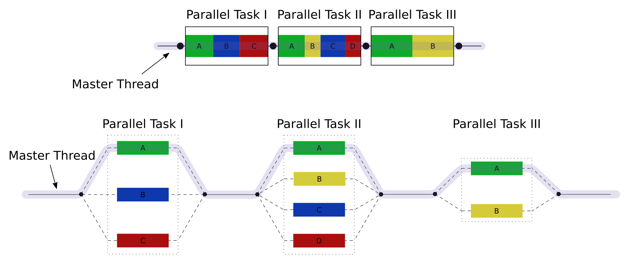
OpenMP
Multithreading implementation.
Master thread executes sequential sections
Master thread forks slave threads
Parallel sections of the code is divided among these slave threads which execute them concurrently
#pragma omp directive indicates parallel block of code
Source : https://en.wikipedia.org/wiki/OpenMP

Slide 6
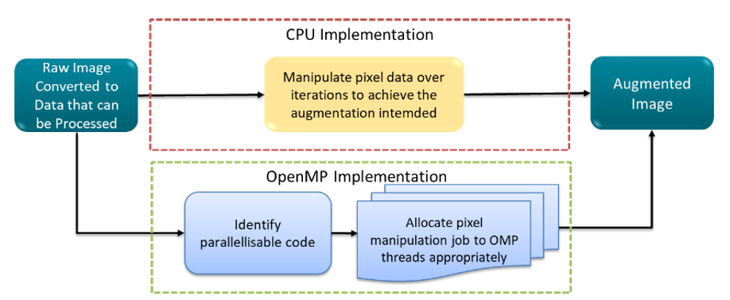
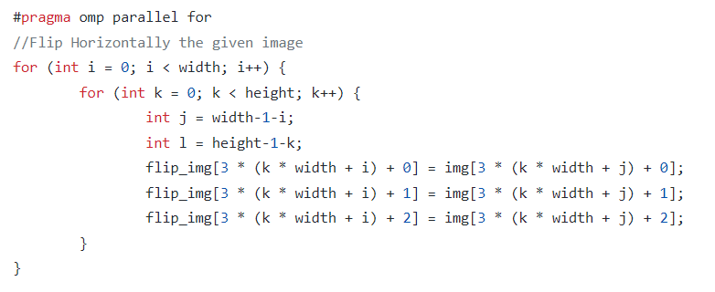
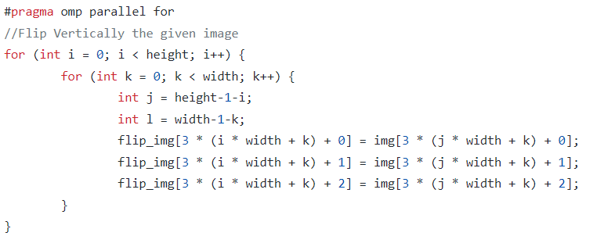
OpenMP Implementation
Vertical and horizontal flipping of images
Task of modifying pixel value is shared among different threads

Slide 7
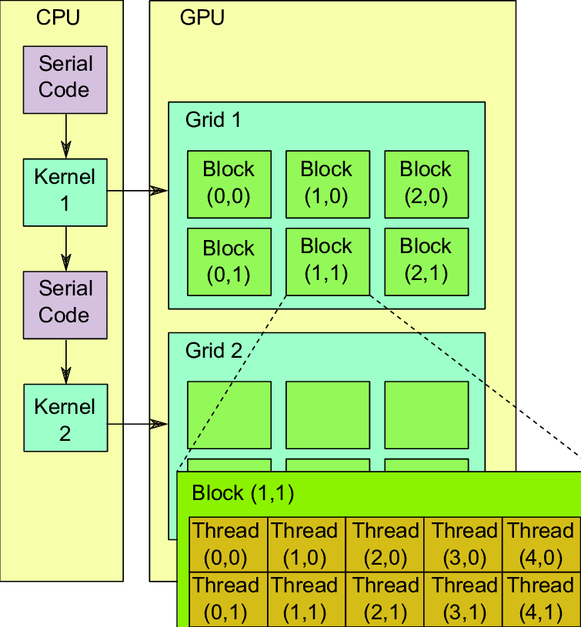
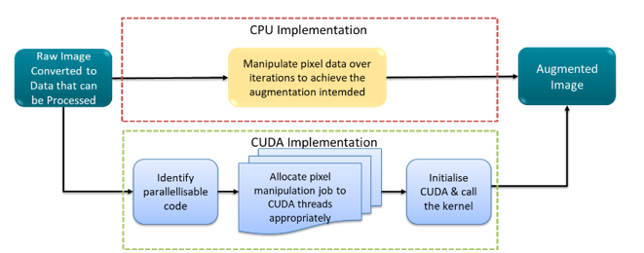
CUDA
Parallel programming which leverages the power of GPU
GPUs have lower clock speed, but since they have huge number of cores, they can efficiently perform parallel processing
Threads are arranged in n dimensions within n dimensional blocks arranged as grids. These are executed by Streaming Processors
Source : https://www.researchgate.net/figure/Schematic-illustration-of-GPU-architecture-and-programming-elements_fig4_274838864

Slide 8
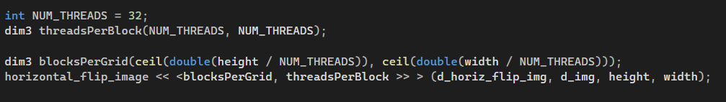
CUDA Implementation
Horizontal, vertical flipping, rotation and scaling up/down of images
Kernel call with 2D grid of blocks .
32x32 threads in each block. Each block handles height/32*width/32 pixels

Slide 9
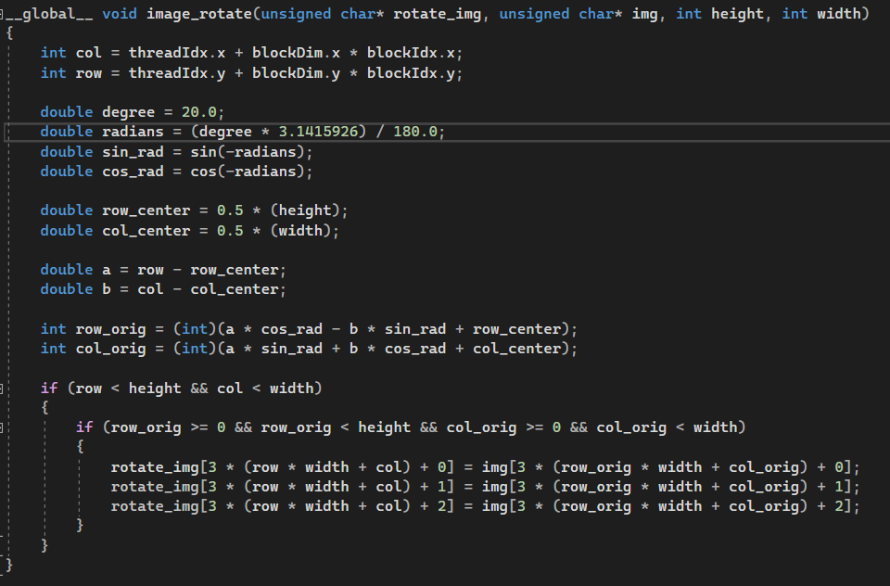
Rotate images

Slide 10
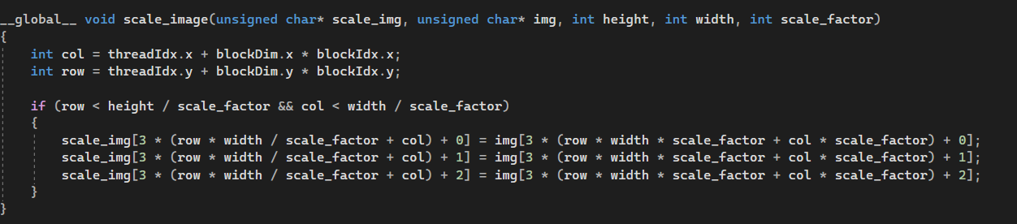
Scaling images

Slide 11
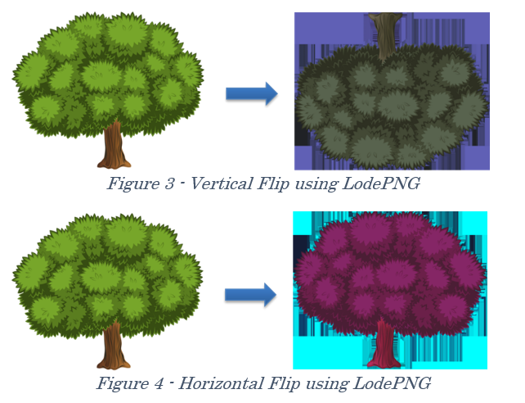
Experiments for loading and saving data
CV::Mat
Challenges : Processing Mat datatype, saving image into GPU, insufficient documentation on GPU Mat. Hence dropped
LoadPng:
Can encode an image into a vector of characters that contain the RBGAlpha information, as well as decode it back into a PNG image
Tried 1D blocks for vertical flip and 2D blocks for horizontal flip
Drawback: Only for PNG images. Encoding is abstracted, so pixel manipulation meddles with contrast/RGB settings of the image
STB is finally used for CUDA based HPC implementation of image augmentation (Vertical Flip, Horizontal Flip, Rotate, Scaling).

Slide 12
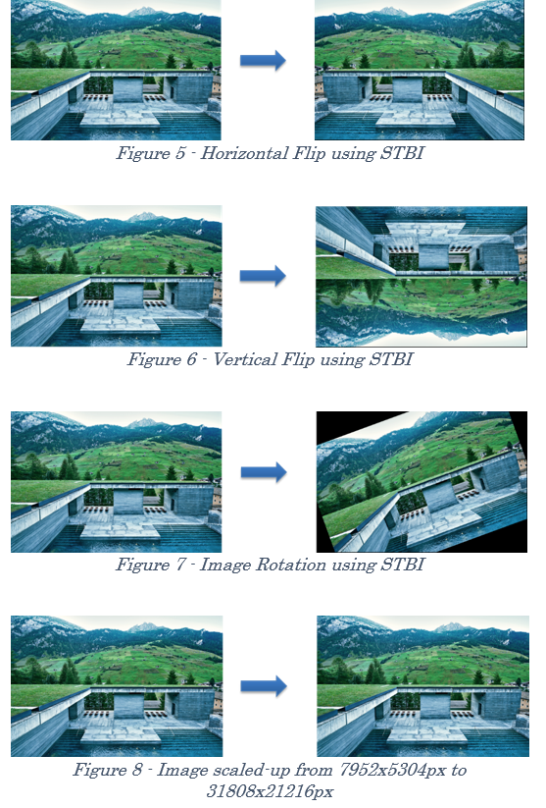
STB Image libraries
Offers an in-built function stbi_load
Also gives the flexibility to load up to 3 channels for a 4-channel image
stibi_image_write functions can be used to save back the image in the disk
More flexible than LoadPNG as it can handle both JPG, PNG etc.
Processing and writing back the processed image is also easier

Slide 13
GitHub Actions CI Introduction
GitHub Actions is a continuous integration and continuous delivery (CI/CD) platform, allows to automate build, test, and deployment pipeline.
GitHub Actions components:
Workflows: A configurable automated process, run one or more jobs. build and test our code in parallel and merge it via pull/push to the project repository.
Events: A specific activity in a repository that triggers a workflow run. Can be activity originated from GitHub on a pull request, opens an issue, or pushes a commit to a repository.
Jobs: A set of steps in a workflow that execute on the same runner, executed in order and are dependent on each other, and can share data from one step to another. Example: Step1 builds application, step2 tests the built application, when all Jobs execute in parallel the packaging job will run finally.
Actions: A custom application for the GitHub Actions platform, performs a complex but frequently repeated task. An action can pull git repository from GitHub, we can write our own actions.
Runners: A server that runs workflows when triggered. Each runner can run a single job at a time.
[1] https://docs.github.com/en/actions/learn-github-actions/understanding-github-actions

Slide 14
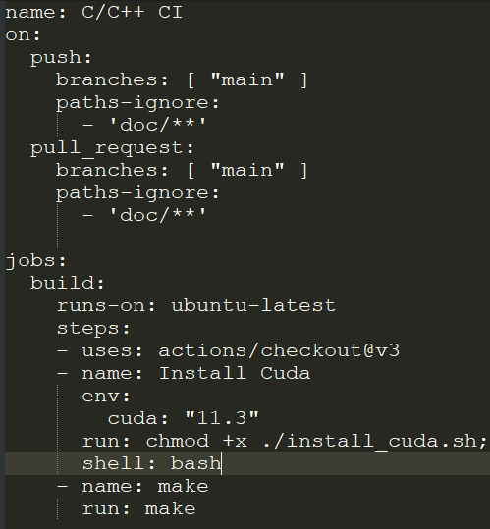
GitHub Actions CI Personalization
For our project Continuous Integration, seamless handling and parallel working we created GitHub project repository[1] and used it’s component as per our project requirement.
Single workflow with one job is used, job: “build” involve multiple steps to install, run build for CUDA and OpenMP make.
To build and test our code in parallel and merge it via pull/push to the project repository.
[1] https://github.com/prakash90om/MLOps_HPC_Image_Processing
Project Schema file: github/workflows/cmake.yml

Slide 15
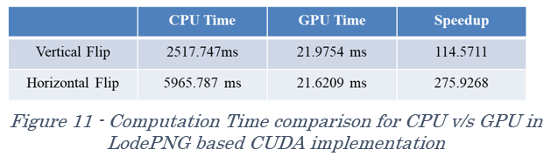
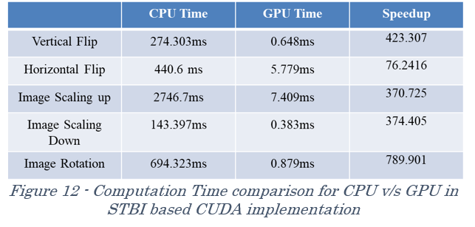
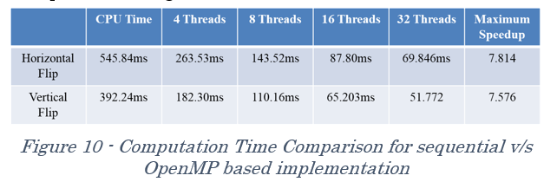
Results

Slide 16
References
1. LodePNG Documentation: https://lodev.org/lodepng
2. OpenMP Documentation: https://www.openmp.org/spec-html/5.0/openmp.html
3. GitHub Actions: https://docs.github.com/en/actions
4. CUDA: https://docs.nvidia.com/cuda/cuda-c-programming-guide/index.html

Slide 17
Thank You!

