Slide 1
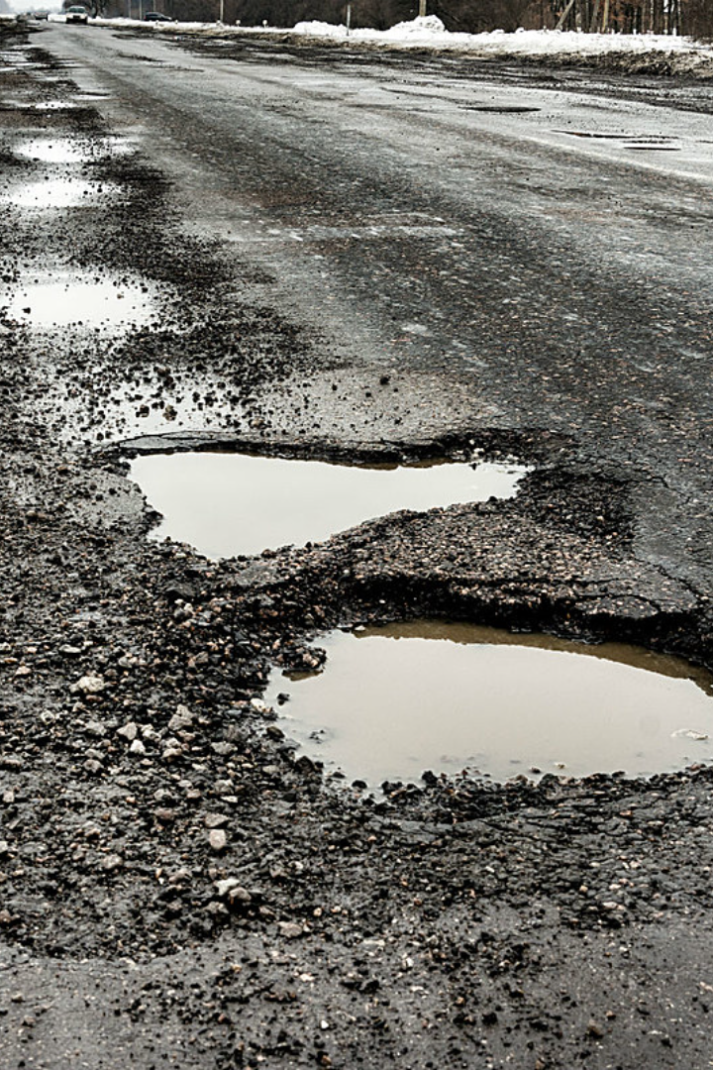
Pothole detection using AI—Team 6
Potholes on roads can cause severe accidents, damage vehicles, and lead to traffic congestion. The use of AI in pothole detection systems can help mitigate these issues and ensure safer roads for all.
Potholes pose a ubiquitous challenge on roadways worldwide, causing a myriad of issues that extend beyond mere inconvenience.
The detrimental effects include compromised road safety, increased vehicle maintenance costs, and a strain on overall infrastructure integrity.
As we navigate through this presentation, we'll explore how innovative Pothole Detection Systems offer a smart and transformative solution to reduce these challenges and improve the road safety.

Slide 2
Traditional Pothole Detection Methods
Visual Inspection
Sensor-based Detection
Complaint Analysis
Road crews manually inspect roads, but this method is time-consuming and prone to human error.
Using sensor technologies like accelerometers and laser profiling, but they have limited accuracy.
Relies on citizens reporting potholes, but it leads to delays in identification and repair.

Slide 3
Importance of pothole detection
Early detection of potholes plays a significant role in protecting the lives by preventing accidents on our roadways.
Besides safety, it prominently lowers the road maintenance costs, ensuring efficient allocation of resources and budget.
Pothole detection systems contribute to the creation of smoother transportation networks, enhancing the overall quality of our roads, infrastructure.
In the essence, the timely identification of potholes is not just a repair strategy; it's a proactive approach to creating a protective, cost-effective, and more efficient and reliable road systems.

Slide 4
YOLO : You Only Use Once
YOLO (You Only Look Once) is an object detection algorithm, and GPT (Generative Pre-trained Transformer) is a language model
YOLO (You Only Look Once):
YOLO is a real-time object detection system which can detect multiple objects in an image or a video frame.
Working : YOLO divides an image into a grid and assigns bounding boxes, class predictions to each grid cell. It then refines the bounding boxes and predicts the class probabilities for each object within those boxes. This approach allows YOLO to make predictions for multiple objects in a single pass, making it computationally efficient.
GPT (Generative Pre-trained Transformer):
GPT is a type of language model based on the transformer architecture. It is designed for natural language understanding and generation tasks.
Working : GPT is pre-trained on a massive amount of text data and learns to generate coherent and contextually relevant text based on the input it receives. It uses a transformer network, which excels at capturing long-range dependencies in data. GPT can be fine-tuned for specific language tasks.

Slide 5
YOLO Segmentation model
YOLO (You Only Look Once) is known for its object detection capabilities(both segmentation and detection) rather than semantic segmentation. However, there have been developments and variations of YOLO to address segmentation tasks as well.
One such model is YOLOv8-Seg, which combines YOLOv8's object detection architecture with a semantic segmentation branch. This allows the model to perform both tasks simultaneously—detecting objects and assigning pixel-wise semantic labels.
The YOLOv8-Seg model typically has two outputs: bounding boxes for object detection and a segmentation map for pixel-level semantic segmentation. The architecture is modified to incorporate both tasks, providing a more comprehensive understanding of the visual content in an image.

Slide 6

The Limitations of Traditional Methods
1
Inefficiency
2
Inaccurate Data
Slow response times and high labor costs for visual inspections.
Missed or misdiagnosed potholes due to limited accuracy of sensor-based systems.
3
Dependency on Citizen Reports
Delayed detection and repair due to reliance on citizen complaints.

Slide 7


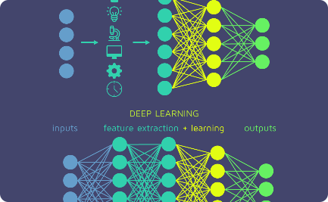
AI-based Pothole Detection
Computer Vision
Machine Learning
Deep Learning
AI algorithms can analyze images and detect potholes accurately.
AI models can learn from data to improve detection accuracy over time.
Deep neural networks enable complex pattern recognition for precise pothole detection.

Slide 8
Implementation of AI-based Pothole Detection
1
Data Collection and Preparation
Gather labeled image data and preprocess it for training the AI model.
Training the AI Model
2
Use advanced machine learning techniques to train the model on the labeled dataset.
3
Real-time Pothole Detection using AI
Deploy the trained model to detect potholes in real-time using computer vision.

Slide 9
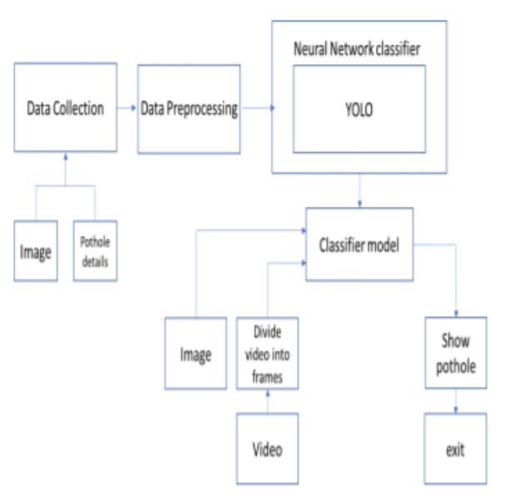
Model

Slide 10
Benefits and Challenges
Benefits of AI-based Pothole Detection
Challenges in Implementing AI-based Detection Systems
Improved accuracy and efficiency
Early detection and timely repairs
Data labeling and preparation
Cost savings in road maintenance
Model training and optimization
Integration with existing road infrastructure

Slide 11
Navigating Challenges: Enhancing Pothole Detection Systems
Few of the navigating challenges to enhance the performance of pothole detection systems are :
Environmental Factors:
Challenge - Pothole detection systems may face issues with the accuracy because of its environmental conditions, such as adverse weather, uneven terrains.
Mitigation - Implementing robust sensor technologies equipped to withstand diverse environmental challenges ensures consistent performance. Current research into weather-resistant sensors is also a promising avenue.
False Positives:
Challenge - The possibility of false positives may result in unwanted repair efforts, resource allocation.
Mitigation - Integration of advanced machine learning algorithms, pattern recognition can refine the system's accuracy, by lowering the number of false positives. Regular updates, system refinement based on real-world data further improves the precision.

Slide 12
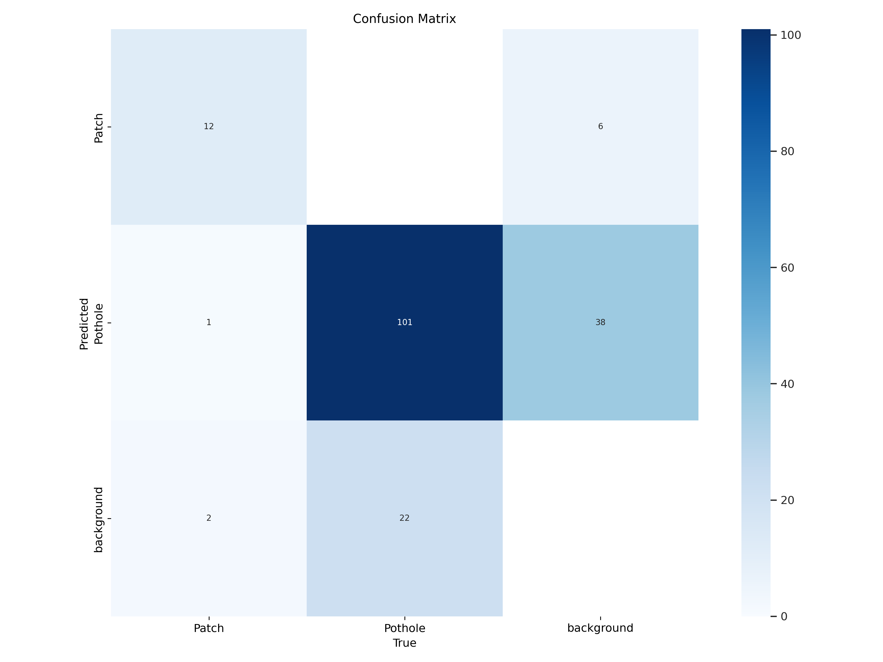
Results:
The performance of the model is shown as a confusion matrix as shown in the slide.
The model has an overall accuracy of 91% in segmenting the potholes and patches.
The accuracy of the model can be further increased by generalizing the model with more trained data on wide scenarios.

Slide 13

Conclusion
AI technology offers great potential for revolutionizing pothole detection.
With improved accuracy and efficiency, AI can enhance road safety and reduce maintenance costs.
Let's embrace this innovative solution for better roads and infrastructure.

