Slide 1
Customer Segmentation
Team Spark
Preetam Reddy Patelu-16341736
Veera Poorna Prakash Reddy Chekkera-16334850
Sreesanth Reddy Samala-16335436
Anil Kumar Thummanapally-16338048

Slide 2
Contents: 1.Abstract 2.About the dataset 3.Implementation 4.Observations 5.Analysis 6.Techniques 7.Results 8.Challenges and future work

Slide 3
Abstract
Customer segmentation refers to the process of dividing a broad consumer business market, normally consisting of existing and potential customers, into sub-groups of consumers based on some type of shared characteristics. In this project we implement it using an online retail database which contains transactions made by customers on an e-commerce website during a period of one year and classify a customer based on region and some other attributes.Using RFM(recency,frequency,monetary) technique we identify the best customers.This gives us a strong position to gain and retain the customers with the help of an efficient marketing team which can push the right offers to corresponding customers.

Slide 4
About the dataset
The dataset which we will be working on is taken from Kaggle,but the data originally comes from “The UCI Machine Learning repository” which contains e-commerce transactions made during an year.
This is a transnational data set for a UK-based and registered non-store online retail which mainly sells unique all-occasion gifts. Many customers of the company are wholesalers.
Dataset consists of 8 columns(Invoice.No,Stock code,Description,Quantity,Invoice date,Unit price,Customer ID,Country) with 542K rows.

Slide 5
Implementation
Part 1: Clean and Analyze the data
Cleaning the data
Exploratory analysis
Feature engineering
Part 2: Creating customer categories
Intermediate dataset grouped by invoices
Final dataset grouped by customers
K-means clustering
Interpreting the clusters

Slide 6
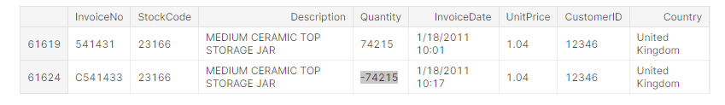
Observations
The dataset contains 90% of the data that is from United Kingdom which is our region of interest.
Data also contains some missing values in “CustomerID” which have been dropped, stock code consists of value “D” which means discount.
Invoice numbers aren’t purely numerical consist of ‘C’ at start and some transactions consist of negative values in quantity as shown below which resembles cancelled orders.

Slide 7
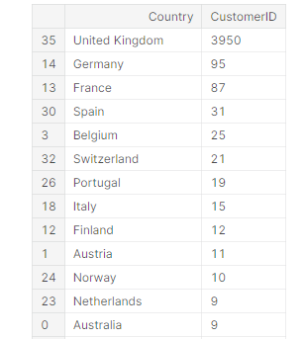
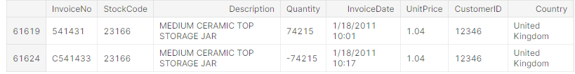
Analysis
This dataset analysis includes clustering,classification,time series analysis and more.
First we group customers based on country(our interest is U.K as majority of data is from U.K),Invoice No.

Slide 8
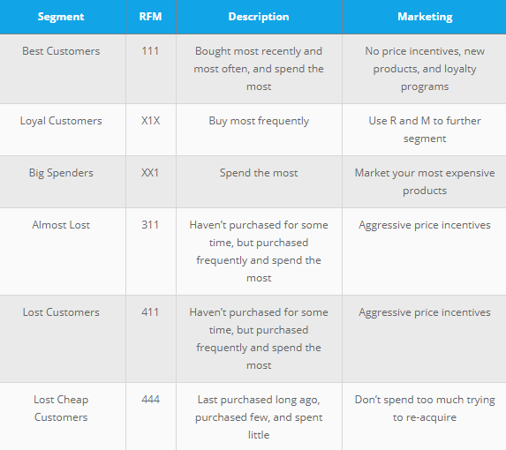
Analysis-Continued
Clustering i.e grouping of customers is done mainly using RFM(Recency,Frequency,Monetary) principle.
From the data we take a Customer’s ID,then link his transactions,invoice date and amount spent,then calculate the RFM score.
Then classify customers as shown in the image.

Slide 9
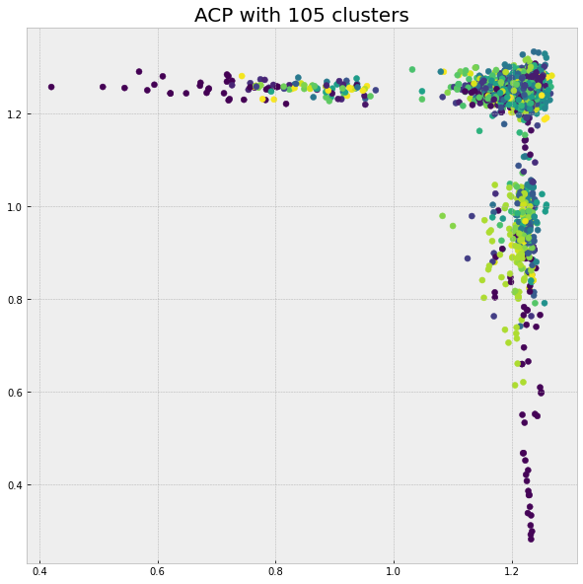
Techniques
RFM (Recency,Frequency,Monetary)
It is a method of consumer segmentation that creates groupings of customers based on their history of purchases and we use the RFM concept to categorize the database's clients.
K-means Clustering
Determine the ideal number of clusters for visualization using the silhouette method. Over a range of feasible values for k, the ideal number of clusters, k, is the one that maximizes the average silhouette.

Slide 10
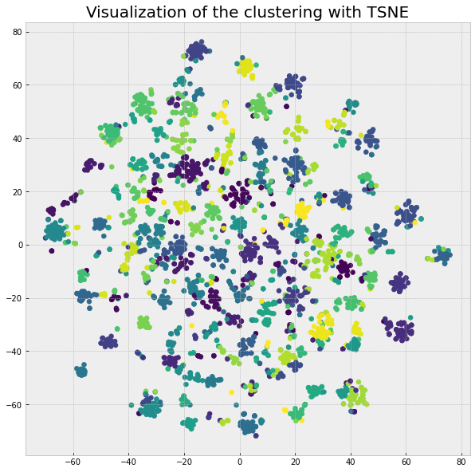
Techniques-Continued
T-SNE
A statistical technique called t-distributed stochastic neighbor embedding (t-SNE) places each data point on a two- or three-dimensional map in order to visualize high-dimensional data.

Slide 11
Results
Classification of customers based on the cluster’s :
Cluster 1: high frequency with a lot of quantity (mean basket price of 478) bought on average and high monetary value (VIP clients).
Cluster 6 : very high purchase frequency with a mean basket price of 60 but good monetary value.
Cluster 2: very high basket price (huge quantity of products bought on average).

Slide 12
Results
Cluster 0: good average customers.
Cluster 7: good and loyal customers.
Cluster 3: almost lost customers.
Cluster 5: highest monetary value but only one or two purchases over the year.
Cluster 4: lost customers.

Slide 13
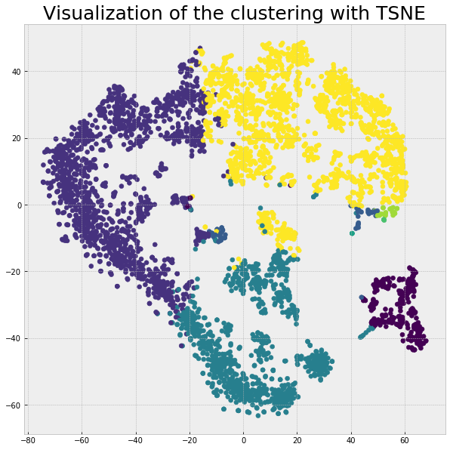

Slide 14
Challenges and Future work
Clustering the customers into categories based on RFM score involves some computational complexity.
We have just selected only one country i.e U.K as region of interest,but can also be extended to other countries.
We can even extend our analysis to every individual customer which provides added advantage for the marketing team to push to right offers to particular customers.

Slide 15

Thank You

