Slide 1
Internet of Things based garbage monitoring system

Slide 2
Presentation Outline
Introduction
Problem in Society
Motive Of Project
Block diagram
Methodology(Hardware/Software)
Application
Conclusions

Slide 3
Introduction
This system is a very innovative system which will help to keep the cities clean.
A web page is build to show the status to the user monitoring it. The web page give a graphical view of the garbage bins and highlights the garbage collected in color in order to show the level of garbage collected.
The LCD screen shows the status of the garbage level.
The system uses ultrasoniv sensors placed over the bins to detect the garbage level and compare it with the garbage bin depth.

Slide 4
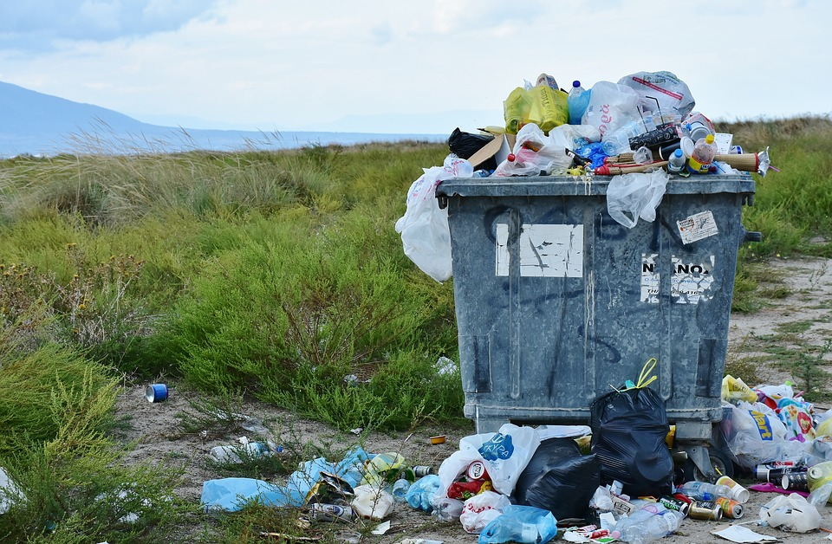
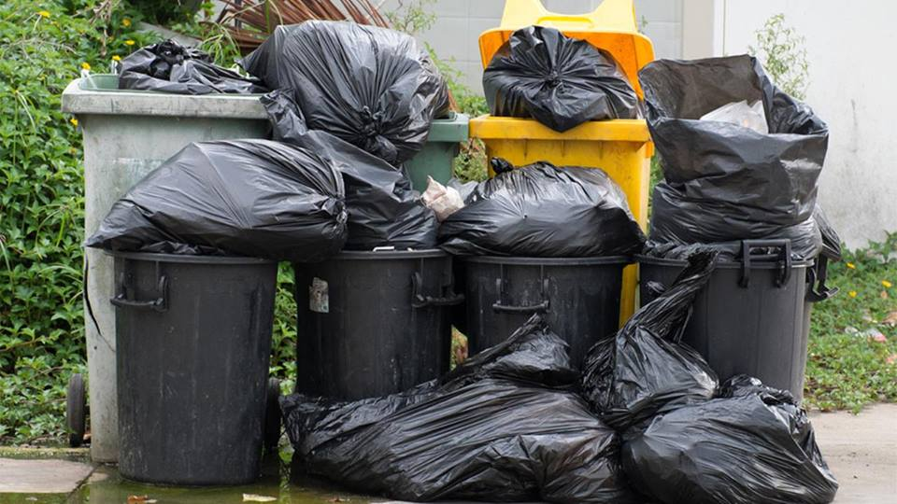
Main Problem
OVER FLOWING OF BIN

Slide 5
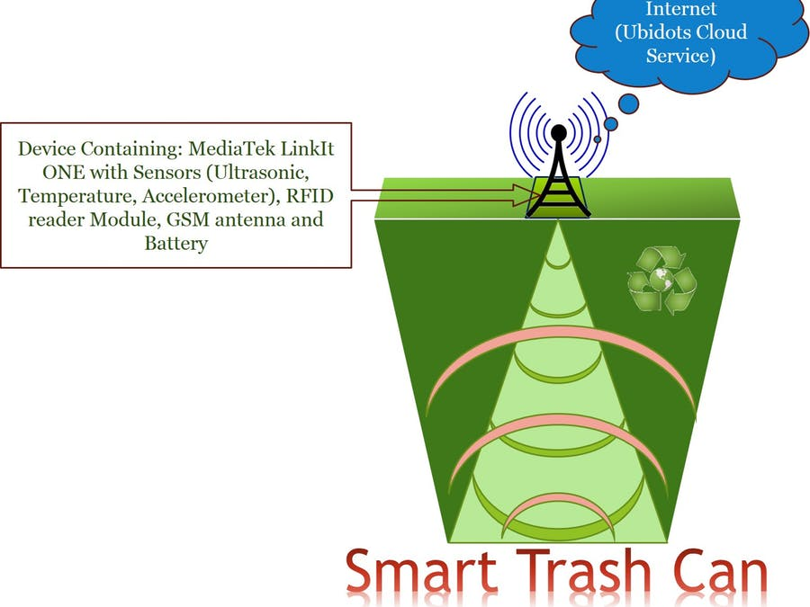
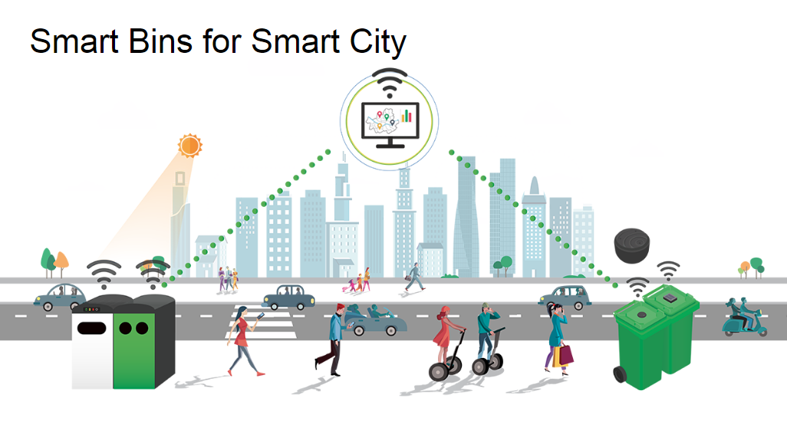
Motive Of This Project

Slide 6
Why we are choose IOT
It is the network of physical objects or "things" embedded with electronics, software, sensors, and network connectivity, which enables these object to collect and exchange data.
Creating opportunities for more direct integration between the physical world and computer-based systems
Data and connected services are the real value of IOT Platforms.

Slide 7
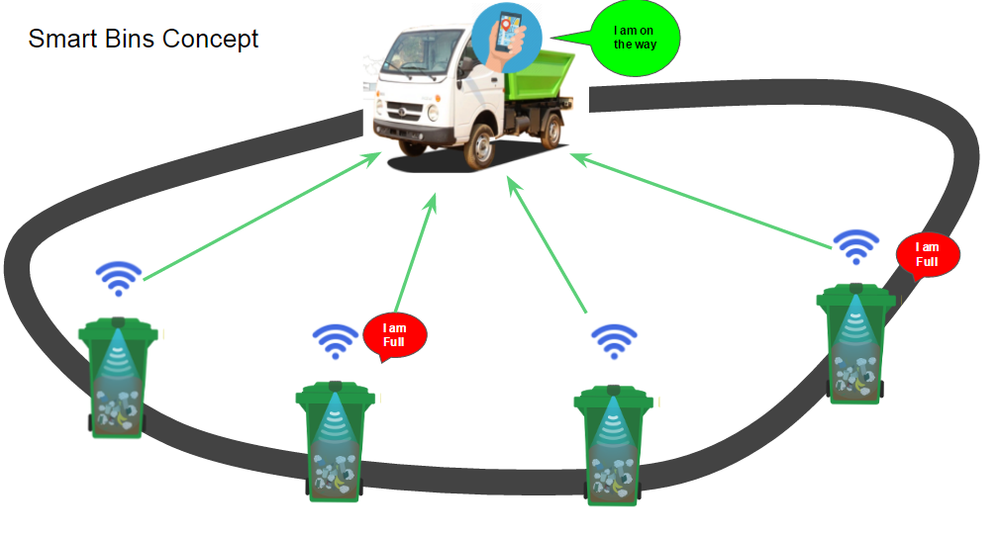

Slide 8
