Slide 1
SMOTE: Synthetic Minority Over-sampling Technique
Siddhant Prakash (1211092724), Kunal Bansal (1211213169)

Slide 2
Problem Statement
Imbalanced class dataset introduce an inherent bias towards majority class in classification tasks.
Many times the minority class is the positive class and the cost of mis-classifying a minority class is much higher than mis-classifying the negative class.
Ideally we want to increase minority class sample to neutralize this bias towards majority class sample.
SMOTE is an algorithm which generates synthetic data to augment minority class sample in feature space.

Slide 3
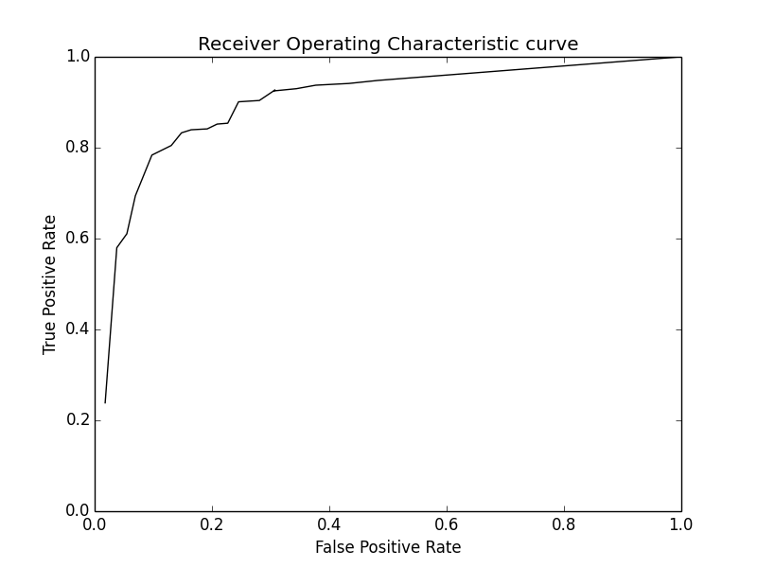
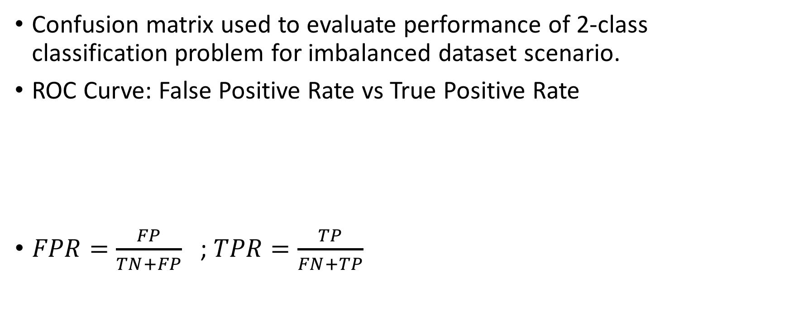
Evaluation Criteria
Confusion matrix used to evaluate performance of 2-class classification problem for imbalanced dataset scenario.
ROC Curve: False Positive Rate vs True Positive Rate
$FPR=\frac{FP}{TN+FP}$ ; $TPR=\frac{TP}{FN+TP}$
 | Predicted Negative | Predicted Positive
Actual Negative | True Negative (TN) | False Positive (FP)
Actual Positive | False Negative (FN) | True Positive (TP)

Slide 4
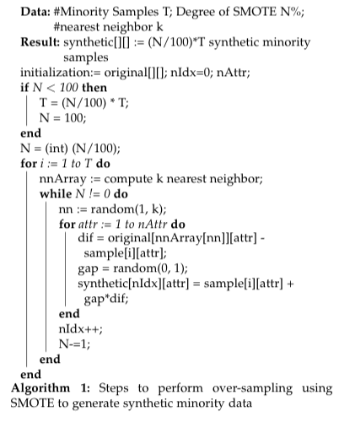
SMOTE Algorithm
Uses k-Nearest Neighbor to generate synthetic data in feature space.
Generates a random sample in between the line joining two samples in feature space from the minority samples.
Searches for the k-nearest neighbor of a minority sample and chooses (degree/100) of those point to generate synthetic points.

Slide 5
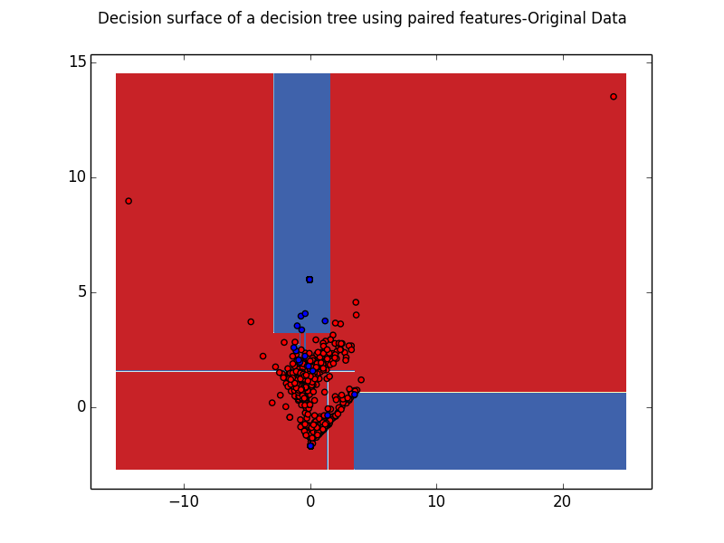
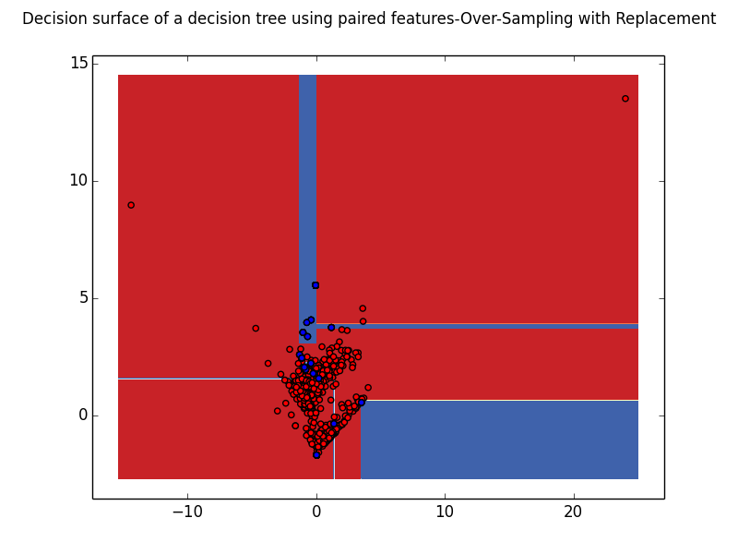
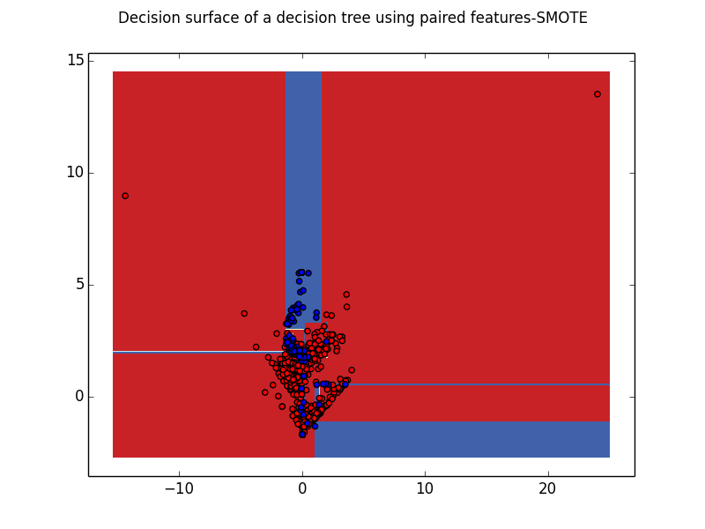
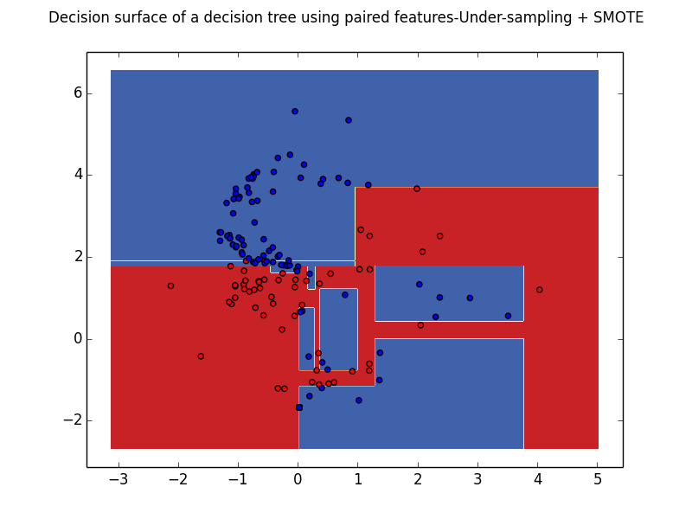

Slide 6
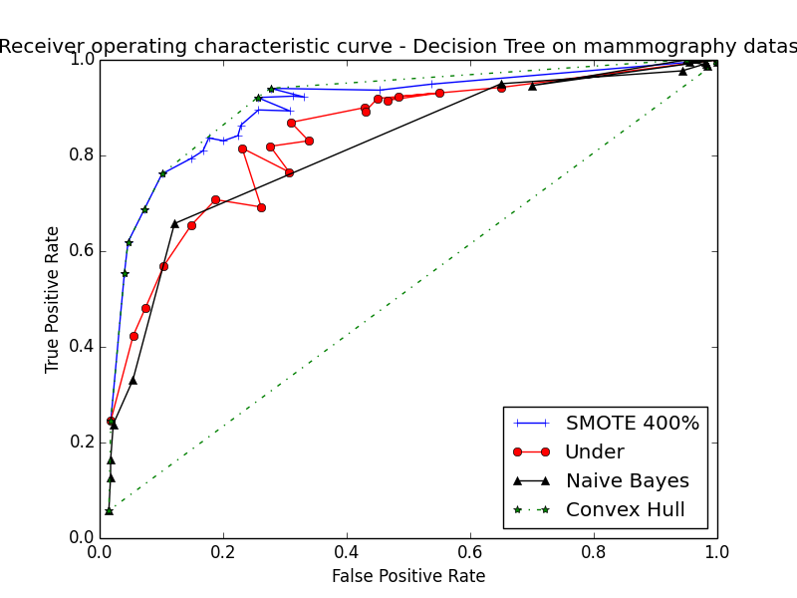
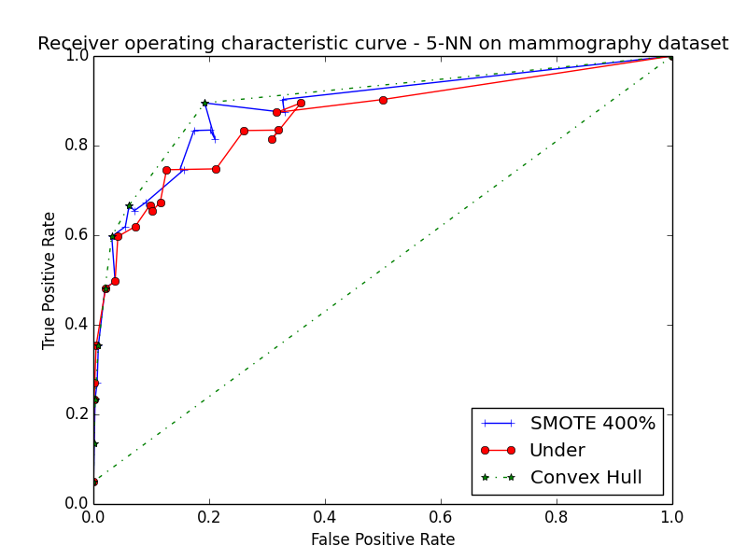
ROC Curves: Convex Hull and AUC
Datasets | Under | SMOTE 100% | SMOTE 200% | SMOTE 300% | SMOTE 400% | SMOTE 500%
Mammography | 0.7220 | 0.7290 | 0.7776 | 0.7919 | 0.7918 | 0.7752
SatImage | 0.7866 | 0.7881 | 0.8259 | 0.8318 | 0.8380 | 0.8283
Pima Indians | 0.6581 | 0.6567 | 0.7014 | 0.7145 | 0.7207 | 0.7327

Slide 7
Summary & Future Works
SMOTE is a new way of over-sampling data which works better than plain over-sampling with replacement.
Results show that SMOTE improves accuracy of classifying minority class samples, decreasing False Positive Rate.
A combination of under-sampling with SMOTE performs better than plain under-sampling.
Automatic calculation of degree of SMOTE based on class distribution will help remove the dependency on providing degree explicitly.

