Slide 1

The IQ’s 2018 Best State Employee To Live
By Bahar, Catherine, Molly & Prakash

Slide 2
Agenda
About Project and Key Questions
Supporting Datasets, Work flow and Jupyter Notebook Scripting
Individual Analysis (State level)
Home Price & Tax – Bahar
Unemployment and Crime Rate – Catherine
Salary – Molly
Climate- Prakash
Conclusion

Slide 3
Project Description
Our opinion on Best State to live in 2018 for “employee” from 6 criteria below,
State Tax
Climate
Unemployment rate
Crime rate
Salary
Home Price
Through observations, plots and correlations, we’re to determine the best state for employee to live and work in.

Slide 4
Question Breakdown
Best State
Out of 50 states, pick the “best choice” from top 20 in categories of salary, crime rate, unemployment rate, climate and tax rate.
Not necessarily to be the best on all of those criteria.
To Live and Work In For Employee (Working People)
Focus is working community and not “retiree” or “retiring soon” community
Affordable housing and tax rate, salary spent on housing + tax < 65%. Having ability to save money
Low crime rate and unemployment i.e. < 4% for each
Acceptable climate i.e. not too hot or cold, less humid. Moderate climate condition (70 – 80 F)

Slide 5
Questions & Criteria Driving to Conclusion
Which state is startup business friendly (low tax)? Tax rate and living cost (housing) → Bahar
Which state with low tax rate, attracts employee? → Bahar
Lower unemployment correlated to crime rate? → Catherine
Higher salary states are the preferred ones? → Molly
Warmer climate preferred state to live in, correlates to home price? → Prakash
Definition of the best state to live and work in (our criteria)
- Modest to high salary range
- Low crime and unemployment rate
- Climate with no extreme condition e.g. hurricane, tornado, snow blizzard

Slide 6
Year 2018 Supporting Datasets
Climate
Crime Rate
Home Prices
2018 Best State Choice
Unemployment Rate
Salary
State Tax

Slide 7
Datasets Origin
The datasets we used for this project were from,
US BLS (Bureau of Labor Statistics)
Zillow
Kaggle
https://www.currentresults.com/Yearly-Weather/USA/recent-yearly-weather-usa-cities-index.php

Slide 8
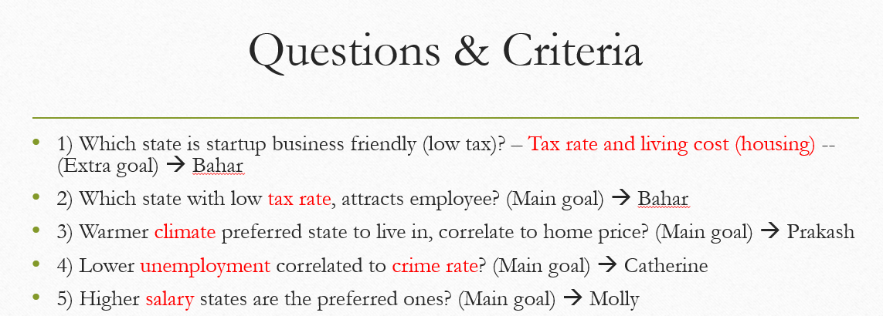
Work Flow
(1)
Get median home prices, salary, tax rate, climate per state
(3)
Get state tax rate and home price trend
(5)
Analyze plots, data & conclude
2018 Best State Choice
(2)
Get Unemployment vs Crime Rate correlation
(4)
Get climate correlation to home price
No. | Tasks | Person in charge
1 | Get median home prices | Bahar
2 | Get median salary | Molly
3 | Get unemployment and crime rate correlation | Catherine
4 | Get state tax and climate datasets | Prakash
5 | Get state tax rate and home price trend | Bahar
6 | Get climate correlation to home price | Prakash
7 | Analyze plots, data & conclusion | All

Slide 9
Things we applied in Jupyter Notebook
Merge some datasets through pandas pd.merge
Cleaned up rows that’s are NaN with drop.na
Format dataframes column(s) if needed from string to int or float
Create new dataframe by selecting columns that are needed for analysis
Used regression, median, mean, max, reset index, Weighted Sum approach, pandas rank and sort to help answer questions
Applied matplotlib for plotting charts like scatter, boxplot, bar for visualization
Made use of Google Gmap API to display states temperature

Slide 10
Climate - Prakash
Warmer climate preferred state to live in, correlates to home price?

Slide 11
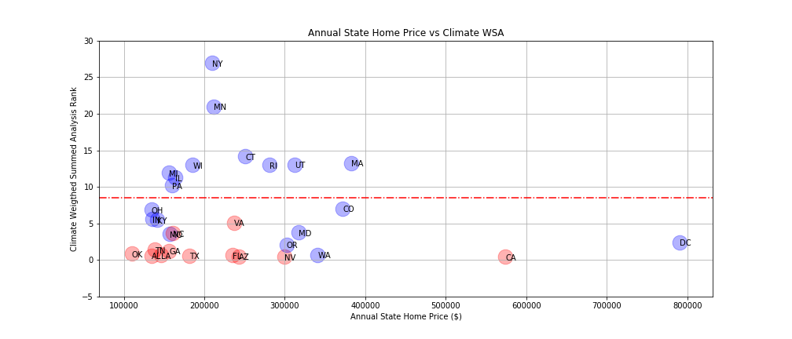
Climate Analysis – Prakash
Warmer climate preferred state to live in, correlate to higher home price?
There’s no obvious correlation for temperature and home price (circled). Thus home prices in higher temperature state isn’t true based on this analysis.
Red dots are State High Temp >= 70 F
Remaining States Region
Top 20 States Region

Slide 12
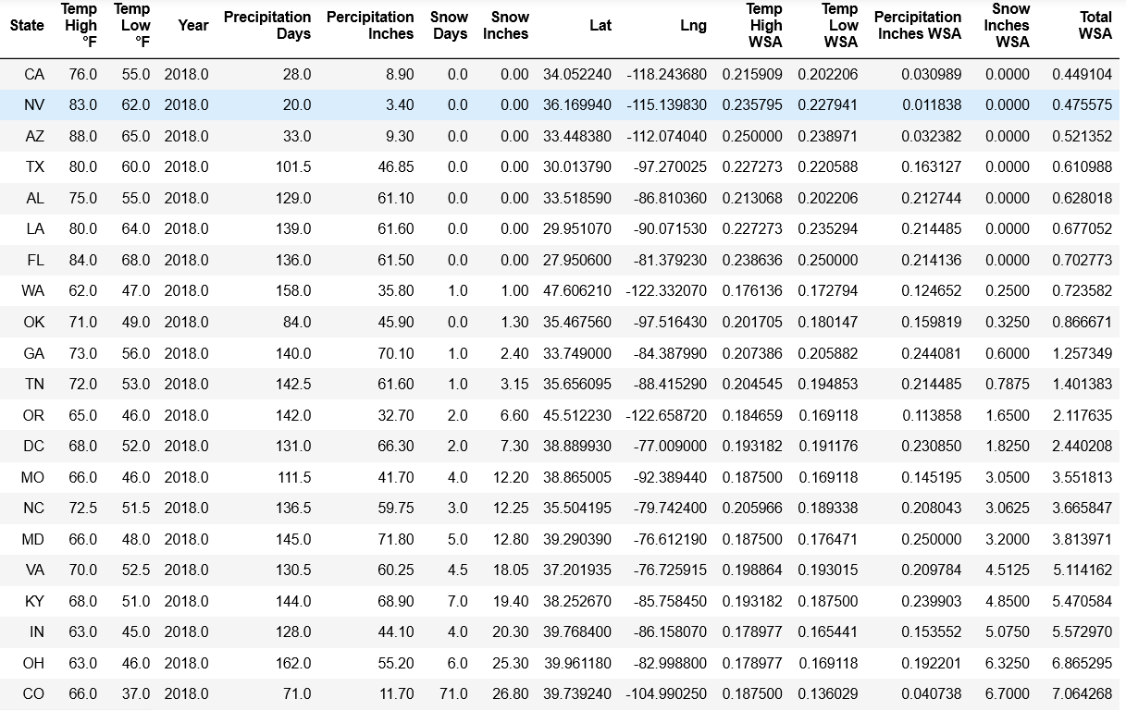
Climate Analysis – Prakash (con’t)
Sorted top 20 States from Weighted Sum Analysis

Slide 13
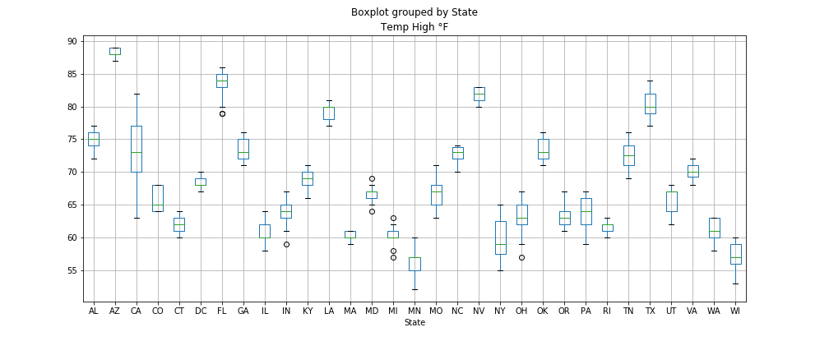
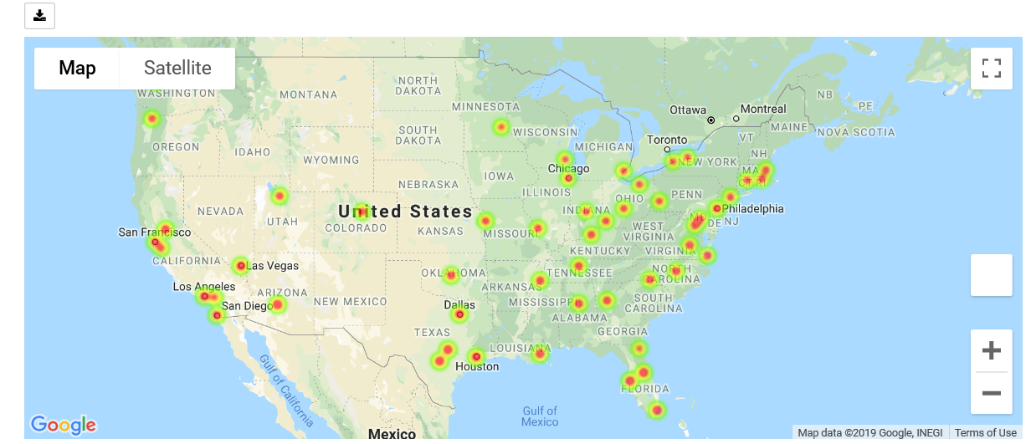
Climate Analysis – Prakash (con’t)
Dataset wasn’t perfect and had some challenges,
Obtaining the 2018 data, hard to find the latest. Mostly were up to 2010
Limited states with climate data for “2018” – refer to Geo Map figure
Some states have wider temperature spread e.g. California therefore used median approach – refer to Temperature boxplot

Slide 14
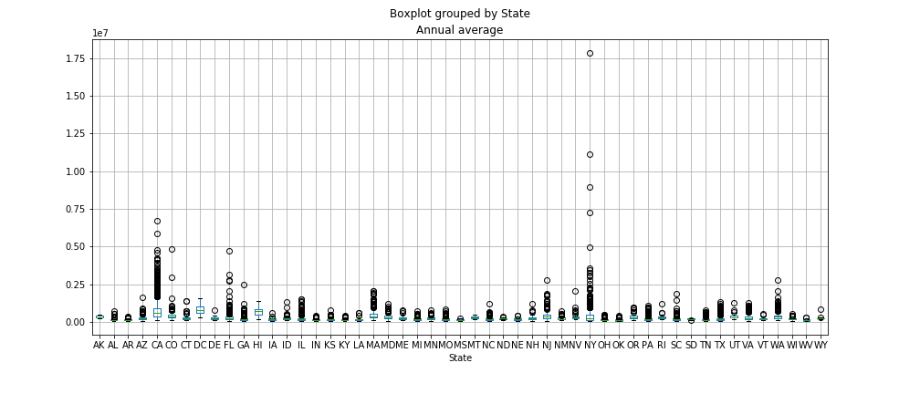
Climate Analysis – Prakash (con’t)
Annual home price by State also had wider spread like climate’s e.g. California and New York

Slide 15
State Tax & Living Cost - Bahar
Which state is startup business friendly (low tax)? Tax rate and living cost (housing)
Which state with low tax rate, attracts employee?

Slide 16
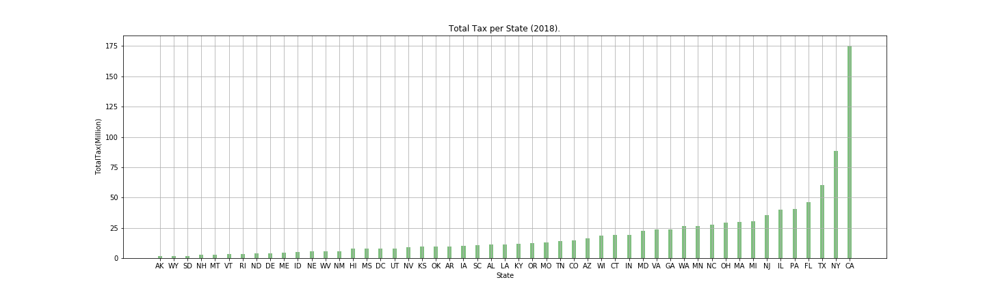
Total Tax rate Sales taxes, Income taxes, property taxes, Estate Taxes, Capital gains Taxes,…

Slide 17
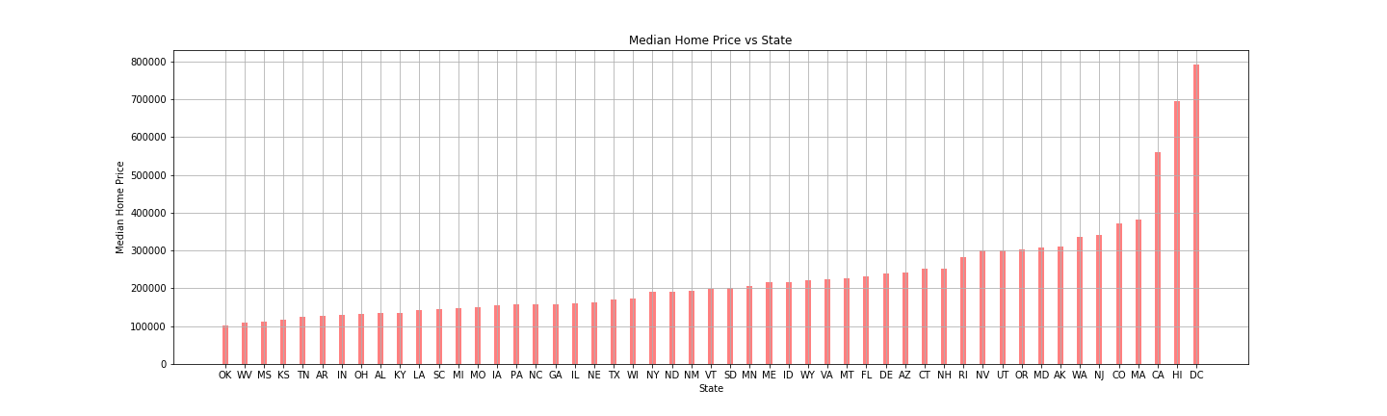
Median Home Price (2018)

Slide 18
Which state is startup business friendly?
Factors considered :
Young adult dwellers
Higher education
Local employment
Taxes
Rent & Real estate

Slide 19
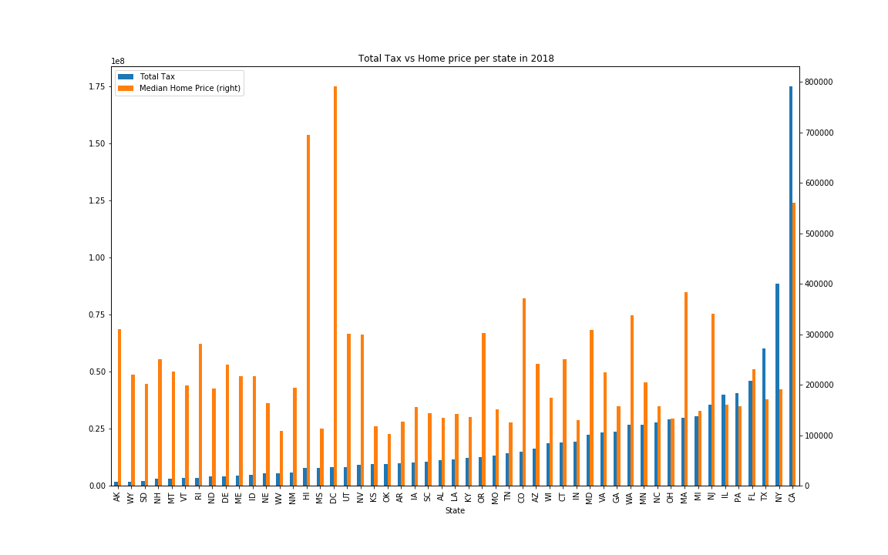
Total Taxes (Million)

Slide 20
10 top States:
California
Texas
Minnesota
Ohio
Tennessee
Washington
Massachusetts
Oregon
Colorado
DC

Slide 21
Unemployment & Crime Rate - Catherine
Lower unemployment correlated to crime rate?

Slide 22
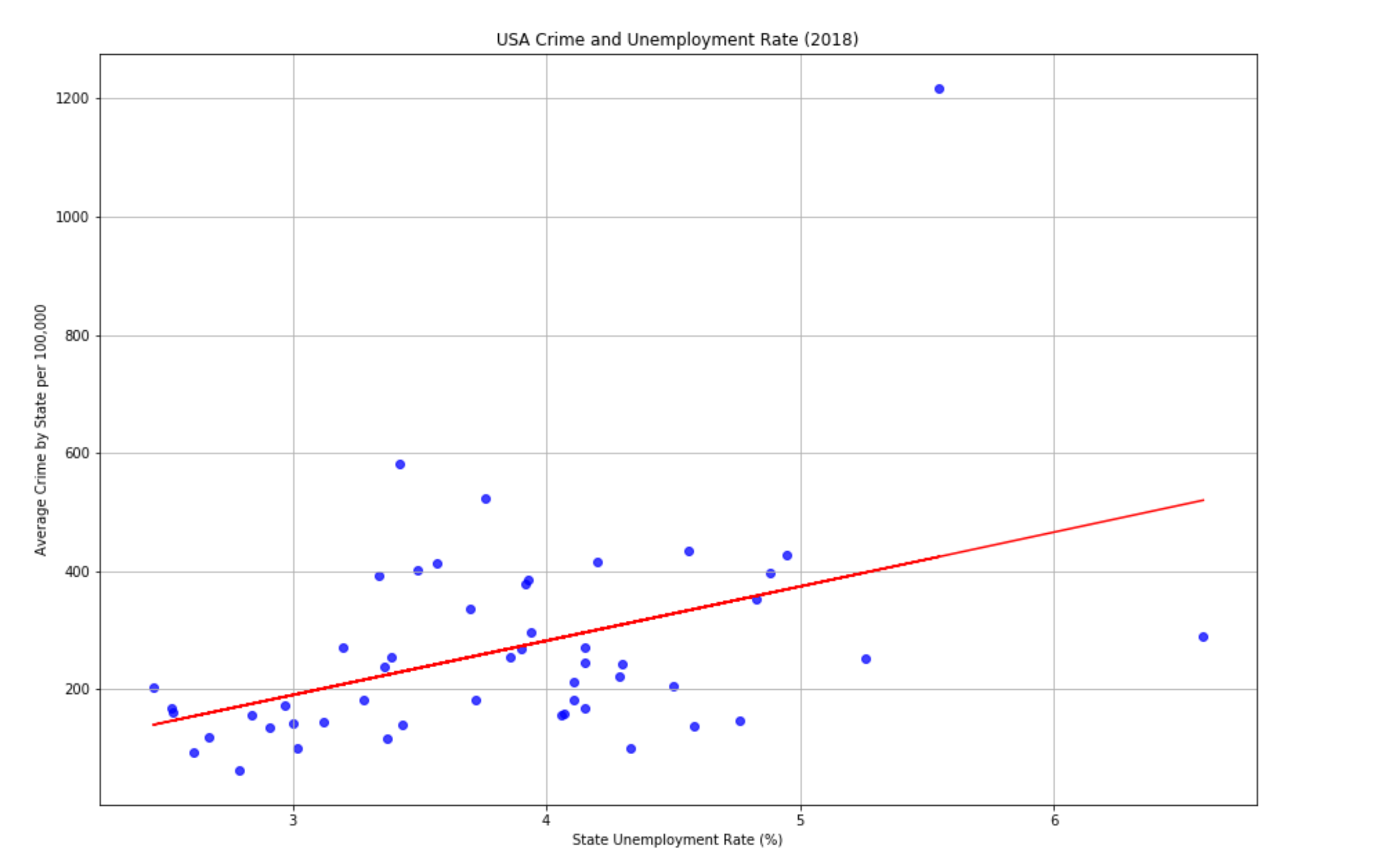
Key Metrics: 1. State Unemployment Rate(%) 2. Average Crime Rate per 100k
Linear Regression Model is statistically significant.
P value is 5.987422407746846e-14.
There is a weak to moderately positive correlation between Average Crime Rate and State Unemployment Rate.
R-squared value is 0.183.
This relationship is best described by the formula
y = 91.8468X - 85.4136, representing the regression line.
Outlier observed: DC, unusually high average crime rate @ 1217 and high unemployment rate at 5.55%.

Slide 23
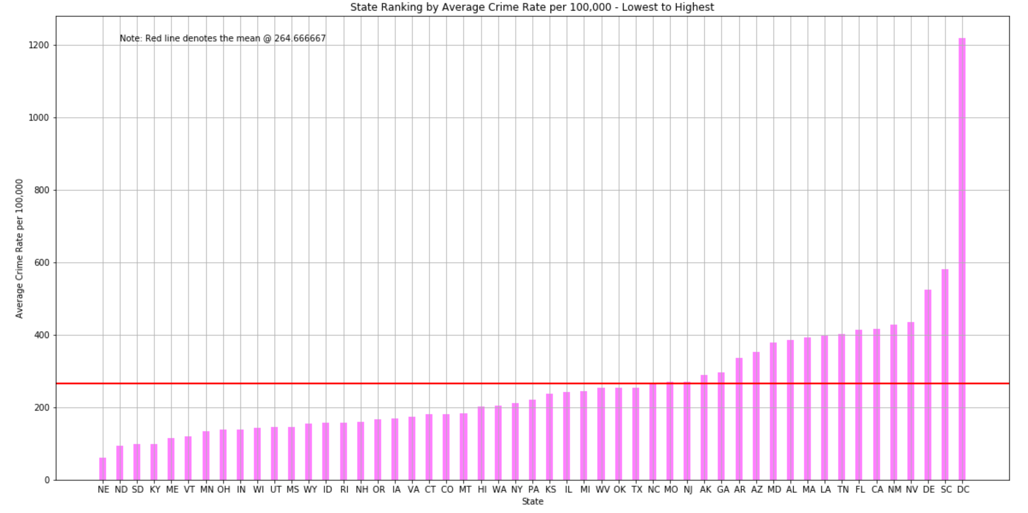
Top 20 States with
The Lowest Avg Crime Rates
Nebraska
North Dakota
South Dakota
Kentucky
Maine
Vermont
Minnesota
Ohio
Indiana
Wisconsin
Utah
Mississippi
Wyoming
Idaho
Rhode Island
New Hampshire
Oregon
Iowa
Virginia
Connecticut
DC has the highest average crime rate per 100k.
The Midwest and the New England states exhibit low average crime rates.

Slide 24
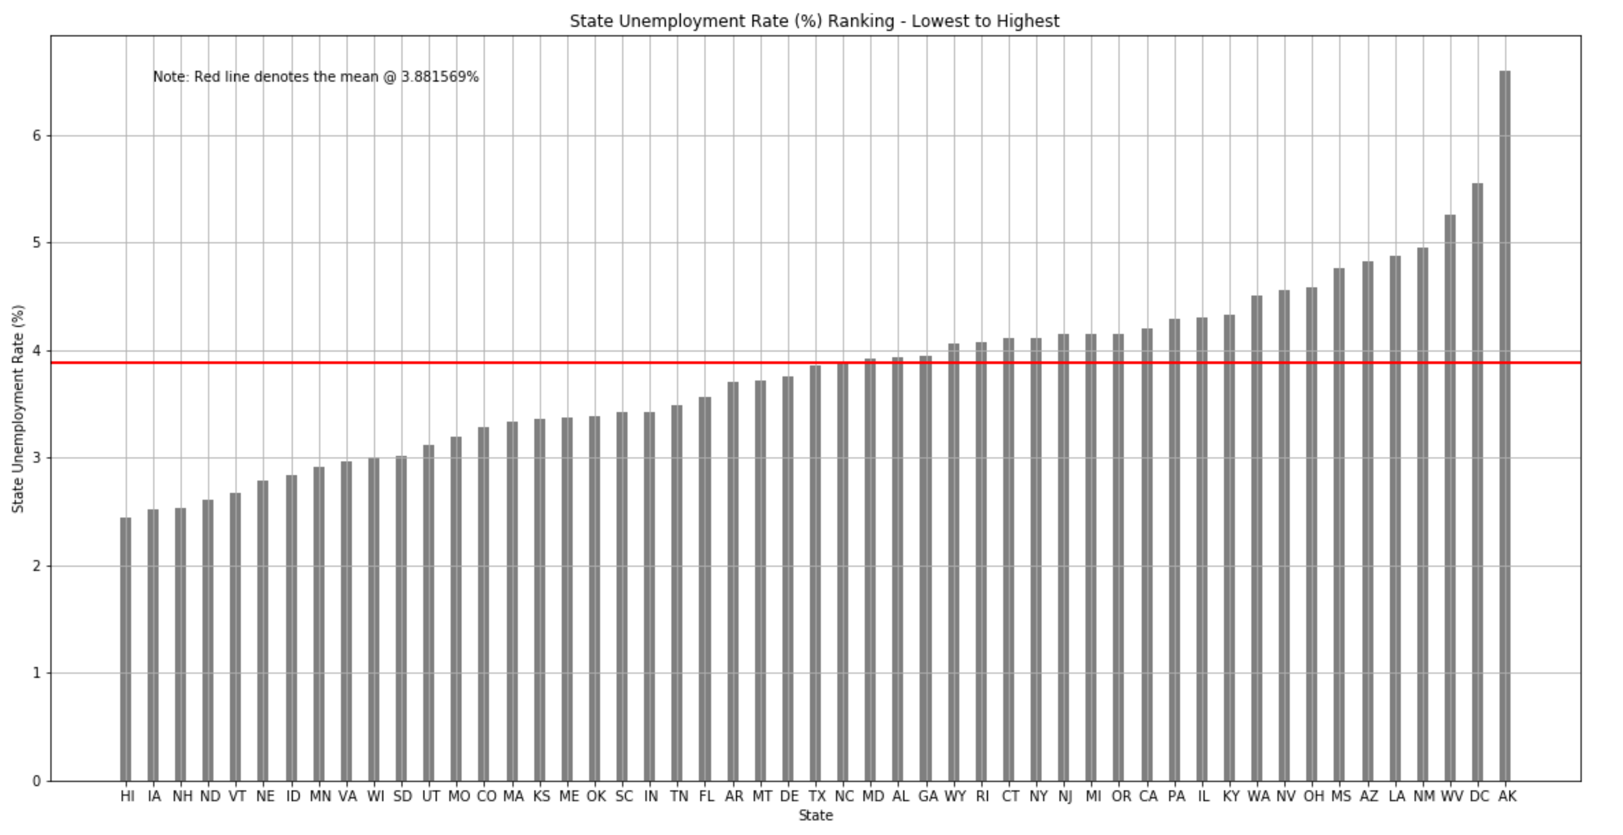
Top 20 States with
The Lowest Unemployment Rates
Hawaii
Iowa
New Hampshire
North Dakota
Vermont
Nebraska
Idaho
Minnesota
Virginia
South Dakota
Utah
Missouri
Colorado
Massachusettes
Kansas
Maine
Oklahoma
South Carolina
Indiana
Tennessee
Hawaii has the lowest unemployment rate @ 2.45%. It maybe attributed to an aging population as there are more people retiring than people entering the labor force.
Alaska has the highest unemployment rate @ 6.59%.Most jobs in Alaska are seasonal or only happen in the summer. This natural rate of unemployment inflates the rate.

Slide 25
Salary - Molly
Higher salary states are the preferred ones?

Slide 26
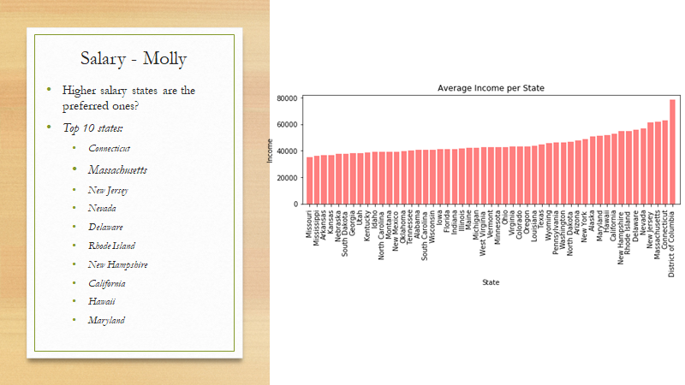

Slide 27
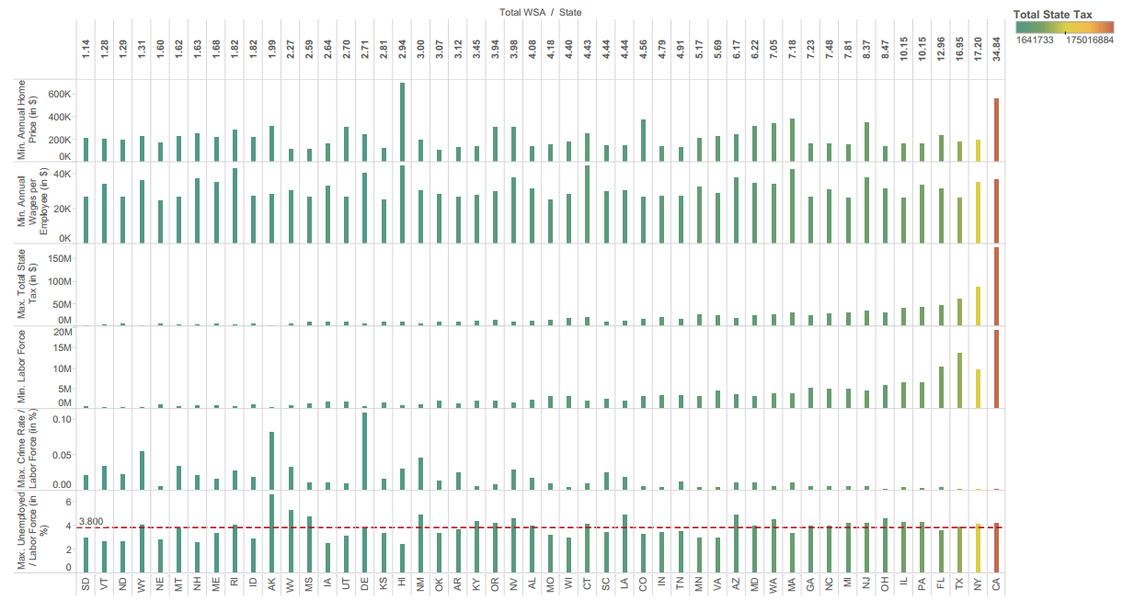
Conclusion
Texas is the winner
Worst
Best

Slide 28
Appendix

Slide 29
Project 1 Technical Requirement
# Technical Requirements
The technical requirements for Project 1 are as follows.
* [ ] Use Pandas to clean and format your data set(s)
* [ ] Create a Jupyter Notebook describing the **data exploration and cleanup** process
* [ ] Create a Jupyter Notebook illustrating the **final data analysis*** [ ] Use Matplotlib to create a total of 6-8 visualizations of your data (ideally, at least 2 per "question" you ask of your data)
* [ ] Save PNG images of your visualizations to distribute to the class and instructional team, and for inclusion in your presentation
* [ ] Optionally, use at least one API, if you can find an API with data pertinent to your primary research questions
* [ ] Create a write-up summarizing your major findings. This should include a heading for each "question" you asked of your data, and under each heading, a short description of what you found and any relevant plots.
- - -### Copyright
Coding Boot Camp © 2017. All Rights Reserved.

Slide 30
State Tax & Living Cost Analysis Files (Bahar)
Files are in folder = \The_Incredible_Quad\Bahar_homeprice
Jupyter NB filename = TotalTax_MedianHomePrice.ipynb
Saved plots = \The_Incredible_Quad\Bahar_homeprice\Images
Dataset files = \The_Incredible_Quad\Bahar_homeprice\

Slide 31
Unemployment & Crime Rate Analysis Files (Catherine)
Files are in folder = \The_Incredible_Quad\Catherine
Jupyter NB filename = Crime and Unemployment Analysis.ipynb
Saved plots = \The_Incredible_Quad\Catherine
Dataset files = The_Incredible_Quad\Catherine

Slide 32
Salary Analysis Files (Molly)
Files are in folder = \The_Incredible_Quad\Molly_salary\
Jupyter NB filename = .ipynb
Saved plots = \The_Incredible_Quad\ Molly_salary\
Dataset files =
*.csv

Slide 33
Climate Analysis Files (Prakash)
Files are in folder – \The_Incredible_Quad\Climate_analysis\
Jupyter NB filename = climate_main_analysis.ipynb
Google API key file = config.py
Saved plots = \The_Incredible_Quad\Climate_analysis\Climate_images\
Dataset files =
Climate_dataset2010_2018.csv
sfr_home_prices.csv

Slide 34
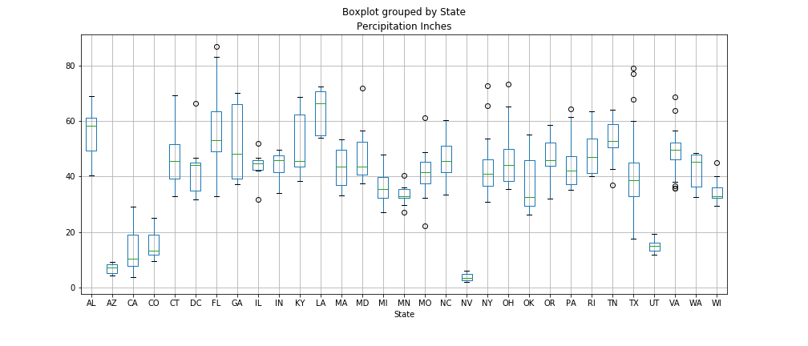
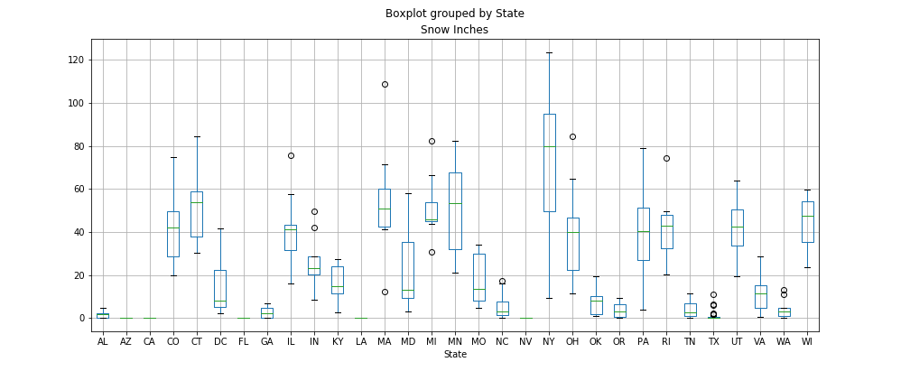
Climate Analysis – Prakash
Percipitation and snow by States spread

Slide 35
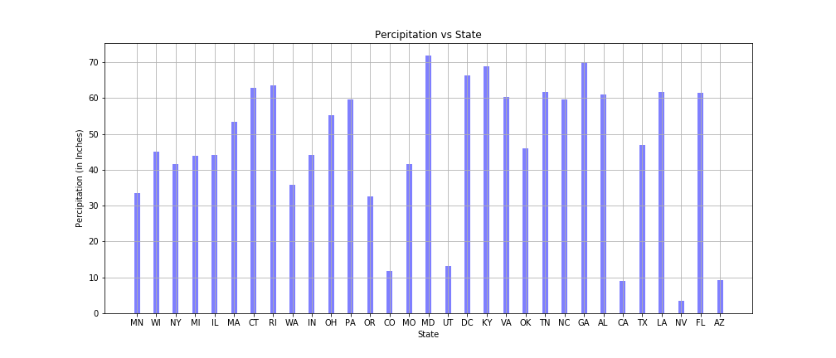
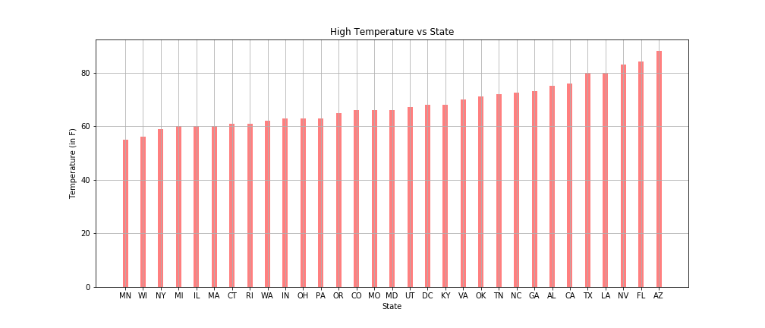
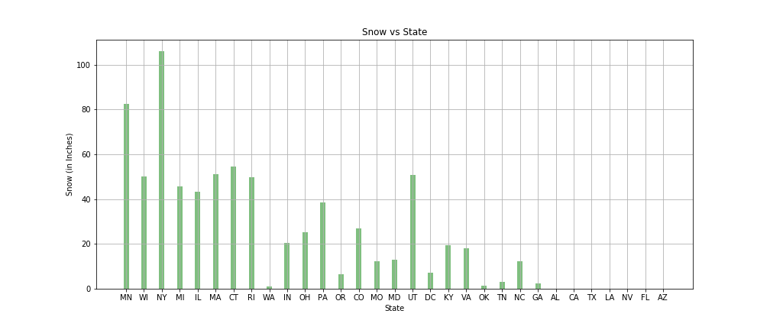
Climate Analysis – Prakash
Temperature, Snow and Percipitation spread by States

Slide 36

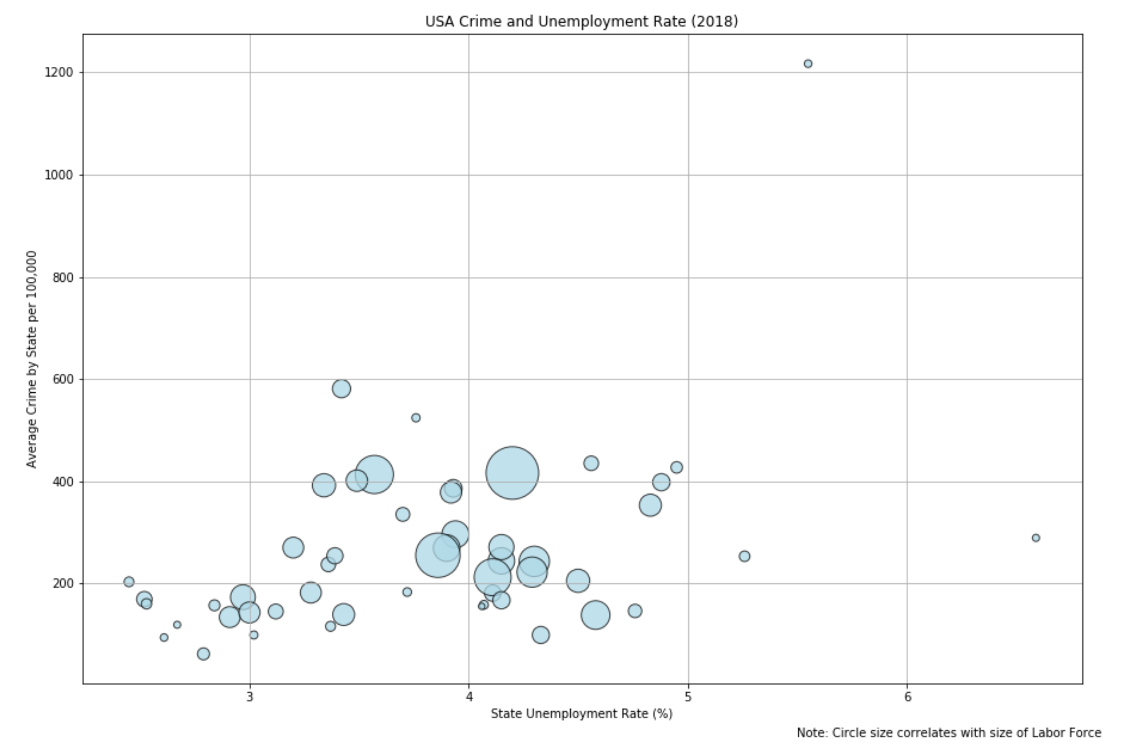

Slide 37
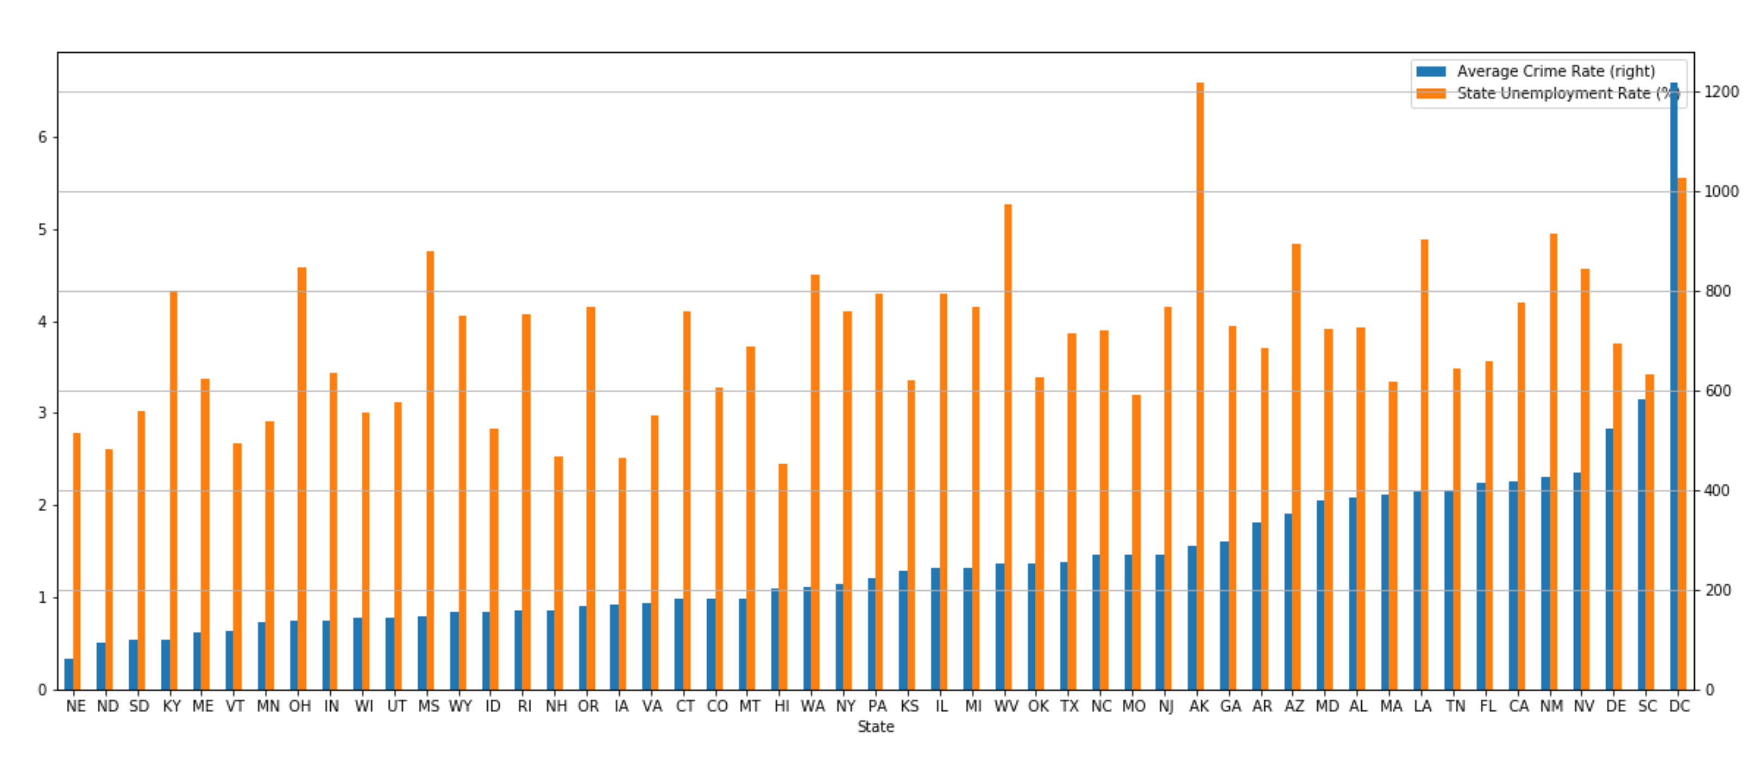
For Appendix

Slide 38
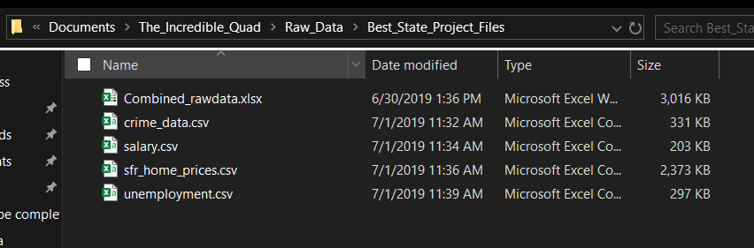
Raw data files location

Slide 39
Coding Rules
Upload scripts to Script folder
Label/ Comment on every code line to help other understand quickly. Explain briefly if needed
Label plot(s) well with legend, title and axes
Append _lst, _df and etc when defining lists, dictionaries, data frames. E.g. mylist_lst, myplot_plt
Backup files locally prior to modification for retrieval
Attempt to solve 1st by yourself, if help needed, slack out

Slide 40
Availability
Date/ Ppl | Bahar | Catherine | Molly | Prakash
7/1 | Yes | Yes | Yes | Yes
7/6 | No | Yes | No | Yes
7/8 | Yes | Yes | No | Yes
7/10 (slides preparation) | Yes | Yes | Yes | Yes
7/13 | Project 1 Presentation & Submission

