Slide 1
The IQ’s 2018 Best State Employee To Live
By Bahar, Catherine, Molly & Prakash

Slide 2
Project 1 Technical Requirement
# Technical Requirements
The technical requirements for Project 1 are as follows.
* [ ] Use Pandas to clean and format your data set(s)
* [ ] Create a Jupyter Notebook describing the **data exploration and cleanup** process
* [ ] Create a Jupyter Notebook illustrating the **final data analysis*** [ ] Use Matplotlib to create a total of 6-8 visualizations of your data (ideally, at least 2 per "question" you ask of your data)
* [ ] Save PNG images of your visualizations to distribute to the class and instructional team, and for inclusion in your presentation
* [ ] Optionally, use at least one API, if you can find an API with data pertinent to your primary research questions
* [ ] Create a write-up summarizing your major findings. This should include a heading for each "question" you asked of your data, and under each heading, a short description of what you found and any relevant plots.
- - -### Copyright
Coding Boot Camp © 2017. All Rights Reserved.

Slide 3
Agenda
About Project and Key Questions
Supporting Datasets, Work flow and Jupyter Notebook Scripting
Individual Analysis (State level)
Home Price & Tax – Bahar
Unemployment and Crime Rate – Catherine
Salary – Molly
Climate- Prakash
Conclusion

Slide 4
Project Description
Our opinion on Best State to live in 2018 for “employee” from 6 criteria below,
State Tax
Climate
Unemployment rate
Crime rate
Salary
Home Price
Through observations, plots and correlations, we’re to determine the best state for employee to live and work in.

Slide 5
Question Breakdown
Best State
Out of 50 states, pick the “best choice” from top 20 in categories of salary, crime rate, unemployment rate, climate and tax rate.
Not necessarily to be the best on all of those criteria.
To Live and Work In For Employee (Working People)
Focus is working community and not “retiree” or “retiring soon” community
Affordable housing and tax rate, salary spent on housing + tax < 65%. Having ability to save money
Low crime rate and unemployment i.e. < 4% for each
Acceptable climate i.e. not too hot or cold, less humid. Moderate climate condition (70 – 80 F)

Slide 6
Questions & Criteria Driving to Conclusion
Which state is startup business friendly (low tax)? Tax rate and living cost (housing) → Bahar
Which state with low tax rate, attracts employee? → Bahar
Lower unemployment correlated to crime rate? → Catherine
Higher salary states are the preferred ones? → Molly
Warmer climate preferred state to live in, correlates to home price? → Prakash
Definition of the best state to live and work in (our criteria)
- Modest to high salary range
- Low crime and unemployment rate
- Climate with no extreme condition e.g. hurricane, tornado, snow blizzard

Slide 7
Year 2018 Supporting Datasets
Climate
Crime Rate
Home Prices
2018 Best State Choice
Unemployment Rate
Salary
State Tax

Slide 8
Datasets Origin
The datasets we used for this project were from,
US BLS (Bureau of Labor Statistics)
Zillow
https://www.currentresults.com/Yearly-Weather/USA/recent-yearly-weather-usa-cities-index.php

Slide 9
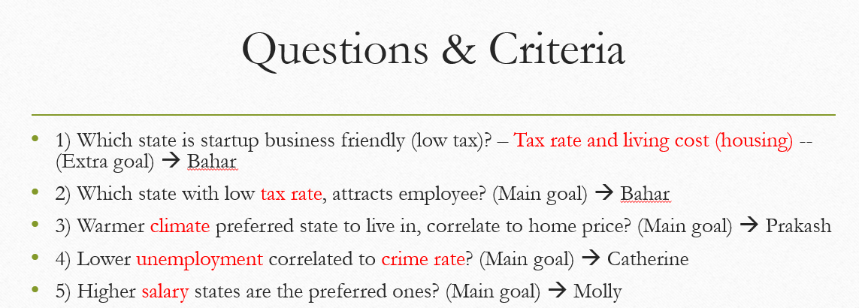
Work Flow
(1)
Get median home prices, salary, tax rate, climate per state
(3)
Get state tax rate and home price trend
(5)
Analyze plots, data & conclude
2018 Best State Choice
(2)
Get Unemployment vs Crime Rate correlation
(4)
Get climate correlation to home price
No. | Tasks | Person in charge
1 | Get median home prices | Bahar
2 | Get median salary | Molly
3 | Get unemployment and crime rate correlation | Catherine
4 | Get state tax and climate datasets | Prakash
5 | Get state tax rate and home price trend | Bahar
6 | Get climate correlation to home price | Prakash
7 | Analyze plots, data & conclusion | All

Slide 10
Things we applied in Jupyter Notebook
Merge some datasets through pandas pd.merge
Cleaned up rows that’s are NaN with drop.na
Format dataframes column(s) if needed from string to int or float
Create new dataframe by selecting columns that are needed for analysis
Used regression, median, mean, max, reset index, Weighted Sum approach, pandas rank and sort to help answer questions
Applied matplotlib for plotting charts like scatter, boxplot, bar for visualization
Made use of Google Gmap API to display states temperature

Slide 11
State Tax & Living Cost - Bahar
Which state is startup business friendly (low tax)? – Tax rate and living cost (housing).
Which state with low tax rate, attracts employee

Slide 12
State Tax & Living Cost – Bahar (con’t)
Which state is startup business friendly (low tax)? – Tax rate and living cost (housing).
Which state with low tax rate, attracts employee

Slide 13
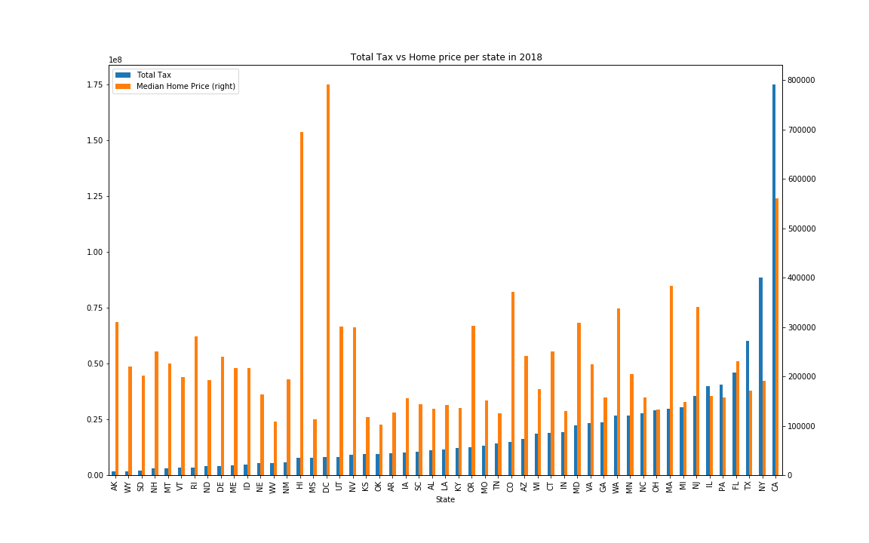
State Tax & Living Cost - Bahar
Which state is startup business friendly (low tax)? – Tax rate and living cost (housing).
Which state with low tax rate, attracts employee

Slide 14
Unemployment & Crime Rate - Catherine
Lower unemployment correlated to crime rate?
Write description/ observation and supporting plots (minimum 2) here

Slide 15
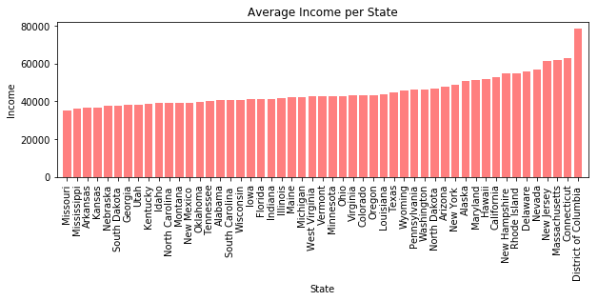

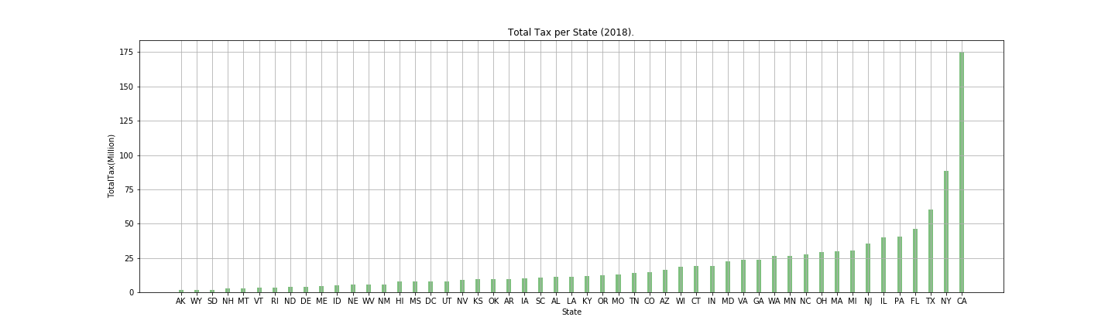
Salary - Molly
Higher salary states are the preferred ones?
Write description/ observation and supporting plots (minimum 2) here

Slide 16
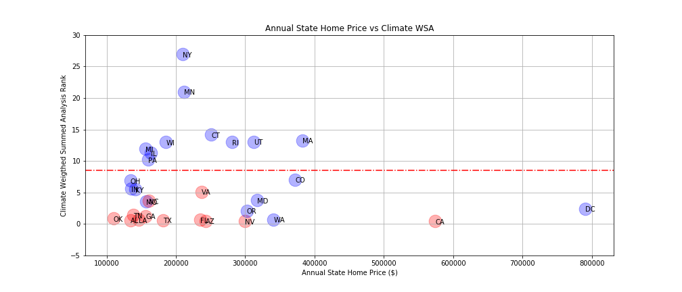
Climate Analysis – Prakash
Warmer climate preferred state to live in, correlate to higher home price?
There’s no obvious correlation for temperature and home price (circled). Thus home prices in higher temperature state isn’t true based on this analysis.
Red dots are State High Temp >= 70 F
Remaining States Region
Top 20 States Region

Slide 17
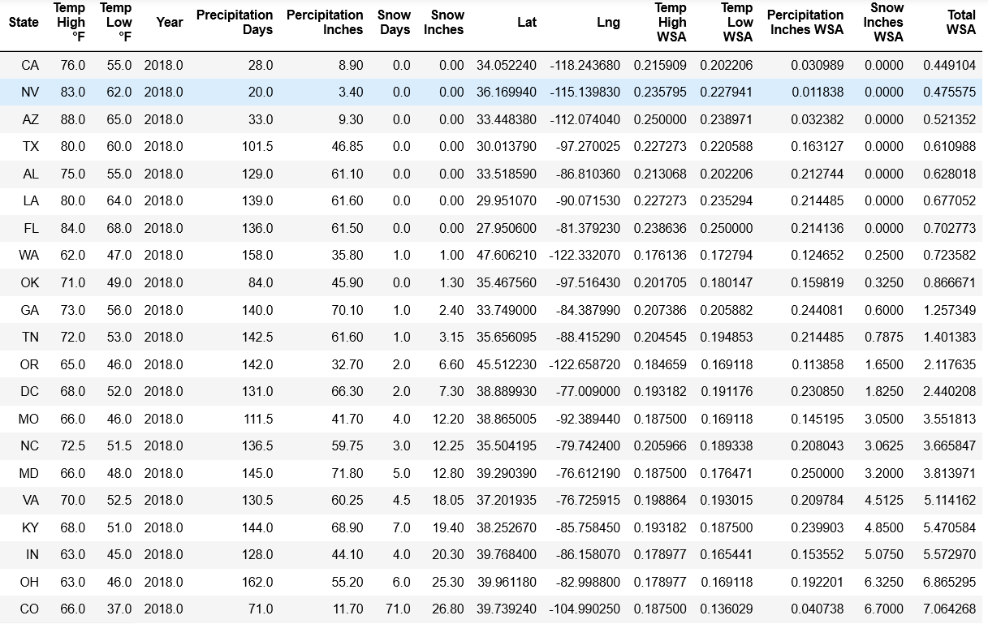
Climate Analysis – Prakash (con’t)
Sorted top 20 States from Weighted Sum Analysis

Slide 18
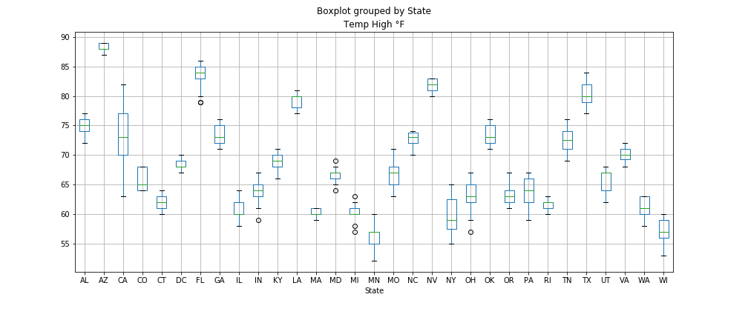
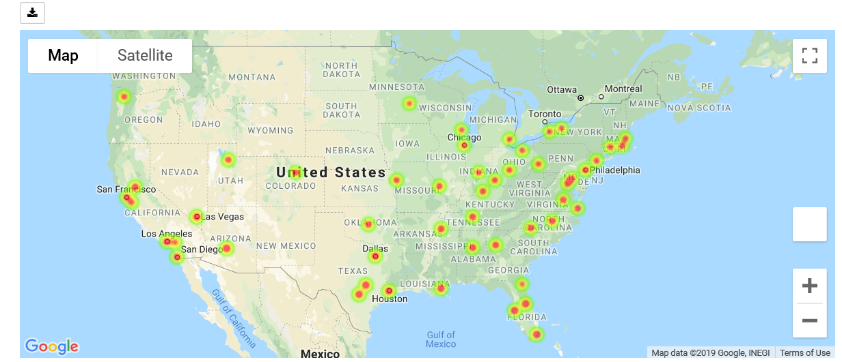
Climate Analysis – Prakash (con’t)
Dataset wasn’t perfect and had some challenges,
Obtaining the 2018 data, hard to find the latest. Mostly were up to 2010
Limited states with climate data for “2018” – refer to Geo Map figure
Some states have wider temperature spread e.g. California therefore used median approach – refer to Temperature boxplot

Slide 19
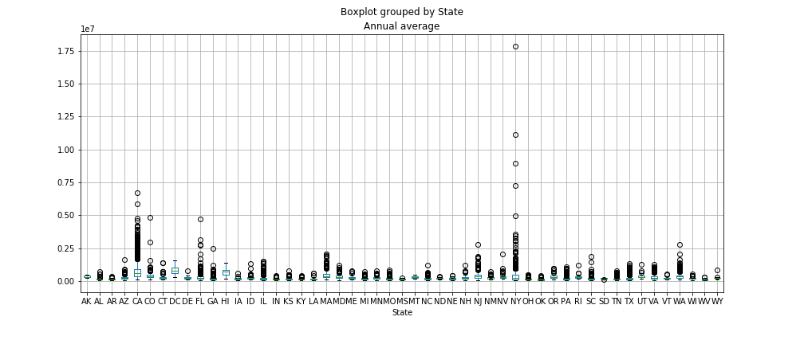
Climate Analysis – Prakash (con’t)
Annual home price by State also had wider spread like climate’s e.g. California and New York

Slide 20
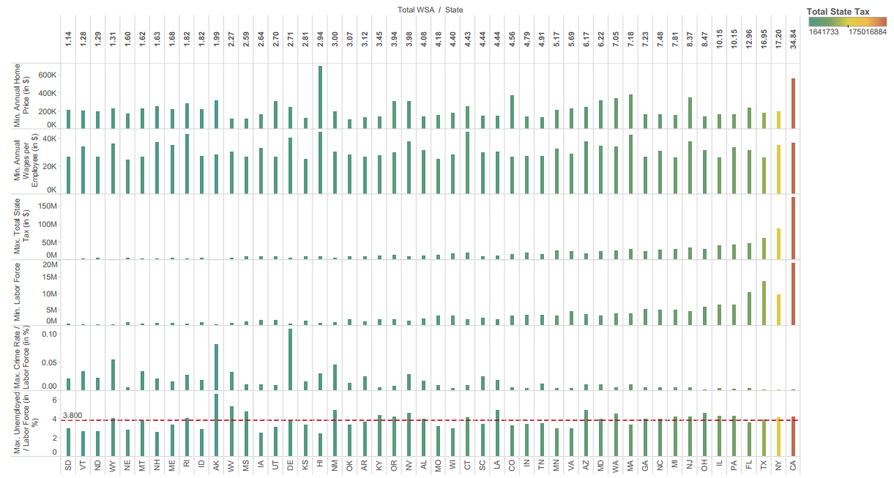
Conclusion
Based on the criteria below,
We choose “State” to be the best one to live and work in
Worst
Best

Slide 21
Backup Slides

Slide 22
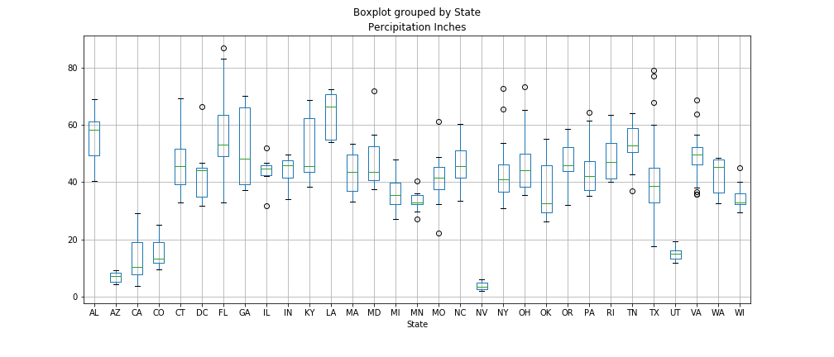
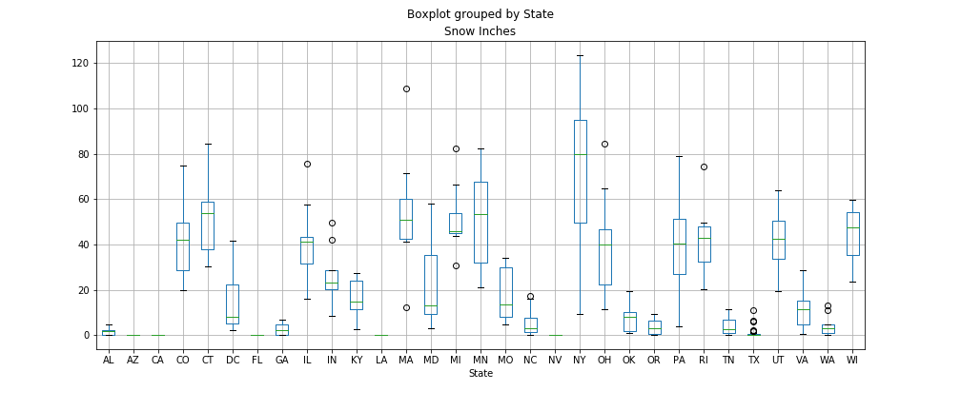
Climate Analysis – Prakash
Percipitation and snow by States spread

Slide 23
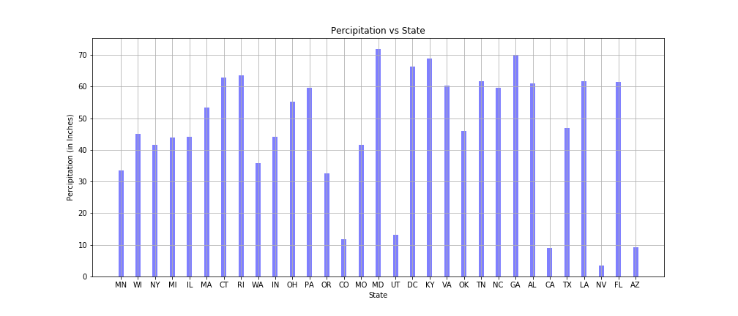
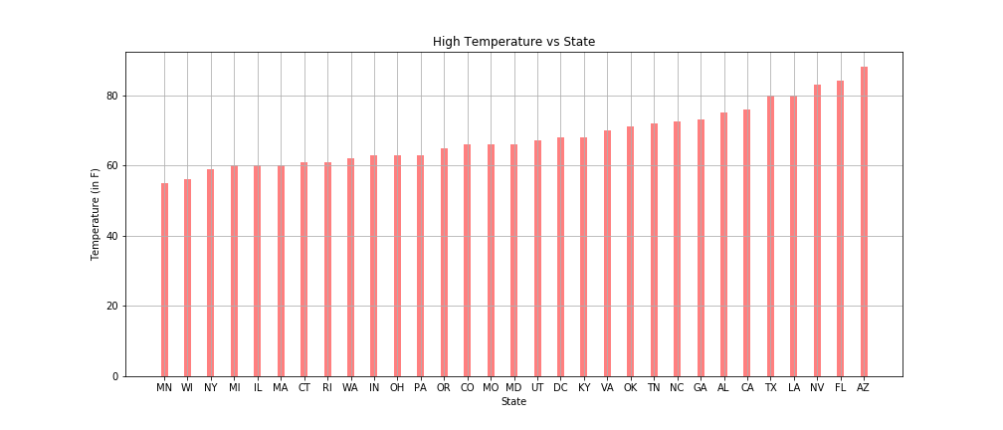
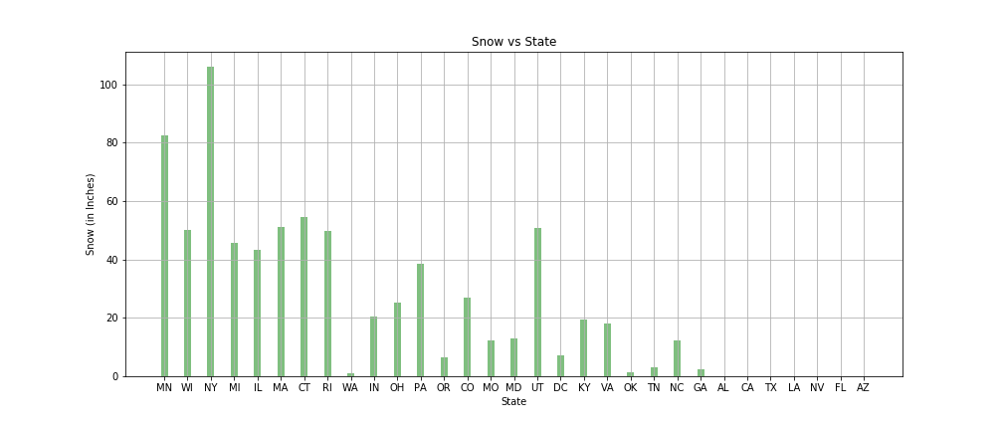
Climate Analysis – Prakash
Temperature, Snow and Percipitation spread by States

Slide 24
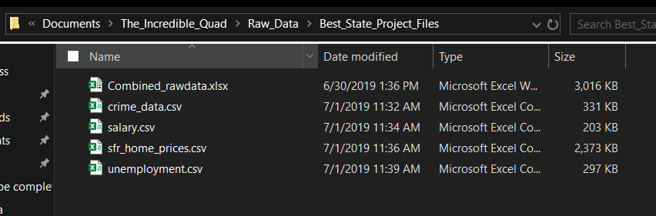
Raw data files location

Slide 25
Coding Rules
Upload scripts to Script folder
Label/ Comment on every code line to help other understand quickly. Explain briefly if needed
Label plot(s) well with legend, title and axes
Append _lst, _df and etc when defining lists, dictionaries, data frames. E.g. mylist_lst, myplot_plt
Backup files locally prior to modification for retrieval
Attempt to solve 1st by yourself, if help needed, slack out

Slide 26
Availability
Date/ Ppl | Bahar | Catherine | Molly | Prakash
7/1 | Yes | Yes | Yes | Yes
7/6 | No | Yes | No | Yes
7/8 | Yes | Yes | No | Yes
7/10 (slides preparation) | Yes | Yes | Yes | Yes
7/13 | Project 1 Presentation & Submission

Slide 27
Appendix

Slide 28
State Tax & Living Cost Analysis Files (Bahar)
Files are in folder = \The_Incredible_Quad\
Jupyter NB filename = .ipynb
Google API key file =
Saved plots = \The_Incredible_Quad\
Dataset files =
*.csv

Slide 29
Unemployment & Crime Rate Analysis Files (Catherine)
Files are in folder = \The_Incredible_Quad\
Jupyter NB filename = .ipynb
Google API key file =
Saved plots = \The_Incredible_Quad\
Dataset files =
*.csv

Slide 30
Salary Analysis Files (Molly)
Files are in folder = \The_Incredible_Quad\
Jupyter NB filename = .ipynb
Google API key file =
Saved plots = \The_Incredible_Quad\
Dataset files =
*.csv

Slide 31
Climate Analysis Files (Prakash)
Files are in folder – \The_Incredible_Quad\Climate_analysis\
Jupyter NB filename = climate_main_analysis.ipynb
Google API key file = config.py
Saved plots = \The_Incredible_Quad\Climate_analysis\Climate_images\
Dataset files =
Climate_dataset2010_2018.csv
sfr_home_prices.csv

