Slide 1

Slate
-17PD27, Prakash Baburaj
-17PD31, Shruthi R

Slide 2

Outline

Slide 3
Our project is a simple Slate where kids can learn to draw alphabets.
The program will challenge you to draw Random alphabets and based on the drawing provided by the user, the machine predicts whether it resembles the required Alphabet using Convolutional Neural Networks and awards points accordingly.

Slide 4

Tools And Technologies used

Slide 5

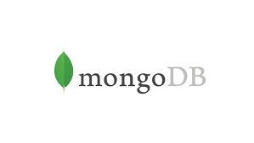

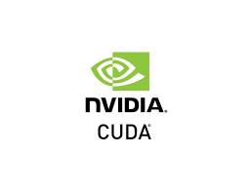


Slide 6

Audience

Slide 7

Makes learning fun for children
It mainly targets Kids of ages 0 - 7 years, from toddlers all the way to preschoolers and kindergartners.
It features a series of tracing games to help kids recognize letter shapes, and put their alphabet knowledge to use in fun matching exercises.
Any toddler, kindergartener or preschool age child can learn English and the English alphabet simply by following the arrows with their finger.

Slide 8
Description

Slide 9
What is SLATE actually?
SLATE is more than just a kid-friendly educational app.
The interface keeps toddlers focused on alphabet reading and writing from moving fingers.

Slide 10
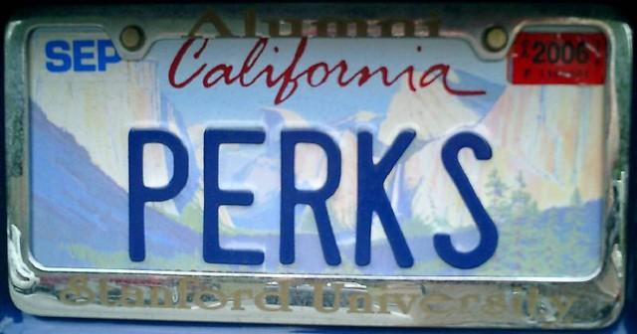
Features

Slide 11
What it provides?
A colorful early education app that helps children learn the English alphabet.
Includes ABC tracing games, letter matching, and more.
Uppercase and lowercase letters to trace, listen to, and match.
Smart interface helps kids focus on letters without accidentally exiting the game.
Just pure educational fun!

Slide 12

Workflow

Slide 13
Pipeline
1.The Alphabet is stored in Mongodb using GridFS which is suitable for storing
for storing large files. Then they are fetched into python using PyMongo.
2.Now, We train a CNN for recognising the different Alphabets with the help of
Tensorflow and the Algorithm is made to run parallel in GPU using CUDA.
3.Finally the Model is deployed in Heroku, which allows free cloud deployment.

Slide 14
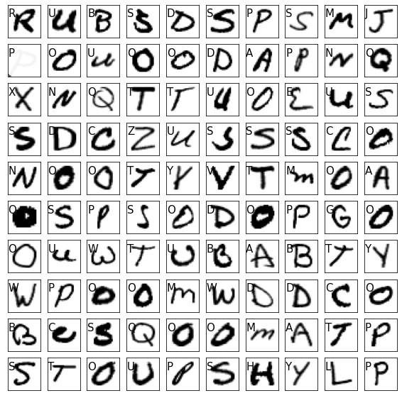
Handwritten alphabets after pre-processing:
Pre-processing includes:
Gray scale conversion
Noise reduction
Normalizing the data(pixels here)
Mapping labels(A-Z) to integers(0-25)

Slide 15
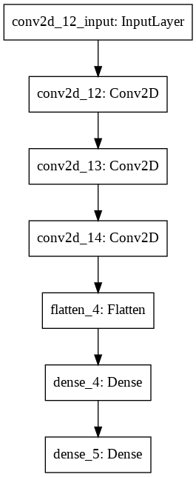
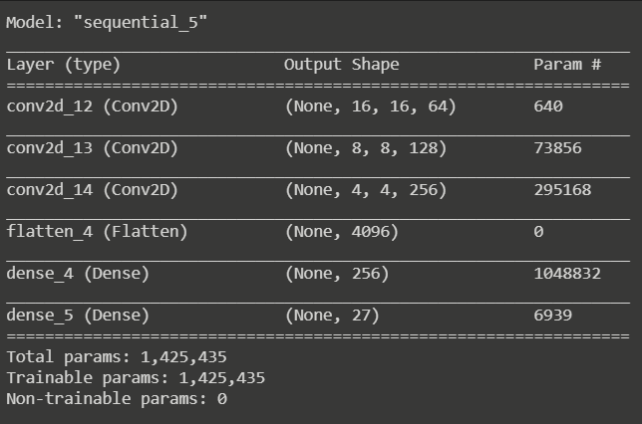
Architecture

Slide 16
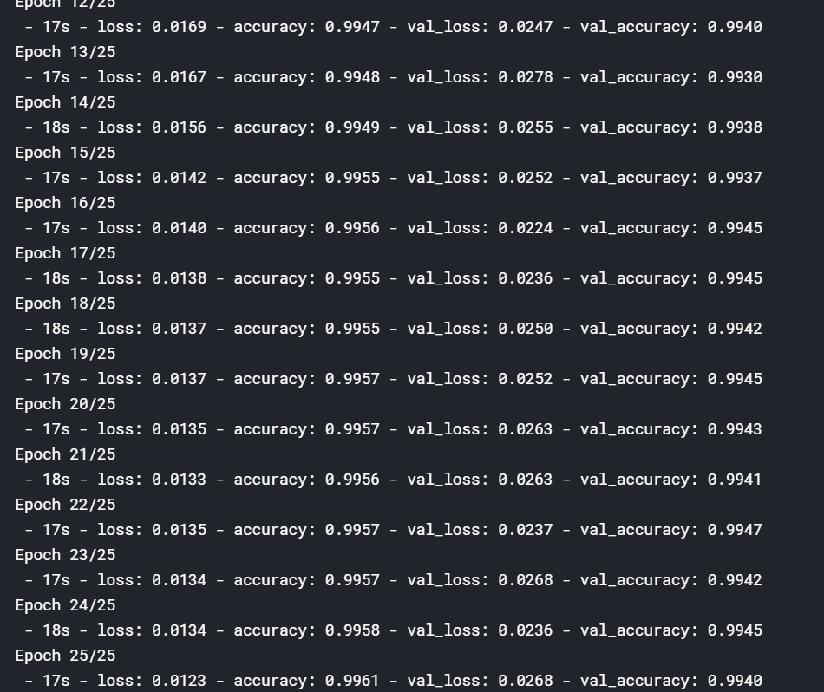
Metrics: Accuracy and Sparse Categorical Cross Entropy loss

Slide 17
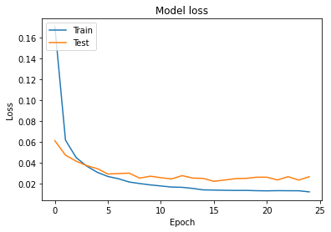
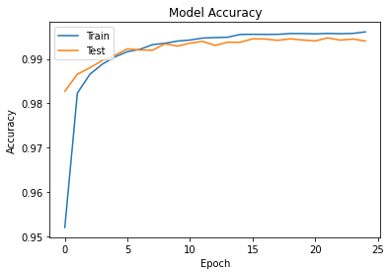
Performance

Slide 18


