Slide 1




Placement Management System
by
Batch : A-15
Department of Computer Science and Engineering
Srinivasa Ramanujan Institute of Technology
(Autonomous)
Rotarypuram Village, B K Samudram Mandal, Ananthapuramu – 515701.
2023-2024

Slide 2


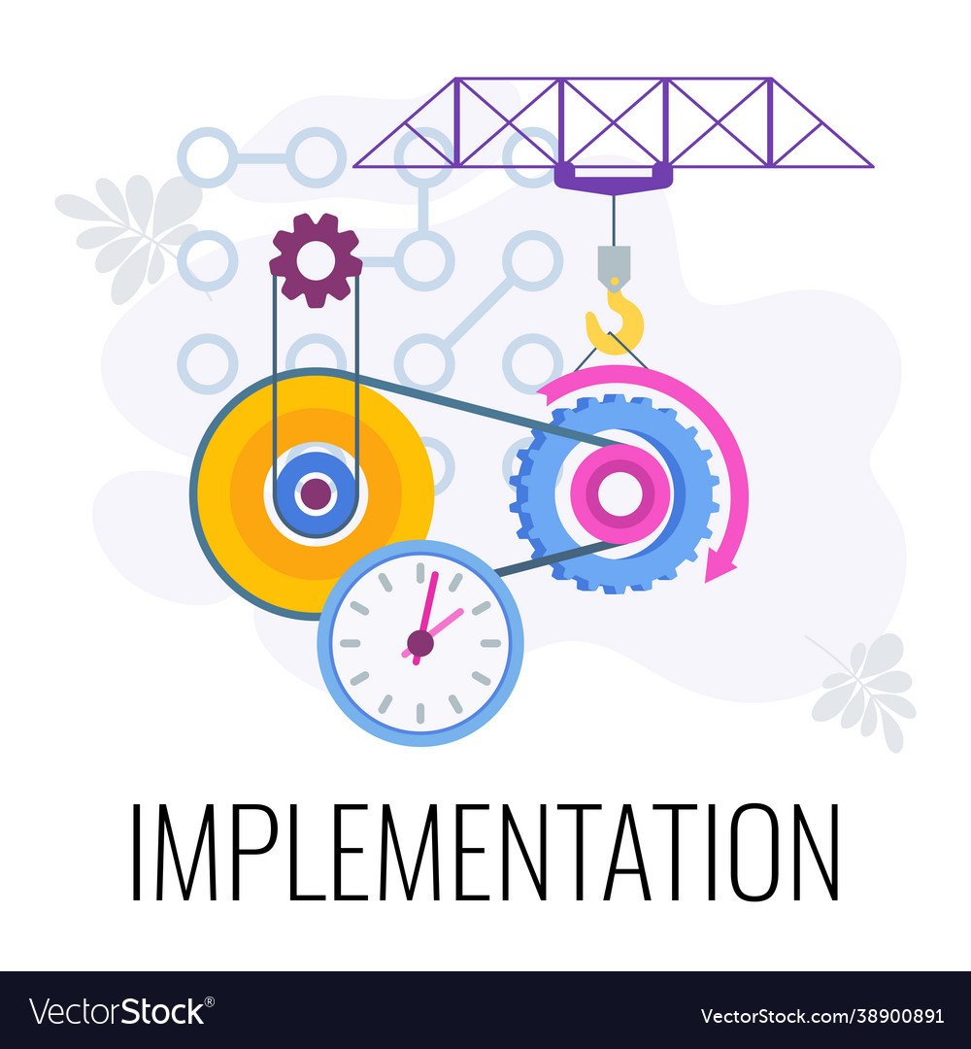




CONTENTS

Slide 3
Problem Statement
Placement processes in educational institutions and organizations suffer from inefficiencies due to manual handling, fragmented information storage, and limited access to opportunities. Students, placement officers, and employers face challenges in communication, matching candidates with positions, and generating accurate reports.
CONTENTS

Slide 4
Abstract
The College Placement management system was developed with the aim of collecting company and student data while limiting large database to a specific class of students or a specific company. The system provides the ability to view personal and academic information of students and companies, and can also search for eligible students and companies, as well as add and delete records by the administrator.
CONTENTS

Slide 5
Project Explanation
Modules
Student Module: Profile Management enables updating personal info. Job Search allows students to explore job openings.
Company Module: Job Posting feature advertises openings; Application Management handles incoming applications.
Admin Module: Dashboard provides system overview; User Management oversees accounts.
Analytics Module: Tracks placement statistics and user engagement, offering insights to optimize processes and enhance decision-making.
CONTENTS

Slide 6
Implementation
We are using Xampp server for storing data. We must switch on the Apache and Sql .
Implement the code using php for login,placements,profile etc and sql for storing the user details .
Admin is the main person who handles all the works in this placement management system.
Admin set the eligibility criteria for the each company and he must update all details of placements in the website.
User enter into the application using user credentials.
User update his profile and upload the resume.
According to company criteria, the user is eligible to the placement or not, can be displayed.
In this application companies details also available.
We can copy the link and we can browse it .
In this application we can view the available drives currently.
CONTENTS

Slide 7
Implementation
Php stands for hypertext preprocessor.it was developed in the year 1994 by Rasmus Lerdorf.
Php is used for development of dynamic web applications.
Php contains creating the sessions,receive or sents the cookies,emailing the information .
Php contains the html,css,javascript language in it.
Now it is trending one and it is server side scripting language.
CONTENTS

Slide 8
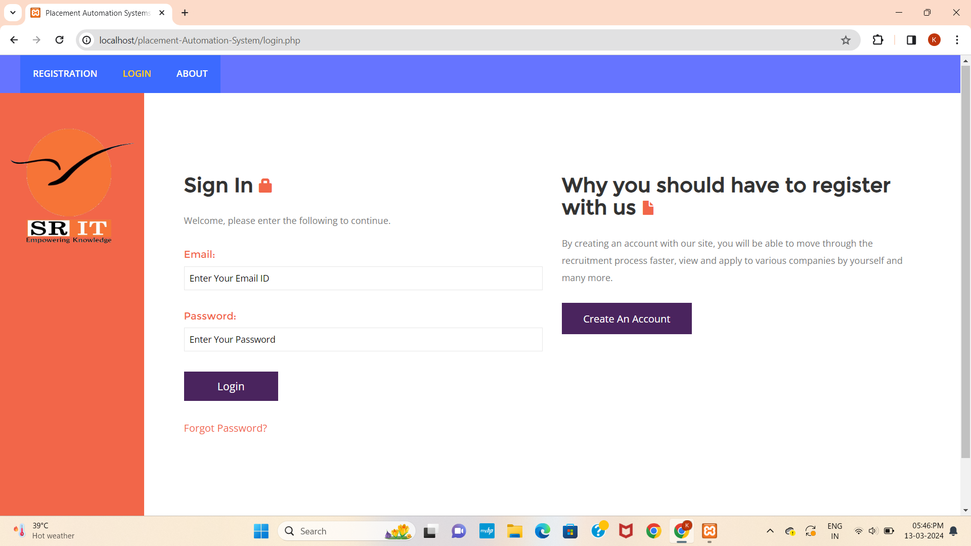
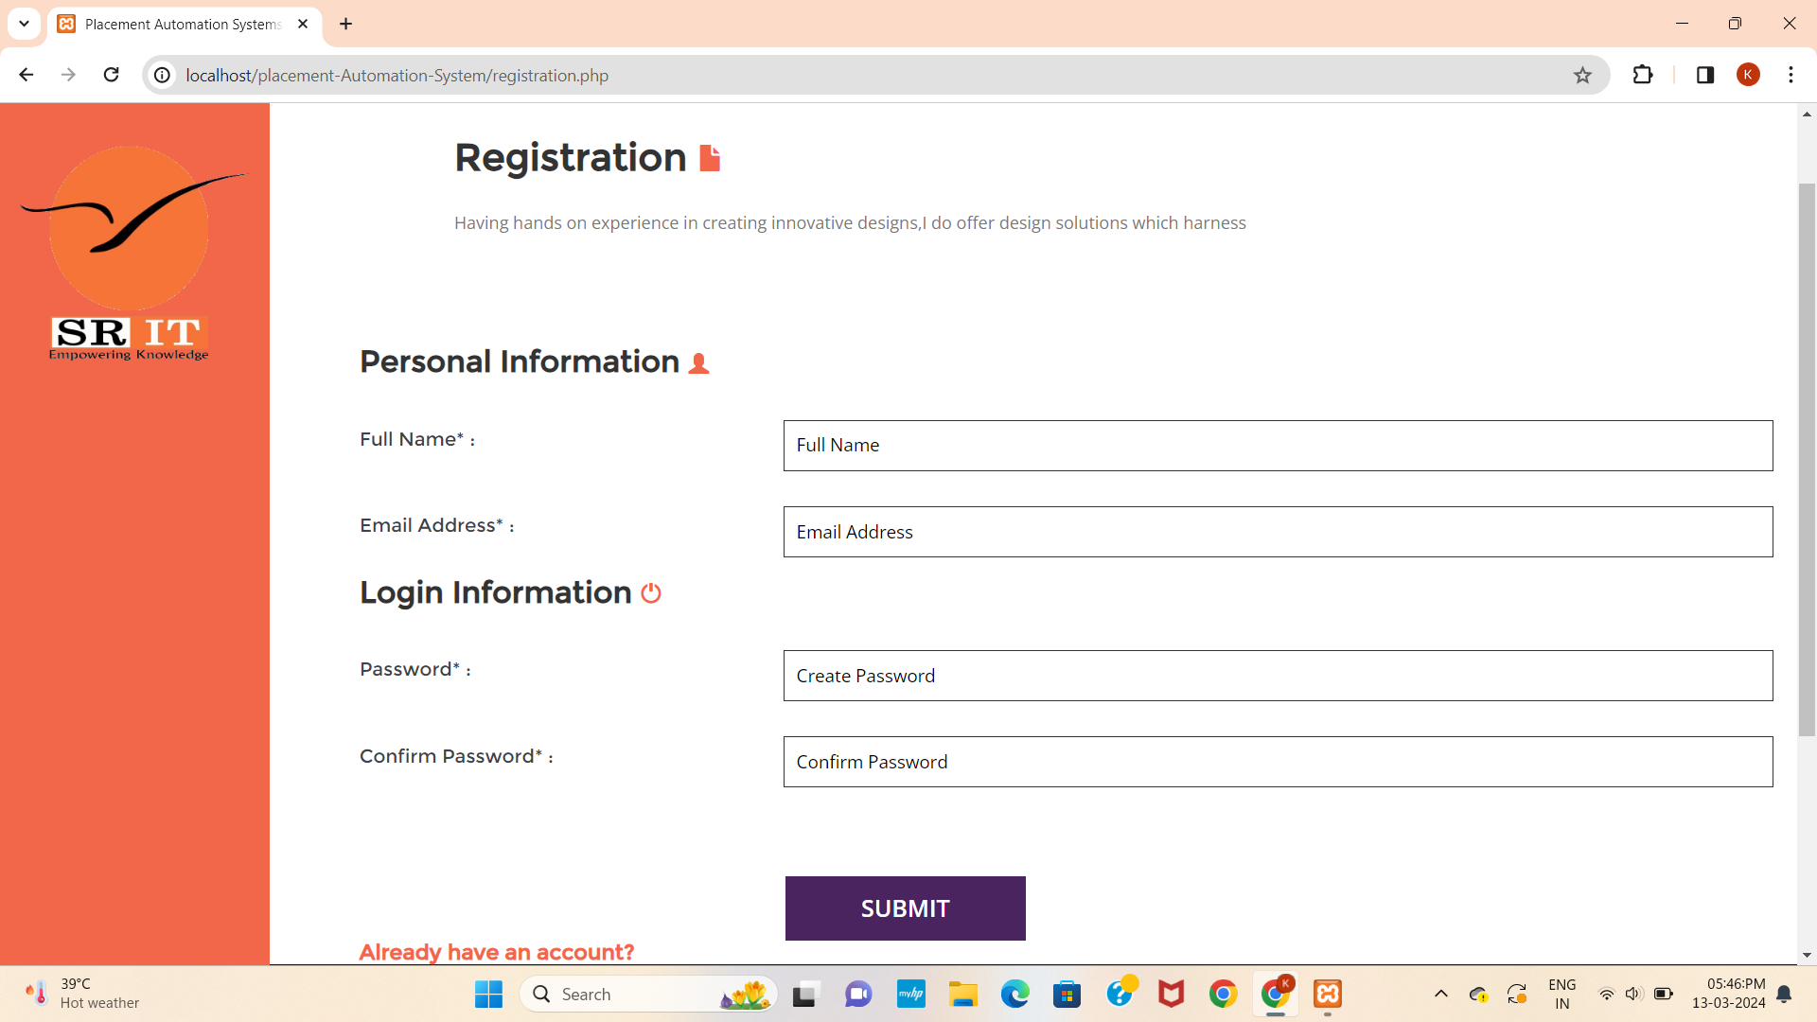
Results
CONTENTS

Slide 9
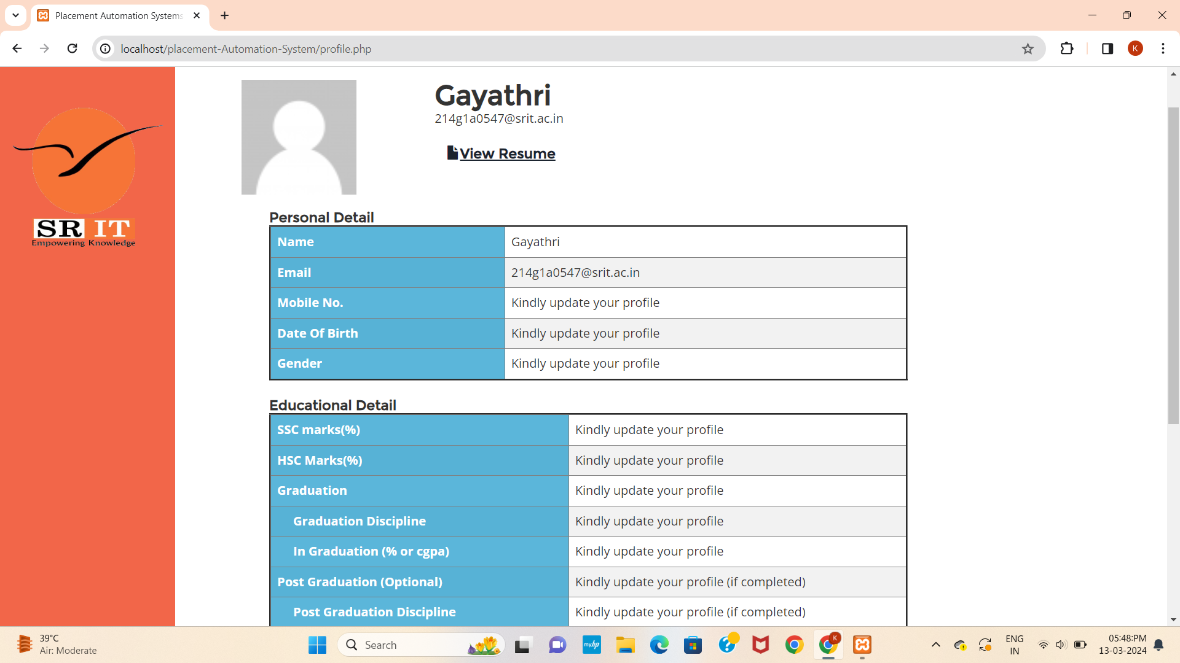
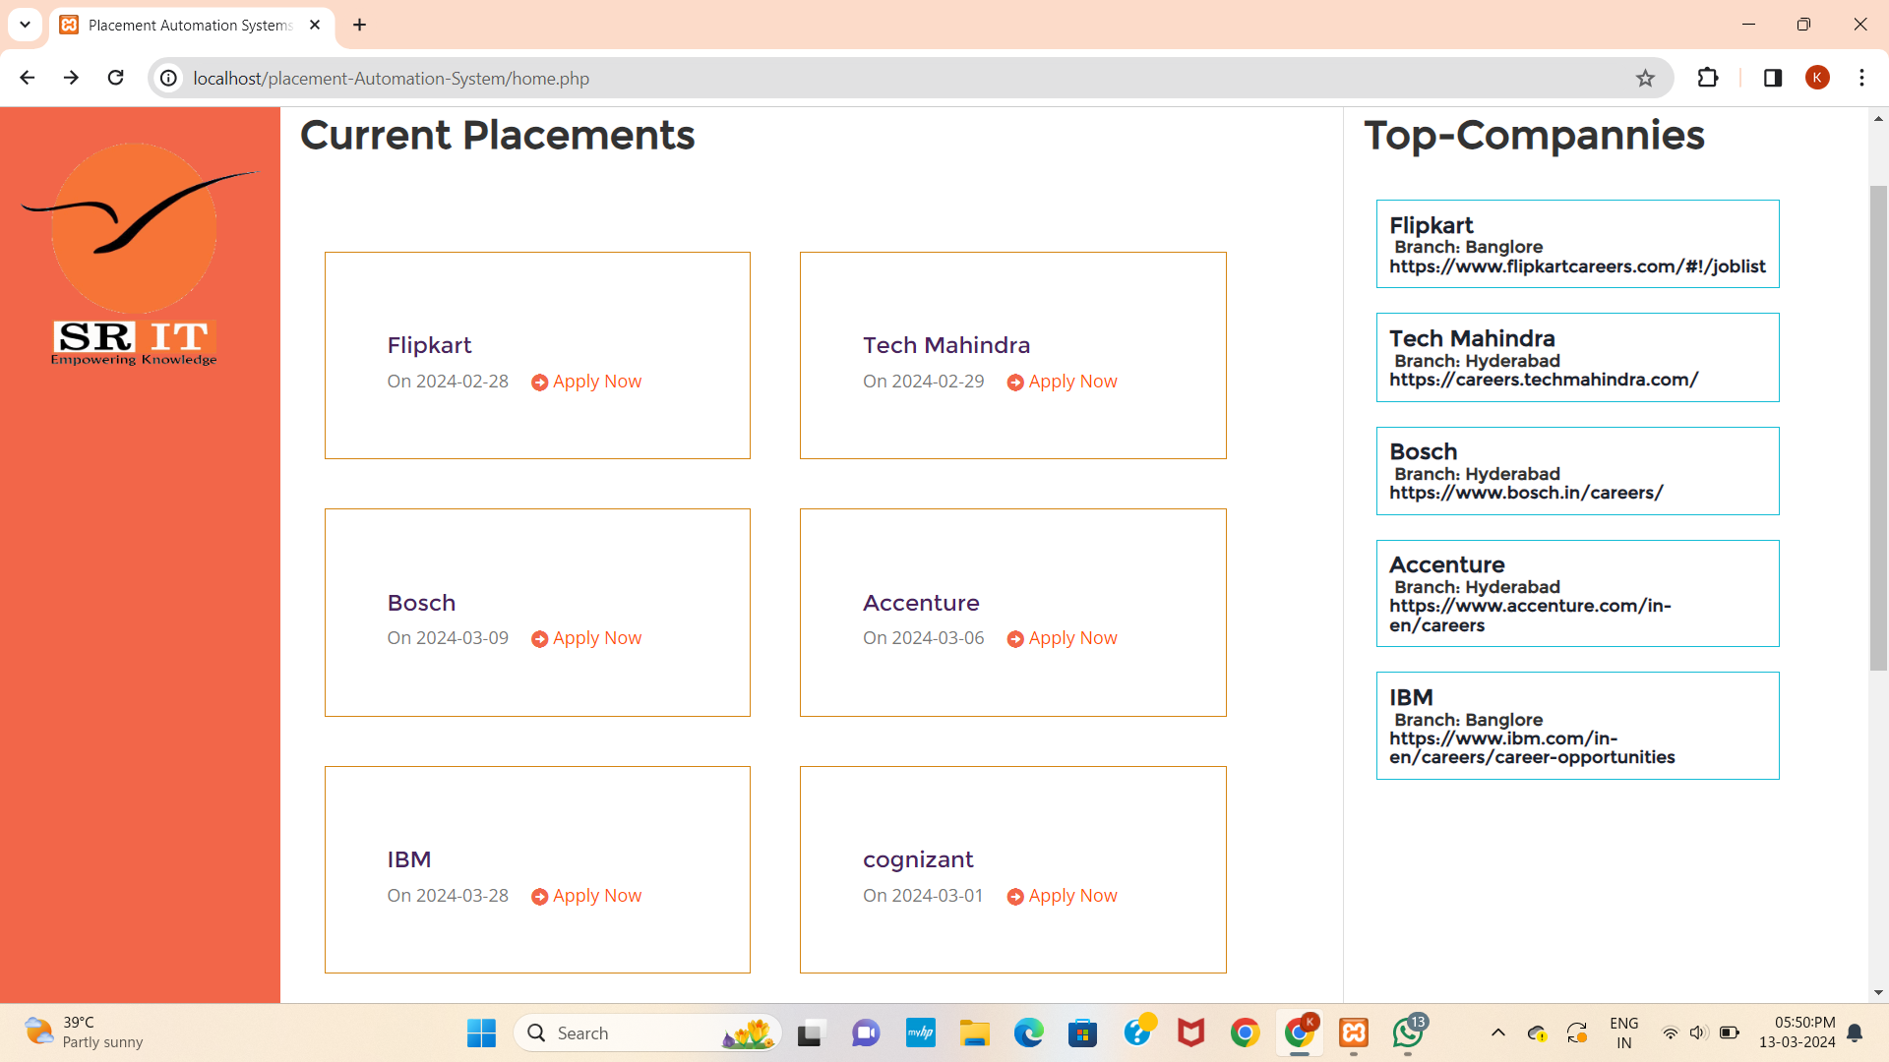
Results
CONTENTS

Slide 10
Future Scope
We can enhance project using the automatic resume builder.
We can go with the Android application too.
We can make web cloning in it and it would be more effective.
We can use machine learning to recommend suitable job for particular user.
We can use alerts for notifying the user about job opening and info of newly added companies.
CONTENTS

Slide 11
Conclusion
The Placement Management System streamlines job search, application management, and communication, enhancing efficiency and transparency. With its user-friendly interface and analytics-driven insights, it empowers users to make informed decisions and achieve successful placements, showcasing technology's transformative impact on recruitment processes.
CONTENTS

Slide 12
References
Books Referred:
"PHP and MySQL Web Development" by Luke Welling and Laura Thomson.
"Learning PHP, MySQL & JavaScript: With jQuery, CSS & HTML5" by Robin Nixon.
YouTube channels:
Traversy MediaLearn
code.academy
Codecourse
Websites:
W3Schools
CodecademyPhp.net
Coding standards:
Php: PSR Standards
Html: W3C html validator
Css: W3C css validator

Slide 13
Thank You!!!

