Slide 1

How to book a shipment
Process Summary:
Fill in the Booking form -> the System will provide service(s) from different courier companies -> Select a courier service -> After Booking confirmation an email is sent to the customer.

Slide 2
Process Detail:
After logging in, click on the “Quick Booking” tab
Select “Manual Booking” (if you are not automatically directed to the Booking form).

Slide 3
Fill in all mandatory fields in the Booking form.
You can navigate to the Collection Address, the Delivery Address and the Shipment Details tabs to provide all required information.

Slide 4
After filling in the form, click on “Get Services” to get an overview of the available services from different courier companies.
Either select the required courier service by double clicking on the row or go to the “Action” menu and click on “Select Service”.

Slide 5
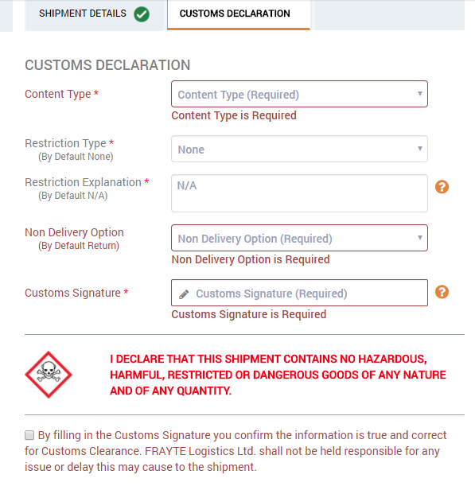
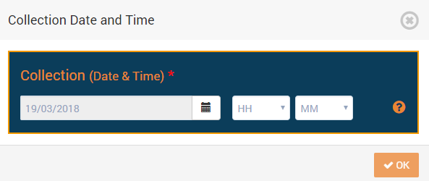
After selecting the service, there may be some new fields added into the Booking form.
For instance, you will need to provide the Collection Date and Time, or complete the Customs Declaration fields.

Slide 6
After filling in these extra fields, you can click the Place Booking icon.
Once the booking has been confirmed, the system will show the shipment details with a tracking number.
The user can download and/or print the label(s) and also send the label(s) by email.
A Clone Shipment facility is also provided here.

