Slide 1

How to install a label printer
Process Summary:
This document will brief on the process and settings required to set up a Zebra Printer Model – GC420T.

Slide 2
Process Detail:
The GC420T comes with a software CD. Run the executable file (RUNCD.EXE) on the CD.
Select GC420t from the list of available models and then select the desired language.

Slide 3
Click the “Run Zebra Setup Utilities“ option.

Slide 4
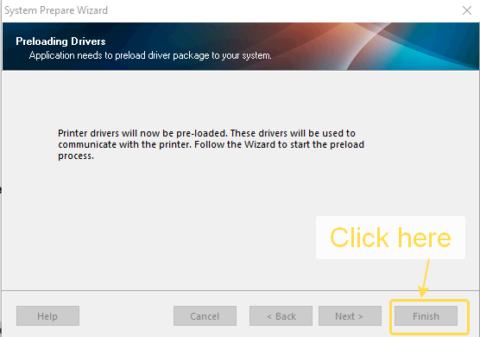
Click Next and then finish.

Slide 5
The Zebra Setup Utilities window will open. Click Install New Printer.

Slide 6
Click Install Printer and then Next.

Slide 7
Select the port your printer is connected to on the computer. In general most people use USB to connect a printer. Name your printer and click Next .
Note: If you want to setup this printer as the Windows default printer then check the box.

Slide 8
Clicking Next will give the option to install Zebra Fonts Downloader. It is recommended to select this option.

Slide 9
Click Next. After finishing the installation, the Zebra Setup Utilities window will show the installed printer.
To get the desired output, some settings need to be set. Click on “Configure Printer Settings”.

Slide 10
The following parameters need to be set:
Set units in “inch”
Set width to “4.00”
Set Height to “6.00”
Orientation “Inverted 180 degrees”

Slide 11
Click Next.
Speed of “4.0”/s is good for quick label printing.
Set Darkness to 14.

Slide 12
Click Next.
Keep the settings as shown in the following screen.

Slide 13
Click Next.
Keep the settings as shown in the following screen.

Slide 14
Click Next.
Click “Set Real Time Clock” and select Set Real Time Clock to Computers Clock.

Slide 15
Click Next.
Enable all the options.

Slide 16
Click Next.
There is no need to define sensor properties.

Slide 17
Click Next.
Optionally you can save these settings for future use. Then click Finish to complete the setup process.
To make the changes come into effect, restart your computer. Your printer is now ready to print labels. It is recommended to use 4” * 6“ sized labels.

