Slide 1

How to track a shipment
Process Summary:
Get tracking details from frayte.com or frayte.co.uk.
Track the shipment created from the system. Once logged into the system, go to the “Track & Trace” tab. Here you can see the tracking link in the grid. Click on the link and the system will provide it’s tracking details.

Slide 2
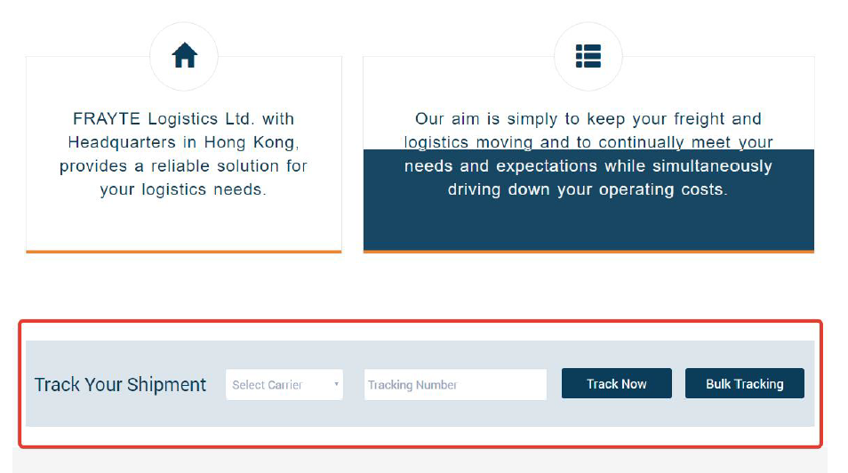
Process Detail:
Track the shipment from frayte.com or frayte.co.uk: Once the user accesses the homepage of the website, in the RED marked area, select the carrier and enter your tracking number. Then click on the “Track Now” button.

Slide 3
The system will show the tracking details as follows.

Slide 4
The system also provides a “Bulk Tracking” feature, where a user can search different tracking numbers in one go.

Slide 5
Track the shipment after login: After logging into the system, a user can see the shipment information on the “Track & Trace” tab.
Here a user can search for a shipment based on the tracking number.

Slide 6
Once the user finds the shipment in the grid, just click on the tracking link. The system will provide the shipment details.

Slide 7
From the “Track & Trace” screen, a user can retrieve the shipment details as well. Click “Actions” and then select the “Detail” option to view the shipment details.
Once the user selects “Detail”, the system will display the shipment details.

Slide 8
On the shipment details page the system is showing the tracking number at different places.
A user just needs to click on any of the links for the system to provide the tracking details.

