Slide 1
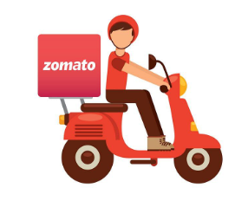
Deliver your food quickly and safely
1.7K+
90K+
1.49M+
By: Kumar Prakash
Food Items
Restaurants
Reviews

Slide 2
About Zomato
Indian tech pioneer: Started as FoodieBay in 2008, rebranded to Zomato to broaden its scope.
Restaurant discovery roots: Initially focused on menus, ratings, and reviews before pivoting to delivery.
Global footprint: Operated in 20+ countries including UAE, UK, and South Africa during its expansion phase.
Quick-commerce push: Acquired Blinkit to enter the 10-minute grocery delivery space.
IPO milestone: Listed publicly in 2021, raising ₹9,375 crore and drawing massive investor interest.
Tech-driven UX: Offers table booking, loyalty programs, and POS systems for restaurants.
Massive scale: Serves 800+ Indian cities with millions of monthly orders and active users.

Slide 3
Zomato Expansion (Problem Statement)
Zomato, amid intensifying competition and plateauing growth in metro hubs, must chart a strategic expansion path that balances scale, efficiency, and innovation. Key challenges include:
Unlocking Tier 2 & 3 potential: Tapping into smaller cities with rising digital adoption but fragmented supply chains.
Global re-entry strategy: Reassessing international markets with better unit economics and localized partnerships.
Revenue model evolution: Shifting from volume-based incentives to loyalty-driven monetization and premium services.
Tech-enabled scalability: Leveraging AI, route optimization, and predictive demand to streamline delivery ops.
Vertical integration: Building or partnering in cloud kitchens, logistics, and warehousing to control margins.
Brand differentiation: Standing out in a crowded space through curated experiences, sustainability, and hyperlocal menus.
Regulatory navigation: Managing compliance, data privacy, and labor laws across diverse geographies

Slide 4
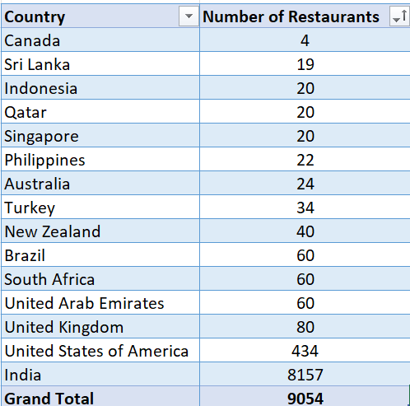
Restaurants Data in Each Country

Slide 5
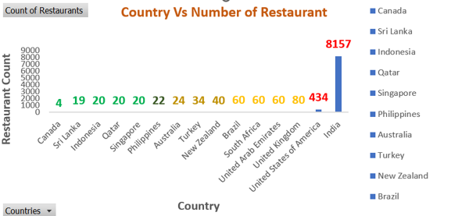
Restaurants Data in Each Country

Slide 6
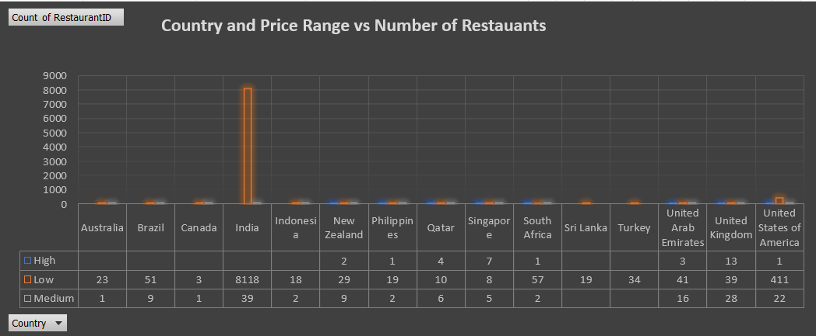

Slide 7

Where Should We Expand?
Canada
Very little Competition. 4 Cities with only 4 restaurants.
Sri Lanka
1 Cities with total 19 restaurants.
Indonesia
4 Cities with 20 restaurants and good-rated food.
Qatar
1 Cities with total of 20 restaurants and lower rating.
Singapore
1 Cities total 20 restaurants and lower rating.

Slide 8
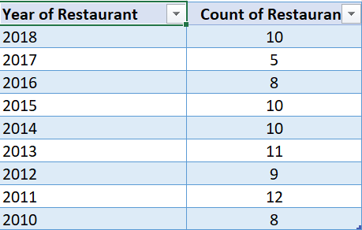
Restaurants Open Every Year
Restaurants Open every year in recommended Countries
(Canada, Sri Lanka, Indonesia, Qatar, Singapore )

Slide 9
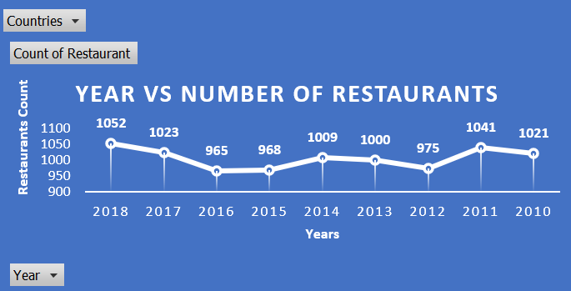
Restaurants Open Every Year

Slide 10
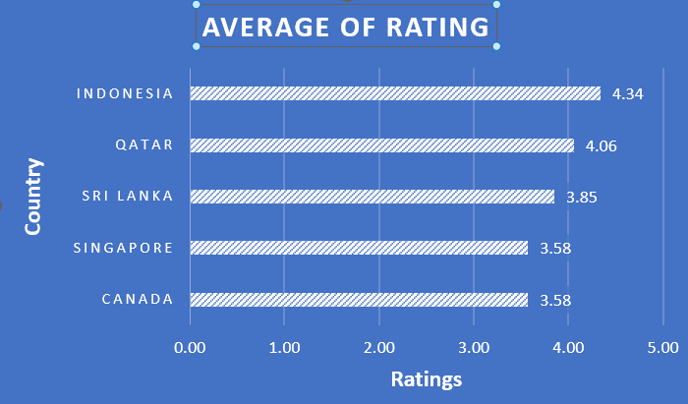
Average Rating by Country

Slide 11
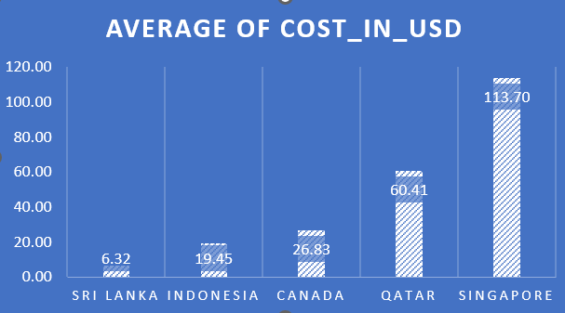
Average Cost_in_USD by Country

Slide 12
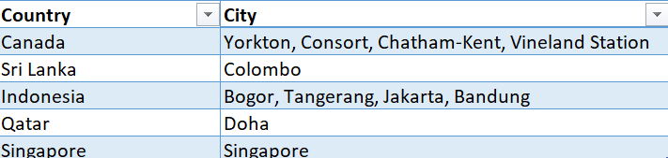
Cities to Expand the Business

Slide 13
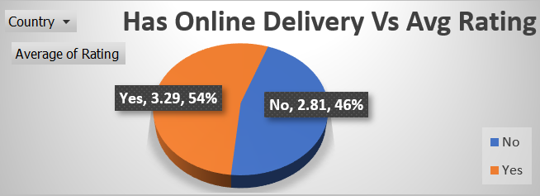
Has Online Delivery vs Average Rating

Slide 14
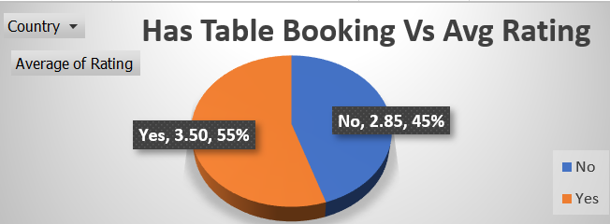
Has Table Booking vs Average Rating

Slide 15


Rating Report
Among all Three Countries Food rating seems Good.
3.5+
3.8+
4.3+
Canada
Sri Lanka
Indonesia

Slide 16
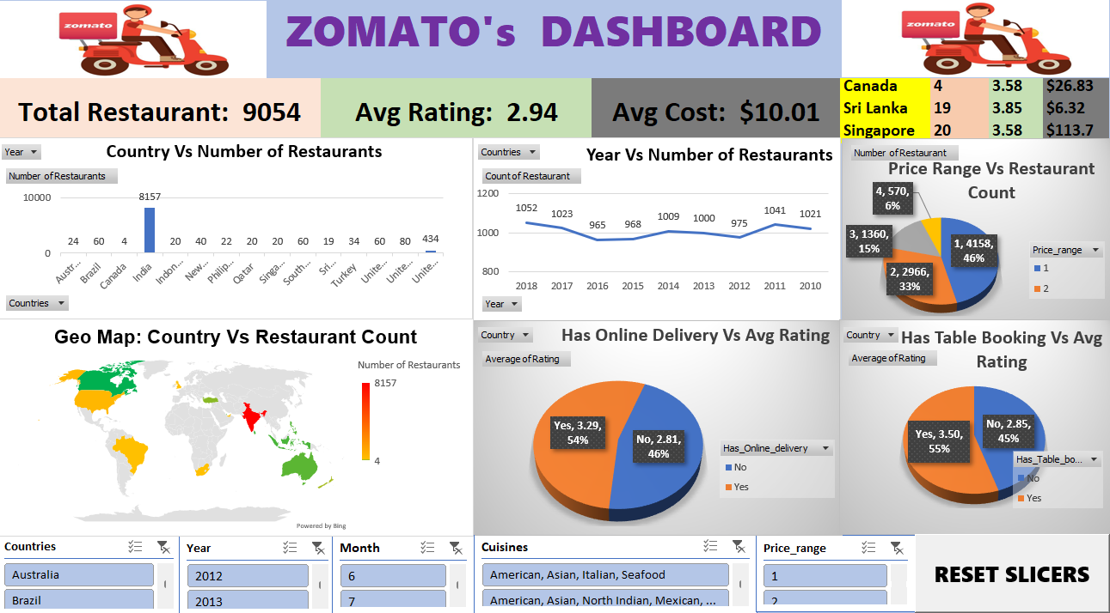
Strategy 01
Strategy 02

Slide 17
Executive Summary Slides
Strategies:
Expand into low-competition countries (Canada, Sri Lanka, Qatar)
Introduce delivery and table booking in high-rating regions
Launch cloud kitchens and loyalty programs for Tier 2 cities.
Risks:
Low brand awareness in new markets.
Operational challenges in non-English-speaking regions.
Opportunity:
Leverage tech-driven dashboards to optimize expansion decisions.

Slide 18
Conclusion
Strategy 01
Strategy 02
Strategy 03
Canada has 4 cities and only 4 restaurants. No restaurant has an online delivery or table booking facility.
Sri Lanka has 1 cities with 19 restaurants. No online delivery or table booking facility
Indonesia has 4 cities with 20 restaurants. No online delivery or table booking facility

Slide 19

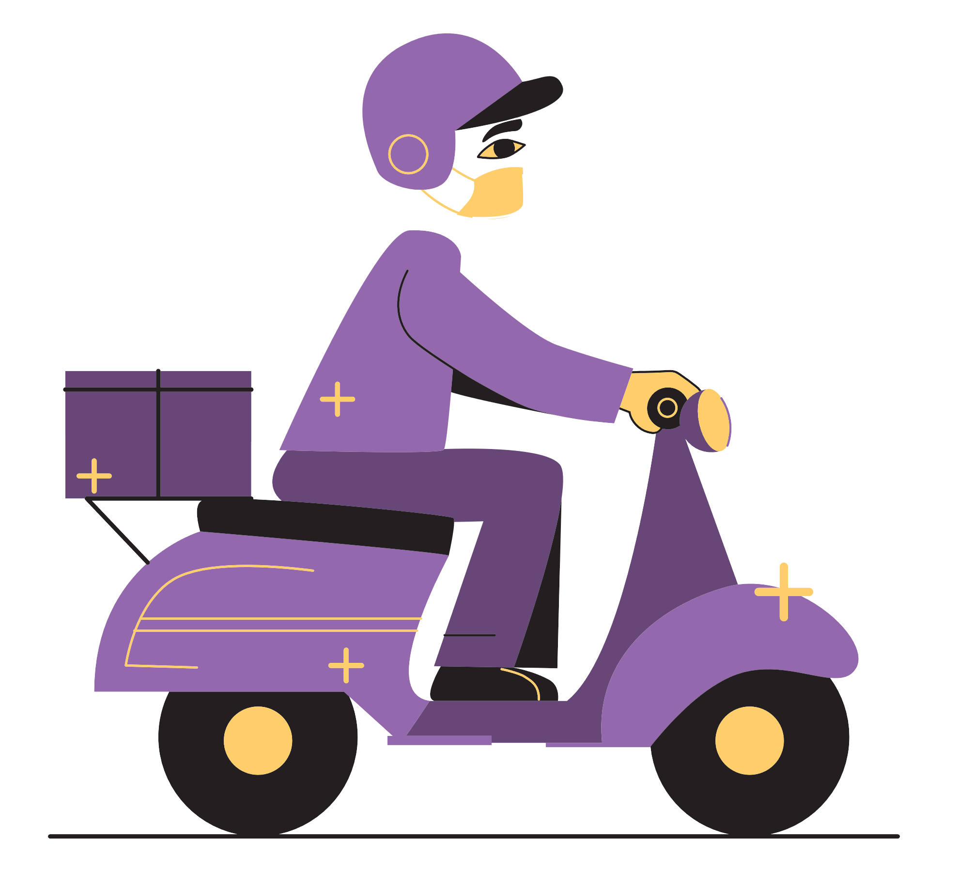
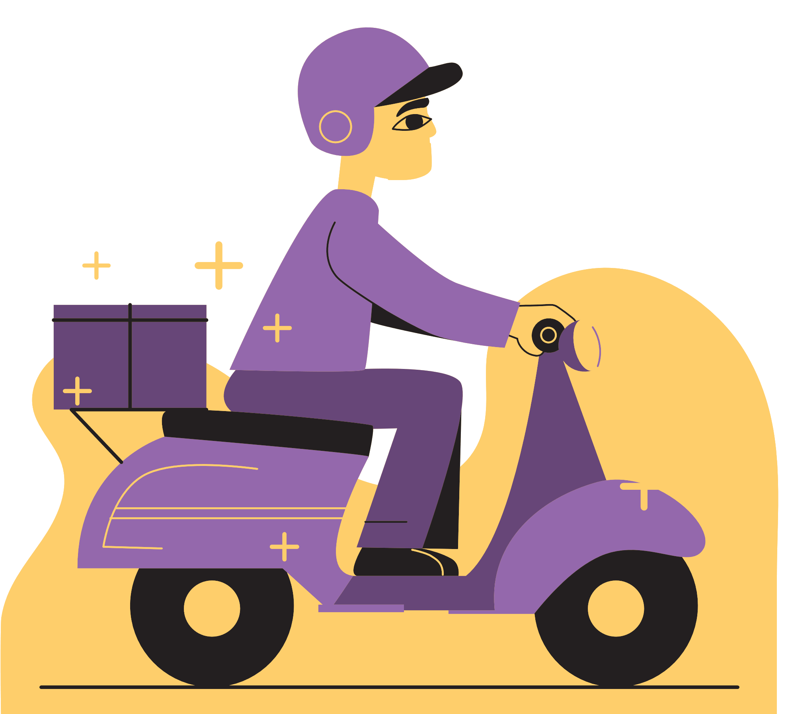

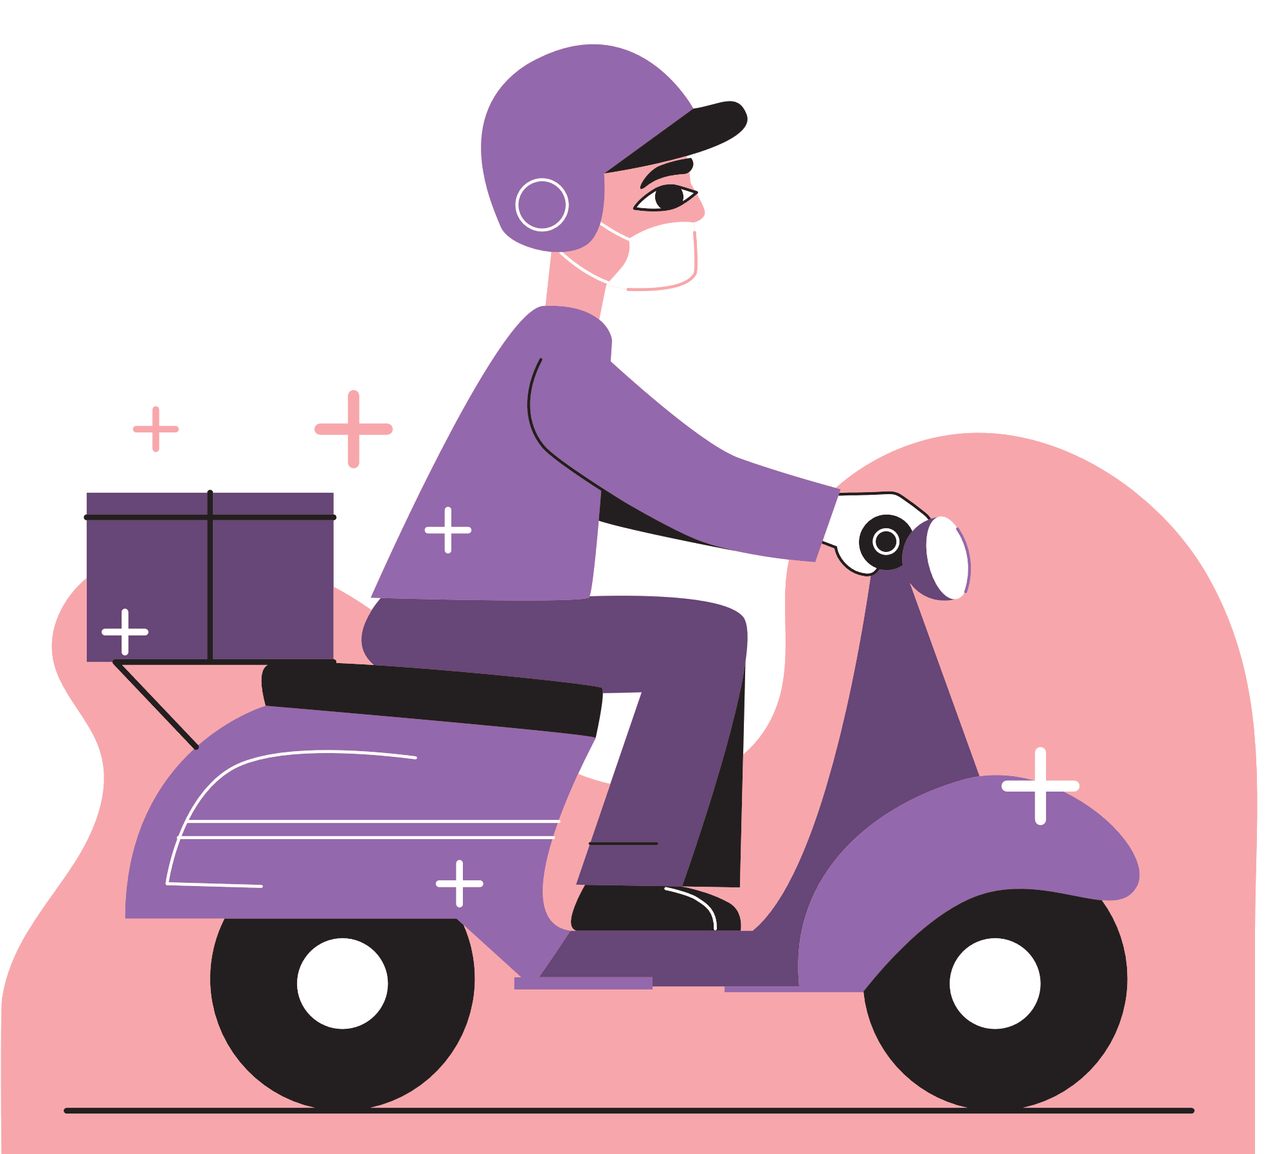
Thank you for listening!
Don't hesitate to ask any questions!

Slide 20


