Slide 1

FIFA World Cup Analysis
GNANA PRAKASH A

Slide 2


FIFA WORLD CUP ANALYSIS :
Project Overview: FIFA World Cup Analysis
The FIFA World Cup is one of the most prestigious and widely viewed sporting events globally. This project aims to analyze various aspects of the FIFA World Cup, providing insights into historical data, team performances, and trends over time. The analysis will cover data from past tournaments, focusing on key metrics that highlight the evolution of the sport and its global impact.

Slide 3
STEPS INVOLVED :
Define Objectives and Scope Objectives:
Clearly define what you aim to achieve with the analysis. For example:Historical performance trends of teams and players.Key metrics of successful teams.
Scope: Specify the range of data to be analyzed (e.g., tournaments from 1930 to 2022).2. Data Collection
Data Collection :
Dataset provided
Data Cleaning and Preparation :
Handling Missing Data: Fill in or remove missing values as appropriate.
Standardization: Ensure data consistency in formats (e.g., date formats, team names).
Removing Duplicates: Identify and remove duplicate records.
Visualization and Reporting
Interactive Dashboards: Use tools like Tableau, Power BI, or Plotly to create interactive visualizations.Dashboards for team and player performance.

Slide 4
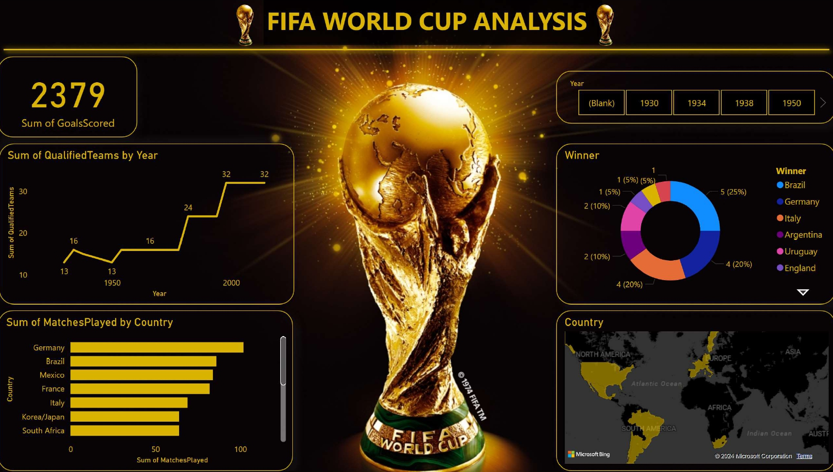
DASHBOARD :

Slide 5

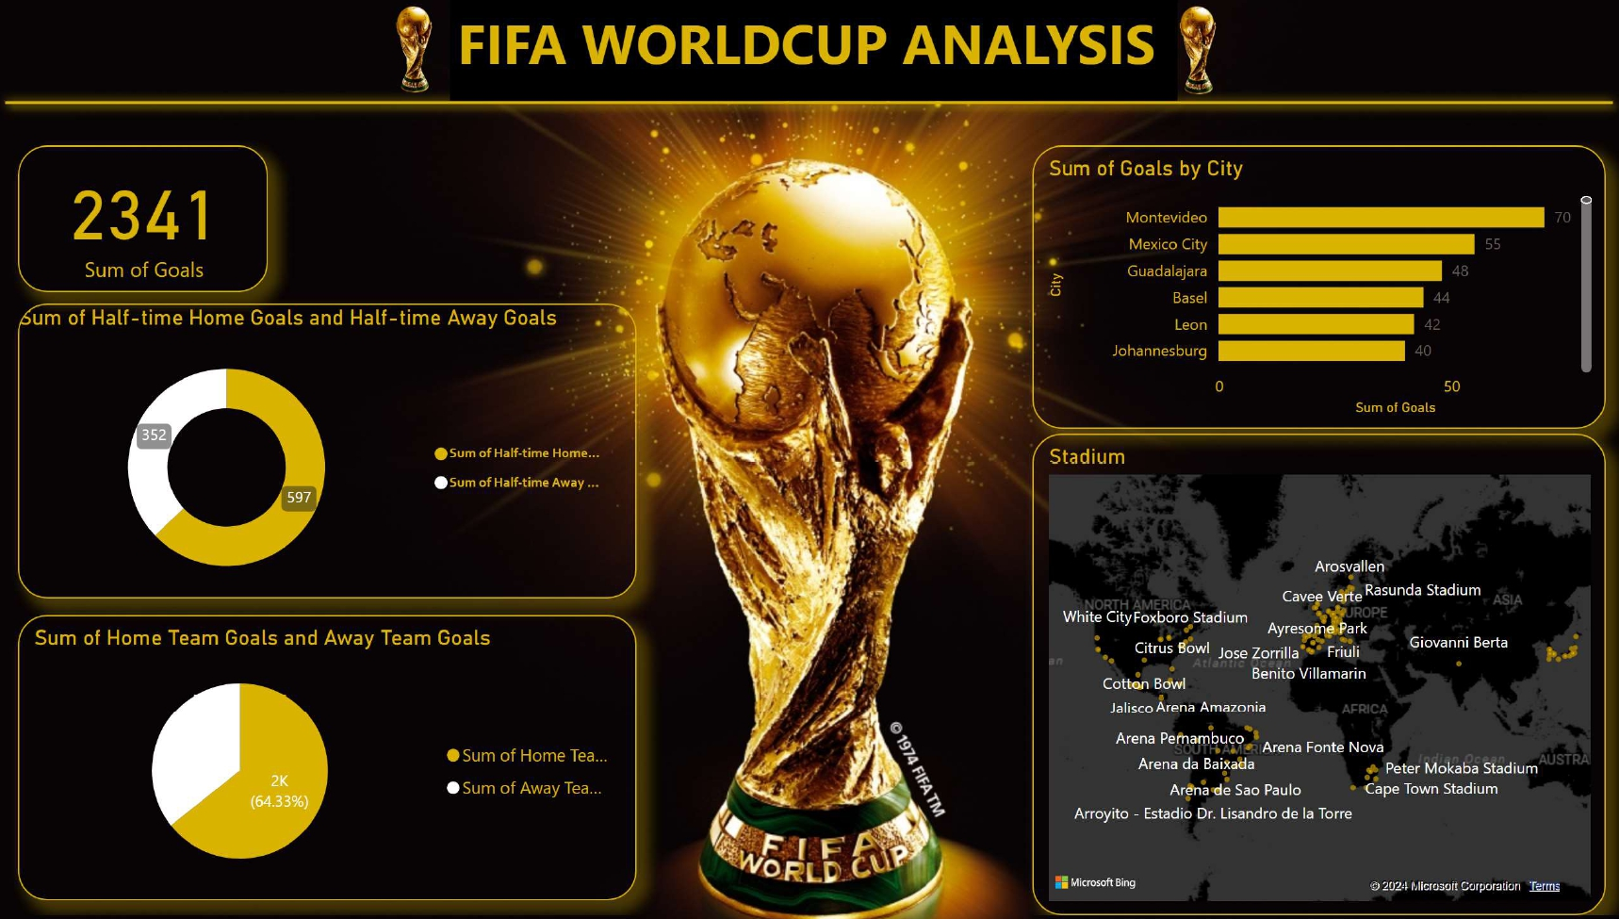

Slide 6
THANK YOU

