Slide 1


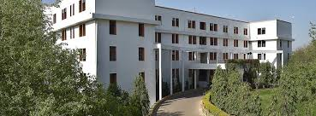
SWAMI KESHVANAND INSTITUTE OF TECHNOLOGY MANAGEMENT AND GRAMOTHAN Jaipur(Raj.)

Slide 2
PRESENTATION
ONLINE LIBRARY MANAGEMENT
SYSTEM
SUPERVISED BY:-
Mr. NEERAJ DHAWAN
PRESENTED BY:-PRAKASH GURJAR
SOURABH CHOURASIA
ASHUTOSH JHA
GAURAV SINGH

Slide 3
TABLE OF CONTENTS
MOTIVATION
INTRODUCTION
PROBLEM STATEMENT
UML DIAGRAMS
ADVANTAGES & DISADVANTAGES
TECHNOLOGY
CONCLUSION
REFERENCE

Slide 4
MOTIVATION
For monitoring and controlling the transactions in a library.
Designed to help librarian to maintain and organize library.
Can keep track of users activities.
Windows application written for 32-bit windows operating systems.

Slide 5
What is Online OLMS?
Automation of library .
Provide facilities to student or member to search for the
required books.
Allows the admin or librarian to create & delete members.
Issue & return books to members.

Slide 6
The Online Library Management System has four main modules:-
Insertion to Database Module
User friendly input screen Extracting from Database module
Attractive Output Screen Report Generation module
Borrowed book list & Available book list Search Facility system - search for books and members.

Slide 7
PROBLEM STATEMENT
Allows for storing details of a large number of books, magazines, Journals.
Allows for add, search, issue, return facilities separately to administrator/Librarian, staff and students.
Different privileges are given to different types of users.

Slide 8
The tasks we have to do are:
To identify the main entities (objects) for this system.
To find out the relationships between these objects.
To find the necessary attributes and functions,
To make a final comprehensive diagram show.
All objects and their relations along with their attributes
and functions should describe in diagrams.

Slide 9
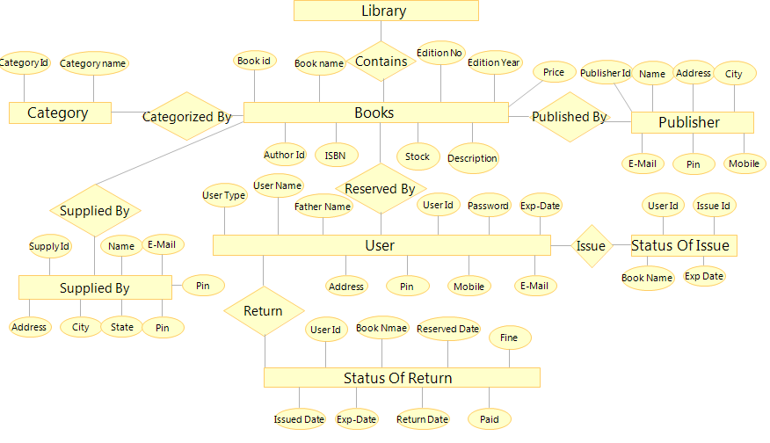
UML DIAGRAMS
ER-Diagram:-

Slide 10
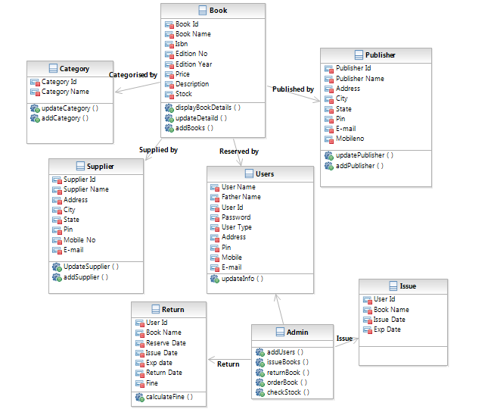
CLASS DIAGRAM

Slide 11
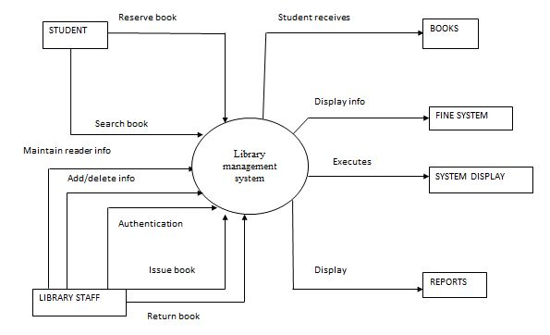
DATA FLOW DIAGRAM

Slide 12
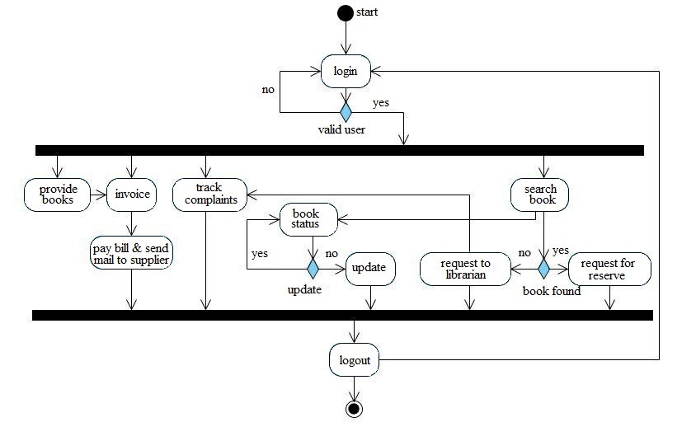
ACTIVITY DIAGRAM

Slide 13
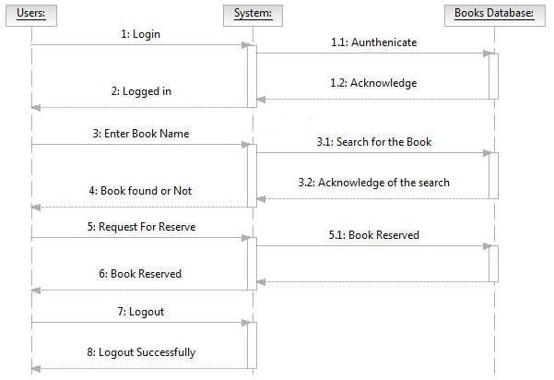
SEQUENCE DIAGRAM
For member searching book:-

Slide 14
ADVATAGE & DISADVANTAGE
ADVANTAGE :-
Save time
Easy to maintain records
24/7 Availability
DISADVANTAGE:-
Requires skillful person
Requires good internet facility

Slide 15
TECHNOLOGY
JSP for front end designing.
Eclipse-Luna for the development of project.
Microsoft SQL server 2008 as a back end.
JDBC is used for the connectivity.
HTML & CSS is also used for designing web pages.

Slide 16
CONCLUSION
Design with keeping quality assurance at extreme the system is developed with the latest technology.
With the aspects of JSP integrates utilities with keep ahead from the current area.
Documentation developed in the view of re-engineer purposed, and the ability of system to prove efficiency in timely manner for every long period.

Slide 17
REFERENCES
BOOKS:
Object Oriented Modeling and Design with UML-Michael
Blaha, James Ram Baugh.
Software Engineering, Seventh Edition, Ian Somerville.
Complete Reference - J2EE - Keogh.
URL:
IBM – www.ibm.in/developerworks.
Java - www.sun.com

Slide 18

THANKS

