Slide 1
Digital Portfolio
STUDENT NAME: PRAKASH K
REGISTER NO AND NMID: 2426J1539& asbruaz2426j1539
DEPARTMENT: B.Sc INFORMATION TECHNOLOGY
COLLEGE: KPR COLLEGE OF ARTS SCIENCE AND RESEARCH/
BHARATHIYAR UNIVERSITY

Slide 2
PROJECT TITLE
Skill Showcase Dashboard

Slide 3


AGENDA
Problem Statement
Project Overview
End Users
Tools and Technologies
Portfolio design and Layout
Features and Functionality
Results and Screenshots
Conclusion
Github Link
3/21/2024 Annual Review

Slide 4

PROBLEM STATEMENT
In the competitive digital landscape, professionals often struggle to showcase their skills, certifications, and projects in an engaging and organized manner. Traditional resumes and static portfolios fail to demonstrate skill progression and achievements dynamically. A dashboard-based portfolio provides a visual, interactive, and modern way to highlight expertise and career growth.

Slide 5

PROJECT OVERVIEW
The Skill Showcase Dashboard is an interactive portfolio web application that allows users to display their technical and creative skills using progress trackers, certifications, badges, and project samples. The dashboard includes light/dark mode support for better accessibility and professional aesthetics.

Slide 6
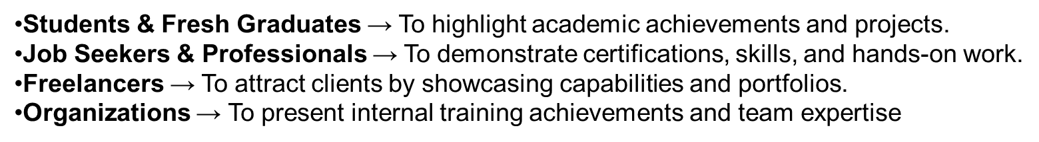

WHO ARE THE END USERS?
.

Slide 7

TOOLS AND TECHNIQUES
Frontend: React.js, Tailwind CSS, ShadCN UI, Lucide Icons
UI Enhancements: Framer Motion (animations), Progress Trackers
Version Control: Git & GitHub
Deployment: Vercel / Netlify

Slide 8
POTFOLIO DESIGN AND LAYOUT
Dashboard Layout: Grid-based cards for each skill
Progress Trackers: Visual representation of skill levels
Certifications & Badges: Highlight achievements and credentials
Sample Works Section: Linked to project demos or case studies
Light/Dark Mode: Professional design toggle for better UX
8

Slide 9
FEATURES AND FUNCTIONALITY
✅ Interactive Skill Progress Tracker
✅ Certifications and Badges listing
✅ Linked Sample Works for each skill
✅ Light/Dark Mode Toggle
✅ Responsive Design (Desktop & Mobile friendly)
✅ Clean UI with modern aesthetics

Slide 10
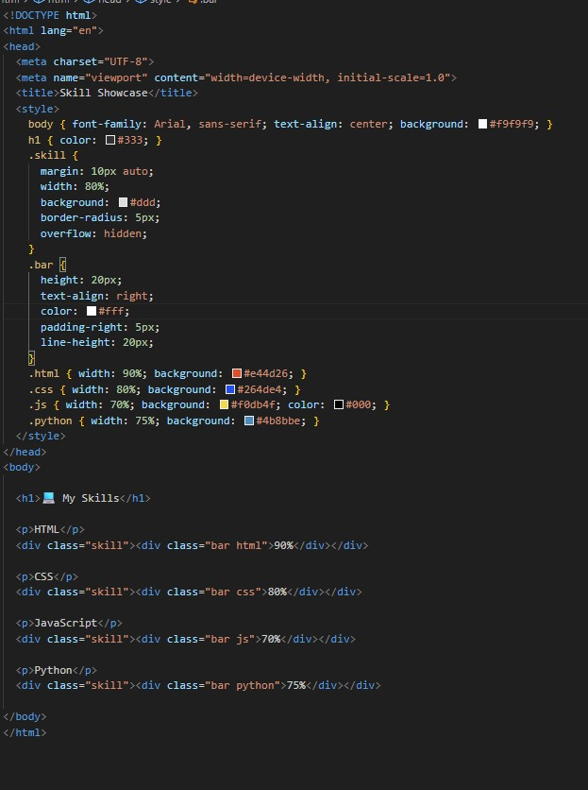
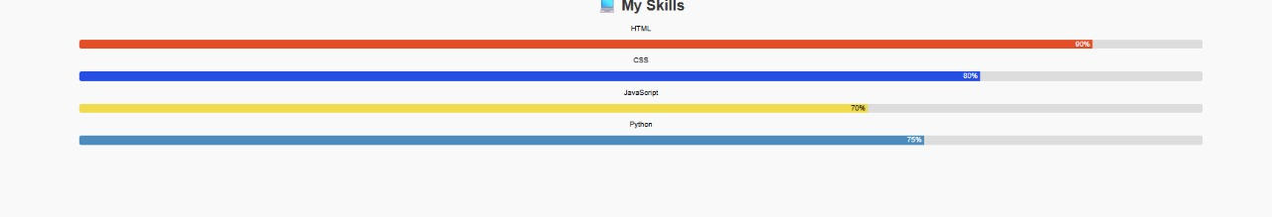

RESULTS AND SCREENSHOTS
3/21/2024 Annual Review
10

Slide 11
CONCLUSION
The Skill Showcase Dashboard serves as an innovative alternative to traditional portfolios by offering a visually engaging and interactive platform. It helps individuals effectively present their career growth, certifications, and projects to recruiters, clients, and collaborators.
GitHub Link :
https://github.com/prakashk006/skill-shocase.git
11

