Slide 1
Database Concepts Campus Hire Program

Slide 2
Agenda
Prerequisite → End user, Front end, Back end ( Example University Result website)
What is Database?
DBA ( Student → Lecturers → Principal → Secretary → Managing Trustee )
Characteristics of DBMS
ER Model
Levels of Abstraction
Data Model
Types of Data Model
Anomalies in DBMS
Background to Normalization

Slide 3
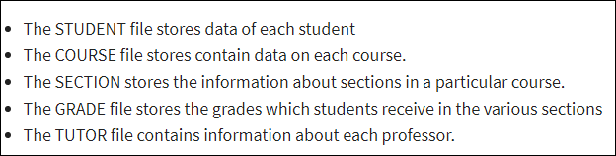
What is Database?
What is Data ? → “Data is a collection of information” → Name, Age, Weight
What is Database ? → “ Database is a collection of Data” . (or) A database in a place where the data is stored.
What is schema → “ Collection of tables, views , procedures, functions, triggers” (or) Logical Representation of the database, which shows how the data is stored logically in the entire database.
select * from ALL_TABLES;
select distinct owner from dba_objects;
select * from dba_objects where owner = 'SYS';
select * from SYS.I_USER1;

Slide 4
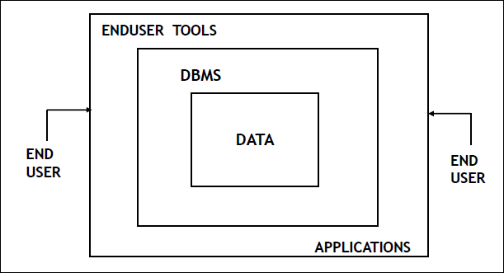
What is DBMS?
DBMS → Database Management System
Definition:
DBMS is a software which is used to manage the database. (or) A Database Management System (DBMS) is software designed to store, retrieve, define, and manage data in a database.
Ex → My SQL, Oracle, dBASE, IBM DB2

Slide 5
DBA
DBA ( Student → Lecturers → Principal → Secretary → Managing Trustee )
Trustee
Secretary
Principal
Lecturers
Student

Slide 6
Characteristics of DBMS
Control of Data Redundancy
DBMS helps in removing redundancies by providing means of integration.
Ex – Roll Number from Student Database not Mobile Number
Sharing of Data
The Database management system allows so many users to access databases at the same time
Ex→ (University Result website)
Maintenance of Integrity
This is one of the most important characteristics of database management system. Integrity ensures the quality and reliability of database system. It protects unauthorized access to the database and makes it more secure. It brings only consistent and accurate data into the database

Slide 7
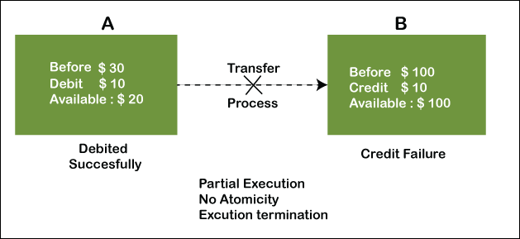
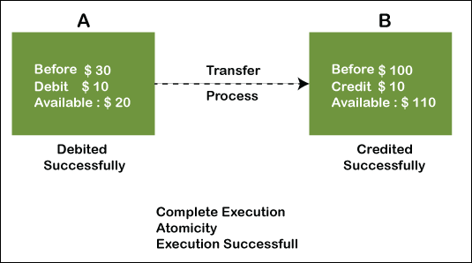
Characteristics of DBMS
Support ACID properties
A (Accuracy) → All or nothing rule (either Abort (or) Commit)
It means if any operation is performed on the data, either it should be performed or executed completely or should not be executed at all

Slide 8
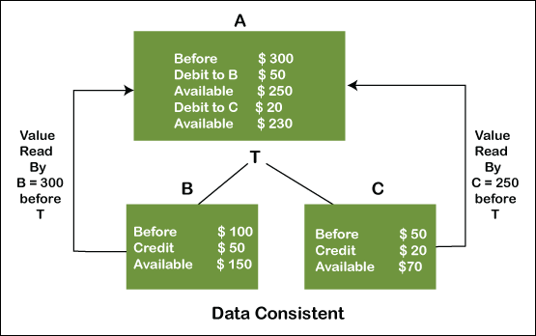
Characteristics of DBMS
Support ACID properties
C (Consistency) → The word consistency means that the value should remain preserved always
There is some time in between the delete & write operation and the database should be consistent during the change

Slide 9
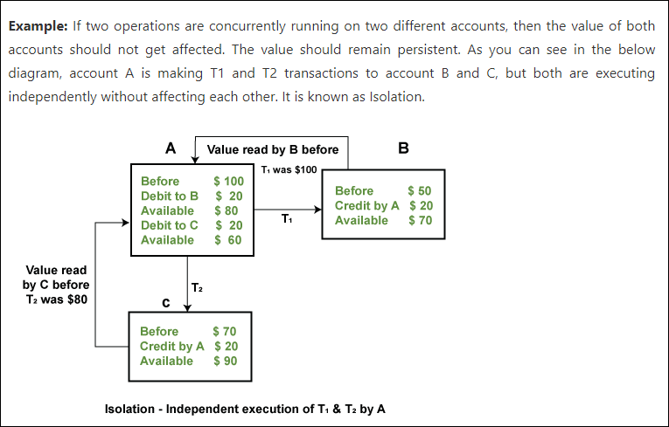
Characteristics of DBMS
Support ACID properties
I (Isolation) → Database should be persistent when you perform concurrent operations (Such as Read (or) Write) on the same database

Slide 10
Characteristics of DBMS
Support ACID properties
D (Durability)→ Once committed data is never lost.
Durability ensures the permanency of something. In DBMS, the term durability ensures that the data after the successful execution of the operation becomes permanent in the database. The durability of the data should be so perfect that even if the system fails or leads to a crash, the database still survives. However, if gets lost, it becomes the responsibility of the recovery manager for ensuring the durability of the database. For committing the values, the COMMIT command must be used every time we make changes.

Slide 11
Characteristics of DBMS
Support for Transaction Control and Recovery
DBMS ensures that updates take place physically after a logical transaction is complete. If a transaction crashes, then the recovery manager may undo transactions i.e. reverse the operations of a transaction
Data Independence
Data Independence is the property of DBMS that allows the user to change the schema definition at one level with no requirement of changing the schema definition at the succeeding higher levels
Availability of Productivity Tools
Tools like query language, screen and report painter and other 4GL tools are available.
Control over Security
DBMS provide tools by which the DBA can ensure security of the database.
Hardware Independence
Most DBMS are available across hardware platforms and operating systems.

Slide 12
ER Model
https://beginnersbook.com/2015/04/e-r-model-in-dbms/

Slide 13
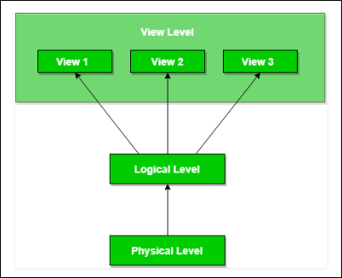
Levels of Abstraction

Slide 14
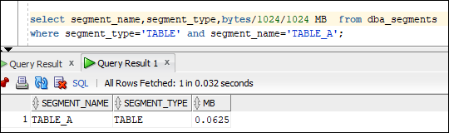
Physical Level
This is the lowest level of data abstraction. It describes how data is stored in database. You can get the complex data structure details at this level.
select segment_name,segment_type,bytes/1024/1024 MB from dba_segments
where segment_type='TABLE' and segment_name='TABLE_A’;
Example:
Let’s say we are storing customer information in a customer table. At physical level, these records can be described as blocks of storage (bytes, gigabytes, terabytes etc.) in memory. These details are often hidden from the programmers.

Slide 15
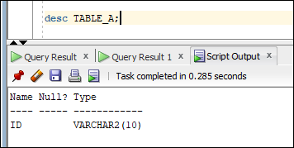
Logical Level
This is the Middle level of data abstraction. It describes What data is stored in database. We can get the complex data structure details at this level.
Example:
At the logical level, these records can be described as fields and attributes along with their data types, their relationship among each other can be logically implemented. The programmers generally work at this level because they are aware of such things about database systems.

Slide 16
View Level
This is the High level of data abstraction. This level describes the user interaction with database system
Example:
At view level, user just interact with system with the help of GUI and enter the details at the screen, they are not aware of how the data is stored and what data is stored; such details are hidden from them
If we have a login-id and password in a university system, then as a student, we can view our marks, attendance, fee structure, etc. But the faculty of the university will have a different view. He will have options like salary, edit marks of a student, enter attendance of the students, etc. So, both the student and the faculty have a different view. By doing so, the security of the system also increases. In this example, the student can't edit his marks but the faculty who is authorized to edit the marks can edit the student's marks. Similarly, the dean of the college or university will have some more authorization and accordingly, he will have his view. So, different users will have a different view according to the authorization they have.

Slide 17
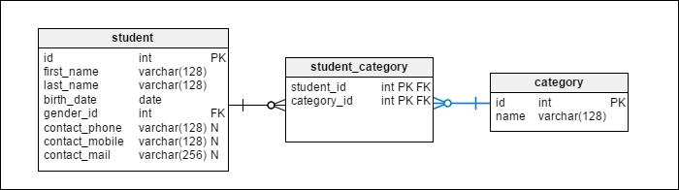
Data Model

Slide 18
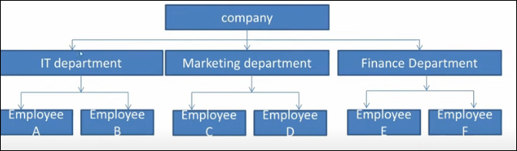
Types of Data Model
Hierarchical Model:
Tree like structure
Each child node will have single parent node
Ex – Parent child Relationship
Many to Many relationships are not allowed
No child can exist without its parents

Slide 19
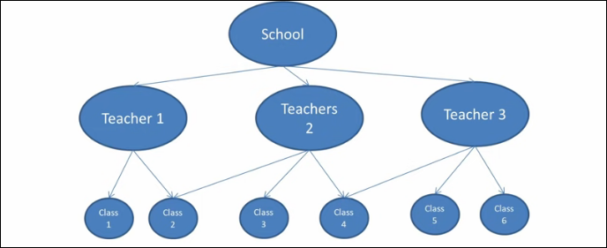
Types of Data Model
Network Model:
Graph like structure
A child can have multiple parent node
Ex – Teacher and class
Many to Many relationships are allowed
Superset of hierarchical model

Slide 20
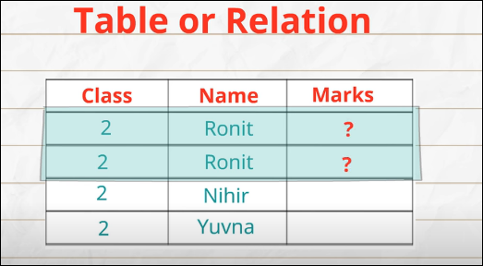
Types of Data Model
Relational Model:
Depicts the relationship between two (or) more tables
Each table is made up of records (horizontal rows known as tuples) and fields (vertical column also known as attributes) → [ One complete unit of information – Records, One type of information – Fields ]
Number of columns (or) attributes called as Degree
Number of Rows (or) tuples called as Cardinality
Ex – Oracle, Sybase

Slide 21
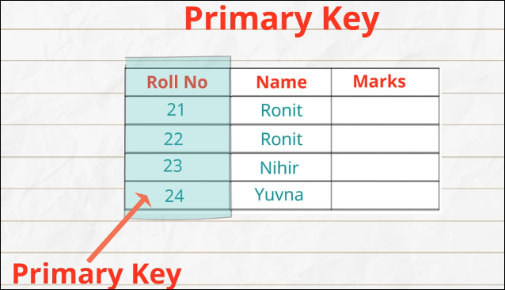
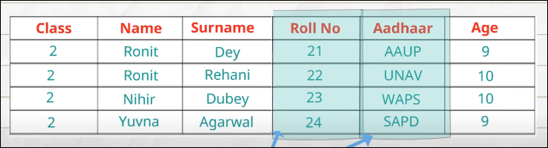
Key helps ??
Primary Key , Candidate Key & Composite key
Typically, a table has one column (or) field uniquely identify the records in the table called Primary Key
There could be more than one attribute uniquely identify the records called candidate key
Out of these 2, one can be selected as PK and other will be an alternate key
For example, we can use Name & Surname as combination which will uniquely identify a row called composite key

Slide 22
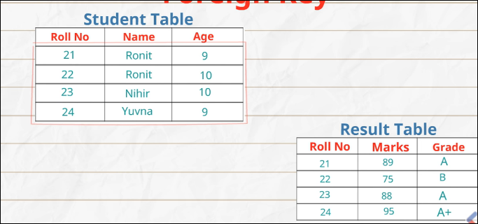
Key helps ??
Foreign key
Foreign key is a field that references a primary key of another table
A column (or) group of column define the relationship between the two tables

Slide 23
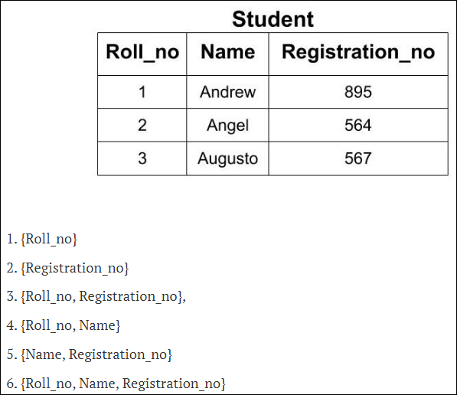
Key helps ??
Super key
Super key is a set of attribute which can uniquely identify a tuple.
For example: In the above EMPLOYEE table, for(EMPLOEE_ID, EMPLOYEE_NAME) the name of two employees can be the same, but their EMPLYEE_ID can't be the same. Hence, this combination can also be a key.

Slide 24
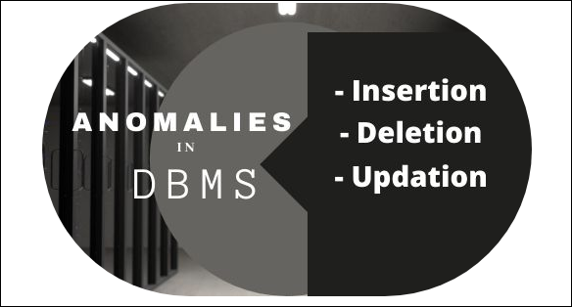
Anomalies in DBMS
What is Anomalies? [ Problem with unnormalized database ]
Anomalies in DBMS are caused when there is too much redundancy in the database’s information. Anomalies can often be caused when the tables that make up the database suffer from poor construction
Type of Anomalies
Update Anomaly
Insertion Anomaly
Deletion Anomaly

Slide 25
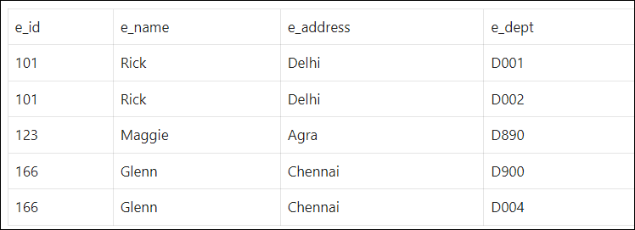
Update Anomaly
In the below table, we have two rows for employee Rick as he belongs to two departments of the company. If we want to update the address of Rick, then we must update the same in two rows or the data will become inconsistent.
If somehow, the correct address gets updated in one department but not in other then as per the database, Rick would be having two different addresses, which is not correct and would lead to inconsistent data.

Slide 26
Insertion Anomaly
Suppose a new employee joins the company, who is under training and currently not assigned to any department then we would not be able to insert the data into the table if the e_dept field doesn’t allow nulls.

Slide 27
Delete Anomaly
Suppose, if at a point of time the company closes the department D890 then deleting the rows that are having e_dept as D890 would also delete the information of employee Maggie since she is assigned only to this department.
*** To overcome these anomalies in DBMS, we need to normalize the data.

Slide 28
Background to normalization
Functional Dependency
FD is a constraint. (Regulation & Rules). It determines the relation of One attribute to another attribute in DBMS .
It maintain the quality of data in the database
It typically explain the relationship between Primary Key & Non key attributes within a table
Syntax
X → Y [ Y is Functionally dependent on X. Hence X is a PK & Y is a Non-key attribute ]
[ X → Determinant ; Y → Dependent ]
Emp_id → Emp_Name
Emp_id → Emp_Address
Emp_id determinants Emp_Name & address
Emp_id | Emp_Name | Emp_Address
101 | Ravi | South street
102 | Rani | North Street
103 | Ravi | South street

Slide 29
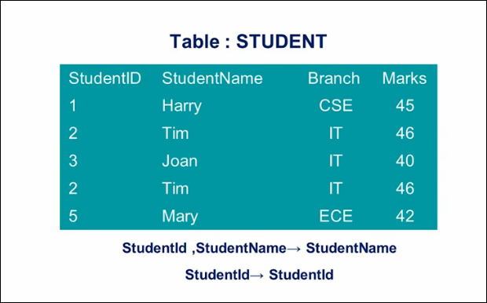
Background to normalization
Trivial Dependency
The Functional dependency X → Y is a Trivial FD if Y is subset of X
Right hand side is the subset of the Left-hand side

Slide 30
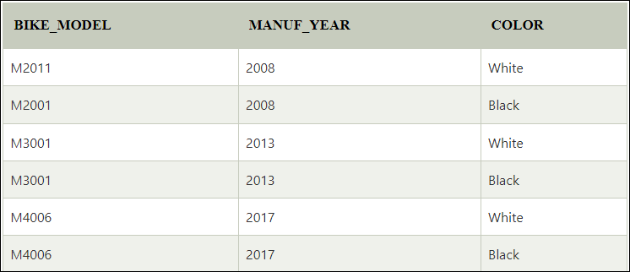
Background to normalization
Multivalued Dependency
Multivalued dependency occurs when two attributes in a table are independent of each other but, both depend on a third attribute.
It consists at lease 3 attributes or more
Here Manuf_Year & Color are independent
Of each other but dependent on Bike_Model
Manuf_Year & Color columns are said to be
Multivalue dependency on Bike_Model
Bike_Model → → Manuf_Year
Bike_Model → → Color

Slide 31
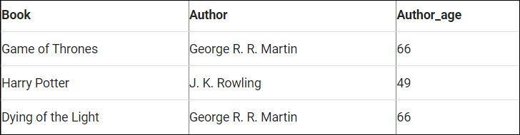
Background to normalization
Transitive Dependency
A functional dependency said to be transitive if it is indirectly formed by two functional dependencies
Example : X → Z is a transitive dependency if the following functional dependencies hold true:
X → Y & Y → Z [ Z is Transitive dependency on X through Y ]
{Book} ->{Author} (if we know the book, we knows the author’s name)
{Author} -> {Author's age}
As per the rule of transitive dependency: {Book} -> {Author's age} should hold, that makes sense because if we know the book name, we can know the author’s age.

Slide 32
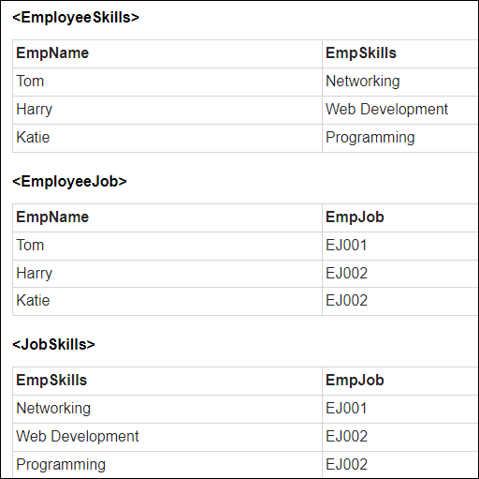
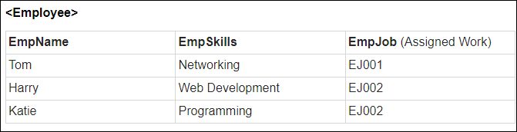
Background to normalization
Join Dependency
If a table can be recreated by joining multiple tables and each of this table have a subset of the attributes of the table, then the table is in Join Dependency.

Slide 33
Normalization
Definition:
Normalization is a scientific method of breaking down complex table structures into simple table structures by using certain rules
It reduces redundancy in a table and eliminate the problems of inconsistency and disk space usage
Most Important NF are:
First Normal Form (1 NF)
Second Normal Form (2 NF)
Third Normal Form (3 NF)
Boyce-Codd Normal Form (BCNF)

Slide 34
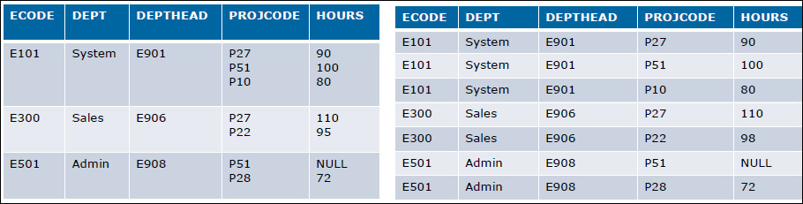
First Normal Form (1-NF)
Rules
Each table cell should contain a single value
Each record needs to be unique
There are no repeating groups
Contains only Atomic values ( Cannot be divided)
Example:

Slide 35
Second Normal Form (2-NF)
Rules
It should be in the 1 NF
It should not have partial dependency
All non key attributes Fully functional dependent on the Primary Key
Example:
Stu_id | Stu_Name
101 | Ravi
102 | Raja
103 | Revathi
Stu_id | Prof_id | Stu_Name | Prof_Name
101 | 201 | Ravi | Raghu
102 | 202 | Raja | Thara
103 | 203 | Revathi | Jack
Prof_id | Prof_Name
201 | Raghu
202 | Thara
203 | Jack

Slide 36
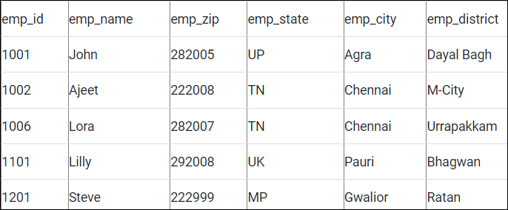
Third Normal Form (3-NF)
Rules
It should be in the 2-NF
Transitive functional dependency of non-prime attribute on any super key should be removed
Example:
Candidate Key → Emp_id
Super keys -> {Emp_id, Emp_Name},
{Emp_id, Emp_Name, Emp_Zip..etc}
Non key attributes → Except Emp_id All keys are part of Non key columns

Slide 37
Third Normal Form (3-NF)
Here, Emp_state, Emp_city & Emp_district dependent on Emp_Zip . And Emp_Zip dependent on Emp_id that makes
non-prime attributes (Emp_state, Emp_city & Emp_district) transitively dependent on super key (Emp_id). This violates the rule of 3NF.
We have to break the table into two tables to remove the transitive dependency

Slide 38
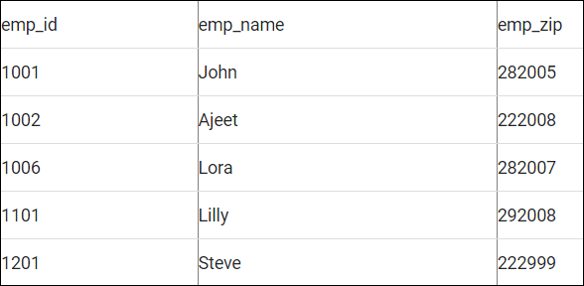
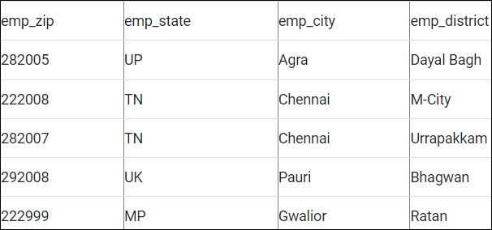
Third Normal Form (3-NF)
Employee Table Employee Zip Table

Slide 39
BCNF
Rules:
It has to be in 3rd Normal Form
Higher version of 3rd NF and was developed by Boyce & Codd
Called as 3.5 NF
If Every FD X → Y , X must be a Super key of the table. It should not be a Non-Prime Attribute
When a Non-Prime attribute determines a Prime attribute called as a Reverse dependency
A Student can enroll any number of courses
A course can handle by many teachers
A Teacher can handle only one course
Satisfy 1 NF ( No repeated Groups)
Satisfy 2 NF (No Partial Dependency)
Satisfy 3 NF (No Transitive Dependency)
Based on this table, Student Name & Course can act as PK, Since all the three column has duplicate values.
{Student Name , Course} → Teacher Name
Teacher → Course ( Non-prime attribute determine prime attribute)
Student Name | Course | Teacher Name
A | DBMS | Priya
B | DBMS | Ramya
C | Python | Sankari
A | Python | Geetha
C | DBMS | Ramya

Slide 40
BCNF
Student Name | Teacher Name
A | Priya
B | Ramya
C | Sankari
A | Geetha
C | Ramya
Course | Teacher Name
DBMS | Priya
DBMS | Ramya
Python | Sankari
Python | Geetha

Slide 41
Q & A

