Slide 1
Create a REST endpoint that returns the sum
list of numbers
by
Thangaprakash Rajendran
Data Engineer

Slide 2
Basic analysis
Following things are used to accomplish the task
Python 3 Framework
REST api (Flask*)
Web Browser
Notes:
Flask – It implements a WSGI application and acts as the central object. It is passed the name of the module or package of the application. Once it is created it will act as a central registry for the view functions, the URL rules, template configuration and much more.

Slide 3
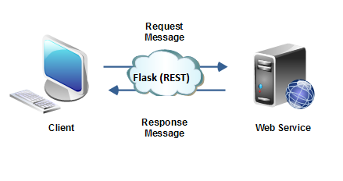
Overall architecture

Slide 4
Task Summary
Create and get a Python list with range of 1 to 4 (1,2,3)
Use the default sum method. It adds and store the result of value 6 in JSON.
Pass the result into web browser by using Flask (3rd party web application framework)
In Future, it would be amendable for passing the value through front end and get the results back in the same browser.
Stored this process in github.

Slide 5
Thank You

