Slide 1
Warehouse Models & Operators
Data Models
  relations
  stars & snowflakes
  cubes
Operators
  slice & dice
  roll-up, drill down
  pivoting
  other
CSE601

Slide 2
Multi-Dimensional Data
Measures - numerical (and additive) data being tracked in business, can be analyzed and examined
Dimensions - business parameters that define a transaction, relatively static data such as lookup or reference tables
Example: Analyst may want to view sales data (measure) by geography, by time, and by product (dimensions)
CSE601

Slide 3
The Multi-Dimensional Model
“Sales by product line over the past six months”
“Sales by store between 1990 and 1995”
Store Info
Key columns joining fact table
to dimension tables
Numerical Measures
Prod Code Time Code Store Code Sales Qty
Fact table for
measures
Product Info
Dimension tables
Time Info
. . .
CSE601

Slide 4
Multidimensional Modeling
Multidimensional modeling is a technique for structuring data around the business concepts
ER models describe “entities” and “relationships”
Multidimensional models describe “measures” and “dimensions”
CSE601

Slide 5
Dimensional Modeling
Dimensions are organized into hierarchies
  E.g., Time dimension: days → weeks → quarters
  E.g., Product dimension: product → product line → brand
Dimensions have attributes
Time Store
Date
Month
Year
StoreID
City
State
Country
Region
CSE601

Slide 6
Dimension Hierarchies
Store Dimension
Product Dimension
Total
Total
Region
Manufacturer
District
Brand
Stores
Products
CSE601
Notes:
1
The simple model we will use to demonstrate the various design alternatives is composed of three dimensions. Only two are shown, Store and Product. The third, Time, is composed of the following attribute hierarchy: date -> month -> quarter -> year.
The Store dimension has an attribute hierarchy of store -> district -> region. Products is composed of products -> brand -> manufacturer.
Based on this simple model, we can see that the granularity of data is products sold in stores by day.

Slide 7
Schema Design
Most data warehouses use a star schema to represent multi-dimensional model.
Each dimension is represented by a dimension table that describes it.
A fact table connects to all dimension tables with a multiple join. Each tuple in the fact table consists of a pointer to each of the dimension tables that provide its multi-dimensional coordinates and stores measures for those coordinates.
The links between the fact table in the center and the dimension tables in the extremities form a shape like a star.
CSE601

Slide 8
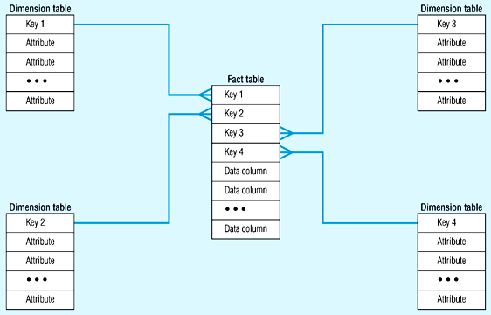
Star Schema (in RDBMS)
CSE601

Slide 9
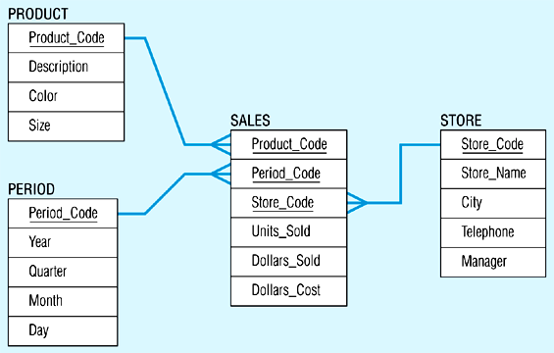
Star Schema Example
CSE601

Slide 10
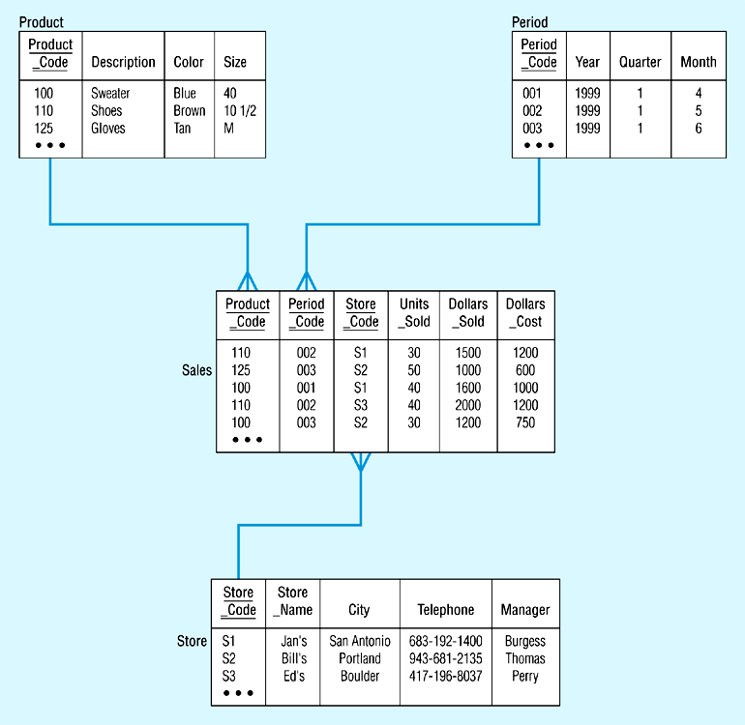
Star Schema with Sample Data
CSE601

Slide 11
The “Classic” Star Schema
A relational model with a one-to-many relationship between dimension table and fact table.
A single fact table, with detail and summary data
Fact table primary key has only one key column per dimension
Each dimension is a single table, highly denormalized
Benefits: Easy to understand, intuitive mapping between the business entities, easy to define hierarchies, reduces # of physical joins, low maintenance, very simple metadata
Drawbacks: Summary data in the fact table yields poorer performance for summary levels, huge dimension tables a problem
CSE601
Notes:
7
The Star is built for simplicity and speed. Forget everything you learned about designing relational databases. The Star Schema makes no excuses for the rules it breaks. The assumption behind it is that the database is static or ìquiet,î meaning that no updates are performed on-line.
Remember that most of the rules of relational database design are derived from the need to maintain atomicity, consistency and integrity (the ìACIDî test) in an On-Line Transaction Processing (OLTP) environment. Since the data warehouse is quiet, these constraints can be relaxed.

Slide 12
Need for Aggregates
Sizes of typical tables:
  Time dimension: 5 years x 365 days = 1825
  Store dimension: 300 stores reporting daily sales
  Production dimension: 40,000 products in each store (about 4000 sell in each store daily)
  Maximum number of base fact table records: 2 billion (lowest level of detail)
A query involving 1 brand, all store, 1 year: retrieve/summarize over 7 million fact table rows.
CSE601

Slide 13
Aggregating Fact Tables
Aggregate fact tables are summaries of the most granular data at higher levels along the dimension hierarchies.
Hierarchy
levels
Product key
Product
Category
Department
Store key
Store name
Territory
Region
Product key
Time key
Store key
Unit sales
Sale dollars
Time key
Date Month
Quarter
Year
Multi-way aggregates:
Territory – Category – Month
(Data values at higher level)
CSE601

Slide 14
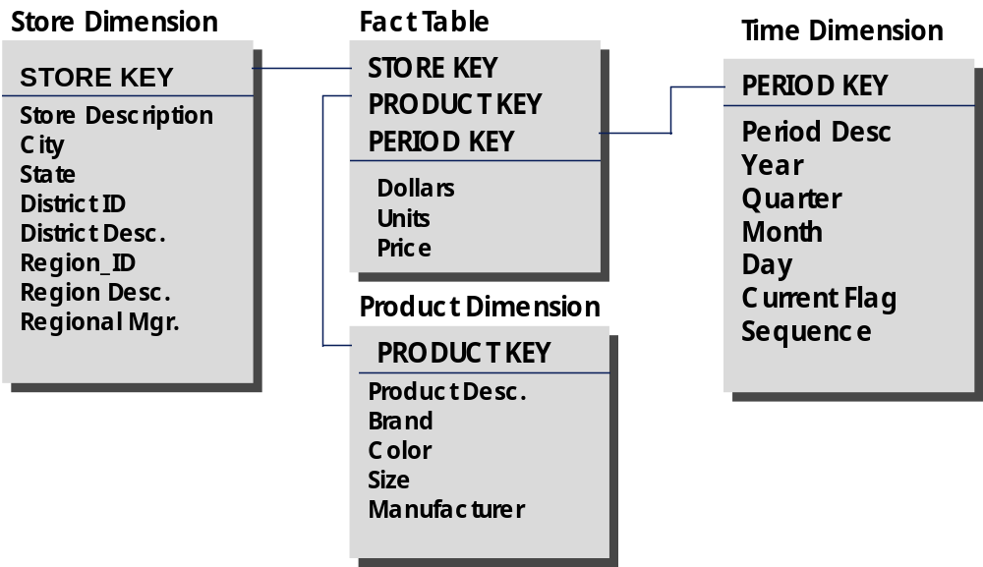
The “Fact Constellation” Schema
District Fact Table
District_ID
PRODUCT_KEY
PERIOD_KEY
Region Fact Table
Region_ID
PRODUCT_KEY
PERIOD_KEY
Dollars
Units
Price
Dollars
Units
Price
CSE601
Notes:
10
The chart above is composed of all of the tables from the Classic Star, plus aggregated fact tables. For example, the Store dimension is formed of a hierarchy of store-> district -> region. The base fact table contains detail data by store. The District fact table contains ONLY data aggregated by district, therefor there are no records in the table with STORE_KEY matching any record for the Store dimension at the store level. Therefor, when we scan the Store dimension table, and select keys that have district = ìTexas,î they will only match STORE_KEY in the District fact table when the record is aggregated for stores in the Texas district. No double (or triple, etc.) counting is possible and the Level indicator is not needed.
These aggregated fact tables can get very complicated, though. For example, we need a District and Region fact table, but what level of detail will they contain about the product dimension? All of the following:
STORE/PROD DISTRICT/PROD REGION/PROD
STORE/BRAND DISTRICT/BRAND REGION/BRAND
STORE/MANUF DISTRICT/MANUF REGION/MANUF
And these are just the combinations from two dimensions!

Slide 15
Aggregate Fact Tables
Product
Base table
Sales facts
Store
Store key
Store name
Territory
Region
Product key
Product
Category
Department
Product key
Time key
Store key
Unit sales
Sale dollars
Dimension
Derived from Product
Category
Time
One-way aggregate
Sale facts
Time key
Date
Month
Quarter
Year
Category key
Category
Department
Category key
Time key
Store key
Unit sales
Sales dollars
CSE601

Slide 16
Families of Stars
Dimension
table
Dimension
table
Dimension
table
Fact table
Fact table
Dimension
table
Dimension
table
Fact table
Dimension
table
Dimension
table
Dimension
table
CSE601

Slide 17
Snowflake Schema
Snowflake schema is a type of star schema but a more complex model.
“Snowflaking” is a method of normalizing the dimension tables in a star schema.
The normalization eliminates redundancy.
The result is more complex queries and reduced query performance.
CSE601

Slide 18
Sales: Snowflake Schema
Category key
Product category
Brand key
Brand name
Category key
Region key
Region name
Product key
Product name
Product code
Brand key
Territory key
Territory name
Region key
Sales fact
Product key
Time key
Customer key
….
Salesrep key
Salesperson name
Territory key
Product
Salesrep
CSE601

Slide 19
Snowflaking
The attributes with low cardinality in each original dimension table are removed to form separate tables. These new tables are linked back to the original dimension table through artificial keys.
Product key
Product name
Product code
Brand key
Brand key
Brand name
Category key
Category key
Product category
CSE601

Slide 20
Snowflake Schema
Advantages:
  Small saving in storage space
  Normalized structures are easier to update and maintain
Disadvantages:
  Schema less intuitive and end-users are put off by the complexity
  Ability to browse through the contents difficult
  Degrade query performance because of additional joins
CSE601

Slide 21
What is the Best Design?
Performance benchmarking can be used to determine what is the best design.
Snowflake schema: easier to maintain dimension tables when dimension tables are very large (reduce overall space). It is not generally recommended in a data warehouse environment.
Star schema: more effective for data cube browsing (less joins): can affect performance.
CSE601

Slide 22
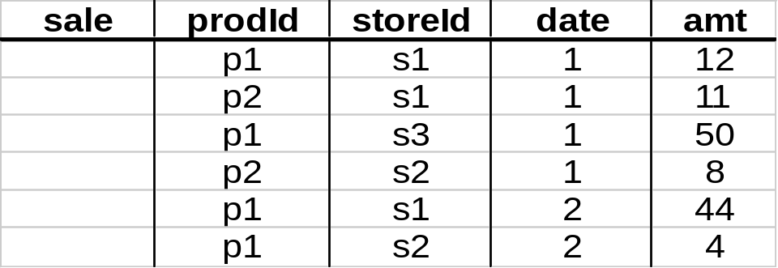
Aggregates
Add up amounts for day 1
In SQL: SELECT sum(amt) FROM SALE
WHERE date = 1
81
CSE601

Slide 23
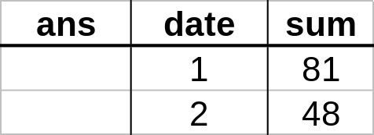
Aggregates
Add up amounts by day
In SQL: SELECT date, sum(amt) FROM SALE
GROUP BY date
CSE601

Slide 24
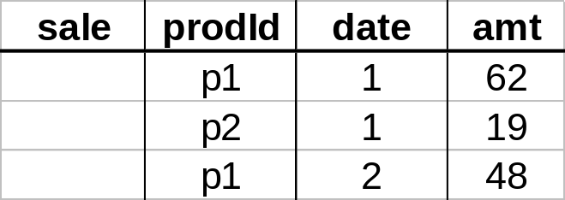
Another Example
Add up amounts by day, product
In SQL: SELECT date, sum(amt) FROM SALE
GROUP BY date, prodId
rollup
drill-down
CSE601

Slide 25
Aggregates
Operators: sum, count, max, min, median, ave
“Having” clause
Using dimension hierarchy
  average by region (within store)
  maximum by month (within date)
CSE601

Slide 26
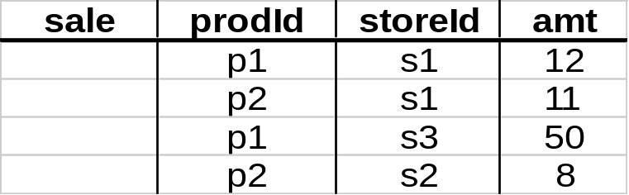
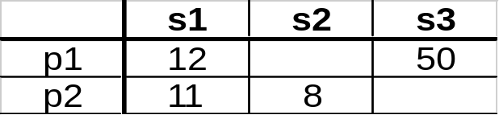
Data Cube
Fact table view:
Multi-dimensional cube:
dimensions = 2
CSE601

Slide 27
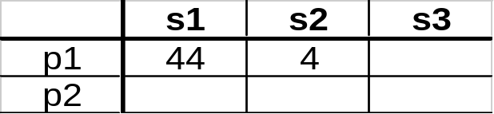
3-D Cube
Fact table view:
Multi-dimensional cube:
day 2
day 1
dimensions = 3
CSE601

Slide 28
Example
roll-up to region
Dimensions:
Time, Product, Store
Attributes:
Product (upc, price, …)
Store …
…
Hierarchies:
Product → Brand → …
Day → Week → Quarter
Store → Region → Country
NY
Store
SF
roll-up to brand
LA
Juice
Milk
Coke
Cream
Soap
Bread
10
34
56
32
12
56
Product
roll-up to week
M T W Th F S S
Time
56 units of bread sold in LA on M
CSE601

Slide 29
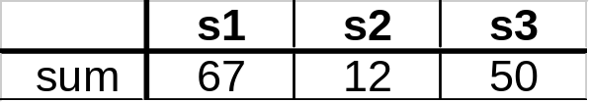
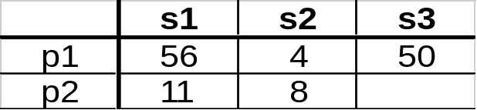
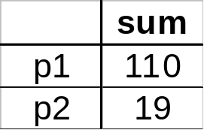
Cube Aggregation: Roll-up
Example: computing sums
day 2
. . .
day 1
129
rollup
drill-down
CSE601

Slide 30
Cube Operators for Roll-up
day 2
. . .
day 1
sale(s1,*,*)
129
sale(s2,p2,*)
sale(*,*,*)
CSE601

Slide 31
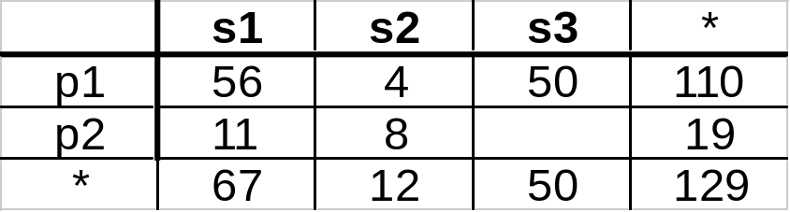
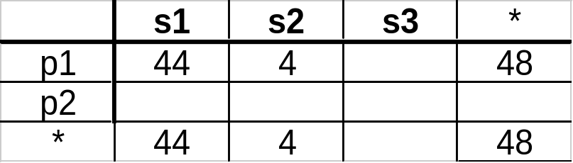
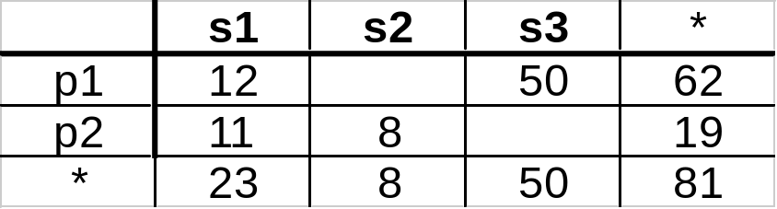
Extended Cube
*
day 2
sale(*,p2,*)
day 1
CSE601

Slide 32
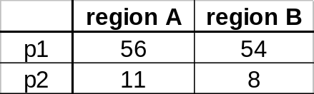
Aggregation Using Hierarchies
day 2
store
day 1
region
country
(store s1 in Region A;
stores s2, s3 in Region B)
CSE601

Slide 33
Slicing
day 2
day 1
TIME = day 1
CSE601

Slide 34
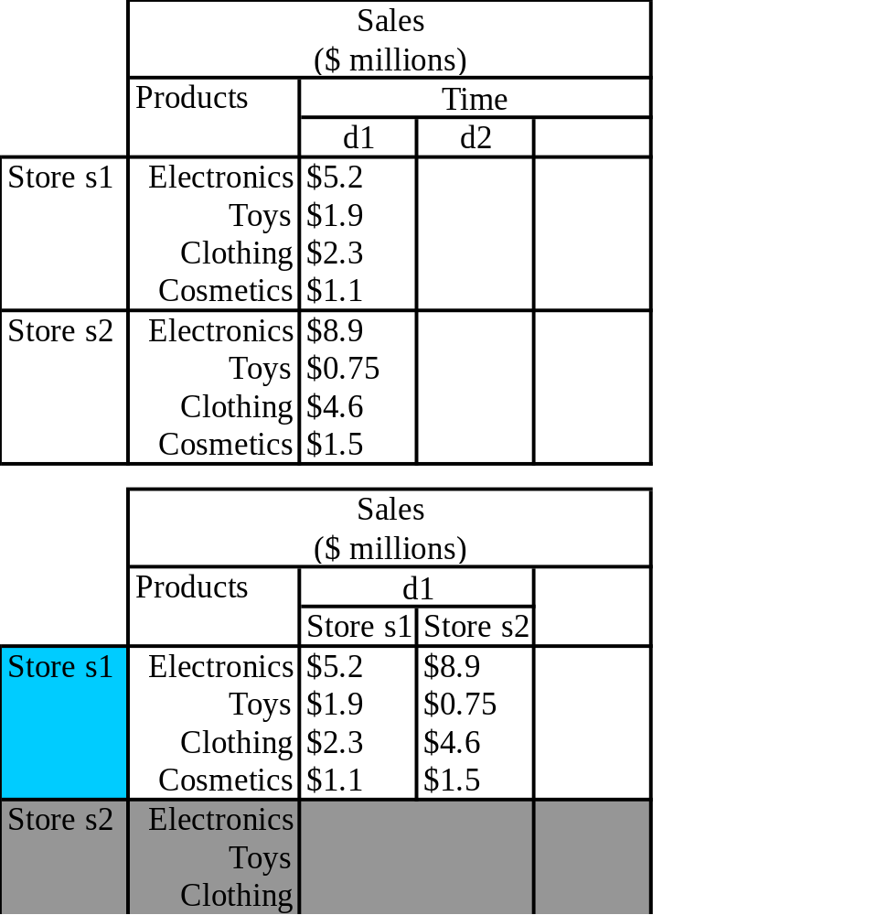
Slicing &
Pivoting
CSE601

Slide 35
Summary of Operations
Aggregation (roll-up)
  aggregate (summarize) data to the next higher dimension element
  e.g., total sales by city, year → total sales by region, year
Navigation to detailed data (drill-down)
Selection (slice) defines a subcube
  e.g., sales where city =‘Gainesville’ and date = ‘1/15/90’
Calculation and ranking
  e.g., top 3% of cities by average income
Visualization operations (e.g., Pivot)
Time functions
  e.g., time average
CSE601

Slide 36
Query & Analysis Tools
Query Building
Report Writers (comparisons, growth, graphs,…)
Spreadsheet Systems
Web Interfaces
Data Mining
CSE601

