Slide 1
Data Warehousing Lifecycle
Conceptual modeling:
System requirements,
data sources and
warehousing activities.
Logical design:
Data flow from sources
to DW, composition and
semantics of activities.
Application development:
DW interfaces, OLAP
and data mining tools.
DW construction:
Schema implementation,
data population and
warehouse tuning.

Slide 2
On-Line Analytical Processing (OLAP)
roll-up to brand
roll-up to region
Store
NY
Store
NY
SF
SF
LA
LA
Juice
Milk
Coke
Cream
Soap
Bread
10 15 18 5 24 32 16
Juice
Milk
Coke
Cream
Soap
Bread
120
Product
Product
roll-up
to week
M T W Th F S S
W1 2 3 4
Time (day)
Time (week)
Dimensions: Time, Product, Store
Hierarchies: Day → Week → Quarter
Product → Brand → …
Store → Region → Country
Operators: roll-up, drill-down,
slice and dice.
Uses: Business data analysis, e.g.,
market-driven trend analysis.

Slide 3




Cube Aggregates Lattice
129
all
city
product
date
city, product
city, date
product, date
use greedy
algorithm to
decide what
to materialize
city, product, date
day 2
day 1
CSE601

Slide 4
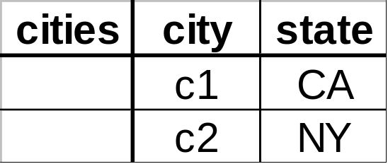
Dimension Hierarchies
all
state
city
CSE601

Slide 5
Dimension Hierarchies
all
city
product
date
city, product
city, date
product, date
state
city, product, date
state, date
state, product
state, product, date
not all arcs shown...
CSE601

Slide 6
Logical Data Modeling: A Star Schema Example
Time
time_key
day
month
year
Branch
branch_key
name
type
1
1
Sales
time_key
branch_key
location_key
product_key
num_units
amount_usd
n
n
n
n
???
Location
location_key
city
state
country
Product
product_key
name
brand
type
1
1
Supplier
supplier_key
name
type
One-to-many relationships between the fact and dimensions.
The fact-dimension relationships are certain.
Dimensions in star models are often tightly coupled.
Star schema does not appear to be very extensible.

Slide 7
Biomedical Data Resources
Static data: data on genotypes, biological entities such as nucleic acids, protein and relationships between these entities.
Dynamic data: data on phenotypes, the dynamics of biological processes.
Data on analysis tools: data on biological and computer science methods which can be used to identify the entities and relationships.
References and annotations: to scientific papers and textual explanations.

Slide 8
Biomedical Data Modeling
Flat file collections: Databases were built up as indexed ASCII text files.
Relational databases: many biology databases were implemented using Oracle, Sybase, or MySQL.
Object-oriented databases: data are modeled as objects that are organized in classes.
Multidimensional databases: data are organized in star like schema.

Slide 9
Using Star Schema in Gene Expression Data Management
“Applying Data Warehouse Concepts to Gene Expression Data Management”, by V. Markowitz and T. Topaloglou
Three modeling data spaces:
  Sample data space
  Gene Annotation data space
  Gene expression data space

Slide 10
Gene Expression Data Space
Experiment
Gene
Experiment_id
Exp_name
Exp_date
Exp_file
Sample
Gene_id
Gene_name
Gene_symbol
Expression
Gene_id
Experiment_id
Analysis_id
Expression_call
Analysis
Analysis_id
Algorithm
version
Clinical
Sample

Slide 11
Sample Data Space
Donor
Demorgraphics
Donor
Clinical
Donor
Biological
Sample
Pathways
Study

Slide 12
Gene Annotation Data Space
Known
gene
Microarray
Design
Sequence
Cluster
Gene
Fragments
Sequence
Pathways
Chromosome

Slide 13
OLAP Operations
Sample selection: extract sets of samples with a certain profile on the sample data space. Eg, a sample set of male colon samples with adenocarcenoma for donors in the age group 40-60.
Classification on organ: total number of samples classified by liver, brain, …

Slide 14
OLAP Operations
Gene selection: extract sets of genes with certain properties over the gene annotation data space. Eg, a gene set of the genes on chromosome 22 …
Aggregates: gene summarization on sample dimension, sample summarization on gene dimension. Etc.

Slide 15
Clinical Data Sapce
Disease
n
n n
Demographics
Clinical Test
n 1
1
n
n
1 n
Followup
Patient
Medical Image
n
1 n
n
n
Drug
Physiology
n
Clinical Sample

Slide 16
Sample Data Sapce
Patient
1
Anatomy Ontology
Biochemical Assay
n
n
n
n
n
Clinical Sample
1
1
n
n
n
mRNA Expression
Genetic Screening
n
Protein Expression

Slide 17
Microarray Data Sapce
Gene Sequence
1
n
1 1
Clinical Sample
Array Probe
n n
mRNA
Expression
n n
1 1
Experiment
Measurement Unit

Slide 18
Proteomic Data Sapce
1 1
Clinical Sample
Gene Sequence
n n
Protein
Expression
n n
1 1
Experiment
Measurement Unit

Slide 19
Experiment Data Sapce
1 1
Project
Protocol
n n
1 n
n 1
Person
Experiment
Platform
n n
1 1
Publication
Normalization

Slide 20
Gene Data Sapce
mRNA Expression
n
1
Protein Expression
Array Probe
n
n
1
1
2
1
Gene Cluster
n
n
Protein-Protein Interaction
Gene Sequence
1
n
n
n
n
n
Promoter
Gene Ontology
Protein Domain

Slide 21
Explicit Definition of Concept Hierarchies
Disease
Gene Ontology
Gene Cluster
n
n
n
n
n
n
Anatomy Ontology
Patient
Gene Sequence
1
1
1
n
n
1 1
n
Clinical Sample
Array Probe
n n
mRNA
Expression
n n
1 1
Experiment
Measurement Unit
n
n
n
1
1
Project
Platform
1
Normalization

Slide 22
Characteristics of Clinical and Genomic Data
Clinical and Genomic Data | Business Data
Complex data structure with many potential dimensions | Easy-to-understand data structure with few dimensions
Often many-to-many relationships between facts and dimensions | Many-to-one relationships between facts and dimensions
Uncertain relationships between fact and dimension objects | Certain relationships between fact and dimension objects
Some measures require advanced temporal support for time validity | Historical data, no advanced temporal support needed
Incomplete and/or imprecise data very common | Few incomplete and/or imprecise data

Slide 23
Large Number of Dimensions and Evolution of Dimensions
If Star schema is used and the number of dimensions is large, the fact table will be huge (combination of foreign keys).
Adding new dimension to Star schema will require re-computing of all data entries in the fact table.

Slide 24
Many-to-Many relationships
The many-to-many relationships cannot be easily modeled using Star schema, which is originally designed to handle many-to-one relationships between business fact and a dimension.

Slide 25
Incompleteness of Data
Clinical data may be incomplete. This may cause a lot of null values in the fact table for foreign keys, which will result in inconsistency.

Slide 26
Star Schema
Dim1
DimKey1
. . .
Fact
DimKey1
DimKey2
DimKey3
DimKey4
Measure1
Measure2
Measure3
Measure4
Dim2
DimKey2
. . .
Dim3
DimKey3
. . .
Dim4
DimKey4
. . .
BioStar Schema
Dim1
DimKey1
. . .
MTable1
DimKey1
FactKey
Measure1
MTable2
DimKey2
FactKey
Measure2
Dim2
DimKey2
. . .
Fact
FactKey
. . .
Dim3
DimKey3
. . .
MTable3
DimKey3
FactKey
Measure3
MTable4
DimKey4
FactKey
Measure4
Dim4
DimKey4
. . .

Slide 27
BioStar Schema for Part of the Clinical Data Space
Disease
DiseaseID
Name
Type
Description
Diagnosis
DiseaseID
PatientID
Symptom
ValidFrom
ValidTo
TestResult
TestID
PatientID
Result
DateTested
ClinicalTest
TestID
TestName
TestType
TestSetting
Patient
PatientID
SSN
Name
Gender
DOB
Drug
DrugID
DrugName
DrugType
Description
DrugUse
DrugID
PatientID
Dosage
ValidFrom
ValidTo
ClinicalSample
SampleID
PatientID
Source
Amount
DateTaken
Extensibility and flexibility

Slide 28
BioStar Schema for the Sample Data Space
GeneticMarker
MarkerID
MarkerName
MarkerType
GeneticLocus
Description
GeneticScreen
MarkerID
SampleID
Result
RawData
Comment
DateTested
SampleAnatomy
TermID
SampleID
Description
AnatomyTerm
TermID
TermType
TermName
Definition
ClinicalSample
SampleID
PatientID
Source
Amount
DateTaken
BiochemAssay
AssayID
AssayName
AssayType
AssaySetting
Description
AssayResult
AssayID
SampleID
Result
Comment
DateTested
mRNAExpression
SampleID
ArrayProbeID
ExperimentID
MeasureUnitID
Expression

Slide 29
BioStar Schema for Part of the Gene Data Space
GOTerm
GOID
Accession
TermType
TermName
Definition
GOAnnotation
GOID
UID
Evidence
ArrayProbe
ArrayProbeID
UID
ArrayID
ProbeName
Description
IsQC
Cluster
ClusterID
NumOfGenes
ExprPattern
ClusteringTool
ToolSetting
Description
GeneCluster
ClusterID
UID
Promoter
PromoterID
UID
PromoterType
PromoterSeq
Length
Description
GeneSequence
UID
SeqType
Accession
Version
SeqDataset
SpeciesID
Status
GeneDomain
DomainID
UID
Alignment
SeqFrom
SeqTo
DomainFrom
DomainTo
EValue
BitScore
DomainModel
DomainID
ModelType
SourceDB
Accession
Title
Length
Description
ProteinInteract
UID1
UID2
Evidence
Description

Slide 30
Star Schema for the Microarray Data Space
ClinicalSample
SampleID
PatientID
Source
Amount
DateTaken
ArrayProbe
ArrayProbeID
UID
ArrayID
ProbeName
Description
IsQC
GeneSequence
UID
SeqType
Accession
Version
SeqDataset
SpeciesID
Status
mRNAExpression
SampleID
ArrayProbeID
ExperimentID
MeasureUnitID
Expression
Experiment
ExperimentID
ExperimentName
ExperimentType
ProjectID
PersonID
PlatformID
ProtocolID
NormalizationID
PublicationID
MeasurementUnit
MeasureUnitID
MeasureUnitName
MeasureUnitType
Description

Slide 31
Star Schema for the Proteomic Data Space
ClinicalSample
SampleID
PatientID
Source
Amount
DateTaken
GeneSequence
UID
SeqType
Accession
Version
SeqDataset
SpeciesID
Status
ProteinExpression
SampleID
UID
ExperimentID
MeasureUnitID
Expression
Experiment
ExperimentID
ExperimentName
ExperimentType
ProjectID
PersonID
PlatformID
ProtocolID
NormalizationID
PublicationID
MeasurementUnit
MeasureUnitID
MeasureUnitName
MeasureUnitType
Description

Slide 32
Star Schema for the Experiment Data Space
Project
ProjectID
ProjectName
Investigator
Description
Person
PersonID
PersonName
LabName
Contact
Experiment
ExperimentID
ExperimentName
ExperimentType
ProjectID
PersonID
PlatformID
ProtocolID
NormalizationID
PublicationID
Platform
PlatformID
Hardware
Software
Settings
Description
Protocol
ProtocolID
ProtocolName
ProtocolText
CreatedBy
Publication
PublicationID
PubMedID
Title
Authors
Abstract
PubDate
Citation
Normalization
NormalizationID
NormType
Software
Parameters
Description

Slide 33
BioStar is not Fact Constellation
You may view measure tables as small “fact” tables, but fact tables in a constellation usually share multiple dimension tables.
Dimension
table
Dimension
table
Dimension
table
Fact table
Fact table
Dimension
table
Dimension
table
Fact table
Dimension
table
Dimension
table
Dimension
table

Slide 34
Extensibility of BioStar
Add a protein structure information dimension to gene data space.
ProteinSequence
ProteinStructure
GeneSequence
UID
SeqType
Accession
Version
SeqDataset
SpeciesID
Status
UID
PDBID
…..
PDBID
…..
Measure table
Dimension table
Populating the two new tables will not affect other tables.

Slide 35
Flexibility of BioStar
Separate tables for fact measures to solve the many-to-many relationship problem → dimension table and its associated measure table can be populated independently → avoid null values.

Slide 36
Sample Classification Hierarchy
All_sample
Normal
Tumor
Adeno-
carcinoma
. . .
CNS_tumor Leukemia
Brain Blood Colon Breast
. . .
Glio-
blastoma
. . .
ALL AML
Colon
tumor
Breast
tumor
. . .
. . . . . . . . . . . . . . . . . . . . . . . . . . . . . . . . . . . .
(Patients)

Slide 37
OLAP for Microarray Data Exploration
Dimensions:
Sample
Gene
Measurement Unit
Operators:
roll-up
drill-down
slice
dice
t-test
p-select
Application:
Exploration of gene
expression data
roll-up to GO terms
roll-up to expression
Measurement
Unit
PA
Val
D13626
D13627
D13628
J04605
L37042
S78653
X60003
Z11518
10 15 18 5 24 32 16
Gene
roll-up to
disease types
1 2 3 4 5 6 7
Sample (patient)

Slide 38
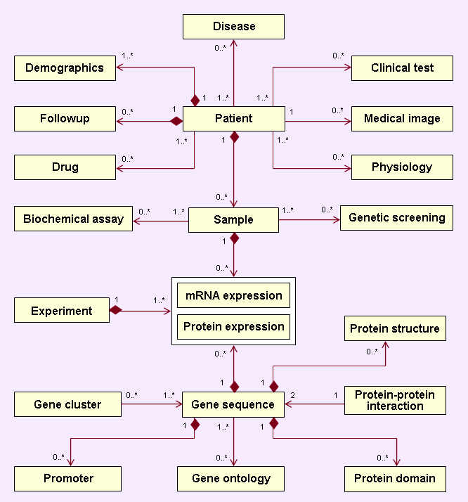
Biomediacl Data Warehouse System Architecture
Data Sources
Data Integration
Data Warehouse
Unified Access
Data Mining
Clinical data and sample annotations
Ad hoc
queries
OLAP
Cluster
analysis
Mining gene
regulatory
networks
Interactome
prediction
Pathway
analysis
Gene functional annotations
Data extraction, trans-
formation, cleaning
& loading
Metadata capturing & integration
Data quality control
Refreshment
A standard interface for application tools
Object-oriented
Defining basic operators
for data access
Microarray
mRNA
expression
Proteomics protein
expression
Promoter
sequences
and motifs
Protein domains & interactome

