Slide 1
Explicit Definition of Concept Hierarchies
Disease
Gene Ontology
Gene Cluster
n
n
n
n
n
n
Anatomy Ontology
Patient
Gene Sequence
1
1
1
n
n
1 1
n
Clinical Sample
Array Probe
n n
mRNA
Expression
n n
1 1
Experiment
Measurement Unit
n
n
n
1
1
Project
Platform
1
Normalization

Slide 2
Sample Classification Hierarchy
All_diseases
Tumor
Normal
Adeno-
carcinoma
. . .
CNS_tumor Leukemia
Brain Blood Colon Breast
. . .
Glio-
blastoma
. . .
ALL AML
Colon
tumor
Breast
tumor
. . .
. . . . . . . . . . . . . . . . . . . . .
. . . . . . . . . . . . . . .
(Patients)
. . . . . . . . . . . . . . . . . . . . .
. . . . . . . . . . . . . . .
(Clinical Samples)

Slide 3
Aggregate Functions
Simple: sum, average, max, min, etc.
Statistical: variance, standard deviation, t-statistic, F-statistic, etc.
User-defined: e.g., for aggregation of Affymetrix gene expression data on the Measurement Unit dimension, we may define the following function:
if PA = ‘P’ or ‘M’,
if PA = ‘A’.
Val
Exp =
0
Here, Exp is summarized gene expression; Val and PA are the numeric value and PA call given by the Affymetrix platform, respectively.

Slide 4
Conventional OLAP Operations
Roll-up: aggregation on a data cube, either by climbing up a concept hierarchy for a dimension or by dimension reduction.
Drill-down: the reverse of roll-up, navigation from less detailed data to more detailed data.
Slice: selection on one dimension of the given data cube, resulting in a subcube.
Dice: defining a subcube by performing a selection on two or more dimensions.
Pivot: a visualization operation that rotates the data axes to provide an alternative presentation.

Slide 5
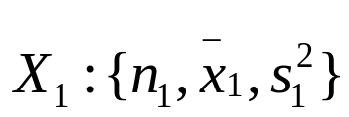
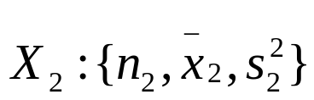
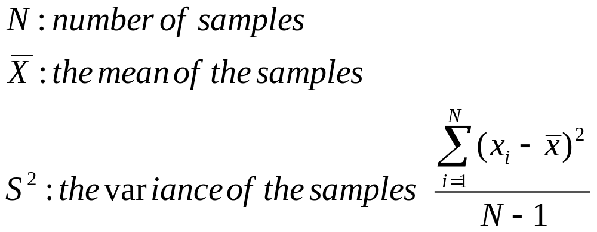
t Test
The t-Test assesses whether the means of two groups are statistically different from each other.
Given two groups of samples and
:
Degrees of freedom.
Due to bias of the sample
Assumption: the differences in the groups follow a normal distribution.

Slide 6
Degrees of Freedom (df)
  Idea: Number of observations that are free to vary
  after sample mean has been calculated
  Example: Suppose the mean of 3 numbers is 8.0
    Let X₁ = 7
    Let X₂ = 8
    What is X₃?
If the mean of these three values is 8.0,
then X₃ must be 9
(i.e., X₃ is not free to vary)
Here, n = 3, so degrees of freedom = n – 1 = 3 – 1 = 2
(2 values can be any numbers, but the third is not free to vary for a given mean)
Basic Business Statistics, 11e © 2009 Prentice-Hall, Inc..
Chap 8-<number>

Slide 7
Student t-distribution
It is family of continuous probability distributions that arises when estimating the mean of a normally distributed population in situations where the sample size is small and population standard deviation is unknown.

Slide 8

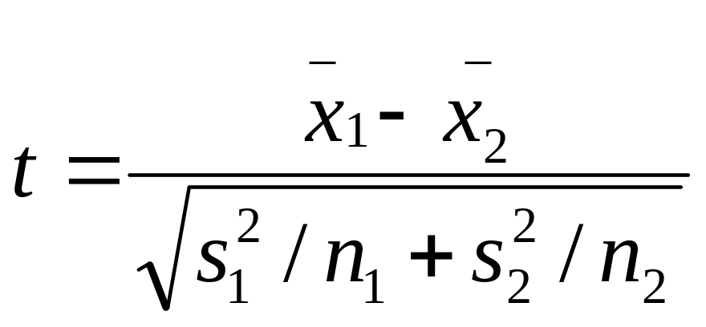
t Test
Hypothesis: H₀(null hypothesis): µ₁=µ₂
H_{α}: µ₁ µ₂
Choose the level of confidence (significance): α = 0.05 (the amount of uncertainty we are prepared to accept in the study.
Test Statistics
The t-value can be positive or negative (positive if the first mean is larger than the second and negative if it is smaller).
Calculate the p-value corresponding to t-value: look up a table.
The t is a family of distributions

Slide 9
Student’s t Distribution
Note: t Z as n increases
Standard Normal(t with df = ∞)
t (df = 13)
t-distributions are bell-shaped and symmetric, but have ‘fatter’ tails than the normal
t (df = 5)
t
0
Basic Business Statistics, 11e © 2009 Prentice-Hall, Inc..
Chap 8-<number>

Slide 10
Selected t distribution values
With comparison to the Z value
Confidence t t t Z
Level (10 d.f.) (20 d.f.) (30 d.f.) (∞ d.f.)
0.80 1.372 1.325 1.310 1.28
0.90 1.812 1.725 1.697 1.645
0.95 2.228 2.086 2.042 1.96
0.99 3.169 2.845 2.750 2.58
Note: t Z as n increases
Basic Business Statistics, 11e © 2009 Prentice-Hall, Inc..
Chap 8-<number>

Slide 11
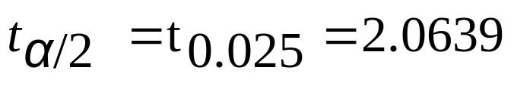
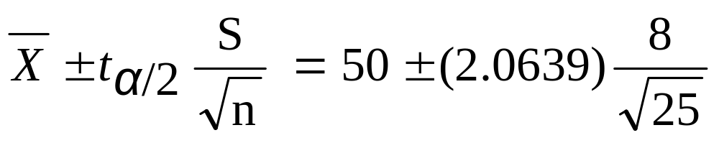
Example of t distribution confidence interval
A random sample of n = 25 has X = 50 and
S = 8. Form a 95% confidence interval for μ
  d.f. = n – 1 = 24, so
  The confidence interval is
46.698 ≤ μ ≤ 53.302
Basic Business Statistics, 11e © 2009 Prentice-Hall, Inc..
Chap 8-<number>

Slide 12
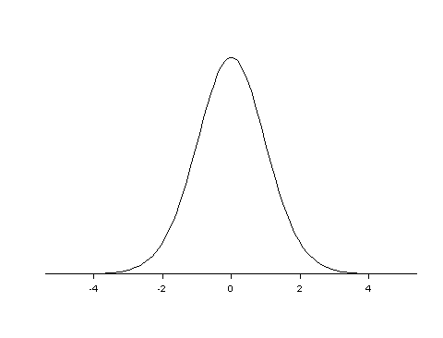
P - Value
The p-value is the upper-tail (or lower tail) area of the t curve.
Steps to accept/reject the null hypothesis H₀
  Calculate the t-statistics
  Look up the table to find the p-value
  Given confidence level α ,
  if p-value is smaller than α,
  then reject H₀; otherwise,
  accept H₀
The t-curve of 25 degrees of freedom
This area is the p-value!
The t-statistics value

Slide 13
New OLAP Operation: Compare
Compare two random variables by computing ratios, differences or t-statistics.
Example:
Different measurements of gene X
Question: Is gene X
expressed differently
between two groups?
Disease 1 Disease 2
Solution:
(1) Compute the mean
and variance.
(2) Compute t and p:
t = 3.120
p = 0.013/0.007
100
90
105
83
78
70
72
81
74
75
Mean 91.2 74.4
Variance 127.7 17.3
N 5 5
Answer: Yes (at 5%
significance level)

Slide 14
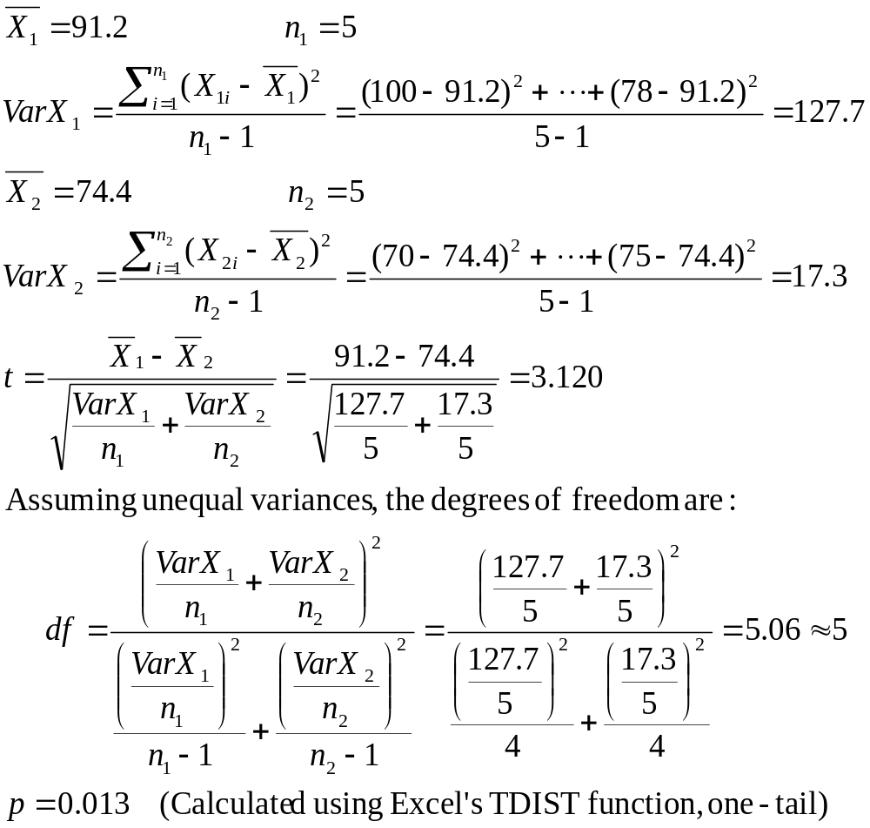

Slide 15
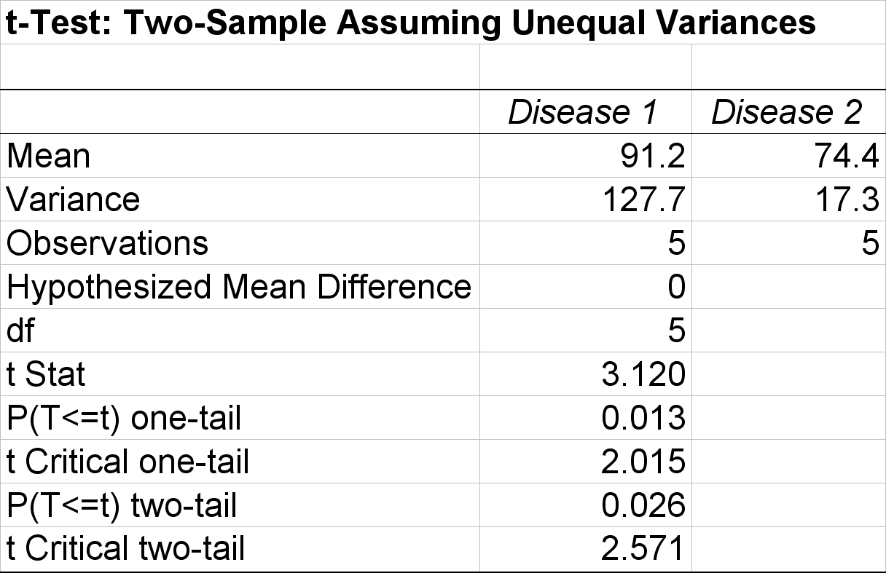
Output from Excel

Slide 16
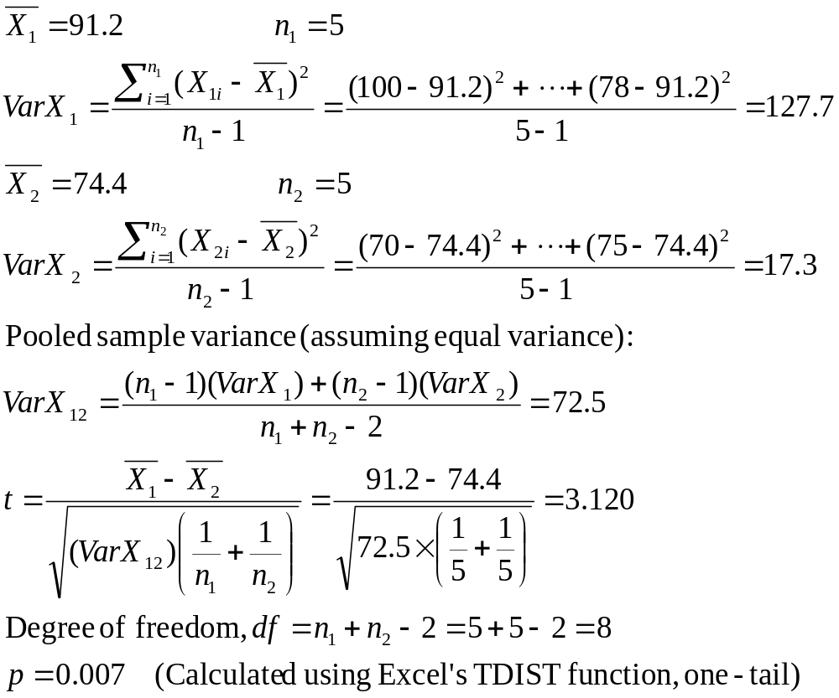

Slide 17
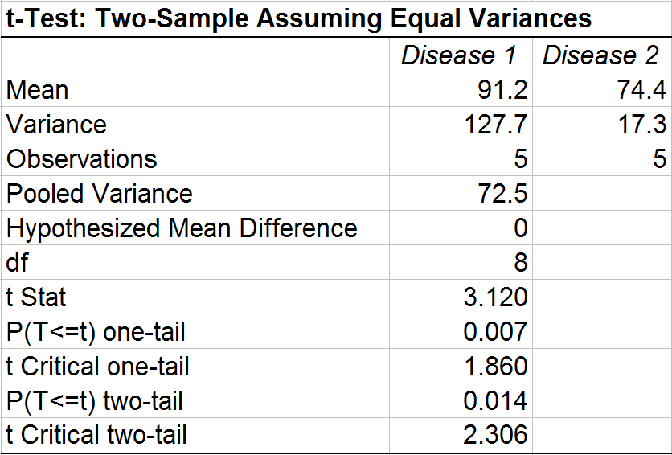
Output from Excel

Slide 18
New OLAP Operation: ANOVA
Analysis of variance (ANOVA) tests if there are differences between any pair of variables.
Example:
Different measurements of gene X
Is there a significant difference between the expression of gene X in the various disease conditions?
Disease 1 Disease 2 Disease 3
100
90
105
83
78
70
72
81
74
75
95
93
79
85
90
mean 91.2 74.4 88.4
st dev 11.3 4.2 6.5

Slide 19
ANOVA
ANalysis Of VAriance (ANOVA) is used to find significant genes in more than two conditions:
For each gene, compute the F statistic.
Calculate the p value for the F statistic.
Gene | Disease A |  |  | Disease B |  |  | Disease C
 | A1 | A2 | A3 | B1 | B2 | B3 | C1 | C2 | C3
g1 | 0.9 | 1.1 | 1.4 | 1.9 | 2.1 | 2.5 | 3.1 | 2.9 | 2.6
g2 | 4.2 | 3.9 | 3.5 | 5.1 | 4.6 | 4.3 | 1.8 | 2.4 | 1.5
g3 | 0.7 | 1.2 | 0.9 | 1.1 | 0.9 | 0.6 | 1.2 | 0.8 | 1.4
g4 | 2.0 | 1.2 | 1.7 | 4.0 | 3.2 | 2.8 | 6.3 | 5.7 | 5.1
∙ ∙ ∙ | ∙ ∙ ∙ | ∙ ∙ ∙ | ∙ ∙ ∙ | ∙ ∙ ∙ | ∙ ∙ ∙ | ∙ ∙ ∙ | ∙ ∙ ∙ | ∙ ∙ ∙ | ∙ ∙ ∙

Slide 20
One-way Analysis of Variance (ANOVA)
Decide whether there are any differences between the values from k conditions (groups).
  H₀: µ₁ = µ₂ = …. = µ_{k}
  H_{α}: There is at least one pair of means that are different from each other.
Assumptions:
  All k populations have the same variance
  All k populations are normal.
ANOVA can be applied to any number of samples. If there are only two groups, the ANOVA will provide the same results as a t-test.
Problem with multiple t-tests: accumulated error may be large.

Slide 21
Idea of ANOVA
The measurement of each group vary around their mean – within group variance.
The means of each condition will vary around an overall mean – inter-group variability.
ANOVA studies the relationship between the inter-group and the within-group variance.

Slide 22
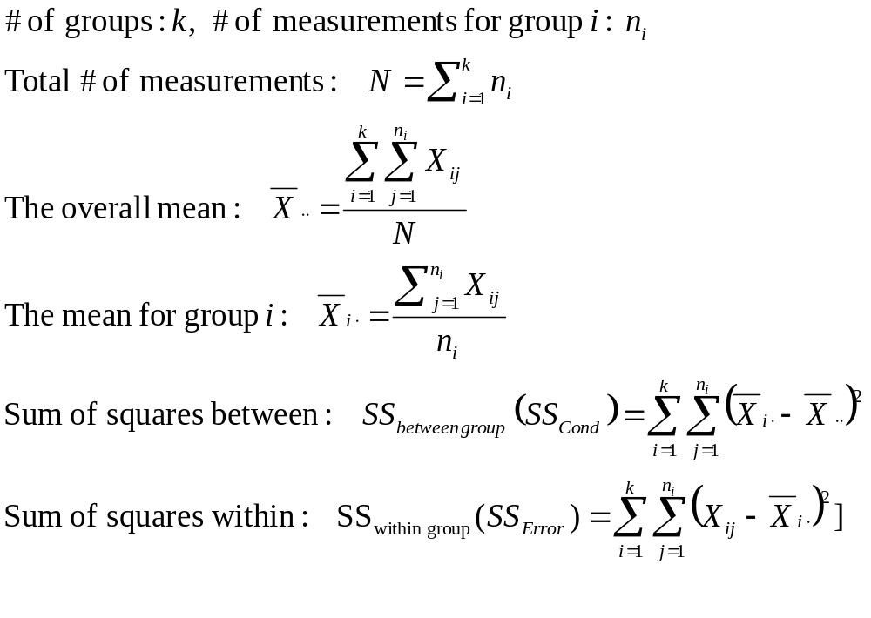

Slide 23
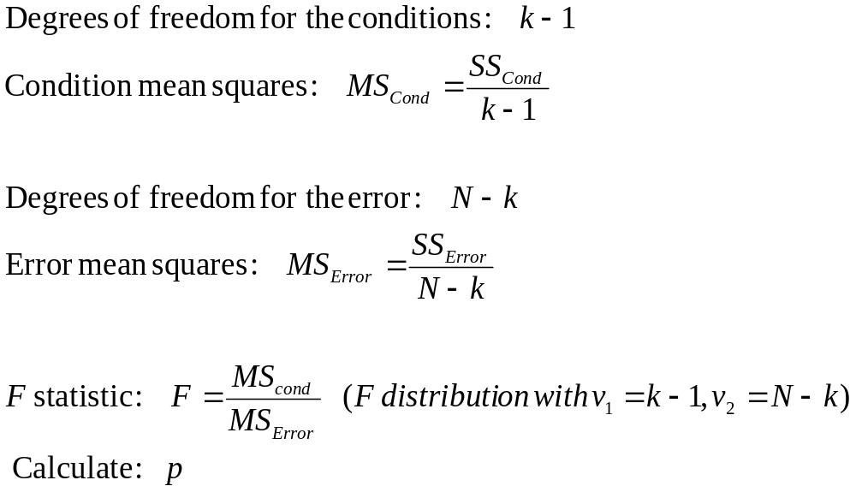

Slide 24
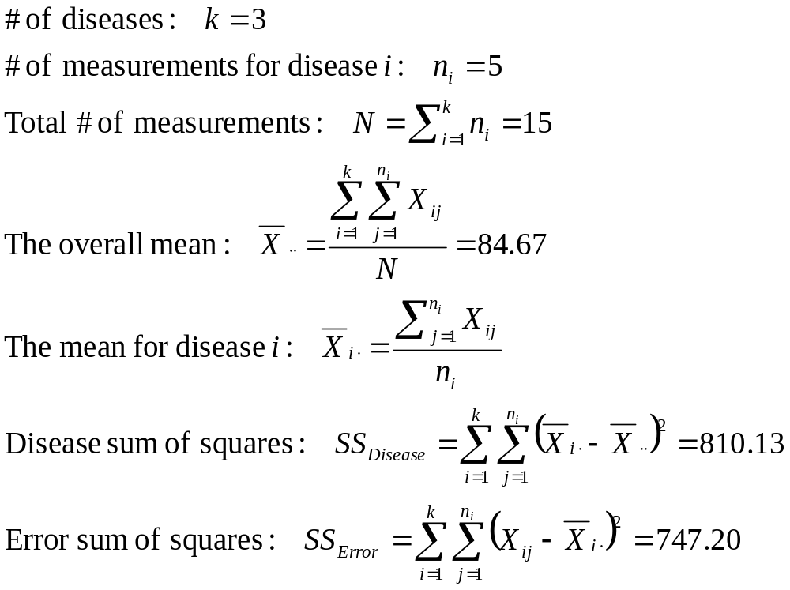

Slide 25
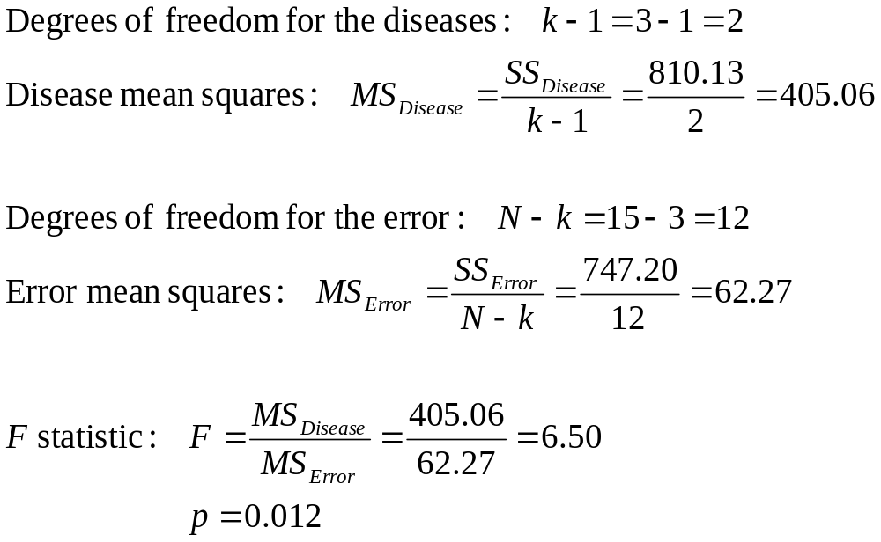

Slide 26
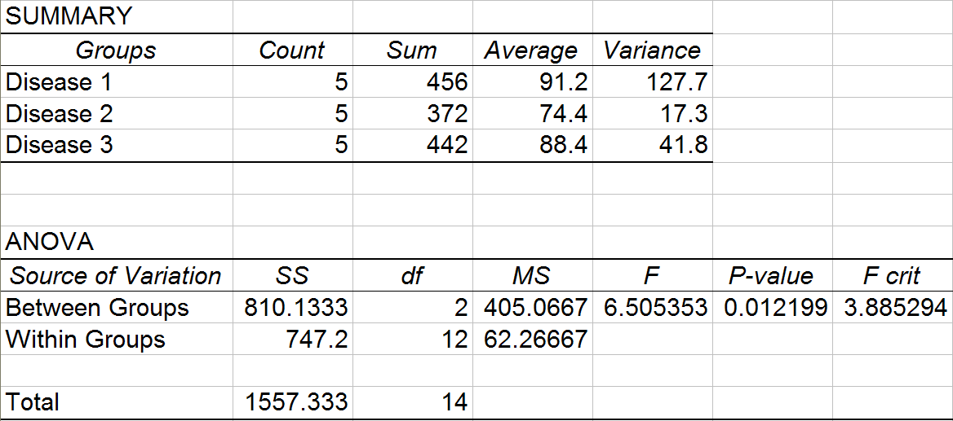
Output from Excel (ANOVA, single factor):
At the 5% significance level, gene X is expressed differently between some of the disease conditions (p = 0.012).

Slide 27
New OLAP Operation: Correlate
Computing the Pearson correlation coefficient between two variables (e.g., between a clinical variable and a gene expression variable).
Example:
Expression
of gene X
Dosage of
Drug Y
Is the gene expression correlated with the drug use?
50
205
45
83
155
78
15
50
0
20
40
20
Cov(X, Y)
ρ_{xy} =
√
(Var X)(Var Y)

Slide 28
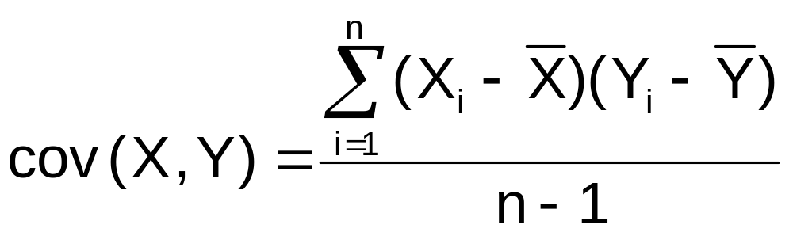
The Covariance
The covariance measures the strength of the linear relationship between two numerical variables (X & Y)
The sample covariance:
Only concerned with the strength of the relationship
No causal effect is implied
Basic Business Statistics, 11e © 2009 Prentice-Hall, Inc..
Chap 3-<number>

Slide 29
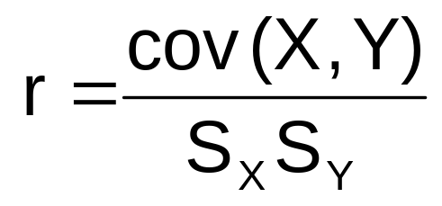
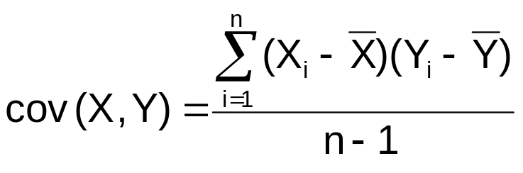
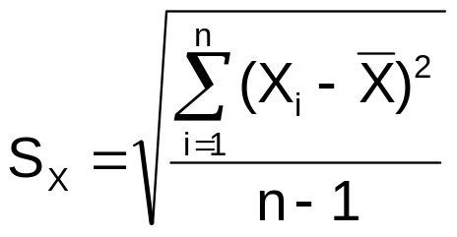

Coefficient of Correlation
Measures the relative strength of the linear relationship between two numerical variables
Sample coefficient of correlation:
where
Basic Business Statistics, 11e © 2009 Prentice-Hall, Inc..
Chap 3-<number>

Slide 30
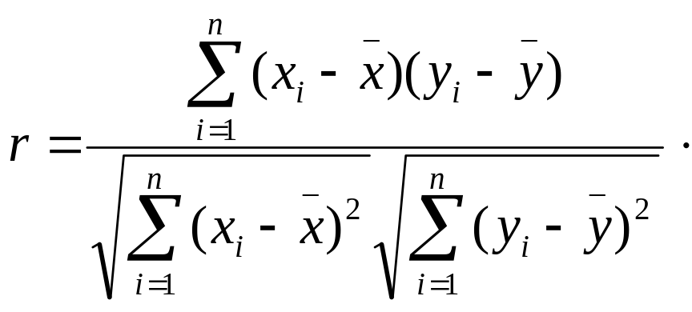
Person’s Correlation Coefficient
Given two groups of samples X = {x₁, …, x_{n} } and Y = { y₁, …, y_{n} } .
Pearson’ correlation coefficient r is given by

Slide 31
Features of the
Coefficient of Correlation
The population coefficient of correlation is referred as ρ.
The sample coefficient of correlation is referred to as r.
Either ρ or r have the following features:
  Unit free
  Ranges between –1 and 1
  The closer to –1, the stronger the negative linear relationship
  The closer to 1, the stronger the positive linear relationship
  The closer to 0, the weaker the linear relationship
Basic Business Statistics, 11e © 2009 Prentice-Hall, Inc..
Chap 3-<number>

Slide 32
Scatter Plots of Sample Data with Various Coefficients of Correlation
Y
Y
X
X
r = -1
r = -.6
Y
Y
Y
X
X
X
r = +1
r = +.3
r = 0
Basic Business Statistics, 11e © 2009 Prentice-Hall, Inc..
Chap 3-<number>

Slide 33
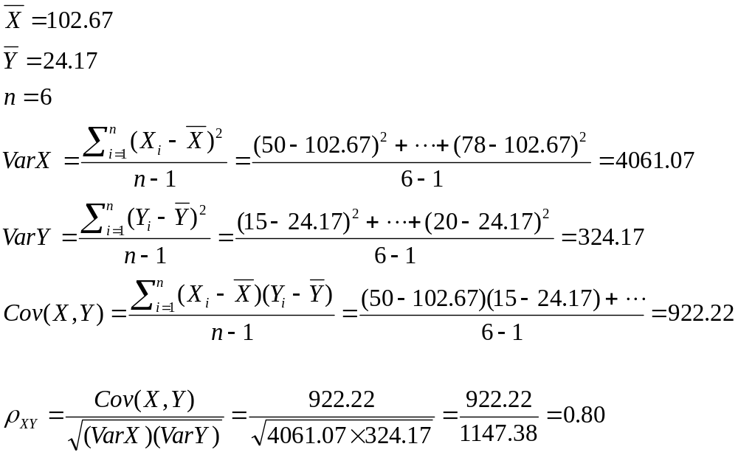
Calculation of the Correlation Coefficient

Slide 34
New OLAP Operation: Select
Given a threshold, select the entries that meet the minimum requirement.
Example:
Gene
p value
For a threshold of p < 0.05, gene 2 and gene 6 are selected.
1
2
3
4
5
6
7
8
0.561
0.004
0.160
0.335
0.083
0.025
0.532
0.476

Slide 35
Discovery of Differentially Expressed Genes (1)
Roll-up the microarray data over the Measurement Unit dimension using the user-defined aggregate function.
Measurement
Unit
PA
Val
D13626
D13627
D13628
J04605
L37042
S78653
X60003
Z11518
10 14 0 0 24 32 16
D13626
D13627
D13628
J04605
L37042
S78653
X60003
Z11518
10 14 18 5 24 32 16
roll-up
Gene
Gene
1 2 3 4 5 6 7
1 2 3 4 5 6 7
Sample (patient)
Sample (patient)

Slide 36
Discovery of Differentially Expressed Genes (2)
Roll-up the data over the Clinical Sample dimension from the patient level to disease level (or normal tissue level). After the roll-up, each cell contains mean, variance and the number of values aggregated.
D13626
D13627
D13628
J04605
L37042
S78653
X60003
Z11518
10 14 0 0 24 32 16
D13626
D13627
D13628
J04605
L37042
S78653
X60003
Z11518
12 0 28 19
roll-up to
disease level
Gene
Gene
1 2 3 4 5 6 7
a b c d
Sample (patient)
Sample (disease)

Slide 37
Discovery of Differentially Expressed Genes (3)
Compare a particular disease type with its corresponding normal tissue type. Compute the t statistic and p value for each gene. Select the genes that have a p value less than a given threshold (e.g., p < 0.05).
p value
D13626
D13627
D13628
J04605
L37042
S78653
X60003
Z11518
12 0 28 19
D13626
D13627
D13628
J04605
L37042
S78653
X60003
Z11518
0.561
0.004
0.160
0.335
0.083
0.025
0.532
0.476
Compare a with c
Gene
Gene
a b c d
Sample (disease)

Slide 38
Discovery of Informative Genes
Roll-up the microarray data over the Measurement Unit dimension
Roll-up the data over the Clinical Sample dimension from the patient level to disease type or normal tissue level
Slice the data for a particular disease type and its corresponding normal tissue type
t-test on each pair of the selected cells for each gene
(p-values are computed and adjusted)
p-select the genes that have p-values less than a given threshold

