Slide 1
The Normal Distribution
Basic Business Statistics, 11e © 2009 Prentice-Hall, Inc.
Chap 6-<number>

Slide 2
The Normal Distribution
‘Bell Shaped’
Symmetrical
Mean, Median and Mode
are Equal
Location is determined by the mean, μ
Spread is determined by the standard deviation, σ
The random variable has an infinite theoretical range:
+ ∞ to − ∞
f(X)
σ
X
μ
Mean
= Median
= Mode
Basic Business Statistics, 11e © 2009 Prentice-Hall, Inc..
Chap 6-<number>

Slide 3
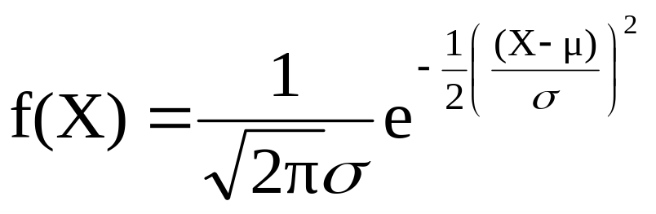
The Normal Distribution
Density Function
The formula for the normal probability density function is
Where e = the mathematical constant approximated by 2.71828
π = the mathematical constant approximated by 3.14159
μ = the population mean
σ = the population standard deviation
X = any value of the continuous variable
Basic Business Statistics, 11e © 2009 Prentice-Hall, Inc..
Chap 6-<number>

Slide 4
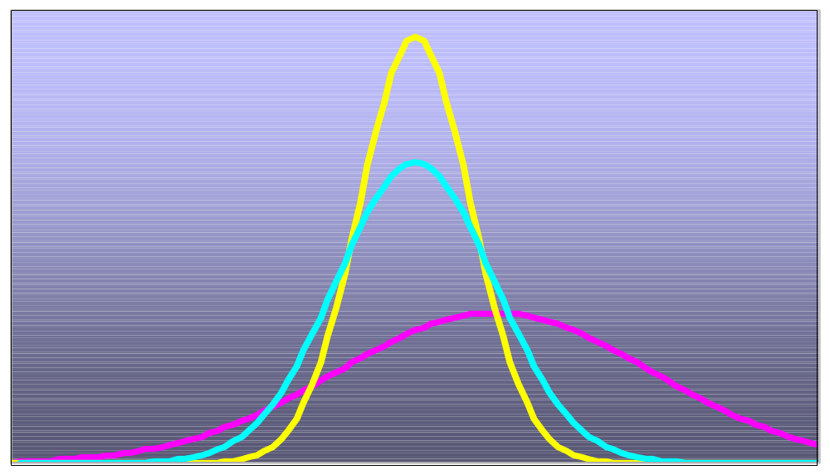
Many Normal Distributions
By varying the parameters μ and σ, we obtain different normal distributions
Basic Business Statistics, 11e © 2009 Prentice-Hall, Inc..
Chap 6-<number>

Slide 5
The Normal Distribution Shape
f(X)
Changing μ shifts the distribution left or right.
Changing σ increases or decreases the spread.
σ
μ
X
Basic Business Statistics, 11e © 2009 Prentice-Hall, Inc..
Chap 6-<number>

Slide 6
The Standardized Normal
Any normal distribution (with any mean and standard deviation combination) can be transformed into the standardized normal distribution (Z)
Need to transform X units into Z units
The standardized normal distribution (Z) has a mean of 0 and a standard deviation of 1
Basic Business Statistics, 11e © 2009 Prentice-Hall, Inc..
Chap 6-<number>

Slide 7
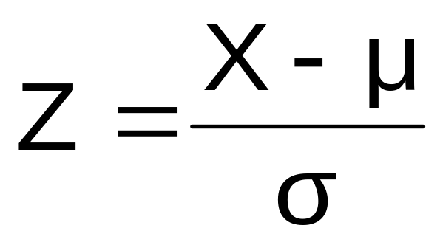
Translation to the Standardized Normal Distribution
Translate from X to the standardized normal (the “Z” distribution) by subtracting the mean of X and dividing by its standard deviation:
The Z distribution always has mean = 0 and standard deviation = 1
Basic Business Statistics, 11e © 2009 Prentice-Hall, Inc..
Chap 6-<number>

Slide 8
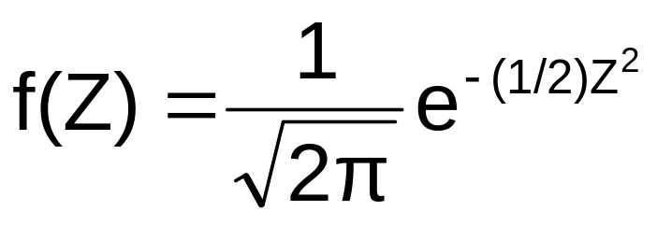
The Standardized Normal Probability Density Function
The formula for the standardized normal probability density function is
Where e = the mathematical constant approximated by 2.71828
π = the mathematical constant approximated by 3.14159
Z = any value of the standardized normal distribution
Basic Business Statistics, 11e © 2009 Prentice-Hall, Inc..
Chap 6-<number>

Slide 9
The Standardized
Normal Distribution
Also known as the “Z” distribution
Mean is 0
Standard Deviation is 1
f(Z)
1
Z
0
Values above the mean have positive Z-values, values below the mean have negative Z-values
Basic Business Statistics, 11e © 2009 Prentice-Hall, Inc..
Chap 6-<number>

Slide 10
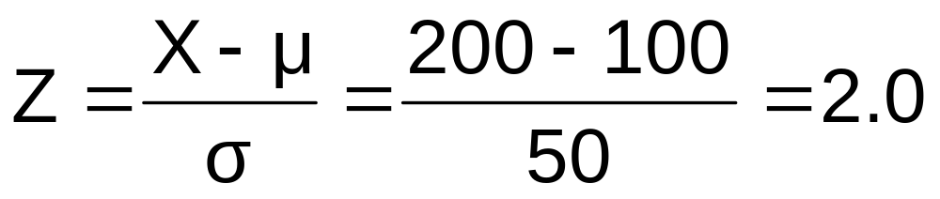
Example
If X is distributed normally with mean of 100 and standard deviation of 50, the Z value for X = 200 is
This says that X = 200 is two standard deviations (2 increments of 50 units) above the mean of 100.
Basic Business Statistics, 11e © 2009 Prentice-Hall, Inc..
Chap 6-<number>

Slide 11
Comparing X and Z units
100
200
X
(μ = 100, σ = 50)
0
2.0
Z
(μ = 0, σ = 1)
Note that the shape of the distribution is the same, only the scale has changed. We can express the problem in original units (X) or in standardized units (Z)
Basic Business Statistics, 11e © 2009 Prentice-Hall, Inc..
Chap 6-<number>

Slide 12
Finding Normal Probabilities
Probability is measured by the area under the curve
f(X)
P
(
≤
≤
)
a
X
b
=
P
(
<
<
)
a
X
b
(Note that the probability of any individual value is zero)
a
b
X
Basic Business Statistics, 11e © 2009 Prentice-Hall, Inc..
Chap 6-<number>

Slide 13


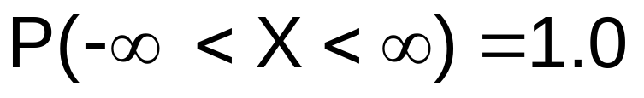
Probability as
Area Under the Curve
The total area under the curve is 1.0, and the curve is symmetric, so half is above the mean, half is below
f(X)
0.5
0.5
μ
X
Basic Business Statistics, 11e © 2009 Prentice-Hall, Inc..
Chap 6-<number>

Slide 14
The Standardized Normal Table
The Cumulative Standardized Normal table in the textbook (Appendix table E.2) gives the probability less than a desired value of Z (i.e., from negative infinity to Z)
0.9772
Example:
P(Z < 2.00) = 0.9772
0
2.00
Z
Basic Business Statistics, 11e © 2009 Prentice-Hall, Inc..
Chap 6-<number>

Slide 15
The Standardized Normal Table
(continued)
The column gives the value of Z to the second decimal point
Z 0.00 0.01 0.02 …
0.0
0.1
The row shows the value of Z to the first decimal point
.
.
.
The value within the table gives the probability from Z = − ∞ up to the desired Z value
2.0
.9772
P(Z < 2.00) = 0.9772
2.0
Basic Business Statistics, 11e © 2009 Prentice-Hall, Inc..
Chap 6-<number>

Slide 16
General Procedure for Finding Normal Probabilities
To find P(a < X < b) when X is distributed normally:
Draw the normal curve for the problem in
terms of X
Translate X-values to Z-values
Use the Standardized Normal Table
Basic Business Statistics, 11e © 2009 Prentice-Hall, Inc..
Chap 6-<number>

Slide 17
Finding Normal Probabilities
Let X represent the time it takes to download an image file from the internet.
Suppose X is normal with mean 8.0 and standard deviation 5.0. Find P(X < 8.6)
X
8.0
8.6
Basic Business Statistics, 11e © 2009 Prentice-Hall, Inc..
Chap 6-<number>

Slide 18
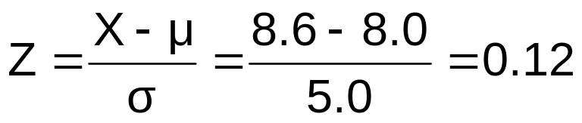
Finding Normal Probabilities
(continued)
Let X represent the time it takes to download an image file from the internet.
Suppose X is normal with mean 8.0 and standard deviation 5.0. Find P(X < 8.6)
μ = 8
σ = 10
μ = 0
σ = 1
8
8.6
X
0
0.12
Z
P(X < 8.6)
P(Z < 0.12)
Basic Business Statistics, 11e © 2009 Prentice-Hall, Inc..
Chap 6-<number>

Slide 19
Solution: Finding P(Z < 0.12)
Standardized Normal Probability
Table (Portion)
P(X < 8.6)
= P(Z < 0.12)
Z
.00
.01
.02
.5478
0.0
.5000
.5040
.5080
0.1
.5398
.5438
.5478
0.2
.5793
.5832
.5871
Z
0.3
.6179
.6217
.6255
0.00
0.12
Basic Business Statistics, 11e © 2009 Prentice-Hall, Inc..
Chap 6-<number>

Slide 20
Finding Normal
Upper Tail Probabilities
Suppose X is normal with mean 8.0 and standard deviation 5.0.
Now Find P(X > 8.6)
X
8.0
8.6
Basic Business Statistics, 11e © 2009 Prentice-Hall, Inc..
Chap 6-<number>

Slide 21
Finding Normal
Upper Tail Probabilities
(continued)
Now Find P(X > 8.6)…
P(X > 8.6) = P(Z > 0.12) = 1.0 - P(Z ≤ 0.12)
= 1.0 - 0.5478 = 0.4522
0.5478
1.000
1.0 - 0.5478 = 0.4522
Z
Z
0
0
0.12
0.12
Basic Business Statistics, 11e © 2009 Prentice-Hall, Inc..
Chap 6-<number>

Slide 22
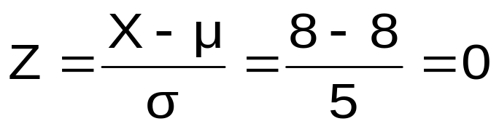
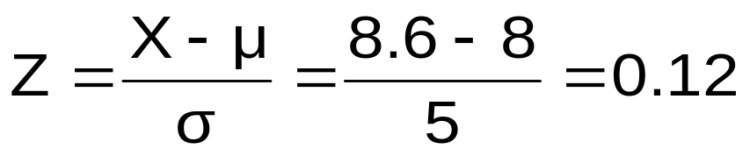
Finding a Normal Probability Between Two Values
Suppose X is normal with mean 8.0 and standard deviation 5.0. Find P(8 < X < 8.6)
Calculate Z-values:
8
8.6
X
0
0.12
Z
P(8 < X < 8.6)
= P(0 < Z < 0.12)
Basic Business Statistics, 11e © 2009 Prentice-Hall, Inc..
Chap 6-<number>

Slide 23
Solution: Finding P(0 < Z < 0.12)
P(8 < X < 8.6)
Standardized Normal Probability
Table (Portion)
= P(0 < Z < 0.12)
= P(Z < 0.12) – P(Z ≤ 0)
Z
.00
.01
.02
= 0.5478 - .5000 = 0.0478
0.0
.5000
.5040
.5080
0.0478
0.5000
0.1
.5398
.5438
.5478
0.2
.5793
.5832
.5871
0.3
.6179
.6217
.6255
Z
0.00
0.12
Basic Business Statistics, 11e © 2009 Prentice-Hall, Inc..
Chap 6-<number>

Slide 24
Probabilities in the Lower Tail
Suppose X is normal with mean 8.0 and standard deviation 5.0.
Now Find P(7.4 < X < 8)
X
8.0
7.4
Basic Business Statistics, 11e © 2009 Prentice-Hall, Inc..
Chap 6-<number>

Slide 25
Probabilities in the Lower Tail
(continued)
Now Find P(7.4 < X < 8)…
P(7.4 < X < 8)
= P(-0.12 < Z < 0)
= P(Z < 0) – P(Z ≤ -0.12)
= 0.5000 - 0.4522 = 0.0478
0.0478
0.4522
The Normal distribution is symmetric, so this probability is the same as P(0 < Z < 0.12)
7.4
8.0
X
-0.12
0
Z
Basic Business Statistics, 11e © 2009 Prentice-Hall, Inc..
Chap 6-<number>

