Slide 1



Developing a
Sampling Distribution
Assume there is a population …
Population size N=4
Random variable, X,
is age of individuals
Values of X: 18, 20,
22, 24 (years)
D
A
B
C
Basic Business Statistics, 11e © 2009 Prentice-Hall, Inc..
Chap 7-<number>

Slide 2
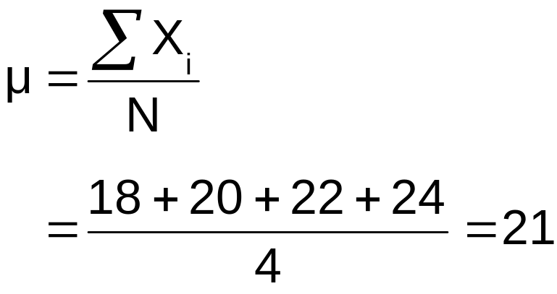
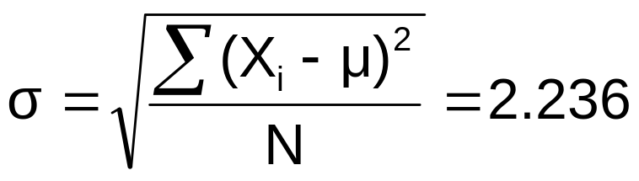
Developing a
Sampling Distribution
(continued)
Summary Measures for the Population Distribution:
P(x)
.3
.2
.1
0
18 20 22 24
A B C D
x
Uniform Distribution
Basic Business Statistics, 11e © 2009 Prentice-Hall, Inc..
Chap 7-<number>

Slide 3
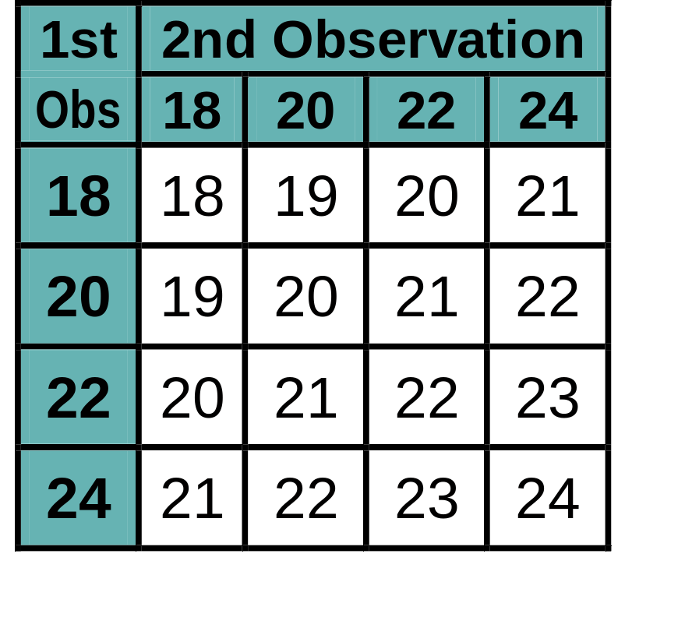
Sampling Distribution of All Sample Means
Developing a
Sampling Distribution
(continued)
16 Sample Means
Sample Means Distribution
_
P(X)
.3
.2
.1
0
_
18 19 20 21 22 23 24
X
(no longer uniform)
Basic Business Statistics, 11e © 2009 Prentice-Hall, Inc..
Chap 7-<number>

Slide 4
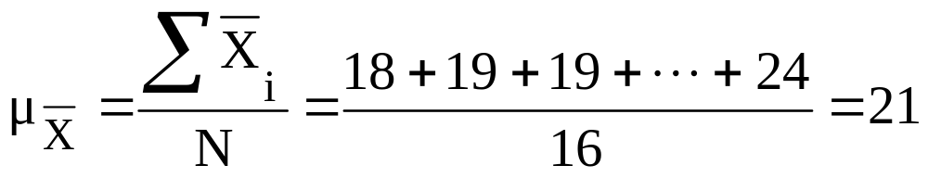
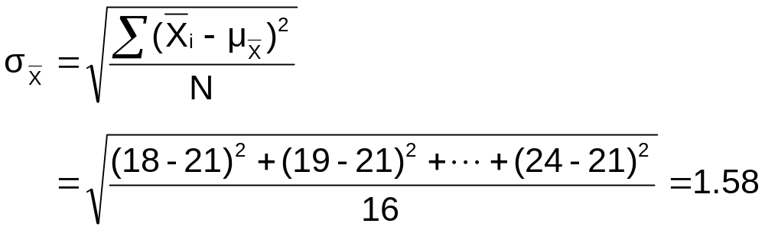
Summary Measures of this Sampling Distribution:
Developing a
Sampling Distribution
(continued)
Basic Business Statistics, 11e © 2009 Prentice-Hall, Inc..
Chap 7-<number>

Slide 5
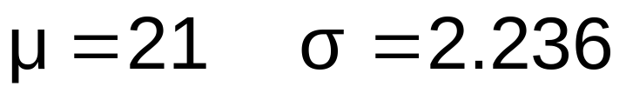
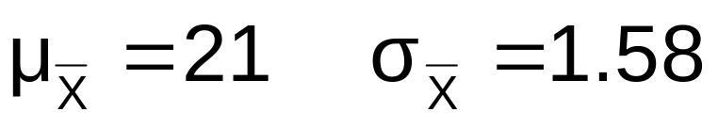
Comparing the Population Distribution to the Sample Means Distribution
Population
N = 4
Sample Means Distribution
n = 2
_
P(X)
P(X)
.3
.3
.2
.2
.1
.1
0
0
_
18 20 22 24
A B C D
X
18 19 20 21 22 23 24
X
Basic Business Statistics, 11e © 2009 Prentice-Hall, Inc..
Chap 7-<number>

Slide 6
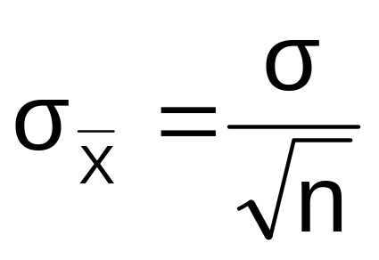
Sample Mean Sampling Distribution:
Standard Error of the Mean
Different samples of the same size from the same population will yield different sample means
A measure of the variability in the mean from sample to sample is given by the Standard Error of the Mean:
(This assumes that sampling is with replacement or
sampling is without replacement from an infinite population)
Note that the standard error of the mean decreases as the sample size increases
Basic Business Statistics, 11e © 2009 Prentice-Hall, Inc..
Chap 7-<number>

Slide 7

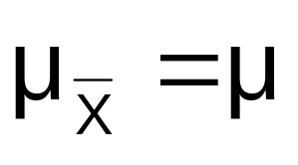
Sample Mean Sampling Distribution:
If the Population is Normal
If a population is normal with mean μ and standard deviation σ, the sampling distribution of is also normally distributed with
and
Basic Business Statistics, 11e © 2009 Prentice-Hall, Inc..
Chap 7-<number>

Slide 8

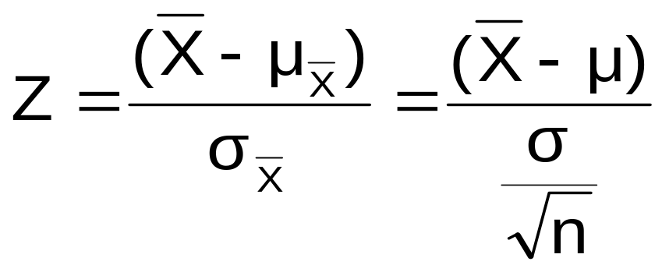



Z-value for Sampling Distribution of the Mean
Z-value for the sampling distribution of :
where: = sample mean
= population mean
= population standard deviation
n = sample size
Basic Business Statistics, 11e © 2009 Prentice-Hall, Inc..
Chap 7-<number>

Slide 9
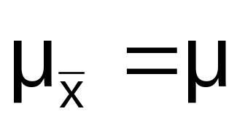


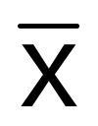

Sampling Distribution Properties
Normal Population Distribution
(i.e. is unbiased )
Normal Sampling Distribution
(has the same mean)
Basic Business Statistics, 11e © 2009 Prentice-Hall, Inc..
Chap 7-<number>

Slide 10


Sampling Distribution Properties
(continued)
  As n increases,
  decreases
Larger sample size
Smaller sample size
Basic Business Statistics, 11e © 2009 Prentice-Hall, Inc..
Chap 7-<number>

Slide 11
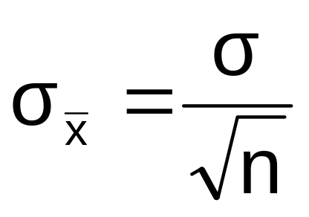
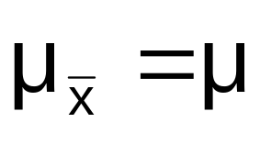
Sample Mean Sampling Distribution:
If the Population is not Normal
We can apply the Central Limit Theorem:
  Even if the population is not normal,
  …sample means from the population will be approximately normal as long as the sample size is large enough.
  Properties of the sampling distribution:
  and
Basic Business Statistics, 11e © 2009 Prentice-Hall, Inc..
Chap 7-<number>

Slide 12
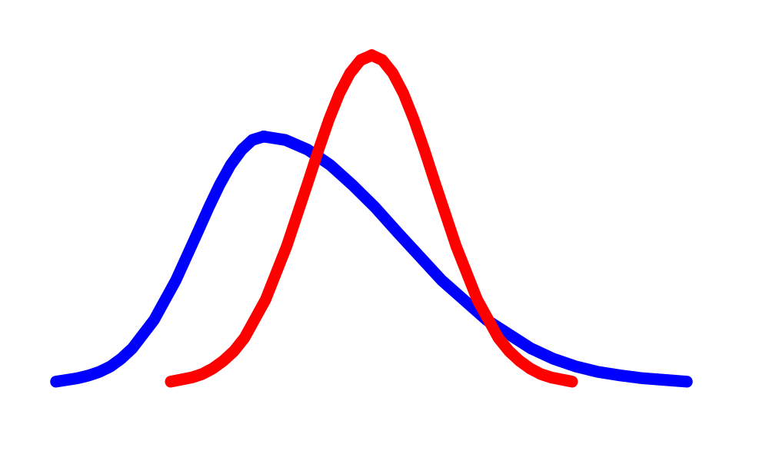
Central Limit Theorem
the sampling distribution becomes almost normal regardless of shape of population
As the sample size gets large enough…
n↑
Basic Business Statistics, 11e © 2009 Prentice-Hall, Inc..
Chap 7-<number>

Slide 13


Sample Mean Sampling Distribution:
If the Population is not Normal
(continued)
Population Distribution
Sampling distribution properties:
Central Tendency
Variation
Sampling Distribution
(becomes normal as n increases)
Larger sample size
Smaller sample size
Basic Business Statistics, 11e © 2009 Prentice-Hall, Inc..
Chap 7-<number>

Slide 14
How Large is Large Enough?
For most distributions, n > 30 will give a sampling distribution that is nearly normal
For fairly symmetric distributions, n > 15
For normal population distributions, the sampling distribution of the mean is always normally distributed
Basic Business Statistics, 11e © 2009 Prentice-Hall, Inc..
Chap 7-<number>

Slide 15
Example
Suppose a population has mean μ = 8 and standard deviation σ = 3. Suppose a random sample of size n = 36 is selected.
What is the probability that the sample mean is between 7.8 and 8.2?
Basic Business Statistics, 11e © 2009 Prentice-Hall, Inc..
Chap 7-<number>

Slide 16


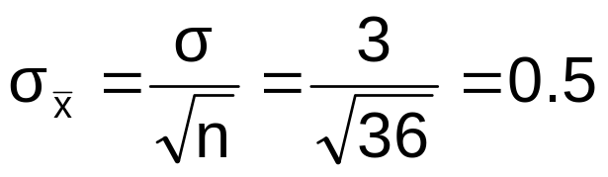
Example
(continued)
Solution:
Even if the population is not normally distributed, the central limit theorem can be used (n > 30)
… so the sampling distribution of is approximately normal
… with mean = 8
…and standard deviation
Basic Business Statistics, 11e © 2009 Prentice-Hall, Inc..
Chap 7-<number>

Slide 17
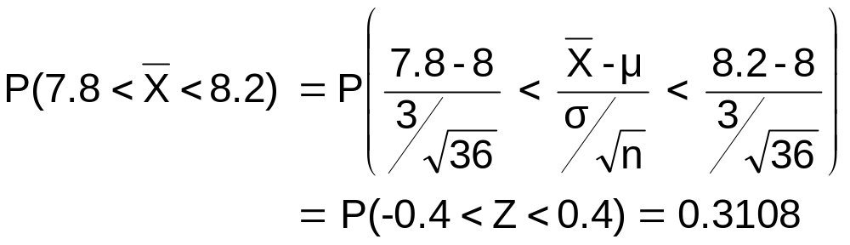



Example
(continued)
Solution (continued):
Population Distribution
Sampling Distribution
Standard Normal Distribution
.1554 +.1554
?
?
?
?
?
?
?
?
?
?
Sample
Standardize
?
?
7.8 8.2
-0.4 0.4
Z
X
Basic Business Statistics, 11e © 2009 Prentice-Hall, Inc..
Chap 7-<number>

