Slide 1
Confidence Interval Estimation
Basic Business Statistics, 11e © 2009 Prentice-Hall, Inc.
Chap 8-<number>

Slide 2
Point Estimates
We can estimate a
Population Parameter …
with a Sample
Statistic
(a Point Estimate)
Mean
μ
X
Proportion
π
p
Basic Business Statistics, 11e © 2009 Prentice-Hall, Inc..
Chap 8-<number>

Slide 3
Confidence Intervals
How much uncertainty is associated with a point estimate of a population parameter?
An interval estimate provides more information about a population characteristic than does a point estimate
Such interval estimates are called confidence intervals
Basic Business Statistics, 11e © 2009 Prentice-Hall, Inc..
Chap 8-<number>

Slide 4
Confidence Interval Estimate
An interval gives a range of values:
  Takes into consideration variation in sample statistics from sample to sample
  Based on observations from 1 sample
  Gives information about closeness to unknown population parameters
  Stated in terms of level of confidence
    e.g. 95% confident, 99% confident
    Can never be 100% confident
Basic Business Statistics, 11e © 2009 Prentice-Hall, Inc..
Chap 8-<number>

Slide 5
Confidence Level
Confidence Level
  Confidence the interval will contain the unknown population parameter
  A percentage (less than 100%)
Basic Business Statistics, 11e © 2009 Prentice-Hall, Inc..
Chap 8-<number>

Slide 6
Confidence Level, (1-α)
(continued)
Suppose confidence level = 95%
Also written (1 - α) = 0.95, (so α = 0.05)
A relative frequency interpretation:
  95% of all the confidence intervals that can be constructed will contain the unknown true parameter
A specific interval either will contain or will not contain the true parameter
  No probability involved in a specific interval
Basic Business Statistics, 11e © 2009 Prentice-Hall, Inc..
Chap 8-<number>

Slide 7
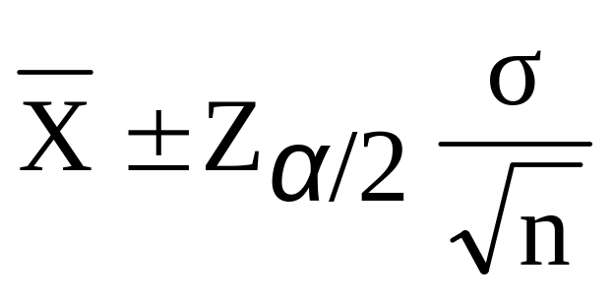


Confidence Interval for μ
(σ Known)
Assumptions
  Population standard deviation σ is known
  Population is normally distributed
  If population is not normal, use large sample
Confidence interval estimate:
where is the point estimate
Z_{α/2} is the normal distribution critical value for a probability of α/2 in each tail
is the standard error
Basic Business Statistics, 11e © 2009 Prentice-Hall, Inc..
Chap 8-<number>

Slide 8
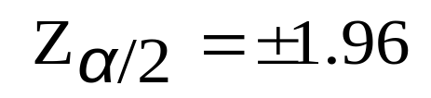

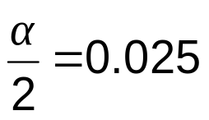
Finding the Critical Value, Z_{α/2}
Consider a 95% confidence interval:
Z units:
Z_{α/2} = -1.96
0
Z_{α/2} = 1.96
X units:
Lower
Confidence
Limit
Upper
Confidence
Limit
Point Estimate
Point Estimate
Basic Business Statistics, 11e © 2009 Prentice-Hall, Inc..
Chap 8-<number>

Slide 9

Common Levels of Confidence
Commonly used confidence levels are 90%, 95%, and 99%
Confidence Coefficient,
Confidence Level
Z_{α/2} value
80%
90%
95%
98%
99%
99.8%
99.9%
0.80
0.90
0.95
0.98
0.99
0.998
0.999
1.28
1.645
1.96
2.33
2.58
3.08
3.27
Basic Business Statistics, 11e © 2009 Prentice-Hall, Inc..
Chap 8-<number>

Slide 10



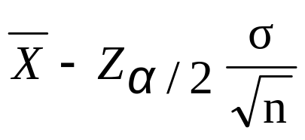
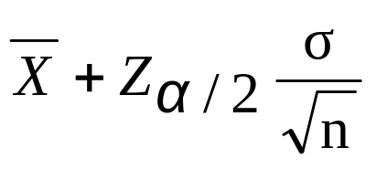
Intervals and Level of Confidence
Sampling Distribution of the Mean
x
Intervals extend from
to
x₁
x₂
(1-α)x100%
of intervals constructed contain μ;
(α)x100% do not.
Confidence Intervals
Basic Business Statistics, 11e © 2009 Prentice-Hall, Inc..
Chap 8-<number>

