Slide 1
Clustering Lecture 1: Basics

Slide 2
Outline
Basics
Motivation, definition, evaluation
Methods
Partitional
Hierarchical
Density-based
Mixture model
Spectral methods
Advanced topics
Clustering in MapReduce
Clustering ensemble
Semi-supervised clustering, subspace clustering, co-clustering, etc.

Slide 3
Readings
Tan, Steinbach, Kumar, Chapters 8 and 9.
Han, Kamber, Pei. Data Mining: Concepts and Techniques. Chapters 10 and 11.
Additional readings posted on website

Slide 4
Clustering Basics
Definition and Motivation
Data Preprocessing and Similarity Computation
Objective of Clustering
Clustering Evaluation

Slide 5
Clustering
Finding groups of objects such that the objects in a group will be similar (or related) to one another and different from (or unrelated to) the objects in other groups
Inter-cluster distances are maximized
Intra-cluster distances are minimized

Slide 6
Application Examples
A stand-alone tool: explore data distribution
A preprocessing step for other algorithms
Pattern recognition, spatial data analysis, image processing, market research, WWW, …
Cluster documents
Cluster web log data to discover groups of similar access patterns

Slide 7
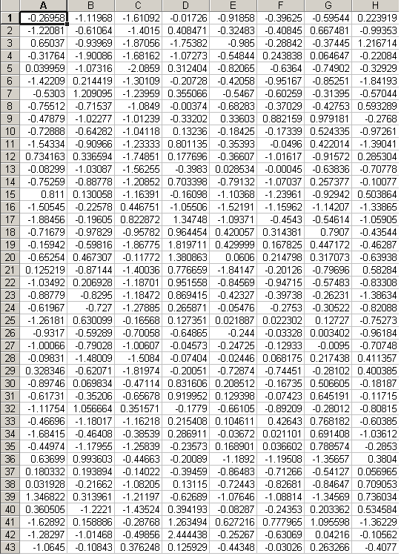





Clustering Co-expressed Genes
Gene Expression Data Matrix
Gene Expression Patterns
Co-expressed Genes
Why looking for co-expressed genes?
⎯ Co-expression indicates co-function;
⎯ Co-expression also indicates co-regulation.

Slide 8
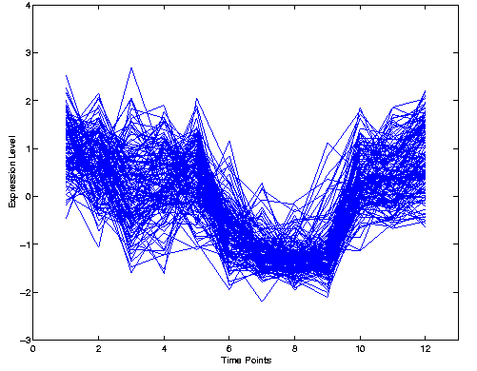
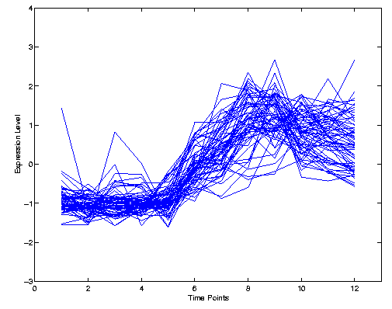
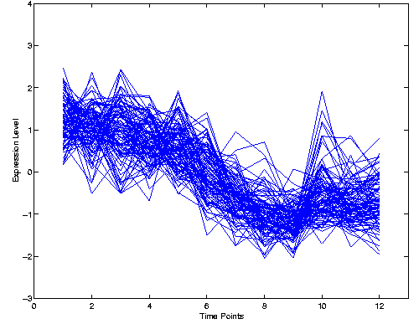
Gene-based Clustering
Examples of co-expressed genes and coherent patterns in gene expression data
Iyer’s data ^{[2]}
[2] Iyer, V.R. et al. The transcriptional program in the response of human fibroblasts to serum. Science, 283:83–87, 1999.
Notes:
The gene-based clustering regards each gene as a data object, and the experiment conditions as attributes.
To illustrate the problem, first we look at the parallel corrdinates for a time-series gene expression data.
The x-axis represents the time point while the y-axis represents the gene expression level.
The expression profile of a gene during the time-series is represented by a horizontal poly-line in the parallel coordinates.
We can see the figure is in a mess, and we cannot see anything interesting in this figure.
However, there exist some groups of genes in the data set. such that the expression levels of
those genes rise and fall cocordantly during the whole time-series.
Those genes are called co-expressed genes and the common
trend of expression levels shared by the genes in the same group are called coherent patterns.
Biologists are interested in the co-expressed genes and coherent patterns because co-expressed genes may have similar gene functions and maybe
regulated by the same mechanisms and coherent patterns may correspond to some important cellular processes.
The purpose of gene-based clustering is to identify co-expressed genes and coherent expression patterns in the data set.

Slide 9
Other Applications
Marketing: Help marketers discover distinct groups in their customer bases, and then use this knowledge to develop targeted marketing programs
City-planning: Identifying groups of houses according to their house type, value, and geographical location
Climate: understanding earth climate, find patterns of atmosphere and ocean

Slide 10
Two Important Aspects
Properties of input data
Define the similarity or dissimilarity between points
Requirement of clustering
Define the objective and methodology

Slide 11
Clustering Basics
Definition and Motivation
Data Preprocessing and Distance computation
Objective of Clustering
Clustering Evaluation

Slide 12
Data Representation
Data: Collection of data objects and their attributes
An attribute is a property or characteristic of an object
Examples: eye color of a person, temperature, etc.
Attribute is also known as dimension, variable, field, characteristic, or feature
A collection of attributes describe an object
Object is also known as record, point, case, sample, entity, or instance
Attributes
Objects
12

Slide 13
Data Matrix
Represents n objects with p attributes
An n by p matrix
The value of the i-th object on the f-th attribute
Attributes
Objects

Slide 14

Gene Expression Data
 | condition 1 | condition 2 | condition 3 | condition 4 | condition…
gene 1 | 0.13 | 0.72 | 0.1 | 0.57
gene 2 | 0.34 | 1.58 | 1.05 | 1.15
gene 3 | 0.43 | 1.1 | 0.97 | 1
gene 4 | 1.22 | 0.97 | 1 | 0.85
gene 5 | -0.89 | 1.21 | 1.29 | 1.08
gene 6 | 1.1 | 1.45 | 1.44 | 1.12
gene 7 | 0.83 | 1.15 | 1.1 | 1
gene 8 | 0.87 | 1.32 | 1.35 | 1.13
gene 9 | -0.33 | 1.01 | 1.38 | 1.21
gene 10 | 0.10 | 0.85 | 1.03 | 1
gene …
Clustering genes
Genes are objects
Experiment conditions are attributes
Find genes with similar behavior

Slide 15
Similarity and Dissimilarity
Similarity
Numerical measure of how alike two data objects are
Is higher when objects are more alike
Often falls in the range [0,1]
Dissimilarity
Numerical measure of how different are two data objects
Lower when objects are more alike
Minimum dissimilarity is often 0
Upper limit varies

Slide 16
Types of Attributes
Discrete
Has only a finite or countably infinite set of values
Examples: zip codes, counts, or the set of words in a collection of documents
Note: binary attributes are a special case of discrete attributes
Ordinal
Has only a finite or countably infinite set of values
Order of values is important
Examples: rankings (e.g., pain level 1-10), grades (A, B, C, D)
Continuous
Has real numbers as attribute values
Examples: temperature, height, or weight
Continuous attributes are typically represented as floating-point variables

Slide 17
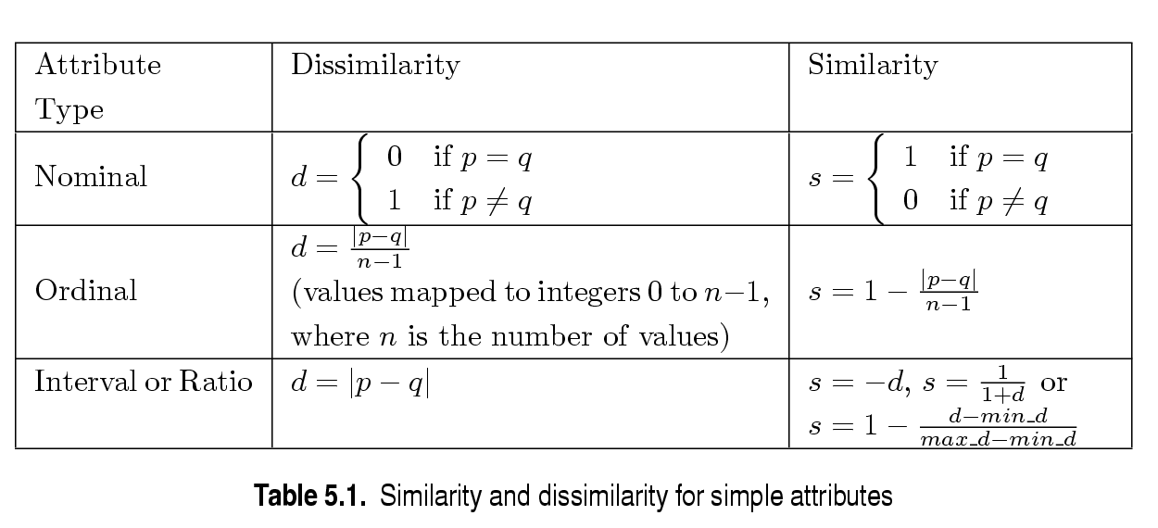
Similarity/Dissimilarity for Simple Attributes
p and q are the attribute values for two data objects.
Discrete
Ordinal
Continuous
Dissimilarity and similarity between p and q

Slide 18
Distance Matrix
Represents pairwise distance in n objects
An n by n matrix
d(i,j): distance or dissimilarity between objects i and j
Nonnegative
Close to 0: similar

Slide 19
Data Matrix -> Distance Matrix
 | s 1 | s 2 | s 3 | s 4 | …
g 1 | 0.13 | 0.72 | 0.1 | 0.57
g 2 | 0.34 | 1.58 | 1.05 | 1.15
g 3 | 0.43 | 1.1 | 0.97 | 1
g 4 | 1.22 | 0.97 | 1 | 0.85
g 5 | -0.89 | 1.21 | 1.29 | 1.08
g 6 | 1.1 | 1.45 | 1.44 | 1.12
g 7 | 0.83 | 1.15 | 1.1 | 1
g 8 | 0.87 | 1.32 | 1.35 | 1.13
g 9 | -0.33 | 1.01 | 1.38 | 1.21
g 10 | 0.10 | 0.85 | 1.03 | 1
…
 | g 1 | g 2 | g 3 | g 4 | …
g 1 | 0 | d(1,2) | d(1,3) | d(1,4)
g 2 |  | 0 | d(2,3) | d(2,4)
g 3 |  |  | 0 | d(3,4)
g 4 |  |  |  | 0
…
Distance Matrix
Original Data Matrix

Slide 20
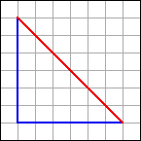
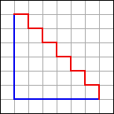
Minkowski Distance—Continuous Attribute
Minkowski distance: a generalization
If q = 2, d is Euclidean distance
If q = 1, d is Manhattan distance
x_{i}
X_{i} (1,7)
12
8.48
q=2
6
q=1
6
X_{j}(7,1)
x_{j}

Slide 21
Standardization
Calculate the mean absolute deviation
Calculate the standardized measurement (z-score)

Slide 22
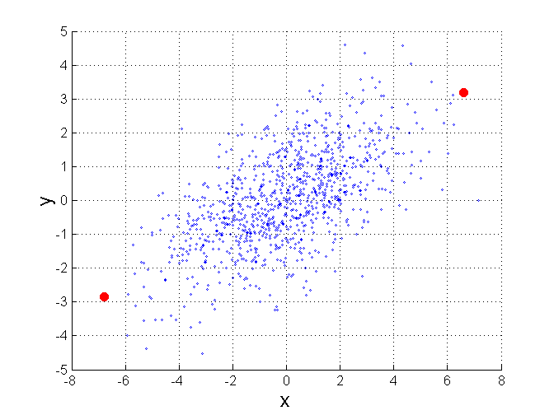
Mahalanobis Distance
Σ is the covariance matrix of the input data X
For red points, the Euclidean distance is 14.7, Mahalanobis distance is 6.

Slide 23
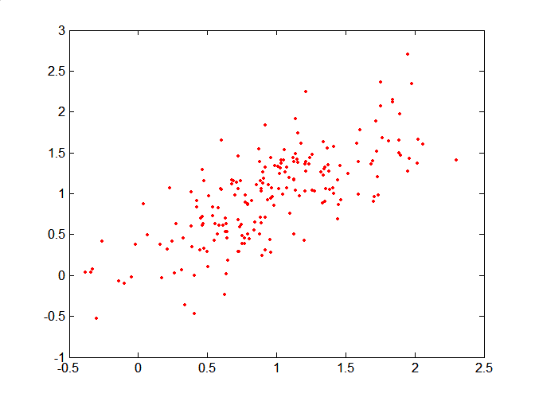
Mahalanobis Distance
Covariance Matrix:
C
B
A: (0.5, 0.5)
B: (0, 1)
C: (1.5, 1.5)
Mahal(A,B) = 5
Mahal(A,C) = 4
A

Slide 24
Common Properties of a Distance
Distances, such as the Euclidean distance, have some well known properties
d(p, q) ≥ 0 for all p and q and d(p, q) = 0 only if p = q. (Positive definiteness)
d(p, q) = d(q, p) for all p and q. (Symmetry)
d(p, r) ≤ d(p, q) + d(q, r) for all points p, q, and r. (Triangle Inequality)
where d(p, q) is the distance (dissimilarity) between points (data objects), p and q.
A distance that satisfies these properties is a metric

Slide 25
Similarity for Binary Attributes
Common situation is that objects, p and q, have only binary attributes
Compute similarities using the following quantities
M₀₁ = the number of attributes where p was 0 and q was 1
M₁₀ = the number of attributes where p was 1 and q was 0
M₀₀ = the number of attributes where p was 0 and q was 0
M₁₁ = the number of attributes where p was 1 and q was 1
Simple Matching and Jaccard Coefficients
SMC = number of matches / total number of attributes
= (M₁₁ + M₀₀) / (M₀₁ + M₁₀ + M₁₁ + M₀₀)
J = number of matches / number of not-both-zero attributes values
= (M₁₁) / (M₀₁ + M₁₀ + M₁₁)

Slide 26
SMC versus Jaccard: Example
p = 1 0 0 0 0 0 0 0 0 0
q = 0 0 0 0 0 0 1 0 0 1
M₀₁ = 2 (the number of attributes where p was 0 and q was 1)
M₁₀ = 1 (the number of attributes where p was 1 and q was 0)
M₀₀ = 7 (the number of attributes where p was 0 and q was 0)
M₁₁ = 0 (the number of attributes where p was 1 and q was 1)
SMC = (M₁₁ + M₀₀)/(M₀₁ + M₁₀ + M₁₁ + M₀₀) = (0+7) / (2+1+0+7) = 0.7
J = (M₁₁) / (M₀₁ + M₁₀ + M₁₁) = 0 / (2 + 1 + 0) = 0

Slide 27
Document Data
Each document becomes a `term' vector,
each term is a component (attribute) of the vector,
the value of each component is the number of times the corresponding term occurs in the document.

Slide 28
Cosine Similarity
If d₁ and d₂ are two document vectors, then
cos( d₁, d₂ ) = (d₁ • d₂) / ||d₁|| ||d₂|| ,
where • indicates vector dot product and || d || is the length of vector d.
Example:
d₁ = 3 2 0 5 0 0 0 2 0 0
d₂ = 1 0 0 0 0 0 0 1 0 2
d₁ • d₂= 3*1 + 2*0 + 0*0 + 5*0 + 0*0 + 0*0 + 0*0 + 2*1 + 0*0 + 0*2 = 5
||d₁|| = (3*3+2*2+0*0+5*5+0*0+0*0+0*0+2*2+0*0+0*0)^{0.5} = (42) ^{0.5} = 6.481
||d₂|| = (1*1+0*0+0*0+0*0+0*0+0*0+0*0+1*1+0*0+2*2) ^{0.5} = (6) ^{0.5} = 2.245
cos( d₁, d₂ ) = .3150

Slide 29
Correlation
Correlation measures the linear relationship between objects
To compute correlation, we standardize data objects, p and q, and then take their dot product (continuous attributes)

Slide 30
Common Properties of a Similarity
Similarities, also have some well known properties.
s(p, q) = 1 (or maximum similarity) only if p = q.
s(p, q) = s(q, p) for all p and q. (Symmetry)
where s(p, q) is the similarity between points (data objects), p and q.

Slide 31
Characteristics of the Input Data Are Important
Sparseness
Attribute type
Type of Data
Dimensionality
Noise and Outliers
Type of Distribution
=> Conduct preprocessing and select the appropriate dissimilarity or similarity measure
=> Determine the objective of clustering and choose the appropriate method

Slide 32
Clustering Basics
Definition and Motivation
Data Preprocessing and Distance computation
Objective of Clustering
Clustering Evaluation

Slide 33
Considerations for Cluster Analysis
Partitioning criteria
Single level vs. hierarchical partitioning (often, multi-level hierarchical partitioning is desirable)
Separation of clusters
Exclusive (e.g., one customer belongs to only one region) vs. overlapping (e.g., one document may belong to more than one topic)
Hard versus fuzzy
In fuzzy clustering, a point belongs to every cluster with some weight between 0 and 1
Weights must sum to 1
Probabilistic clustering has similar characteristics
Similarity measure and data types
Heterogeneous versus homogeneous
Cluster of widely different sizes, shapes, and densities

Slide 34
Requirements of Clustering
Scalability
Ability to deal with different types of attributes
Minimal requirements for domain knowledge to determine input parameters
Able to deal with noise and outliers
Discovery of clusters with arbitrary shape
Insensitive to order of input records
High dimensionality
Incorporation of user-specified constraints
Interpretability and usability
What clustering results we want to get?

Slide 35
Notion of a Cluster can be Ambiguous
How many clusters?
Six Clusters
Two Clusters
Four Clusters

Slide 36
Partitional Clustering
Input Data
A Partitional Clustering

Slide 37
Hierarchical Clustering
Clustering Solution 1
Clustering Solution 2

Slide 38
Types of Clusters: Center-Based
Center-based
A cluster is a set of objects such that an object in a cluster is closer (more similar) to the “center” of a cluster, than to the center of any other cluster
The center of a cluster is often a centroid, the average of all the points in the cluster, or a medoid, the most “representative” point of a cluster
4 center-based clusters

Slide 39
Types of Clusters: Density-Based
Density-based
A cluster is a dense region of points, which is separated by low-density regions, from other regions of high density.
Used when the clusters are irregular or intertwined, and when noise and outliers are present.
6 density-based clusters

Slide 40
Clustering Basics
Definition and Motivation
Data Preprocessing and Distance computation
Objective of Clustering
Clustering Evaluation

Slide 41
Cluster Validation
Cluster validation
Quality: “goodness” of clusters
Assess the quality and reliability of clustering results
Why validation?
To avoid finding clusters formed by chance
To compare clustering algorithms
To choose clustering parameters
e.g., the number of clusters

Slide 42
Aspects of Cluster Validation
Comparing the clustering results to ground truth (externally known results)
External Index
Evaluating the quality of clusters without reference to external information
Use only the data
Internal Index
Determining the reliability of clusters
To what confidence level, the clusters are not formed by chance
Statistical framework

Slide 43
Comparing to Ground Truth
Notation
N: number of objects in the data set
P={P₁,…,P_{s}}: the set of “ground truth” clusters
C={C₁,…,C_{t}}: the set of clusters reported by a clustering algorithm
The “incidence matrix”
N × N (both rows and columns correspond to objects)
P_{ij} = 1 if O_{i} and O_{j} belong to the same “ground truth” cluster in P; P_{ij}=0 otherwise
C_{ij} = 1 if O_{i} and O_{j} belong to the same cluster in C; C_{ij}=0 otherwise

Slide 44
Rand Index and Jaccard Coefficient
A pair of data object (O_{i},O_{j}) falls into one of the following categories
SS: C_{ij}=1 and P_{ij}=1; (agree)
DD: C_{ij}=0 and P_{ij}=0; (agree)
SD: C_{ij}=1 and P_{ij}=0; (disagree)
DS: C_{ij}=0 and P_{ij}=1; (disagree)
Rand index
may be dominated by DD
Jaccard Coefficient

Slide 45
Clustering
 | g 1 | g 2 | g 3 | g 4 | g 5
g 1 | 1 | 1 | 1 | 0 | 0
g 2 | 1 | 1 | 1 | 0 | 0
g 3 | 1 | 1 | 1 | 0 | 0
g 4 | 0 | 0 | 0 | 1 | 1
g 5 | 0 | 0 | 0 | 1 | 1
Clustering
 | Same Cluster | Different Cluster
Same Cluster | 9 | 4
Different Cluster | 4 | 8
Groundtruth
Groundtruth
 | g 1 | g 2 | g 3 | g 4 | g 5
g 1 | 1 | 1 | 0 | 0 | 0
g 2 | 1 | 1 | 0 | 0 | 0
g 3 | 0 | 0 | 1 | 1 | 1
g 4 | 0 | 0 | 1 | 1 | 1
g 5 | 0 | 0 | 1 | 1 | 1

Slide 46
Entropy and Purity
Notation
the number of objects in both the k-th cluster of the clustering solution and j-th cluster of the groundtruth
the number of objects in the k-th cluster of the clustering solution
the number of objects in the j-th cluster of the groundtruth
Purity
Normalized Mutual Information

Slide 47
Example
 | P 1 | P 2 | P 3 | P 4 | P5 | P6 | Total
C1 | 3 | 5 | 40 | 506 | 96 | 27 | 677
C 2 | 4 | 7 | 280 | 29 | 39 | 2 | 361
C 3 | 1 | 1 | 1 | 7 | 4 | 671 | 685
C 4 | 10 | 162 | 3 | 119 | 73 | 2 | 369
C 5 | 331 | 22 | 5 | 70 | 13 | 23 | 464
C 6 | 5 | 358 | 12 | 212 | 48 | 13 | 648
total | 354 | 555 | 341 | 943 | 273 | 738 | 3204

Slide 48
Internal Index
“Ground truth” may be unavailable
Use only the data to measure cluster quality
Measure the “cohesion” and “separation” of clusters
Calculate the correlation between clustering results and distance matrix

Slide 49
Cohesion and Separation
Cohesion is measured by the within cluster sum of squares
Separation is measured by the between cluster sum of squares
where |Ci| is the size of cluster i, m is the centroid of the whole data set
BSS + WSS = constant
WSS (Cohesion) measure is called Sum of Squared Error (SSE)—a commonly used measure
A larger number of clusters tend to result in smaller SSE

Slide 50
Example
m
×
×
×
1
m₁
2
3
4
m₂
5
K=1 :
K=2 :
K=4:

Slide 51
Silhouette Coefficient
Silhouette Coefficient combines ideas of both cohesion and separation
For an individual point, i
Calculate a = average distance of i to the points in its cluster
Calculate b = min (average distance of i to points in another cluster)
The silhouette coefficient for a point is then given by s = 1 – a/b if a < b, (s = b/a - 1 if a ≥ b, not the usual case)
Typically between 0 and 1
The closer to 1 the better
Can calculate the Average Silhouette width for a cluster or a clustering

Slide 52
Correlation with Distance Matrix
Distance Matrix
D_{ij} is the similarity between object O_{i} and O_{j}
Incidence Matrix
C_{ij}=1 if O_{i} and O_{j} belong to the same cluster, C_{ij}=0 otherwise
Compute the correlation between the two matrices
Only n(n-1)/2 entries needs to be calculated
High correlation indicates good clustering

Slide 53
Correlation with Distance Matrix
Given Distance Matrix D = {d₁₁,d₁₂, …, d_{nn} } and Incidence Matrix C= { c₁₁, c₁₂,…, c_{nn} } .
Correlation r between D and C is given by

Slide 54
Are There Clusters in the Data?
Random Points
DBSCAN
K-means
Complete Link

Slide 55
Measuring Cluster Validity Via Correlation
Correlation of incidence and distance matrices for the K-means clusterings of the following two data sets
Corr = -0.9235
Corr = -0.5810

Slide 56
Using Similarity Matrix for Cluster Validation
Order the similarity matrix with respect to cluster labels and inspect visually.

Slide 57
Using Similarity Matrix for Cluster Validation
Clusters in random data are not so crisp

Slide 58
Reliability of Clusters
Need a framework to interpret any measure
For example, if our measure of evaluation has the value, 10, is that good, fair, or poor?
Statistics provide a framework for cluster validity
The more “atypical” a clustering result is, the more likely it represents valid structure in the data

Slide 59
Statistical Framework for SSE
Example
Compare SSE of 0.005 against three clusters in random data
SSE Histogram of 500 sets of random data points of size 100—lowest SSE is 0.0173
SSE = 0.005

Slide 60
Determine the Number of Clusters Using SSE
SSE curve
Clustering of Input Data
SSE wrt K

Slide 61
Take-away Message
What’s clustering?
Why clustering is important?
How to preprocess data and compute dissimilarity/similarity from data?
What’s a good clustering solution?
How to evaluate the clustering results?

