Slide 1

Chapter 5: Mining Frequent Patterns, Association and Correlations

Slide 2
What Is Frequent Pattern Analysis?
Frequent pattern: a pattern (a set of items, subsequences, substructures, etc.) that occurs frequently in a data set
First proposed by Agrawal, Imielinski, and Swami [AIS93] in the context of frequent itemsets and association rule mining
Motivation: Finding inherent regularities in data
  What products were often purchased together?— Beer and diapers?!
  What are the subsequent purchases after buying a PC?
  What kinds of DNA are sensitive to this new drug?
  Can we automatically classify web documents?
Applications
  Basket data analysis, cross-marketing, catalog design, sale campaign analysis, Web log (click stream) analysis, and DNA sequence analysis.

Slide 3
Why Is Freq. Pattern Mining Important?
Discloses an intrinsic and important property of data sets
Forms the foundation for many essential data mining tasks
  Association, correlation, and causality analysis
  Sequential, structural (e.g., sub-graph) patterns
  Pattern analysis in spatiotemporal, multimedia, time-series, and stream data
  Classification: associative classification
  Cluster analysis: frequent pattern-based clustering
  Data warehousing: iceberg cube and cube-gradient
  Semantic data compression: fascicles
  Broad applications

Slide 4
Basic Concepts: Frequent Patterns and Association Rules
Transaction-id | Items bought
10 | A, B, D
20 | A, C, D
30 | A, D, E
40 | B, E, F
50 | B, C, D, E, F
Itemset X = {x₁, …, x_{k}}
Find all the rules X → Y with minimum support and confidence
  support, s, probability that a transaction contains X ∪ Y
  confidence, c, conditional probability that a transaction having X also contains Y
Customer
buys both
Customer
buys diaper
Let sup_{min} = 50%, conf_{min} = 50%
Freq. Pat.: {A:3, B:3, D:4, E:3, AD:3}
Association rules:
  A → D (60%, 100%)
  D → A (60%, 75%)
Customer
buys beer

Slide 5
Association Rule
What is an association rule?
  An implication expression of the form X → Y, where X and Y are itemsets and X∩Y=∅
  Example:
  {Milk, Diaper} → {Beer}

Slide 6
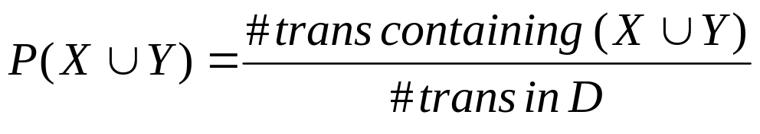
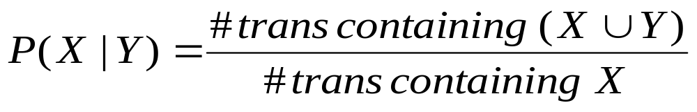
2. What is association rule mining?
  To find all the strong association rules
  An association rule r is strong if
    Support(r) ≥ min_sup
    Confidence(r) ≥ min_conf
  Rule Evaluation Metrics
    Support (s): Fraction of transactions that contain both X and Y
    Confidence (c): Measures how often items in Y appear in transactions that contain X

Slide 7
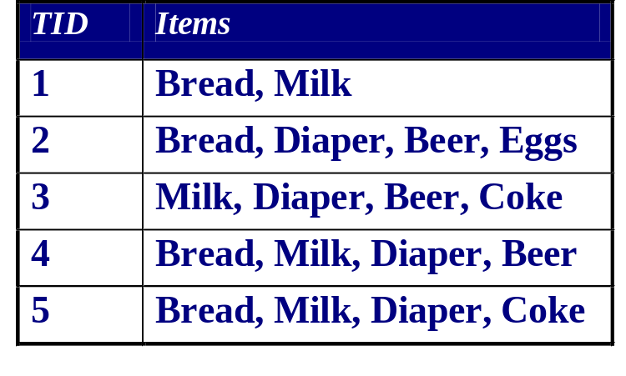
Example of Support and Confidence
To calculate the support and confidence of rule
{Milk, Diaper} → {Beer}
# of transactions: 5
# of transactions containing
{Milk, Diaper, Beer}: 2
Support: 2/5=0.4
# of transactions containing
{Milk, Diaper}: 3
Confidence: 2/3=0.67

Slide 8
Definition: Frequent Itemset
Itemset
  A collection of one or more items
    Example: {Bread, Milk, Diaper}
  k-itemset
    An itemset that contains k items
Support count (σ)
  # transactions containing an itemset
  E.g. σ({Bread, Milk, Diaper}) = 2
Support (s)
  Fraction of transactions containing an itemset
  E.g. s({Bread, Milk, Diaper}) = 2/5
Frequent Itemset
  An itemset whose support is greater than or equal to a min_sup threshold

Slide 9
Association Rule Mining Task
An association rule r is strong if
  Support(r) ≥ min_sup
  Confidence(r) ≥ min_conf
Given a transactions database D, the goal of association rule mining is to find all strong rules
Two-step approach:
  1. Frequent Itemset Identification
    Find all itemsets whose support ≥ min_sup
  2. Rule Generation
    From each frequent itemset, generate all confident rules whose confidence ≥ min_conf

Slide 10
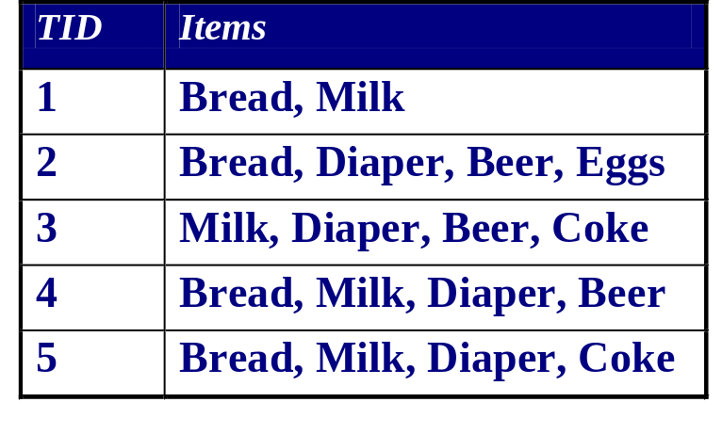
Rule Generation
Suppose min_sup=0.3, min_conf=0.6,
Support({Beer, Diaper, Milk})=0.4
All candidate rules:
{Beer} → {Diaper, Milk} (s=0.4, c=0.67)
{Diaper} → {Beer, Milk} (s=0.4, c=0.5)
{Milk} → {Beer, Diaper} (s=0.4, c=0.5)
{Beer, Diaper} → {Milk} (s=0.4, c=0.67)
{Beer, Milk} → {Diaper} (s=0.4, c=0.67)
{Diaper, Milk} → {Beer} (s=0.4, c=0.67)
All non-empty real subsets
{Beer} , {Diaper} , {Milk}, {Beer, Diaper}, {Beer, Milk} , {Diaper, Milk}
Strong rules:
{Beer} → {Diaper, Milk} (s=0.4, c=0.67)
{Beer, Diaper} → {Milk} (s=0.4, c=0.67)
{Beer, Milk} → {Diaper} (s=0.4, c=0.67)
{Diaper, Milk} → {Beer} (s=0.4, c=0.67)

Slide 11

Frequent Itemset Indentification: the Itemset Lattice
Level 0
Level 1
Level 2
Level 3
Level 4
Given I items, there are 2^{I}-1 candidate itemsets!
Level 5

Slide 12

Frequent Itemset Identification: Brute-Force Approach
Brute-force approach:
  Set up a counter for each itemset in the lattice
  Scan the database once, for each transaction T,
    check for each itemset S whether T⊇ S
    if yes, increase the counter of S by 1
  Output the itemsets with a counter ≥ (min_sup*N)
  Complexity ~ O(NMw) Expensive since M = 2^{I}-1 !!!

Slide 13
EXAMPLE DB
TID
Atts
1
a b c
M = 5
N = 10
I = {a,b,c,d,e},
D = {{a,b,c},{a,b,d},
{a,b,e},{a,c,d},{a,c,e},
{a,d,e},{b,c,d},{b,c,e},
{b,d,e},{c,d,e}}
2
a b d
3
a b e
4
a c d
5
a c e
6
a d e
7
b c d
8
b c e
9
b d e
Given attributes which are not binary valued (i.e. either nominal or
10
c d e
ranged) the attributes can be “discretised” so that they are represented by a number of binary valued attributes.

Slide 14
BRUTE FORCE EXAMPLE
List all possible combinations in an array.
a
6
cd
3
abce
0
b
6
acd
1
de
3
ab
3
bcd
1
ade
1
c
6
abcd
0
bde
1
For each record:
Find all combinations.
For each combination index into array and increment support by 1.
Then generate rules
ac
3
e
6
abde
0
bc
3
ae
3
cde
1
abc
1
be
3
acde
0
d
6
abe
1
bcde
0
ad
6
ce
3
abcde
0
bd
3
ace
1
abd
1
bce
1

Slide 15
In general, Support threshold = 5%
Frequents Sets (F):
ab(3) ac(3) bc(3)
ad(3) bd(3) cd(3)
ae(3) be(3) ce(3)
de(3)
a
6
cd
3
abce
0
b
6
acd
1
de
3
ab
3
bcd
1
ade
1
c
6
abcd
0
bde
1
Rules:
a→b conf=3/6=50%
b→a conf=3/6=50%
Etc.
ac
3
e
6
abde
0
bc
3
ae
3
cde
1
abc
1
be
3
acde
0
d
6
abe
1
bcde
0
ad
6
ce
3
abcde
0
bd
3
ace
1
abd
1
bce
1

Slide 16
Advantages:
Very efficient for data sets with small numbers of attributes (<20).
Disadvantages:
Given 20 attributes, number of combinations is 2²⁰-1 = 1048576. Therefore array storage requirements will be 4.2MB.
Given a data sets with (say) 100 attributes it is likely that many combinations will not be present in the data set --- therefore store only those combinations present in the dataset!

Slide 17
How to Get an Efficient Method?
The complexity of a brute-force method is O(MNw)
  M=2^{I}-1, I is the number of items
How to get an efficient method?
  Reduce the number of candidate itemsets
  Check the supports of candidate itemsets efficiently

Slide 18
Anti-Monotone Property
Any subset of a frequent itemset must be also frequent — an anti-monotone property
  Any transaction containing {beer, diaper, milk} also contains {beer, diaper}
  {beer, diaper, milk} is frequent → {beer, diaper} must also be frequent
In other words, any superset of an infrequent itemset must also be infrequent
  No superset of any infrequent itemset should be generated or tested
  Many item combinations can be pruned!

Slide 19


Illustrating Apriori Principle
Level 0
Level 1
Found to be Infrequent
Pruned Supersets

Slide 20
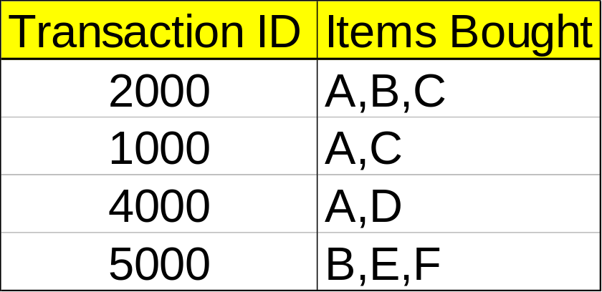
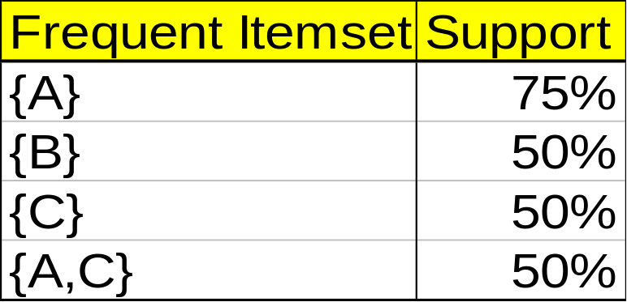
An Example
Min. support 50%
Min. confidence 50%
For rule A ⇒ C:
  support = support({A λC}) = 50%
  confidence = support({A λC})/support({A}) = 66.6%
The Apriori principle:
  Any subset of a frequent itemset must be frequent

Slide 21
Mining Frequent Itemsets: the Key Step
Find the frequent itemsets: the sets of items that have minimum support
  A subset of a frequent itemset must also be a frequent itemset
    i.e., if {AB} is a frequent itemset, both {A} and {B} should be frequent itemsets
  Iteratively find frequent itemsets with cardinality from 1 to k (k-itemset)
Use the frequent itemsets to generate association rules.

Slide 22
Apriori: A Candidate Generation-and-Test Approach
Apriori pruning principle: If there is any itemset which is infrequent, its superset should not be generated/tested! (Agrawal & Srikant @VLDB’94, Mannila, et al. @ KDD’ 94)
Method:
  Initially, scan DB once to get frequent 1-itemset
  Generate length (k+1) candidate itemsets from length k frequent itemsets
  Test the candidates against DB
  Terminate when no frequent or candidate set can be generated

Slide 23
Intro of Apriori Algorithm
Basic idea of Apriori
  Using anti-monotone property to reduce candidate itemsets
  Any subset of a frequent itemset must be also frequent
  In other words, any superset of an infrequent itemset must also be infrequent
Basic operations of Apriori
  Candidate generation
  Candidate counting
How to generate the candidate itemsets?
  Self-joining
  Pruning infrequent candidates

Slide 24








The Apriori Algorithm — Example
Database D
L₁
C₁
Scan D
C₂
C₂
L₂
Scan D
C₃
Scan D
L₃

Slide 25
Apriori-based Mining
Data base D
1-candidates
Freq 1-itemsets
2-candidates
TID
Items
Itemset
Sup
Itemset
Sup
Itemset
10
a, c, d
Scan D
a
2
a
2
ab
20
b, c, e
b
3
b
3
ac
30
a, b, c, e
c
3
c
3
ae
40
b, e
d
1
e
3
bc
Min_sup=0.5
e
3
be
3-candidates
Freq 2-itemsets
Counting
ce
Scan D
Itemset
Itemset
Sup
Itemset
Sup
bce
ac
2
ab
1
Scan D
bc
2
ac
2
Freq 3-itemsets
be
3
ae
1
Itemset
Sup
ce
2
bc
2
bce
2
be
3
ce
2

Slide 26
The Apriori Algorithm
C_{k}: Candidate itemset of size k
L_{k} : frequent itemset of size k
L₁ = {frequent items};
for (k = 1; L_{k} !=∅; k++) do
  Candidate Generation: C_{k+1} = candidates generated from L_{k};
  Candidate Counting: for each transaction t in database do increment the count of all candidates in C_{k+1} that are contained in t
  L_{k+1} = candidates in C_{k+1} with min_sup
return ∪_{k} L_{k};

Slide 27
Candidate-generation: Self-joining
Given L_{k}, how to generate C_{k+1}?
Step 1: self-joining L_{k}
  INSERT INTO C_{k+1}
  SELECT p.item₁, p.item₂, …, p.item_{k}, q.item_{k}
  FROM L_{k} p, L_{k} q
  WHERE p.item₁=q.item₁, …, p.item_{k-1}=q.item_{k-1}, p.item_{k} < q.item_{k}
Example
L₃={abc, abd, acd, ace, bcd}
Self-joining: L₃*L₃
  abcd ← abc * abd
  acde ← acd * ace
C₄={abcd, acde}

Slide 28
Candidate Generation: Pruning
Can we further reduce the candidates in C_{k+1}?
For each itemset c in C_{k+1} do
    For each k-subsets s of c do
    If (s is not in L_{k}) Then delete c from C_{k+1}
    End For
    End For
Example
L₃={abc, abd, acd, ace, bcd}, C₄={abcd, acde}
acde cannot be frequent since ade (and also cde) is not in L₃, so acde can be pruned from C₄.

Slide 29
How to Count Supports of Candidates?
Why counting supports of candidates a problem?
  The total number of candidates can be very huge
  One transaction may contain many candidates
Method
  Candidate itemsets are stored in a hash-tree
  Leaf node of hash-tree contains a list of itemsets and counts
  Interior node contains a hash table
  Subset function: finds all the candidates contained in a transaction

Slide 30
Challenges of Apriori Algorithm
Challenges
  Multiple scans of transaction database
  Huge number of candidates
  Tedious workload of support counting for candidates
Improving Apriori: the general ideas
  Reduce the number of transaction database scans
  Shrink the number of candidates
  Facilitate support counting of candidates
Improving Apriori: the general ideas
  Reduce the number of transaction database scans
    DIC: Start count k-itemset as early as possible
    S. Brin R. Motwani, J. Ullman, and S. Tsur, SIGMOD’97.
  Shrink the number of candidates
    DHP: A k-itemset whose corresponding hashing bucket count is below the threshold cannot be frequent
    J. Park, M. Chen, and P. Yu, SIGMOD’95
  Facilitate support counting of candidates

Slide 31
Performance Bottlenecks
The core of the Apriori algorithm:
  Use frequent (k – 1)-itemsets to generate candidate frequent k-itemsets
  Use database scan and pattern matching to collect counts for the candidate itemsets
The bottleneck of Apriori: candidate generation
  Huge candidate sets:
    10⁴ frequent 1-itemset will generate 10⁷ candidate 2-itemsets
    To discover a frequent pattern of size 100, e.g., {a₁, a₂, …, a₁₀₀}, one needs to generate 2¹⁰⁰ ≈ 10³⁰ candidates.
  Multiple scans of database:
    Needs (n +1 ) scans, n is the length of the longest pattern

