Slide 1
Implementing a Warehouse
Monitoring: Sending data from sources
Integrating: Loading, cleansing,...
Processing: Query processing, indexing, ...
Managing: Metadata, Design, ...
CSE601

Slide 2
Warehouse Maintenance
Warehouse data ≈ materialized view
  Initial loading
  View maintenance
Derived Warehouse Data
  indexes
  aggregates
  materialized views
View maintenance
CSE601

Slide 3
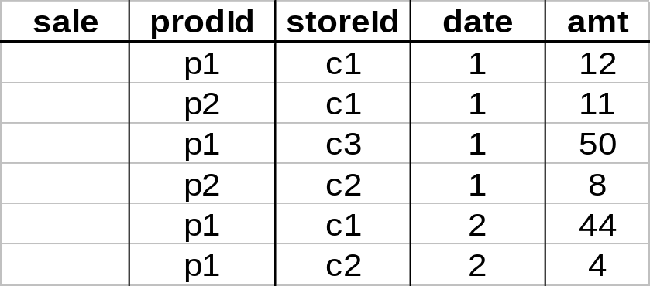
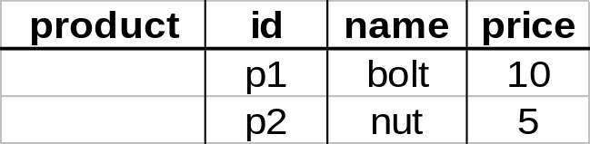
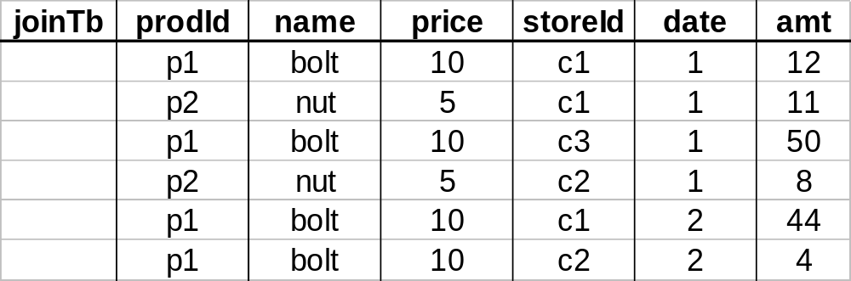
Materialized Views
Define new warehouse relations using SQL expressions
does not exist
at any source
CSE601

Slide 4
Differs from Conventional View Maintenance...
Warehouses may be highly aggregated and summarized
Warehouse views may be over history of base data
Process large batch updates
Schema may evolve
CSE601

Slide 5
Differs from Conventional View Maintenance...
Base data doesn’t participate in view maintenance
  Simply reports changes
  Loosely coupled
  Absence of locking, global transactions
  May not be queriable
CSE601

Slide 6
Processing
ROLAP servers vs. MOLAP servers
Index Structures
What to Materialize?
Algorithms
Client
Client
Query & Analysis
Metadata
Warehouse
Integration
Source
Source
Source
CSE601

Slide 7
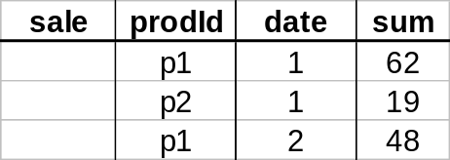
ROLAP Server
Relational OLAP Server
tools
ROLAP
server
Special indices, tuning;
Schema is “denormalized”
utilities
relational
DBMS
CSE601

Slide 8
MOLAP Server
Multi-Dimensional OLAP Server
City
Sales
B
A
milk
soda
eggs
soap
M.D. tools
Product
1 2 3 4
Date
utilities
multi-dimensional
server
could also
sit on
relational
DBMS
CSE601

Slide 9
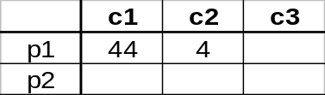
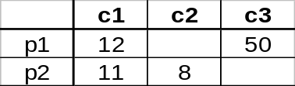

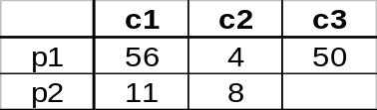
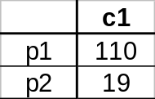
What to Materialize?
Store in warehouse results useful for common queries
Example:
total sales
day 2
. . .
day 1
129
materialize
CSE601

Slide 10
Cube Aggregates Lattice
129
all
city
product
date
city, product
city, date
product, date
use greedy
algorithm to
decide what
to materialize
city, product, date
day 2
day 1
CSE601

Slide 11
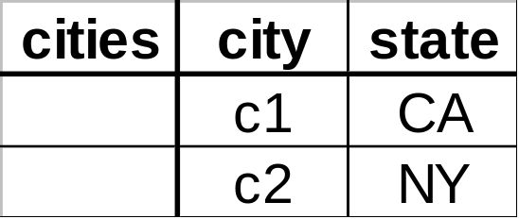
Dimension Hierarchies
all
state
city
CSE601

Slide 12
Dimension Hierarchies
all
city
product
date
city, product
city, date
product, date
state
city, product, date
state, date
state, product
state, product, date
not all arcs shown...
CSE601

Slide 13
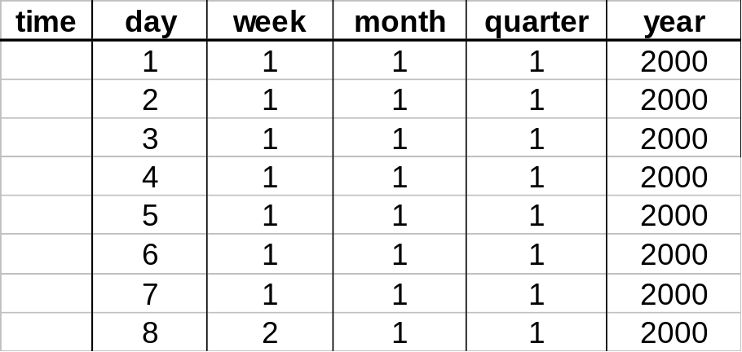
Interesting Hierarchy
all
years
weeks
quarters
months
conceptual
dimension table
days
CSE601

Slide 14
Implementation of OLAP Server
ROLAP: relational OLAP – data are stored in tables in relational databases or extended-relational databases. They use an RDBMS to manage the warehouse data and aggregations using often a star schema.
They support extensions to SQL.
A cell in the multi-dimensional structure is represented by a tuple.
Advantage: scalable (no empty cells for sparse cube).
Disadvantage: no direct access to cells.
CSE601

Slide 15
Implementation of OLAP Server
MOLAP: multidimensional OLAP – implements the multidimensional view by storing data in special multidimensional data structure (MDDS).
Advantage: fast indexing to pre-computed aggregations. Only values are stored.
Disadvantage: not very scalable and sparse.
CSE601

