Slide 1
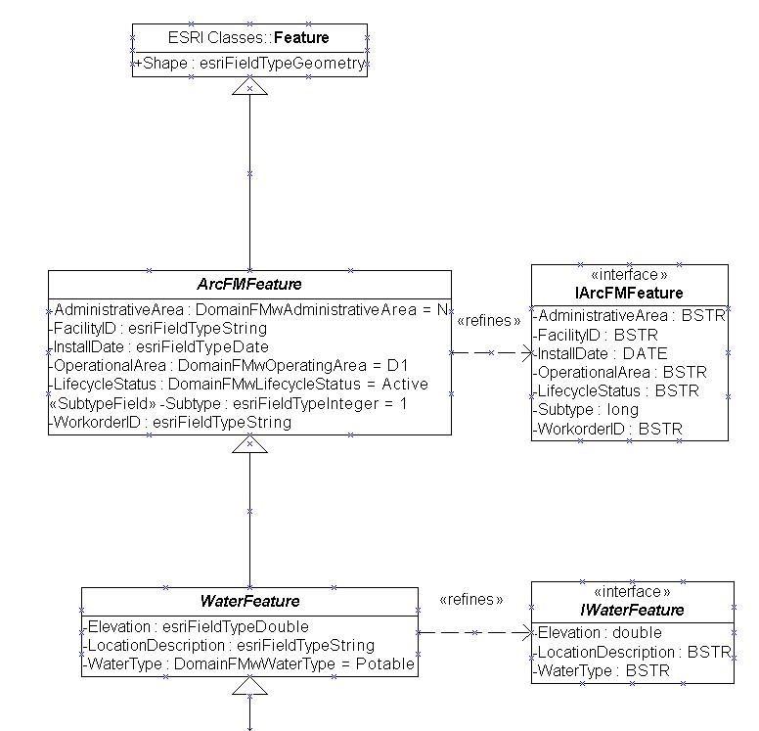
Modeling Process
Conceptual Model
Lists, flow diagrams, etc
Real World
Objects and relationships
Logical Model
Diagram in CASE Tool
Physical Model
Database
Schema
(Object state)
Graphic courtesy of ESRI

Slide 2
Data Model Levels
Reality
Human-oriented
Conceptual Model
Increasing
Abstraction
Logical Model
Computer-oriented
Physical Model

Slide 3
Unified Modeling Language
Entity-relationship diagrams
Design the methodologies, diagram notations
UML
Not a design methodology
Just a diagrammatic notation based on methods
Endorsed by leading software and database companies

Slide 4
UML ( cont. )
Diagrammatic notation = “visual language”...
For constructing a data model
Drawings, relationships constructed in Visio (other tools available)
Tools to input a drawing into ArcGIS
input drawing to the data model

Slide 5
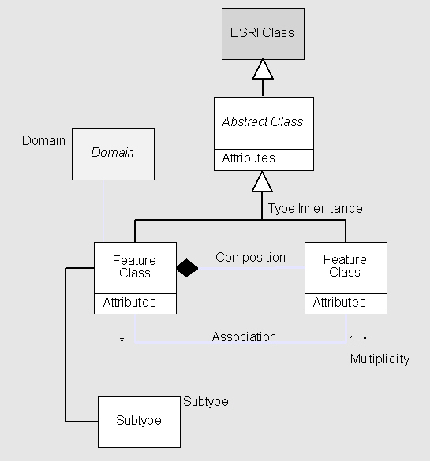
UML Notation
a class is shown as a box
top part contains the name of the class
lower part contains the attributes
methods associated with the class
lines connect boxes and indicate relationships

Slide 6
Relationships
Links between classes, shown as lines
One to one
One to many
Many to many

Slide 7
BioWeb Schema: A Logical Data Model for the Biomedical Data
Kalyani Beerevelly
Gautami Reddy Chitteti

Slide 8
Conceptual E-R Model
Disease
n
n n
Demographics
Clinical Test
n 1
1
n
n
1 n
Followup
Patient
Medical Image
n
1 n
n
n
Drug
Physiology
n
Clinical Sample

Slide 9
Characteristics of Clinical and genomic data
Complex data structure with many potential dimensions
Many- to- many and Uncertain relationships between fact and dimension objects
Require advanced temporal support for time validity
Incomplete and/or imprecise data very common

Slide 10
Solutions
Neither Snow flake nor star schema is good to represent many-to-many relationships.
BioStar model uses the concept of introducing bridge table in between fact table and dimension tables called the measure tables.
The pitfall of BioStar model is - to retrieve particular data many joins are required.

Slide 11
Bio Star Schema
Disease
DiseaseID
Name
Type
Description
Diagnosis
DiseaseID
PatientID
Symptom
ValidFrom
ValidTo
TestResult
TestID
PatientID
Result
DateTested
ClinicalTest
TestID
TestName
TestType
TestSetting
Patient
PatientID
SSN
Name
Gender
DOB
Drug
DrugID
DrugName
DrugType
Description
DrugUse
DrugID
PatientID
Dosage
ValidFrom
ValidTo
ClinicalSample
SampleID
PatientID
Source
Amount
DateTaken

Slide 12
Bio Web Model
Idea--have one measure table for one or more related Dimension tables.
For instance diagnosis measure table can have the measures of drug use and disease symptom since we can observe a valid relation between disease and the drugs used.
This information can be very useful during the mining of the data.

Slide 13
Bio Web Schema
Dim1
DimKey4
. . .
Dim4
MTable124
DimKey1
DimKey2
DimKey4
FactKey
Measures…
MTable234
DimKey2
DimKey3
DimKey4
FactKey
Measures…
Dim1
DimKey1
. . .
Fact
FactKey
. . .
Dim3
DimKey3
. . .
Dim1
DimKey2
. . .
Dim2

Slide 14
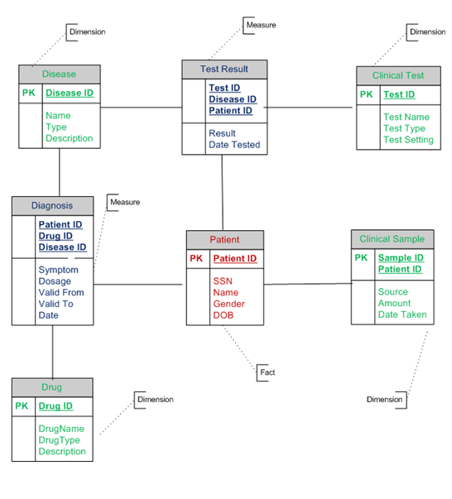
BioWeb Schema for Clinical data

Slide 15
Benefits of BioWeb Model
This model reduces the number of physical joins.
It is easy for consolidation of few results from the measure tables which couldn’t be made from bio star.
For instance, from the diagnosis table it is easy to consolidate which disease has been treated using which drug. In the BioStar model, this consolidation was not possible. What could be concluded was which patient was prescribed which drug and what disease did he suffer from separately.
Temporal attributes of the measure tables allow multiple entries. For instance, if the same patient is diagnosed on same day the measure tables allow in the BioWeb model.

Slide 16
Pitfalls of BioWeb Model
Adding a dimension to existing measure table or adding fields in any table would require re-computing data entries of the measure table. Hence measure table should not be connected to more number of dimension tables.
Connecting multiple dimension tables to one measure table might increase the size of the measure table but on the brighter side this gives some direct results which could be very useful.

Slide 17
HierBio
By
Chirag Gorasia (3454 8106)
Rahul Malviya (3654 8590)

Slide 18
Introduction
Hierarchical model
Easily models 1-1 and 1-n associations as parent-child relationships.
Easily extensible and scalable
Very efficient to retrieve and update records.
Fairly intuitive to construct.
Real world implementation of Hierarchical models: www.mismo.org and IBM IMS

Slide 19
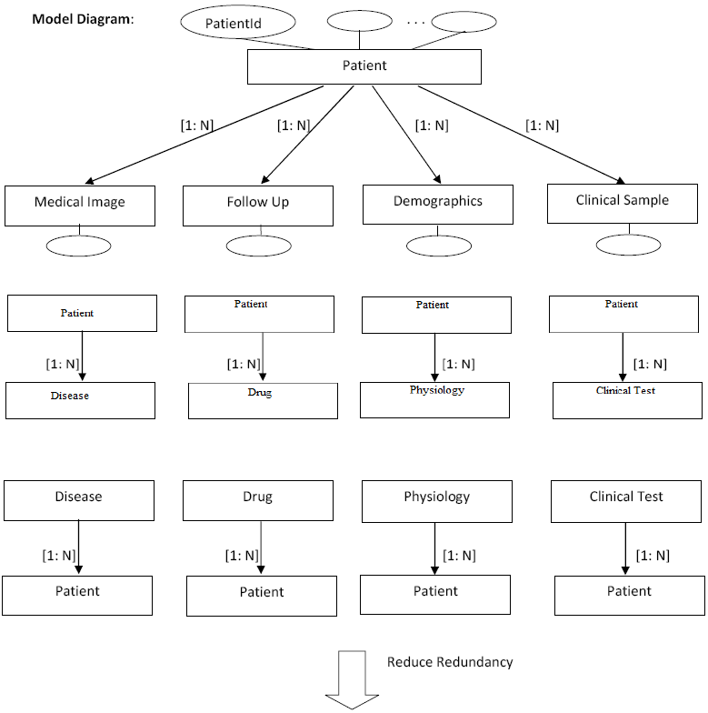
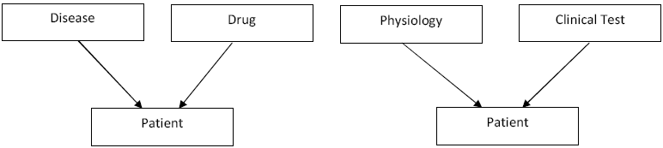

Slide 20
XML Representation for n-n association
<clinicalData>
<patient patientId=1000 SSN=000-00-0000 Name="ABC“ Gender=”M” DOB=09/16/2009 >
<patientDisease
diseaseId=10000
diseaseName="XXX"
/>
<patientDisease
diseaseId=10001
diseaseName="XXY"
/>
</patient>
<patient patientId=1001 SSN=000-00-0001 Name="ABCD“ Gender=”F” DOB=09/14/2009>
<patientDisease
diseaseId=10000
diseaseName="XXX"
/>
</patient>
< patientDisease diseaseId=10000 diseaseName="XXX“ patient=1001,1000 />
< patientDisease diseaseId=10001 diseaseName="XXY“ patient=1000 />
</clinicalData>

