Slide 1
Introduction
Object Oriented (OO) Data Models since mid-90’s
Reasons for creation of Object Oriented Databases
Need for more complex applications
Need for additional data modeling features
Increased use of object-oriented programming languages
Commercial OO Database products –
Several in the 1990’s, but did not make much impact on mainstream data management

Slide 2
20.1 Overview of Object-Oriented Concepts(1)
Main Claim:
OO databases try to maintain a direct correspondence between real-world and database objects so that objects do not lose their integrity and identity and can easily be identified and operated upon
Object:
Two components:
state (value) and behavior (operations)
Similar to program variable in programming language, except that it will typically have a complex data structure as well as specific operations defined by the programmer

Slide 3
Overview of Object-Oriented Concepts (2)
In OO databases, objects may have an object structure of arbitrary complexity in order to contain all of the necessary information that describes the object.
In contrast, in traditional database systems, information about a complex object is often scattered over many relations or records, leading to loss of direct correspondence between a real-world object and its database representation.

Slide 4
Overview of Object-Oriented Concepts (3)
The internal structure of an object in OOPLs includes the specification of instance variables, which hold the values that define the internal state of the object.
An instance variable is similar to the concept of an attribute, except that instance variables may be encapsulated within the object and thus are not necessarily visible to external users

Slide 5
Overview of Object-Oriented Concepts (4)
Some OO models insist that all operations a user can apply to an object must be predefined. This forces a complete encapsulation of objects.
To encourage encapsulation, an operation is defined in two parts:
signature or interface of the operation, specifies the operation name and arguments (or parameters).
method or body, specifies the implementation of the operation.

Slide 6
Overview of Object-Oriented Concepts (5)
Operations can be invoked by passing a message to an object, which includes the operation name and the parameters.
The object then executes the method for that operation.
This encapsulation permits modification of the internal structure of an object, as well as the implementation of its operations, without the need to disturb the external programs that invoke these operations

Slide 7
Objects
Object: triple (i, c, v)
i: a unique object identifier (oid).
c: a constructor (how the object value is constructed).
atom, set, tuple, list, array, bag
v: the object value.

Slide 8
Defining Objects
Abstract data type – Data type that consist of one or more data types
create type ADDRESS_TY as object
(Street VARCHAR2(50),
City VARCHAR2(25),
State CHAR(2),
Zip NUMBER);
create type PERSON_TY as object
(Name VARCHAR2(25),
Address ADDRESS_TY);
create table CUSTOMER
(Customer_ID NUMBER,
Person PERSON_TY);

Slide 9
Objects
Basic values, such as integer, may not be represented as objects, avoiding too many OID.
OID is different from key in the relational data model. A key is defined by the value of one or more attributes and can be modified.
Example of OID: 000028020948A19E8DE0697291E0340800208D6C1D48A19E8DE0687291E0340800208D6C1D04000AE10000

Slide 10
Object Identity, Object Structure, and Type Constructors (2)
Type Constructors:
In OO databases, the state (current value) of a complex object may be constructed from other objects (or other values) by using certain type constructors.
The three most basic constructors are atom, tuple, and set.
Other commonly used constructors include list, bag, and array.
The atom constructor is used to represent all basic atomic values, such as integers, real numbers, character strings, Booleans, and any other basic data types that the system supports directly.

Slide 11
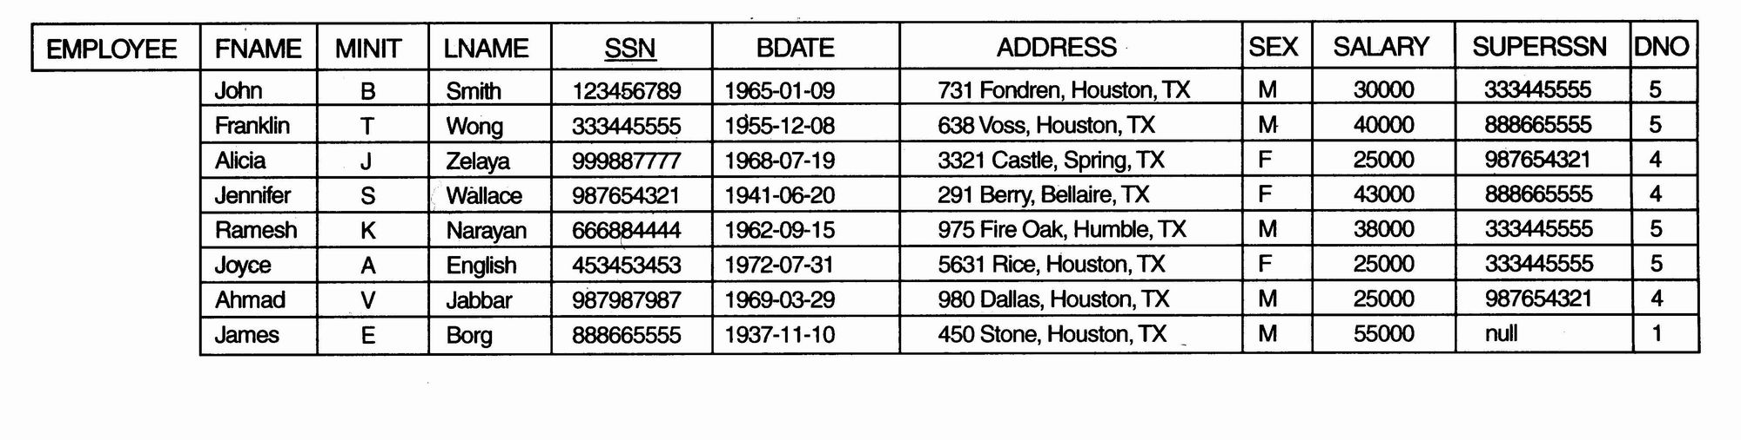
Object Identity, Object Structure, and Type Constructors (3)
Example 1
One possible relational database state corresponding to COMPANY schema

Slide 12
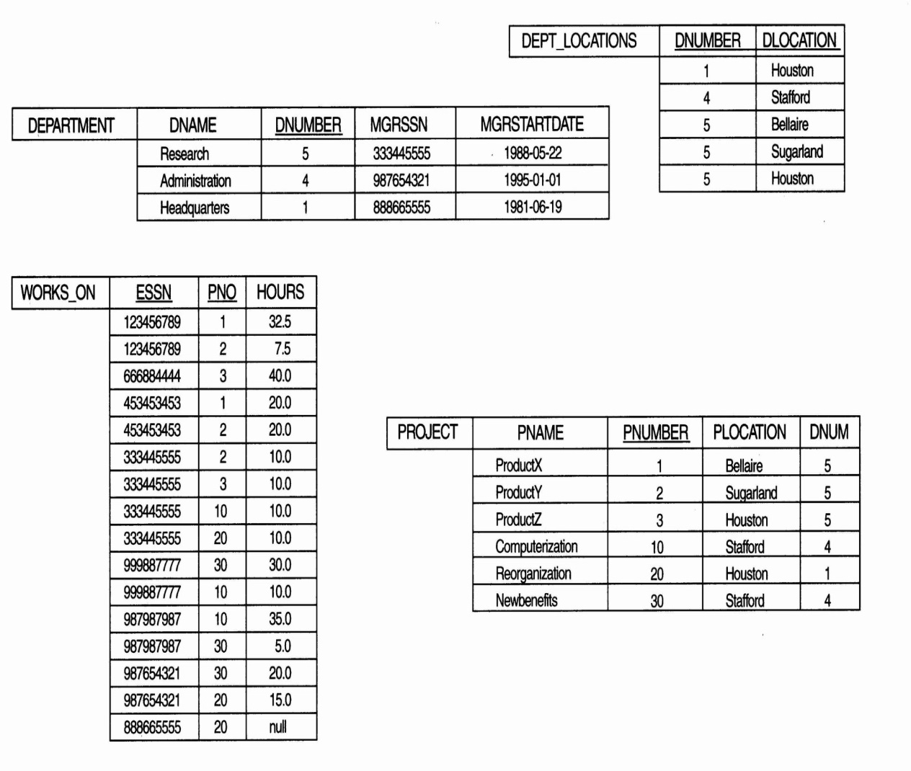
Object Identity, Object Structure, and Type Constructors (4)
Example 1 (contd.):

Slide 13
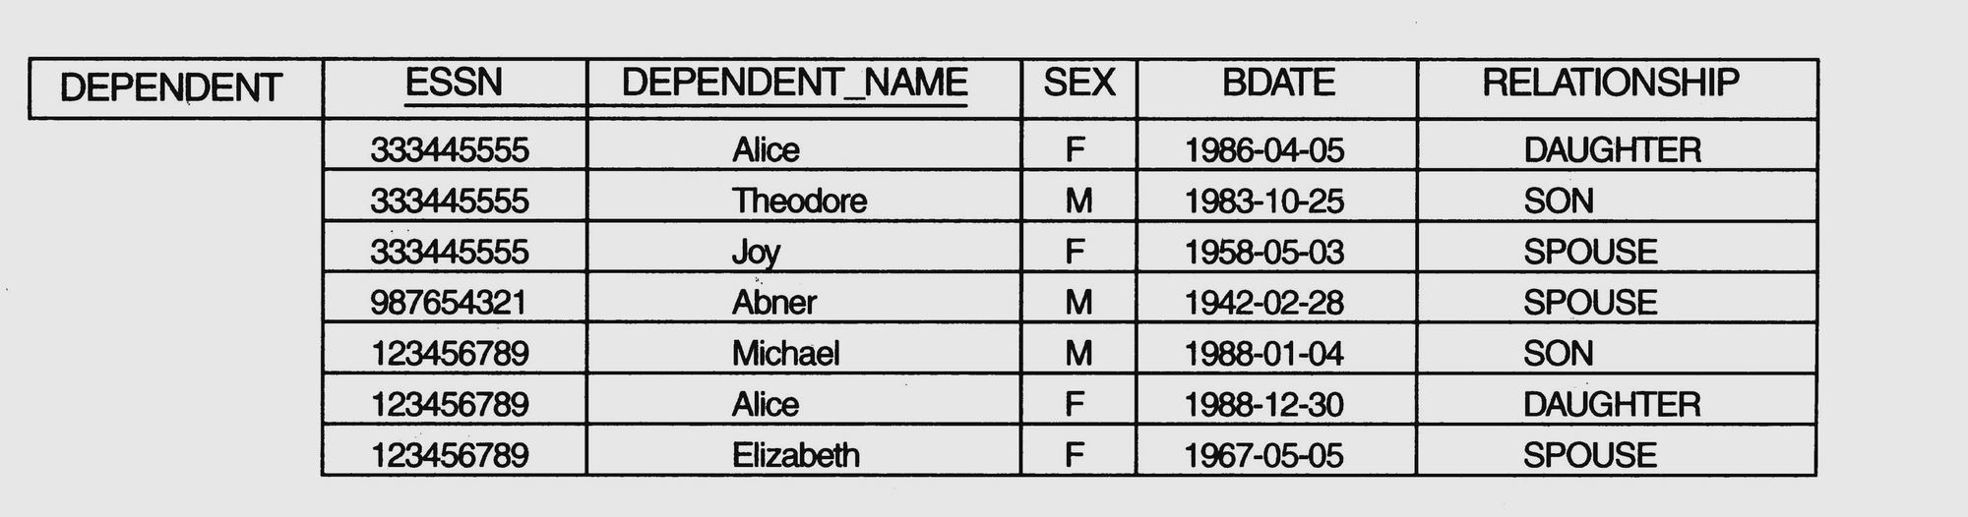
Object Identity, Object Structure, and Type Constructors (5)
Example 1 (contd.)

Slide 14
Object Identity, Object Structure, and Type Constructors (6)
Example 1 (contd.)
We use i₁, i₂, i₃, . . . to stand for unique system-generated object identifiers. Consider the following objects:
o₁ = (i₁, atom, ‘Houston’)
o₂ = (i₂, atom, ‘Bellaire’)
o₃ = (i₃, atom, ‘Sugarland’)
o₄ = (i₄, atom, 5)
o₅ = (i₅, atom, ‘Research’)
o₆ = (i₆, atom, ‘1988-05-22’)
o₇ = (i₇, set, {i1, i2, i3})

Slide 15
Object Identity, Object Structure, and Type Constructors (7)
Example 1(contd.)
o₈ = (i₈, tuple, <dname:i₅, dnumber:i₄, mgr:i₉, locations:i₇, employees:i₁₀, projects:i₁₁>)
o₉ = (i₉, tuple, <manager:i₁2, manager_start_date:i₆>)
o₁₀ = (i₁₀, set, {i₁₂, i₁₃, i₁₄})
o₁₁ = (i₁₁, set {i₁₅, i₁₆, i₁₇})
o₁₂ = (i₁₂, tuple, <fname:i₁₈, minit:i₁₉, lname:i₂₀, ssn:i₂₁, . . ., salary:i₂₆, supervi­sor:i₂₇, dept:i₈>)
. . .

Slide 16
Object Identity, Object Structure, and Type Constructors (8)
Example 1 (contd.)
The first six objects listed in this example represent atomic values.
Object seven is a set-valued object that represents the set of locations for department 5; the set refers to the atomic objects with values {‘Houston’, ‘Bellaire’, ‘Sugarland’}.
Object 8 is a tuple-valued object that represents department 5 itself, and has the attributes DNAME, DNUMBER, MGR, LOCATIONS, and so on.

Slide 17
Object Identity, Object Structure, and Type Constructors (9)
Example 2:
This example illustrates the difference between the two definitions for comparing object states for equality.
o₁ = (i₁, tuple, <a₁:i₄, a₂:i₆>)
o₂ = (i₂, tuple, <a₁:i₅, a₂:i₆>)
o₃ = (i₃, tuple, <a₁:i₄, a₂:i₆>)
o₄ = (i₄, atom, 10)
o₅ = (i₅, atom, 10)
o₆ = (i₆, atom, 20)

Slide 18
Object Identity, Object Structure, and Type Constructors (10)
Example 2 (contd.):
In this example, The objects o1 and o2 have equal states, since their states at the atomic level are the same but the values are reached through distinct objects o4 and o5.
However, the states of objects o1 and o3 are identical, even though the objects themselves are not because they have distinct OIDs.
Similarly, although the states of o4 and o5 are identical, the actual objects o4 and o5 are equal but not identical, because they have distinct OIDs.

Slide 19
Methods – must be named within the type declaratiom
create type PERSON_TY as object
(
Name NAME_TY,
Address ADDRESS_TY,
member function AGE(BirthDate IN DATE) return NUMBER,
PRAGMA RESTRICT_REFERENCES(AGE,WNDS)
);
/
create or replace type body PERSON_TY as
member function AGE(BirthDate DATE) return NUMBER is
Begin
RETURN(ROUND((SysDate - BirthDate) / 365));
end;
end;
/

Slide 20
Collectors – Varying array, nested table
Representing multivalued attributes using varying length arrays – a set of objects, each with the same datatype
SQL> create type TOOL_TY as object
2 (ToolName VARCHAR2(25));
3 /
SQL> create or replace type TOOLS_VA as varray(5) of VARCHAR2(25);
2 /

Slide 21
SQL> create or replace type TOOLS_VA as varray(5) of TOOL_TY;
2 /
SQL> create table BORROWER
2 (Name VARCHAR2(25) primary key,
3 Tools TOOLS_VA);
SQL> insert into BORROWER values
2 ('JED HOPKINS',
3 TOOLS_VA('HAMMER', 'SLEDGE', 'AX'));

Slide 22
Nested Table: a table within a table
A nested table is a collection of rows, represented as a column within the main table.
SQL> create or replace type ANIMAL2_TY as object
2 (Breed VARCHAR2(25),
3 Name VARCHAR2(25),
4 BirthDate Date);
5 /
SQL> create type ANIMALS_NT as table of ANIMAL2_TY;
2 /

Slide 23
SQL> create table BREEDER1
2 (BreederName VARCHAR2(25),
3 Animals ANIMALS_NT)
4 nested table ANIMALS store as ANIMALS_NT_TAB;
SQL> insert into BREEDER1 values
2 ('JANE JAMES',
3 ANIMALS_NT(
4 ANIMAL2_TY('DOG', 'BUTCH', '31-MAR-97'),
5 ANIMAL2_TY('DOG', 'ROVER', '05-JUN-97'),
6 ANIMAL2_TY('DOG', 'JULLO', '10-JUN-97')
7 ));

Slide 24
Dealing with nested table
Insert into table
(select Animals from Breeder1
where BreederName = ‘James’)
Values
(Animal2_ty (‘Dog’,’Markus’,’01-Aug-01’));
Delete table (select Animals from Breeder1
where BreederName = ‘James’) N
Where N.Name = ‘Julio’;

Slide 25
Update
update table (select Animals from Breeder1
where BreederName = ‘James’) N
Set N.Birthdate = ’01-Sep-01’
Where N.Name = ‘Julio’;

Slide 26
Object Table: each row is a row object
SQL> create or replace type ANIMAL_TY as object
2 (Breed VARCHAR2(25),
3 Name VARCHAR2(25),
4 BirthDate Date);
5 /
SQL> create table ANIMAL of ANIMAL_TY;
SQL> insert into ANIMAL values (ANIMAL_TY('DOG', 'BENJI', '03-SEP-96'));
SQL>update Animal
set BirthDate = ’01-May-01’
where Name = ‘Lyle’;

Slide 27
Difference from tuple table
Each row within the object table has an oid – system assigned
The rows of an object table can be referenced by other objects within the DB.

Slide 28
View OID
SQL> select REF(A)
2 from ANIMAL A
3 where Name = 'FRANCES';
REF(A)
--------------------------------------------------------------------------------
000028020948A19E8DE0697291E0340800208D6C1D48A19E8DE0687291E0340800208D6C1D04000AE10000
REF can be used to reference row objects. You cannot reference column objects. Column objects include abstract data types and collectors.

Slide 29
Reference single row objects
SQL> create table KEEPER
2 (KeeperName VARCHAR2(25),
3 AnimalKept REF ANIMAL_TY);
SQL> insert into KEEPER
2 select 'CATHERINE WEILZ', REF(A)
3 from ANIMAL A
4 where Name = 'BENJI';
SQL> select * from KEEPER;
KEEPERNAME ANIMALKEPT
--------------------------------------------------------------------------------
CATHERINE WEILZ
000022020848A19E8DE06A7291E0340800208D6C1D48A19E8DE0687291E0340800208D6C1D

Slide 30
SQL> select DEREF(K.AnimalKept)
2 from KEEPER K
3 where KeeperName = 'CATHERINE WEILZ';
DEREF(K.ANIMALKEPT)(BREED, NAME, BIRTHDATE)
--------------------------------------------------------------------------------
ANIMAL_TY('DOG', 'BENJI', '03-SEP-96')

Slide 31
SQL> select VALUE(A)
2 from ANIMAL A;
VALUE(A)(BREED, NAME, BIRTHDATE)
--------------------------------------------------------------------
ANIMAL_TY('MULE', 'FRANCES', '01-APR-97')
ANIMAL_TY('DOG', 'BENJI', '03-SEP-96')

Slide 32
SQL> select * from ANIMAL;
BREED NAME BIRTHDATE
------------------------- ------------------------- ---------
MULE FRANCES 01-APR-97
DOG BENJI 03-SEP-96

Slide 33
Reference a group of row objects
SQL> create type animals_NT as table of animal_ty;
2 /
SQL> create table breeder
2 (breedername VARCHAR2(25),
3 Animals animals_NT)
4 nested table animals store as animals_NT_TAB;
SQL> insert into breeder values
2 ('James', animals_NT(animal_ty('dog', 'butch', '31-MAR-01'),
3 animal_ty('dog', 'ROVER', '05-JUN-01'),
4 animal_ty('dog', 'JULIO', '10-JUN-01')));

Slide 34
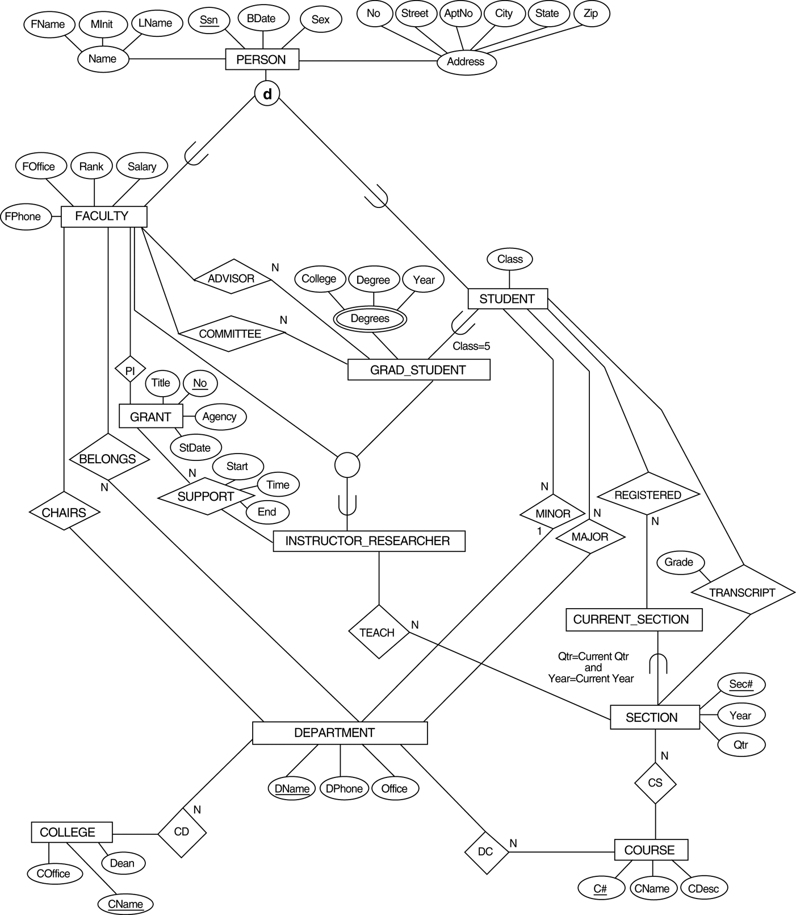

Slide 35
Project schema
create type DEPARTMENT_TY as object (
DName CHAR(5),
DPhone CHAR(18),
Office VARCHAR2(10)
);
/
create table DEPARTMENT_TB of DEPARTMENT_TY(PRIMARY KEY(DName));
create type DEPARTMENTS_NT as table of REF DEPARTMENT_TY;
/

Slide 36
create type COURSE_TY as object (
CNumber CHAR(5),
CName CHAR(10),
CDesc VARCHAR2(30),
Dept REF DEPARTMENT_TY
);
/
create table COURSE_TB of COURSE_TY(PRIMARY KEY(CNumber));

Slide 37
create type SECTION_TY as object
(
SecNumber NUMBER,
Year NUMBER,
Qtr NUMBER,
Course REF COURSE_TY
);
/
create table SECTION_TB of SECTION_TY(PRIMARY KEY(SecNumber));

Slide 38
create type ADDRESS_TY as object
(
No NUMBER,
Street CHAR(20),
AprtNo CHAR(3),
City VARCHAR2(30),
State VARCHAR2(20),
Zip CHAR(10)
);
/
create type NAME_TY as object
(
FName VARCHAR2(15),
MInit CHAR(1),
LName VARCHAR2(20)
);
/

Slide 39
create type PERSON_TY as object
(
Name NAME_TY,
Address ADDRESS_TY,
SSN NUMBER,
BirthDate DATE,
Sex CHAR(1),
member function AGE(BirthDate IN DATE) return NUMBER,
PRAGMA RESTRICT_REFERENCES(AGE,WNDS)
);
/
create or replace type body PERSON_TY as
member function AGE(BirthDate DATE) return NUMBER is
Begin
RETURN(ROUND((SysDate - BirthDate) / 365));
end;
end;
/

Slide 40
create type SECTIONS_NT as table of REF SECTION_TY;
/
create type FACULTY_TY as object
(
Person PERSON_TY,
FPhone CHAR(18),
FOffice VARCHAR2(10),
Rank NUMBER,
Salary NUMBER,
Dept DEPARTMENTS_NT,
TeachSections SECTIONS_NT
);
/
create table FACULTY_TB of FACULTY_TY(PRIMARY KEY(Person.SSN))
nested table Dept store as DEPARTMENTS_NT_TAB1
nested table TeachSections store as SECTIONS_NT_TAB3;

Slide 41
create type TRANSCRIPT_TY as object
(
SectionRef REF SECTION_TY,
Grade CHAR(2)
);
/
create type TRANSCRIPT_NT as table of TRANSCRIPT_TY;
/

Slide 42
create type STUDENT_TY as object
(
Person PERSON_TY,
Class NUMBER,
MajorDept REF DEPARTMENT_TY,
RegisteredSections SECTIONS_NT,
TranscriptSections TRANSCRIPT_NT
);
/
create table STUDENT_TB of STUDENT_TY(PRIMARY KEY(Person.SSN))
nested table RegisteredSections store as SECTIONS_NT_TAB1
nested table TranscriptSections store as SECTIONS_NT_TAB2;

