Slide 1
The Demo of the HIV/Drug Use Data Warehouse
The customer query website of HIV/Drug Use is based on the its data warehouse which mentioned last week . The requirement of this website as follows:
High query efficiency
Allow Complicated query

Slide 2
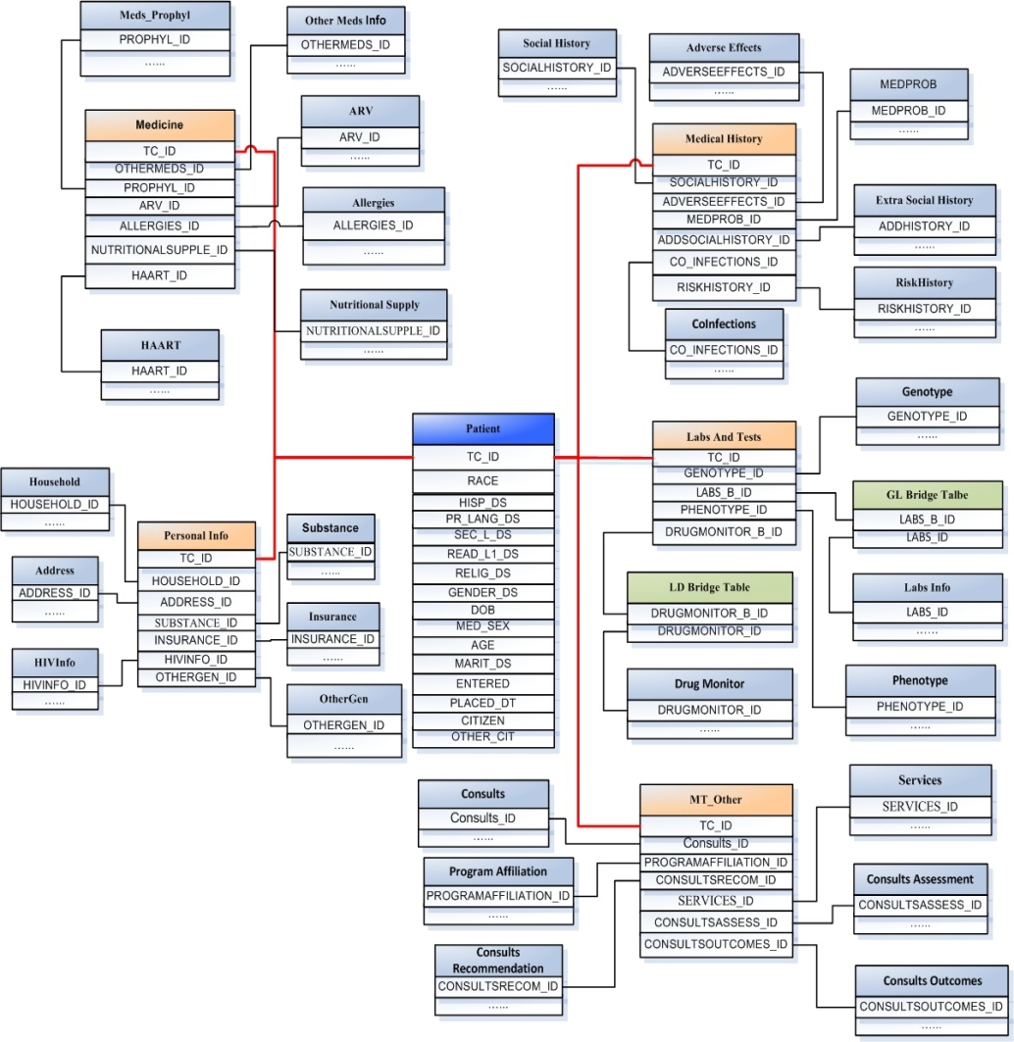
The Demo of the HIV/Drug Use Data Warehouse
I have made five separate query zone ,since we have five measure tables which one is the core of a category.

Slide 3
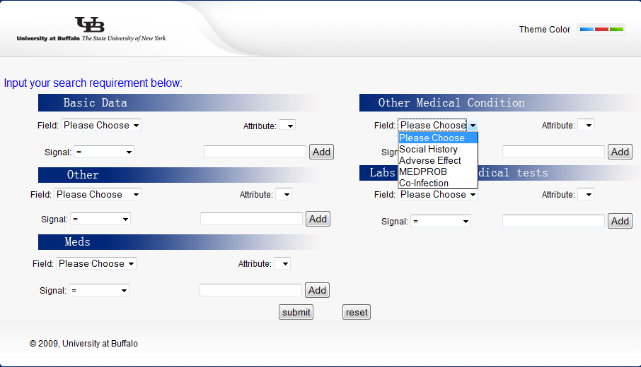
The Demo of the HIV/Drug Use Data Warehouse
To select the dimension tables in from a certain category

Slide 4
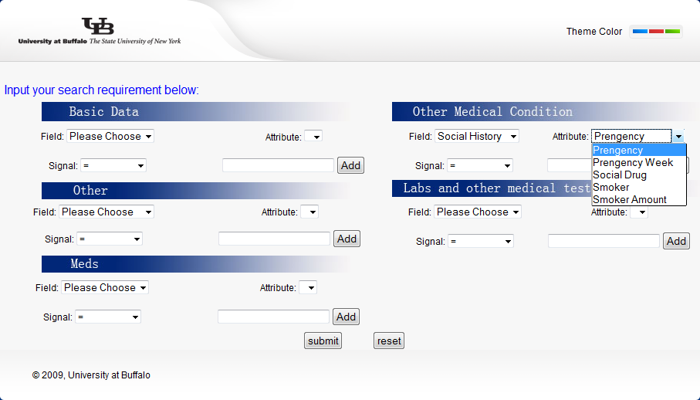
The Demo of the HIV/Drug Use Data Warehouse
To select an attribute from a certain dimension table

Slide 5
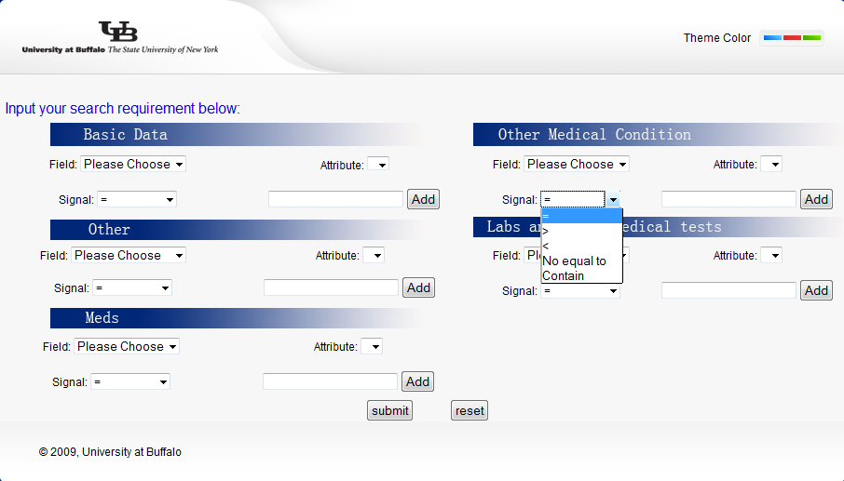
The Demo of the HIV/Drug Use Data Warehouse
To select the operator

Slide 6
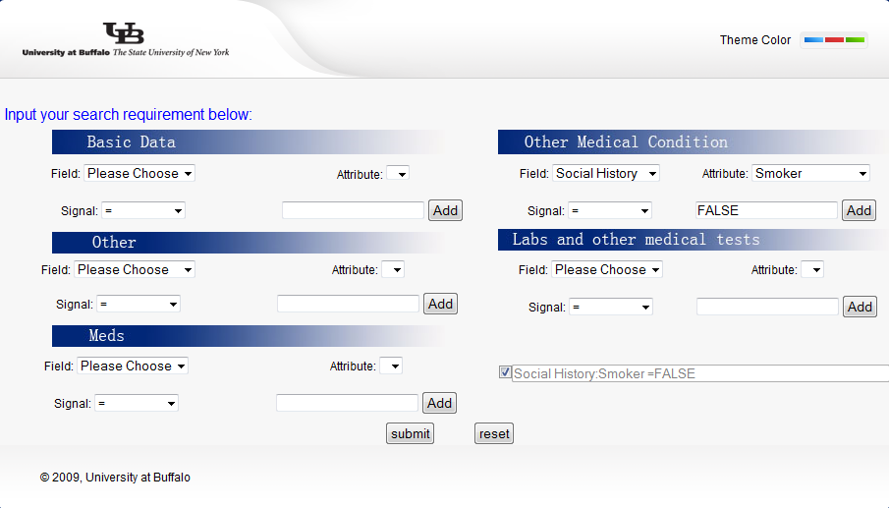
The Demo of the HIV/Drug Use Data Warehouse
To add query requirement

Slide 7
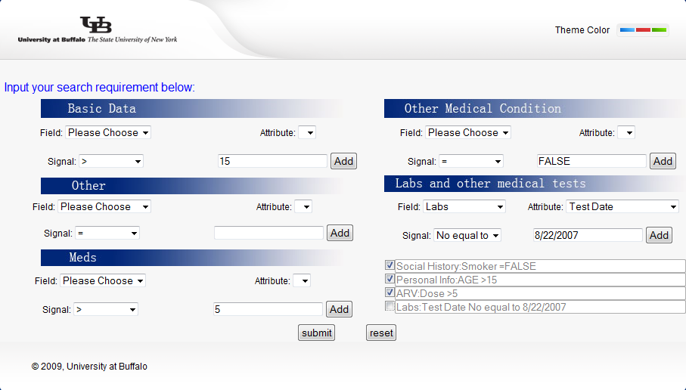
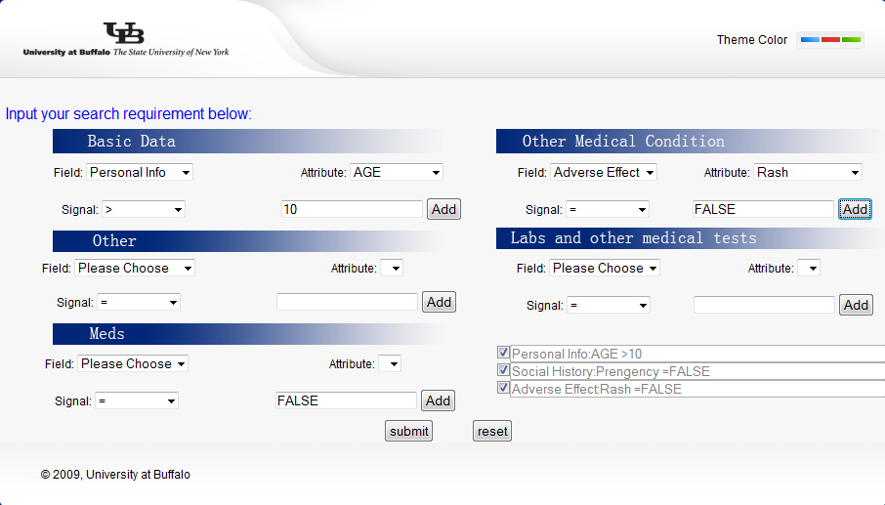
The Demo of the HIV/Drug Use Data Warehouse
To manage the query requirement List

Slide 8
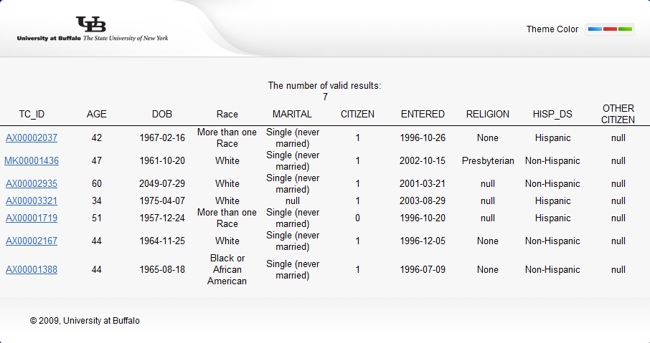
The Demo of the HIV/Drug Use Data Warehouse
To query result

Slide 9
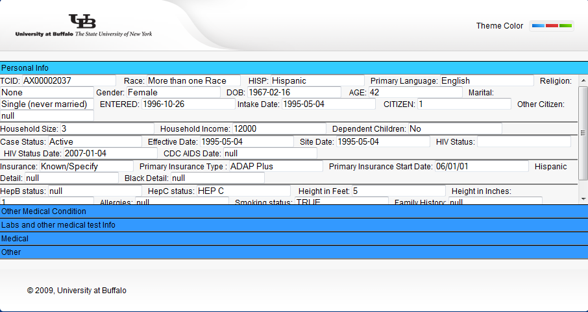
The Demo of the HIV/Drug Use Data Warehouse
To detailed for each query result,which include all the info of this patient from all five categories

Slide 10
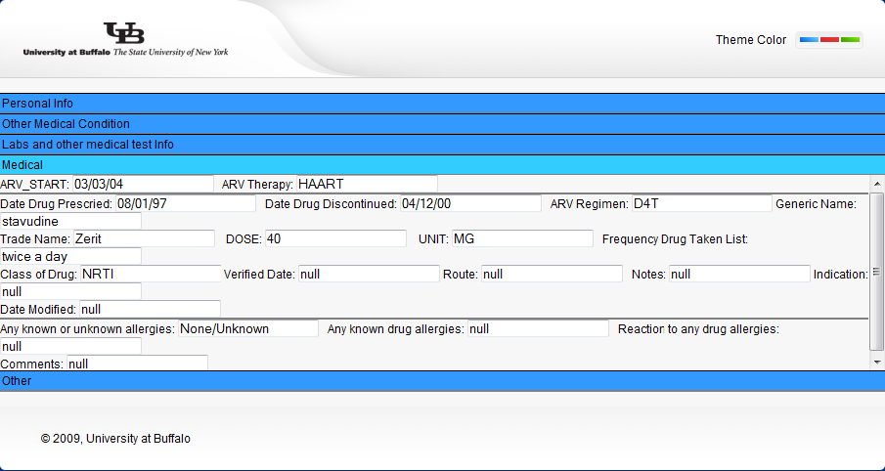
The Demo of the HIV/Drug Use Data Warehouse

