Slide 1
The Data Warehouse Schema of HIV/AIDS and Drug Use Project
Characteristic of Source Data
Our data is about the patients and their drug use situation information which includes 22 tables , which respectively belongs to five categories :Personal Info, Medical History, Other Info, Labs and Tests, Medicines.

Slide 2
The Info about the five categories
Personal: Including 2 tables of patients’ personal information: Personal and Other Genotype
Medical History: Including 4 tables of patients’ medical history : Illness and Social history, Coinfection, Medical Problem, and Extra Social history.
Labs and Tests: Including 4 tables of patients’ labs and tests info: Genotype, Labs info, Phenotype and Drug monitor.

Slide 3
The Info about the five categories
Medicines : Including 6 tables of patients’ medical info: Prophyl , Allergies, HAART, ARV, Nutritional Supply and Other Medicines Info.
Consult and Service: Including 6 tables of patients’ Medical service and result:Services, Consults ,Consults Outcomes, Consults Assessment, Consults Recommendation and Program Affiliation.

Slide 4
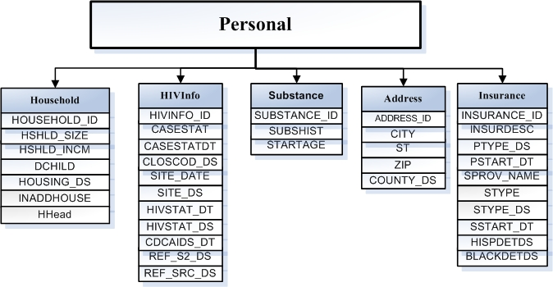
The construction of the data warehouse
Step 1: Split the tables which are in 1NF

Slide 5
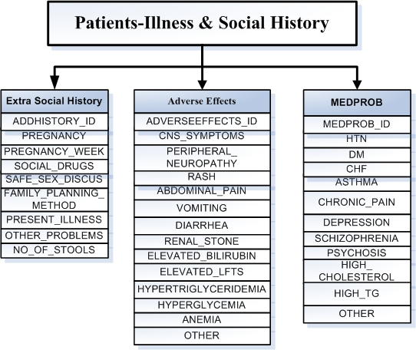

Slide 6
The construction of the data warehouse
Step 2: According to the situation, build up the measure tables
Since the tables originally come from five categories , then I have used five Measure tables :Personal Info, Medical History, Other Info, Labs and Tests, Medicines which can stand for these five categories and connect to the dimension table belong to it.

Slide 7
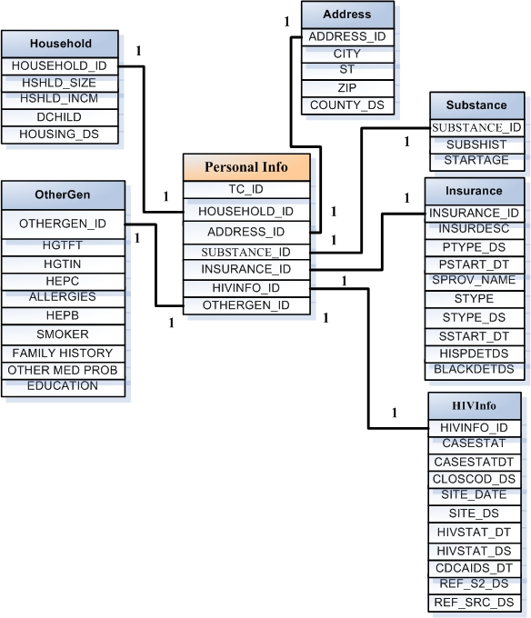
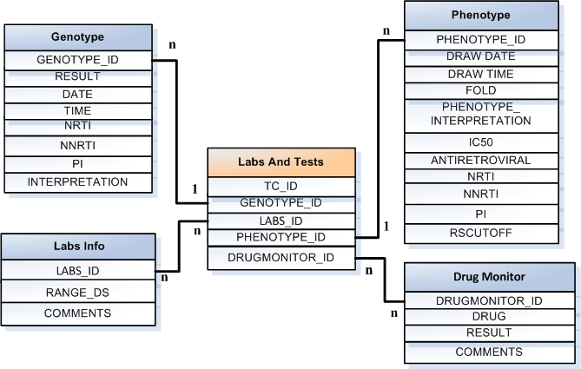
The ER Diagrams of the five categories
1

Slide 8
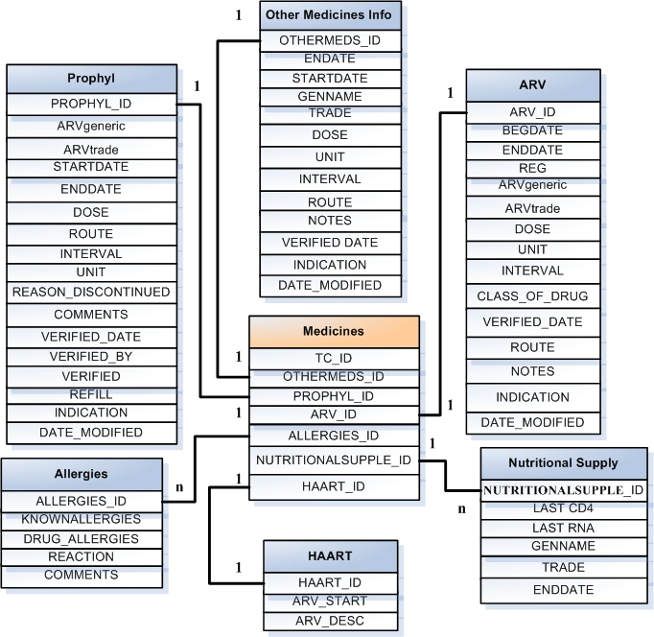
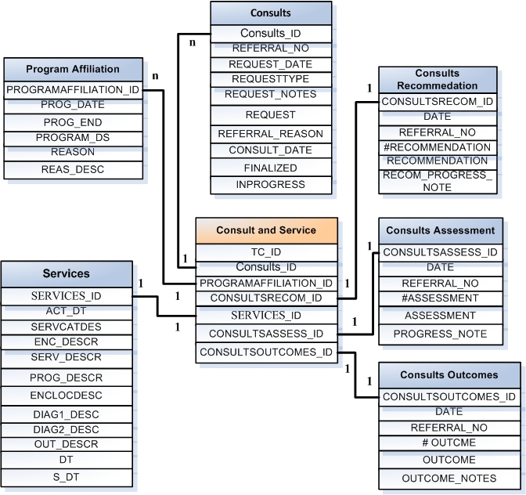
The ER Diagrams of the five categories

Slide 9
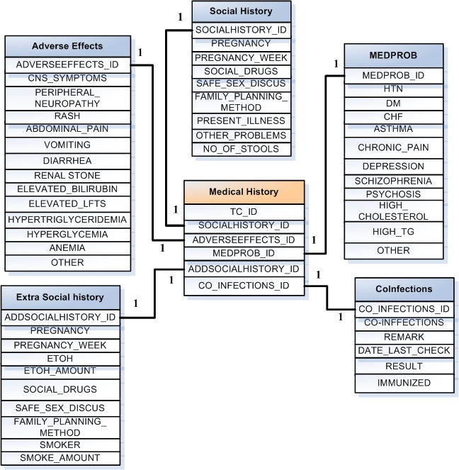
The ER Diagrams of the five categories

Slide 10

The construction of the data warehouse
Step 3: Solving the “many to many ” relation in each diagram
In order to solve the “many to many” relation between fact table and dimension table, We use the bridge table. Bridge Table is a kind of table exists between the fact table and dimension table whose relation is “many to many”.

Slide 11
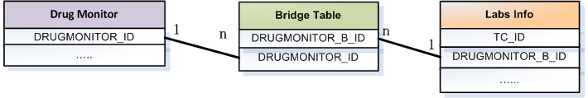
What I need is a bridge table

Slide 12
The construction of the data warehouse
Step 4: Integration the measure tables
Now that we’ve completed the design of five measure tables, it is time to integrate them together with a fact table.

Slide 13
The construction of the data warehouse
Between the dimension tables and the fact table , I use the Bio-Star Schema .What’s more, as we mentioned before, all the tables own a TC_ID, then I use the Patient as the fact table, and the schema is shown as following:

Slide 14
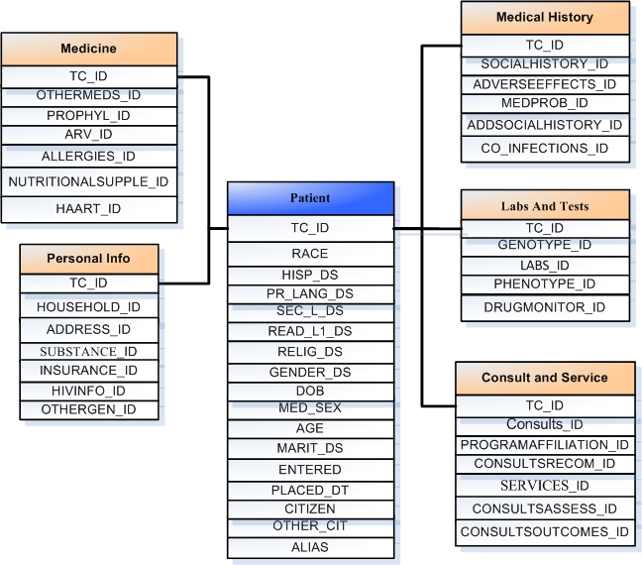

Slide 15
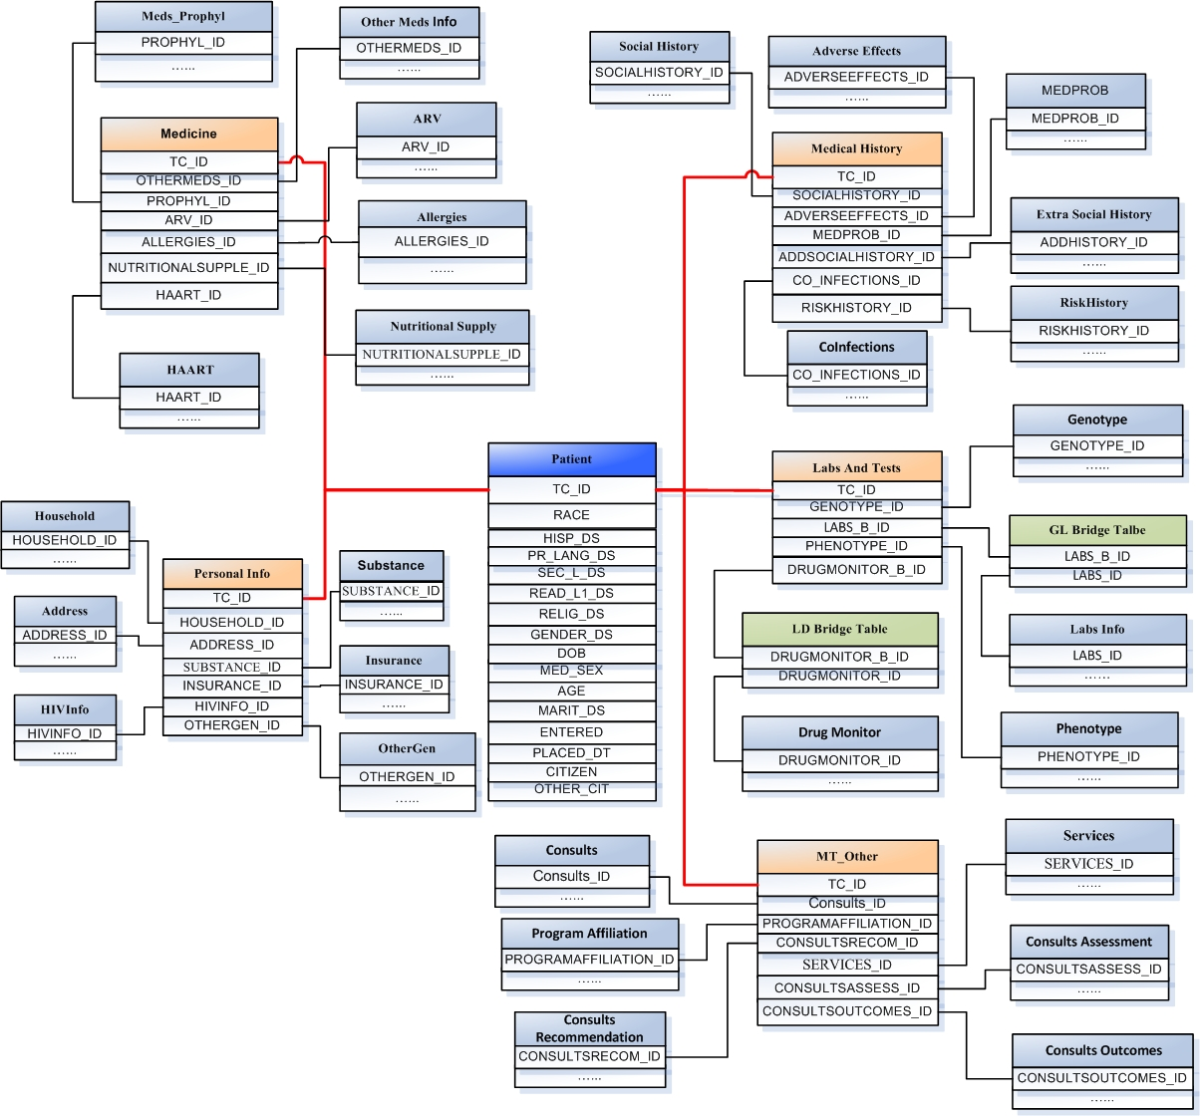

Slide 16
Characteristic of the schema
Splitting the normal form-1NF tables into several smaller sub-tables which belong to 3NF bases on their content. This may help to decrease the redundancy of the data .
Try to maintain the structure of the original tables , which may let the clients understand better.
Using a Bio-Star Schema to connect the dimension tables ,which may let the schema more flexible, better understanding and easier management.
Splitting the normal form 1NF tabless into several smaller sub-tables which belong to 3NF bases on their content. This may help to decrease the redundancy of the data .
Try to maintain the structure of the original tables , which help the clients understand better.
Easily handle the many-to-many relationships.
Using a Bio-Star Schema to connect the dimension tables ,which help the schema more flexible, better understanding and easier management.

Slide 17
Thank You

