Slide 1
Agenda
Abstract
Objective
Literature Survey
Proposed System
Architectural Diagram
Data Flow Diagram
Algorithms
Module Details
Model summary
Image Classification output
Conclusion and Future work
Reference

Slide 2
Abstract
Pneumonia in lung based disease which inflames air sacs in lungs.
The air sacs may filled with fluid or cough which cause fever ,difficulty in breathing.
It is an life threatening disease to children and people older than age of 65.
it is classified into two categories baced on infecting agent.
i. Bacterial Pneumonia - caused by bacteria (Strecptococus).
ii. Viral Pneumonia - caused by virus (SARS-COV 2).

Slide 3
Objective
To detect the presence types Pneumonia disease with the help of X-Ray image datasets using deep learning.
The architecture to Convolutional Neural Networks algorithm, AlexNet is used to find better accuracy.

Slide 4
Literature Survey
Title | Author and Year | method | Advantages
1.COVID-19 Pneumonia and Influenza Detection Using Convolutional Neural Networks | Julianna Antonchuk ,. Benjamin Prescott ,. 2021 | To analyse visual imagery of CXR images using Convolutional Neural Networks | It explores an End-to-End Solution Leveraging The Assure ML
2. Pneumonia Detection Using Convolutional Neural Networks | Y. Luka racic, Tomo popovic ., 2021 | Images of Chest X-Ray, dataset, Preprocessing of Images Using convolutional Neural Networks | It Represent The Result Of Model That Build a Confusion Matrix
Disadvantages
Incorrectly Clasified of Images of dataset by CNN
Training accuracy and Validation accuracy is loss in Models
.

Slide 5
Title | Author and Year | method | Advantages
3.Optimized CNN based Diagnosis System to Detect the Pneumonia from Chest Radiographs | Mohhammed Aledhari ., 2016 | pre-trained model fed into the fine turning portion of the CNN using Receiver Operating Characteristic (ROC) | Attempted to Augment That Data with random Horizondal Flipping
4. Preliminary study of Pneumonia symptoms detection method using cellular Neural Networks | A. Abdullah, et al., 2011 | Medical diagnosis to Cellular Neural Networks to CT images obtained diagnosis imaging | Speed up the converage of the algorithm improve prediction accuracy of target area.
Disadvantages
CAD Accuracy and Contract is Average of Expected
Different Grayscale color
.

Slide 6
Proposed System
The dataset can be increased and more advanced features can be
added for more accuracy.
CNN model is proposed for Image Classification from an input image of Normal, Bacterial Pneumonia, Viral Pneumonia, and covid-19.
X-ray Image Dataset Input
Pre-processing
Training & Testing Dataset
CNN algorithm based Classification
Image Classification
Classify types of tumours
Accuracy validation

Slide 7
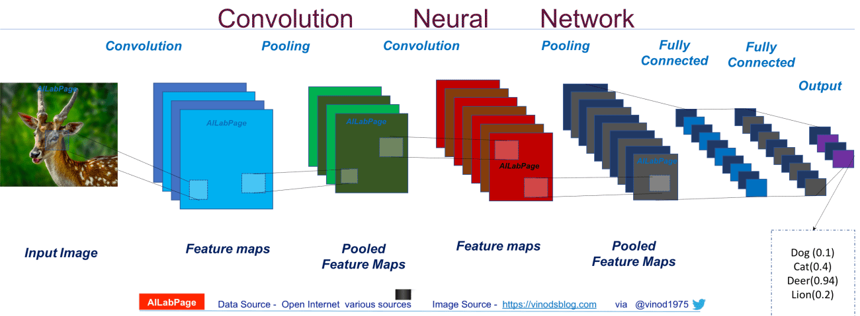
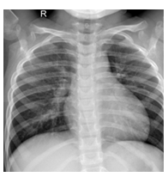
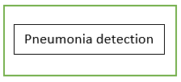
Architecture of CNN

Slide 8
Data Flow Diagram
Normal
X-Ray dataset from Kaggle
Diagnosis
using CNN
Viral
Bacterial

Slide 9
Preprocessing
Image Dataset
1
Data Preprocessing
2
Predict output
4
image
resized
CNN Layers
3
image
upload
image
classification

Slide 10
CNN Layers
pooling
layers
2.1
Fully connected
2.2
Softmax
layers
2.3
Dense layer
2.4
input size
connect
neuran
activation
Function

Slide 11
Hardware Specification
Processor : Intel(R) Celeron(R) CPU 1.40GHz
RAM : 4GB (minimum)
ROM : 4GB and More
Keyboard : Standard keyboard
Monitor : 14.0 inch color monitor

Slide 12
Software Specification
Operating System : Windows10 pro •
Software : Google colaboratory •
Language : PYTHON •
Framework : Tensor Flow •
Library : Keras API

Slide 13
Algorithm
A Convolutional Neural Network is a Deep Neural Network, that takes inputs as images, assigns weights and biases to various aspects of the image and then differentiates among different class of images.
Convo2D - Converting input image into 2D
Maxpooling - Pooling operation that selects the maximum element from the region of the feature map covered by the filter
Flatten - Converting the data into a 1-dimensional array for inputting it to the next layer.
Dense - To classify image based on output from convolutional layers.

Slide 14
AlexNet
AlexNet was the first Convolutional Network which used GPU to Boost Performance.
AlexNet is a Convolutional Neural Network that is eight Layers.
You can load a pretrained version of the network trained on mor than a millon imagesfrom the ImageNet database.
AlexNet was bornout of the need to improve the results of the dataset.

Slide 15
Modules Details
Datasets collection.
Data Preprocessing.
Image classification based on AlexNet.
Pneumonia Classification using on CNN.
Performance Evaluation.

Slide 16
Dataset Collection
Dataset are collected from Kaggle.
Pneumonia classification :
Normal, Bacterial, Viral and Covid
Datasets :
Total Images-10014 | Train set | Test Set
Normal | 3270 | 270
Bacterial Pneumonia | 3001 | 200
Viral Pneumonia | 1656 | 256
Covid Pneumonia | 1291 | 100

Slide 17
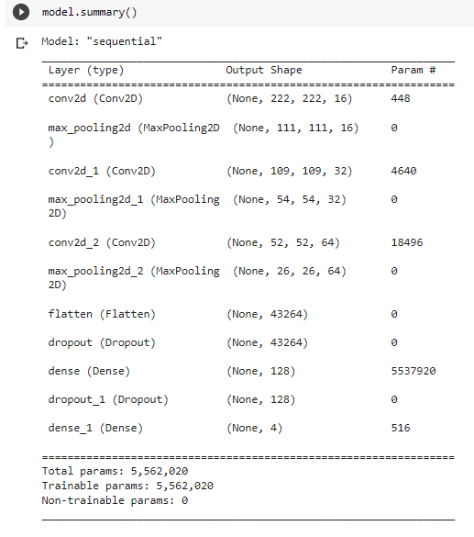
Model Summary

Slide 18
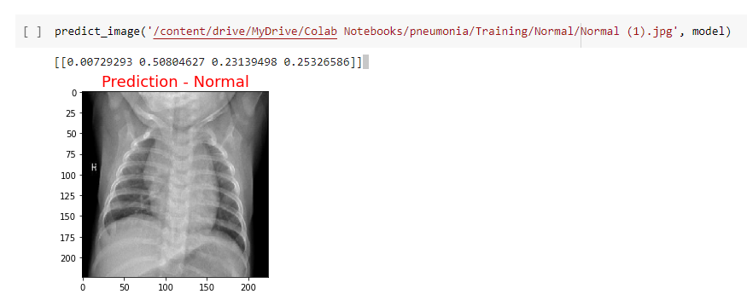
Image Classification Output

Slide 19
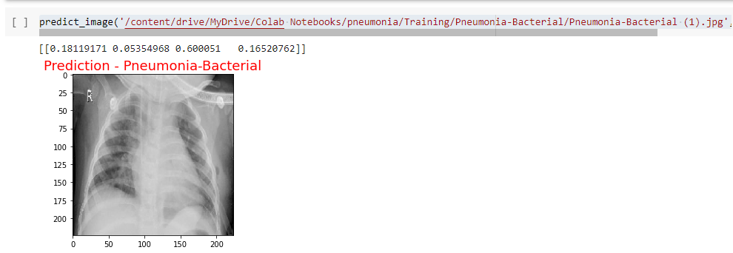

Slide 20
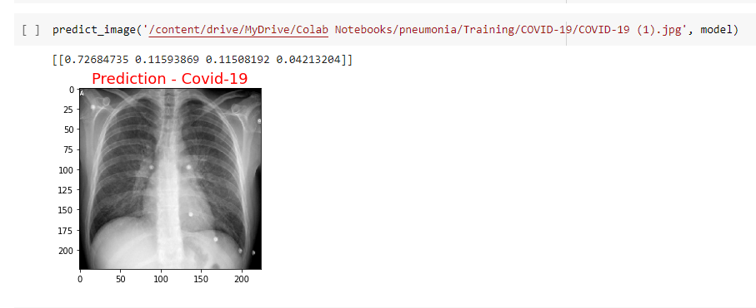

Slide 21
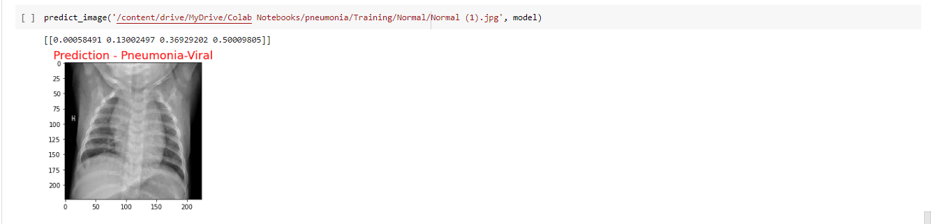

Slide 22
Conclusion and Future work
The types of Pneumonia are classified successfully from the given image.
In this study, we used CNN architecture and one CNN-based AlexNet architecture in this study.
Our main goal suitable model with high accuracy such that pneumonia detection could be simplified in the medical sector.
In order to assess performance with a wider dataset, we can attempt with AlexNet.
In the future, possible solutions for considering these problems are great area for the research domain in future.

Slide 23
References
1. “COVID-19 Pneumonia and Influenza Detection Using convolutional Neural Networks” ,Julianna Antonchuk., Benjamin Prescott., 2021.
2. “Pneumonia Detection Using Convolutional Neural Networks”, Y. Luka racic ., Tomo popovic, 2021.
3. “Pneumonia Detection Using Convolutional Neural Networks”
S. Shah, H et al, 2020.
4. “Deep Learning For Automatic Pneumonia”., Alexandr A.Kalinin ., 2020
.

