Slide 1
OCSP Stapling
Introduction
Different methods for certificate revocation checks
Implementation Flowchart
Implementation overview of ocsp method
Questions

Slide 2
Introduction
its online certificate status protocol used to verify status of a digital certificate.
It is one of the digital certificate revocation check method.
Also known as the TLS Certificate Status Request extension
Requirements:
RDK secure connection shall support checking Certificate Revocation List
Ex: commands(curl, wget) and browsers

Slide 3
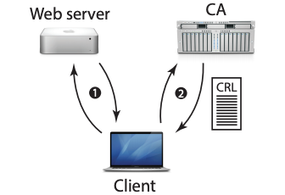
Different methods for certificate revocation checks
CRL: Certificate revocation List
Disadvantages:
1. Potentially client fetches large CRL’s
2. Time and space consuming.
3. Unnecessarily put lot of load on CA servers.

Slide 4
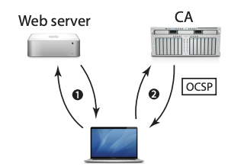
Different methods for certificate revocation checks
OCSP: online certificate status protocol
Client asks for the revocation status of only the particular certificate
Disadvantages:
1. Unnecessary load on CA servers
2. Time latency

Slide 5
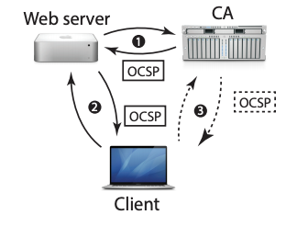
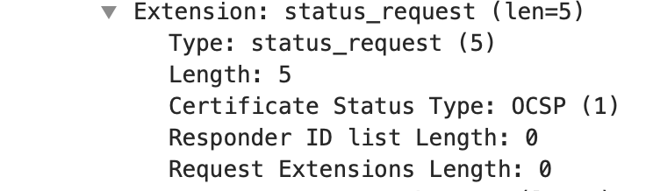
Different methods for certificate revocation checks
OCSP staple
The server is supposed to prefetch the OCSP response and provide it in the handshake, and if it does not, the client can fetch the OCSP response as in

Slide 6
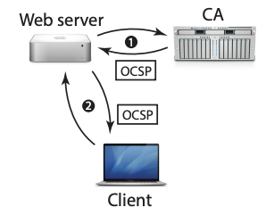
Different methods for certificate revocation checks
OCSP must staple
the server must provide an OCSP response in the handshake or the client will reject the certificate.
Disadvantages:
Thousands of server still doesn’t support ocsp stapling, so most of the connections will terminate

Slide 7
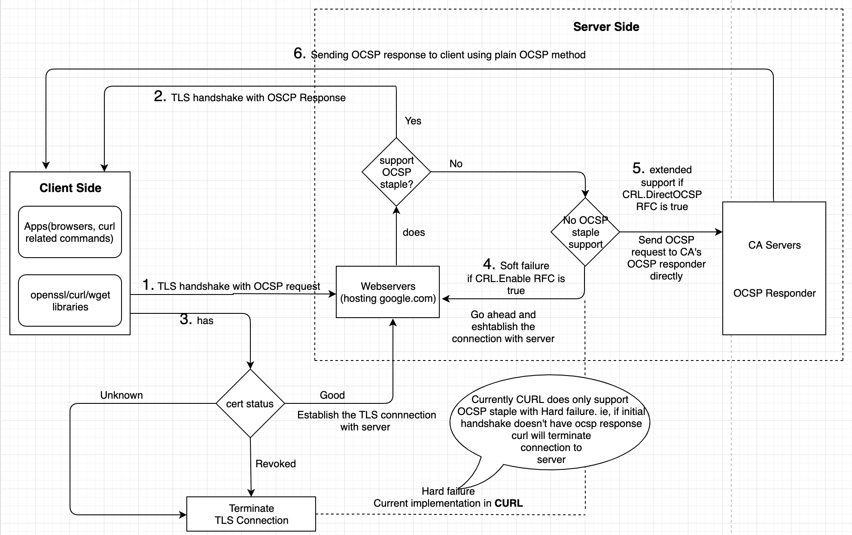
Implementation Flowchart
RFC parameters:
Device.DeviceInfo.X_RDKCENTRAL-COM_RFC.Feature.CRL.Enable to enable OCSP stapling
Device.DeviceInfo.X_RDKCENTRAL-COM_RFC.Feature.CRL.DirectOCSP to enable ocsp

Slide 8
Detailed Implementation steps for ocsp method
If client didn't receive stapled ocsp response as part of initial handshake(refer slide 3), then
1. Get and parse the server certificate and store it in .PEM format.
2. Get, parse the CA's chain of certificates and store it in .PEM format.
3. parse the OCSP responder URI from the server certificate.
char *SaveCerts(SSL* ssl, char *issuercert, char *servercert)
{
………}

Slide 9
4. Prepare ocsp request to send to CA's responder.
request = prepare_ocsp_request(issuercertname, servercertname);
if(!request)
goto end;
5. Get the OCSP response from CA's responder.
response = get_ocspresponse_from_CA(BACKEND->handle, request, timeout, ocsp_uri);
if(!response)
goto end;
6. Once we get the ocsp response from CA,
7. check the cert status
7.1GOOD: continue establish the connection. 7.2 cert status REVOKED: terminate TLS connection immediately. 7.3 cert status UNKNOWN: terminate TLS connection immediately.
To check certificate status from the curl, you need to use –cert-status option to every curl commands
EX: curl -v –cert-status https://google.com/
Implementation reviews:
https://gerrit.teamccp.com/#/q/topic:RDK-25237-1910_sprint+(status:open+OR+status:merged)

Slide 10
Logs for each cases using curl commands
1. If server supports ocsp stapling
curl -v --cert-status https://my.xfinity.com/
* SSL certificate verify ok. * SSL certificate status: good (0)
2. If server doesn’t support stapling just do soft fail
curl -v --cert-status https://google.com/
* No OCSP response received, ocsp staple soft fail support
> GET / HTTP/1.1
> Host: google.com
3. . If server doesn’t support stapling contact CA and get ocsp response
No OCSP response received, getting response from CA
* SSL certificate status1: good (0) > GET / HTTP/1.1 > Host: www.google.com

Slide 11
Thank You….
Prakash K S

