Slide 1
CUSTOMER SHOPPING BEHAVIOUR
Customer shopping behaviour
Turn 3,900 purchase records into practical signals about value, loyalty, product demand, and growth opportunities.

Slide 2
01 — CUSTOMER BASE
The customer base is broad, active, and mostly loyal
A large observed base is already giving the business repeatable signals to act on.
3,900
3,116
$59.76
PURCHASES
LOYAL CUSTOMERS
AVERAGE PURCHASE
Across 18 customer, product, and transaction fields.
80% of the observed base.
Average review rating: 3.75.
Customer mix also includes 701 returning and 83 new customers.
Customer shopping behaviour
2

Slide 3
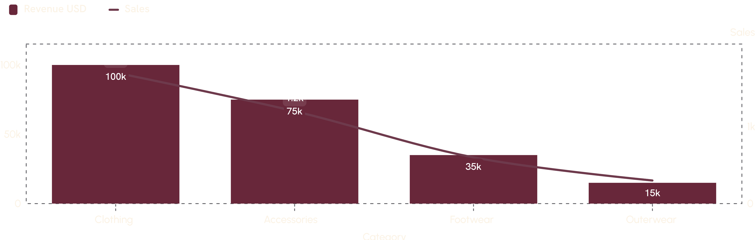
02 — CATEGORY ECONOMICS
Clothing is the commercial engine
Clothing leads both revenue and sales volume. Accessories follow, while footwear and outerwear contribute meaningfully less in the dashboard view.
Clothing is the clear category leader on both revenue and volume, with accessories second.
Customer shopping behaviour
3

Slide 4
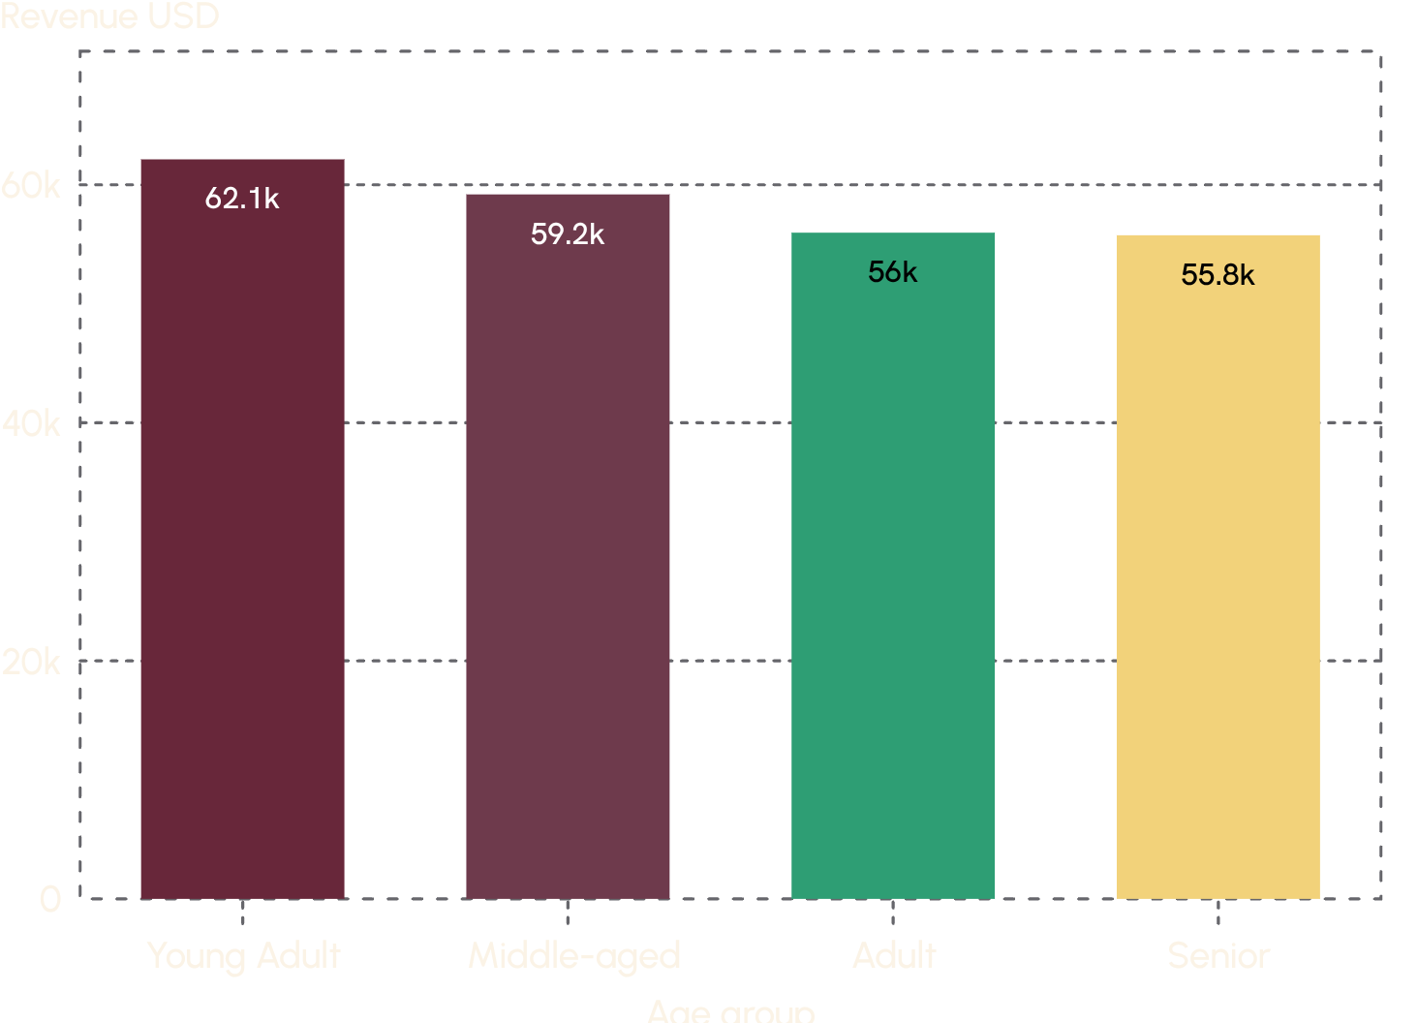
03 — CUSTOMER VALUE
Young adults contribute the most revenue
Young adults lead, while the other age groups remain relatively close behind. That points to broad-based demand rather than a single-age dependency.
Customer shopping behaviour
4

Slide 5
04 — PROMOTION
Discounts attract high-value shoppers, not just bargain hunters
MOST DISCOUNT-DEPENDENT PRODUCTS
Product | Discount rate
Hat | 50.00%
Sneakers | 49.66%
Coat | 49.07%
Sweater | 48.17%
Pants | 47.37%
839 customers used discounts and still spent above the average purchase amount.
Use discounts to increase basket value, while protecting margin through tighter targeting.
Discount dependence is highest across these five products.
Customer shopping behaviour
5

Slide 6
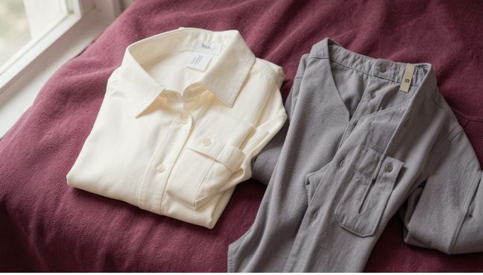

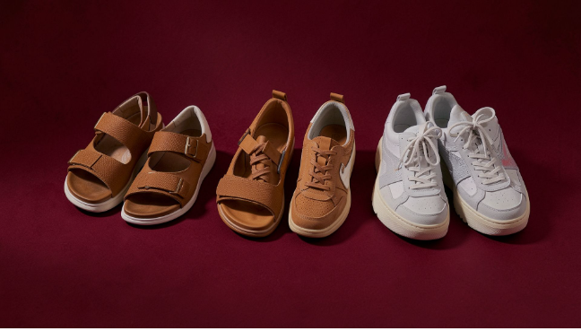
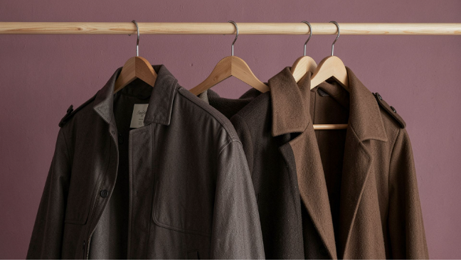
05 — PRODUCT DEMAND
Product demand is concentrated in familiar wardrobe staples
Use proven traffic drivers to open the door, then cross-sell adjacent products.
CLOTHING
ACCESSORIES
FOOTWEAR
OUTERWEAR
Blouse · Pants · Shirt
Jewelry · Sunglasses · Belt
Sandals · Shoes · Sneakers
Jacket · Coat
Customer shopping behaviour
6

Slide 7
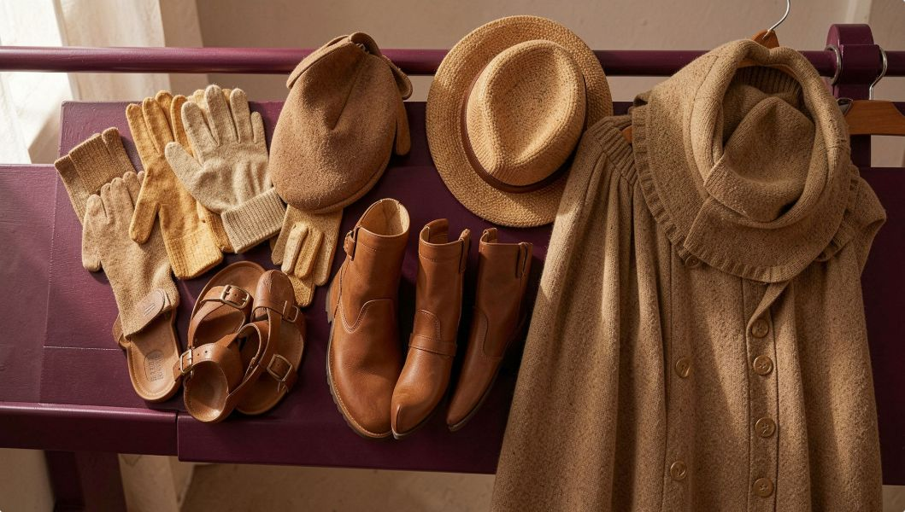
06 — CUSTOMER SIGNAL
Ratings are strongest for seasonal, occasion-led products
3.86
3.84
GLOVES
SANDALS
These products offer a useful starting point for campaigns built around confidence, seasonality, or outfit completion.
3.82
3.80
BOOTS
HAT
3.78
SKIRT
Average rating by product.
Customer shopping behaviour
7

Slide 8
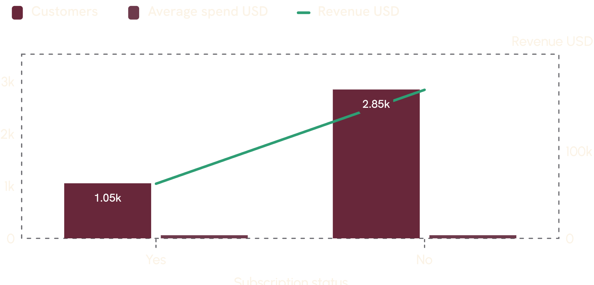
07 — SUBSCRIPTION GAP
Subscription reach is still a growth gap
Most customers are not subscribed, while average spend is almost identical across the two groups. Subscriptions are a retention and relationship lever, not yet a higher-spend segment.
27%
73%
SUBSCRIBERS
NON-SUBSCRIBERS
1,053 customers
2,847 customers
Customer shopping behaviour
8

Slide 9
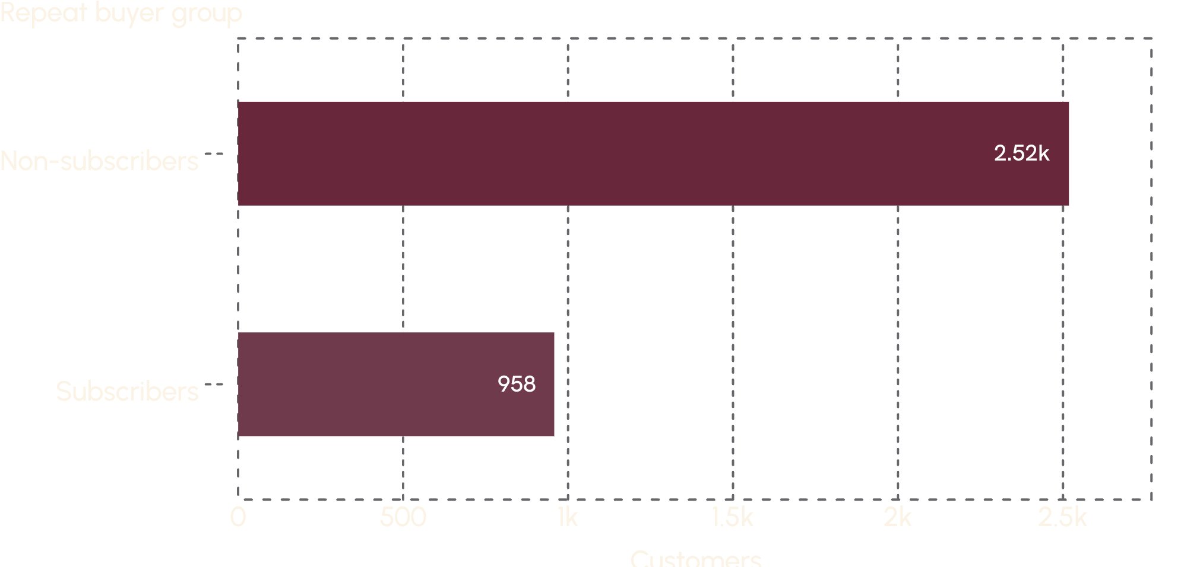
08 — RETENTION OPPORTUNITY
Repeat purchasing is widespread but not translating into subscriptions
There is a large conversion opportunity among customers who already return. Make subscription value tangible through exclusive benefits, convenience, or loyalty rewards rather than relying on spend alone.
3,476
2,518
NON-SUBSCRIBER REPEAT BUYERS
REPEAT BUYERS
Returning behaviour is already widespread.
A clear audience for subscription conversion.
Customer shopping behaviour
9

Slide 10
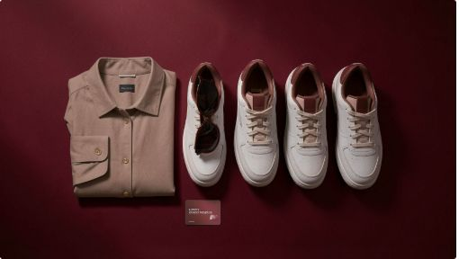
09 — COMMERCIAL ACTIONS
Five actions turn the analysis into growth
Use the dashboard as the shared operating view for monitoring these levers.
01
02
03
04
05
Boost subscriptions
Strengthen loyalty
Rebalance discounts
Merchandise winners
Target by value
Target repeat buyers with exclusive benefits.
Reward returning customers and move more into the loyal segment.
Protect margin on products with high discount dependence.
Prioritize young adults while keeping campaigns relevant across age groups.
Feature best-selling and top-rated products, then cross-sell around them.

