Slide 1
Using Git Successfully (SSH, Merge Conflicts, incremental commits, continuous integration)
Sai Prakash Reddy Mamidi – S533725
Sai Ram Badisa – S534148
Haritha Atmakuri – S534049

Slide 2



SaiRam Badisa
Sai Prakash reddy Mamidi
Haritha Atmakuri

Slide 3
Why we use an SSH key
When working with a GitHub repository, you'll often need to identify yourself to GitHub using your username and password. An SSH key is an alternate way to identify yourself that doesn't require you to enter you username and password every time.
SSH keys come in pairs, a public key that gets shared with services like GitHub, and a private key that is stored only on your computer. If the keys match, you're granted access.
The cryptography behind SSH keys ensures that no one can reverse engineer your private key from the public one.

Slide 4

Generating an SSH key pair
The first step in using SSH authorization with GitHub is to generate your own key pair.
You might already have an SSH key pair on your machine. You can check to see if one exists by moving to your .ssh directory and listing the contents.
If you see id_rsa.pub, you already have a key pair and don't need to create a new one.
If you don't see id_rsa.pub, use the following command to generate a new key pair. Make sure to replace <your mail_id> with your own email address.

Slide 5

When asked where to save the new key, hit enter to accept the default location.
Enter for accepting this as your default location.
You will then be asked to provide an optional passphrase. This can be used to make your key even more secure, but for this lesson you can skip it by hitting enter twice.

Slide 6
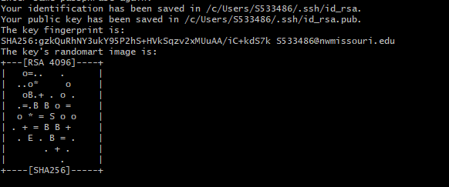
When the key generation is complete, you should see the following confirmation:

Slide 7
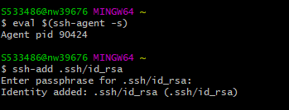
You will then need to add the SSH key to the ssh-agent. To do this type the following commands in git bash:
To be able to use this key with TortoiseGit you will need to add it to Putty.

Slide 8
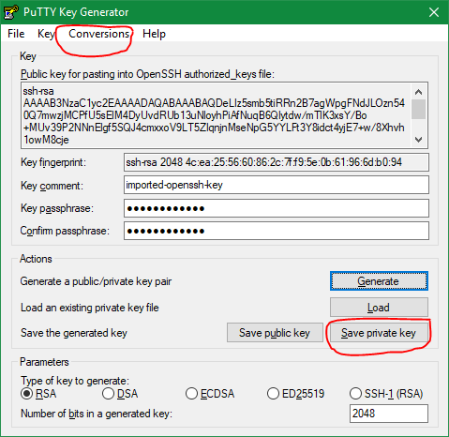
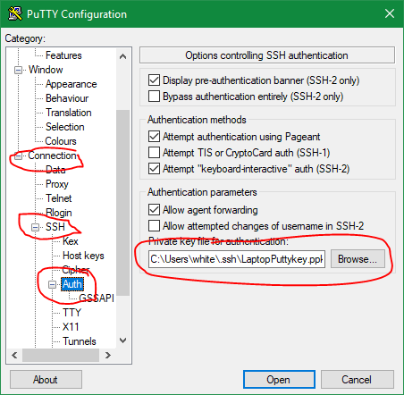

Slide 9
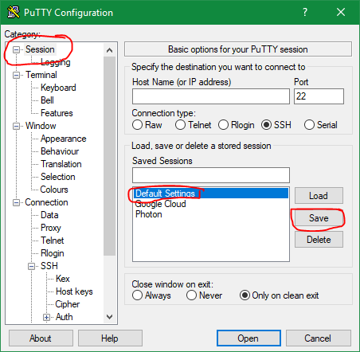

Slide 10
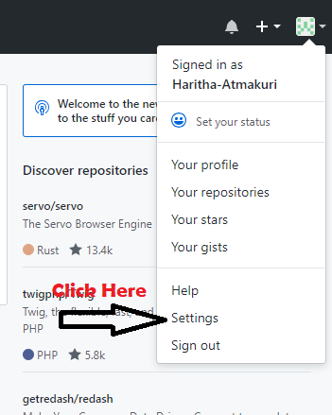
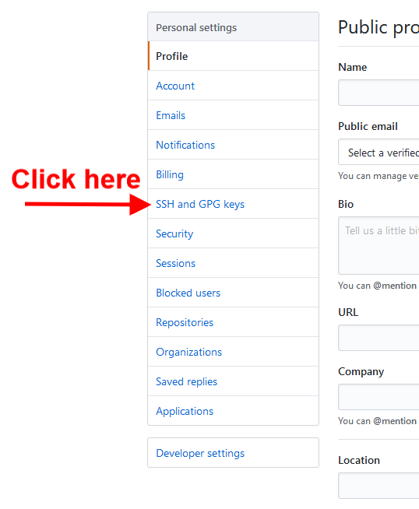
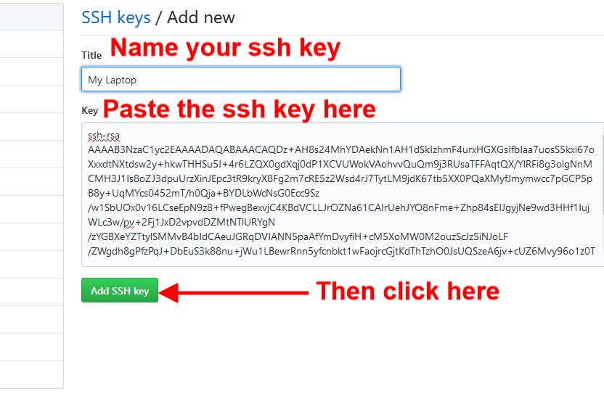
Add the SSH key to GitHub
Go to your GitHub page and click on your profile:
GitHub:

Slide 11
Merge Conflicts

Slide 12
Merging and conflicts are a common part of the Git experience.
Git makes merging super easy. Most of the time, Git will figure out how to automatically integrate new changes.
Conflicts generally arise when two people have changed the same lines in a file, or if one developer deleted a file while another developer was modifying it.
In these cases, Git cannot automatically determine what is correct. Conflicts only affect the developer conducting the merge, the rest of the team is unaware of the conflict.

Slide 13
Types of Merge Conflicts :
Git fails to start the merge: Whenever any file has some merge conflicts and this has to be fixed which cannot be done by git itself.
Git fails during the merge: A failure DURING a merge indicates a conflict between the current local branch and the branch being merged.
2)Git will do its best to merge the files but will leave things for you to resolve manually in the conflicted files
How to identify merge conflicts:
whenever we try to push some code or try to change any code without pulling it or try to override it we should first push the code.

Slide 14
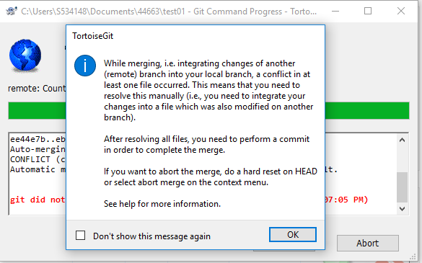
How to solve the merge conflicts:
Whenever we get any merge conflicts it actually pops out a dialog box which says that merge conflicts has occurred and then we can solve it by accepting the incoming changes by accepting it or not.

Slide 15
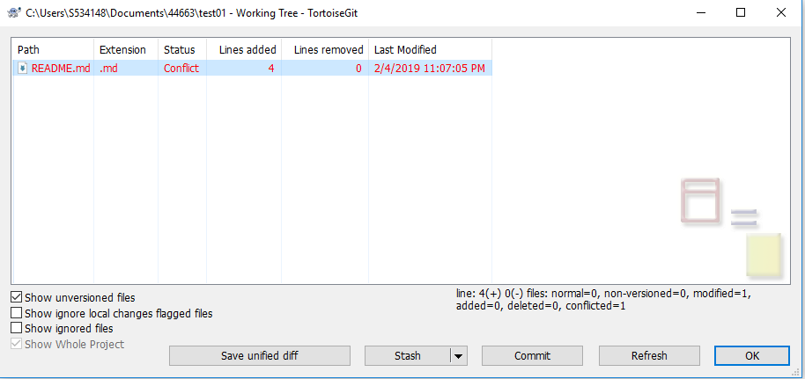
After accepting the merge conflicts the changes can be reflected in the repo.

Slide 16
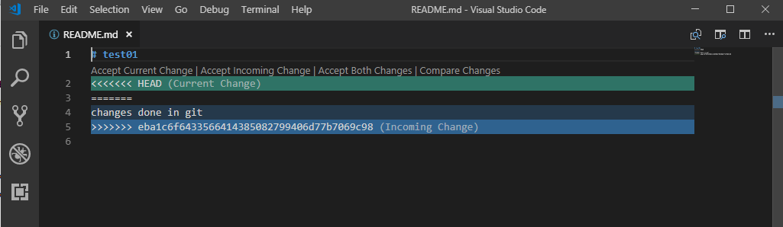

Slide 17
Incremental Commits

Slide 18
Commits after a small change in the code
Easy to find bugs in the code

Slide 19
Continuous Integration

Slide 20
Advantages of Continuous Integration
Ensures everyone’s changes integrate
Catch bugs
Reduce merge conflicts
Notes:
When a developer adds a new work to a branch, the server will automatically build and test the code to determine whether it works and can be integrated with the code on the main branch

Slide 21
Thank You

