Slide 1
BANK
MARKETING
CLASSIFICATION
Group (9) Vineet Reddy Saddi
Shiva Kotagiri
Sai Vamsee
Prakash Sai Alla
Models Used Logistic Regression
Neural Network
Classification Tree
KNN Classification

Slide 2
TABLE OF
CONTENTS
PROJECT DESCRIPTION
DATA PREPROCESSING
LOGISTIC REGRESSION
NEURAL NETWORK
CLASSIFICATION TREE
KNN CLASSIFICATION
MODEL COMPARISON
RECOMMENDATIONS
SUMMARY & TASKS

Slide 3
PROJECT
DESCRIPTION
A bank uses phone campaigns to encourage customers to subscribe to term deposits. However, most customers do not subscribe which makes the dataset imbalanced and harder to evaluate using accuracy alone.
Our goal is to build a machine learning model that predicts which customers are more likely to subscribe.
This helps the bank focus on high-potential customers and reduce unnecessary calls and improve campaign efficiency.
KEY TERMS
Sensitivity tells us how many actual subscribers the model was able to identify. This is important because missing potential subscribers means losing business opportunities.
Precision tells us how many customers predicted as subscribers subscribed. This helps us avoid wasting calls on customers who are unlikely to convert.
ROC AUC measures how well the model ranks likely subscribers above non-subscribers. A higher AUC means the model is better at separating the two groups.
Cutoff is the probability threshold used to decide whether a customer is classified as a subscriber. The default is usually 0.5 but adjusting it can improve the balance between finding more subscribers and keeping predictions reliable.
BUSINESS QUESTIONS
Q1: Which factors most influence subscription?
Q2: Which model best predicts who will subscribe?
Q3: What cutoff gives the best precision vs sensitivity?
Q4: Which model is most usable for the business?

Slide 4
DATA
PREPROCESSING
We used seed 12345 so the random data split stays consistent and gives the same result every time
For Logistic Regression and Decision Tree, we used 6K records for training and 4K for validation.
For the Neural Network, we used 5K for training, 3K for validation, and 2K for testing.
We used both number-based variables like age, duration, Euribor3m and nr.employed and category-based variables like job, marital status and previous outcome.
Missing values were filled in, and some variables were standardized so the models could read the data properly.
WHAT WE FOUND
STRONGEST PREDICTOR
MULTICOLLINEARITY
Duration:- longer calls mean higher subscription chance
Euribor3m & Nr.employed: ~0.95 correlation, they move very closely together and may carry similar information in the model
ECONOMIC FACTORS
IMBALANCE
Economic factors like employment variation rate and consumer price index influenced customer subscription outcomes
Since about 89% of customers did not subscribe, accuracy alone can be misleading, so we evaluated the models using AUC and F1-score

Slide 5
MODELS
USED
LOGISTIC REGRESSION
Used as the simple baseline model with selected predictors such as previous, age, campaign,
p-days, euribor3m, job and p-outcome to explain subscription probability
PROJECT DESCRIPTION
LOGISTIC REGRESSION
NEURAL NETWORK
Used on the 6K training and 4K validation split to create clear decision rules from customer and campaign variables
NEURAL NETWORK
CLASSIFICATION TREE
Used with 5K training, 3K validation and 2K testing records to capture more complex patterns after standardizing the input variables
MODEL COMPARISON
KNN CLASSIFICATION
Missing values were filled and key numerical variables were scaled so the models could use clean and comparable data.

Slide 6
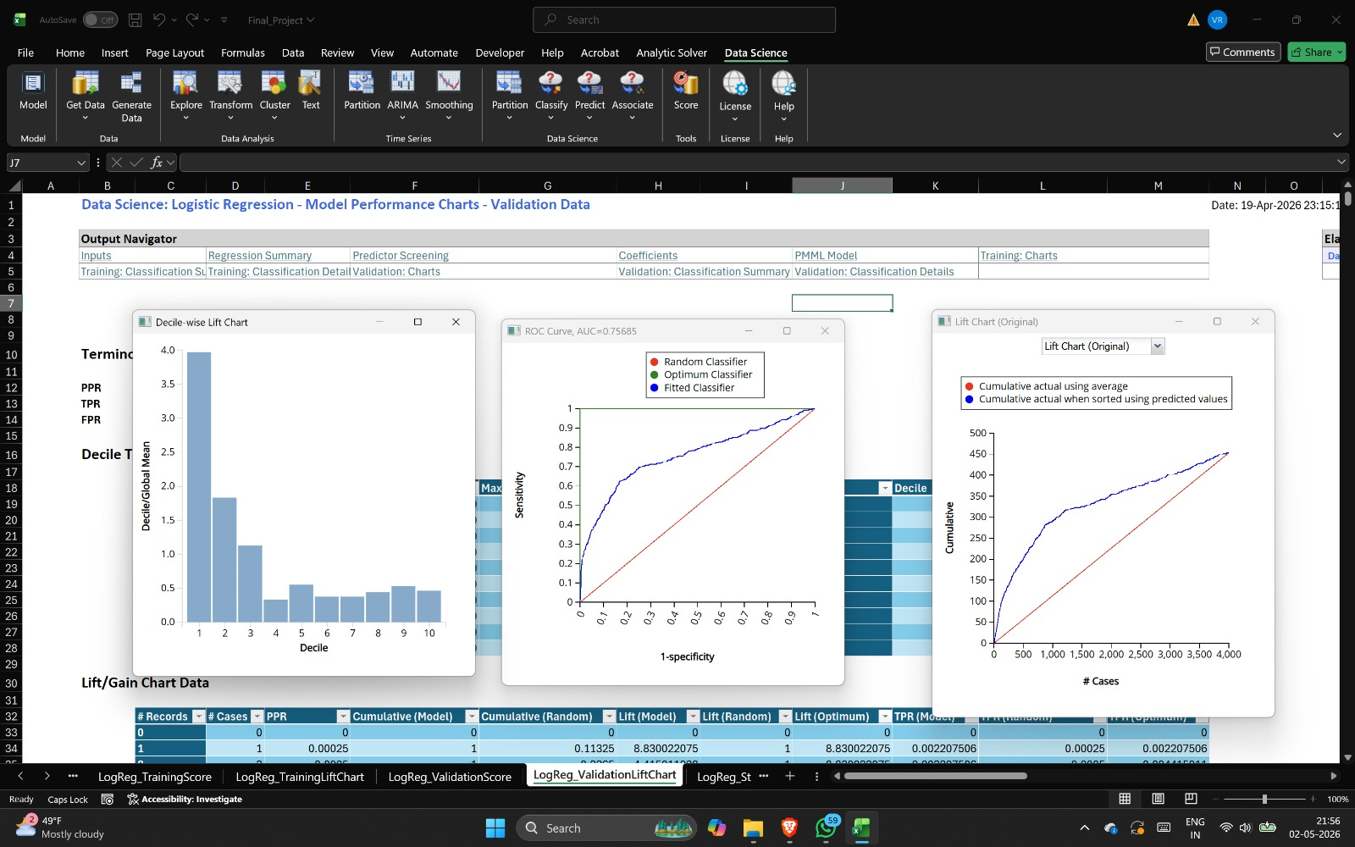
LOGISTIC
REGRESSION
We used Logistic Regression as a simple starting model because it is easy to understand and explain.
Each variable shows how it affects the chance of a customer subscribing to a term deposit.
The main variables used were previous, age, campaign, p-days, euribor3m, job and p-outcome.
We selected these variables by checking which predictors were useful and statistically important for the model.
METRIC | TRAINING | VALIDATION
Accuracy | 89.15% | 90.33%
Specificity | 98.07% | 99.01%
Sensitivity | 20.08% | 22.30%
ROC AUC | 0.7572 | 0.7569
Sensitivity = 22% - which misses 78% of real subscribers at default cutoff. Needs cutoff tuning.
Validation: ROC (AUC=0.757), Decile Lift, Cumulative Lift

Slide 7
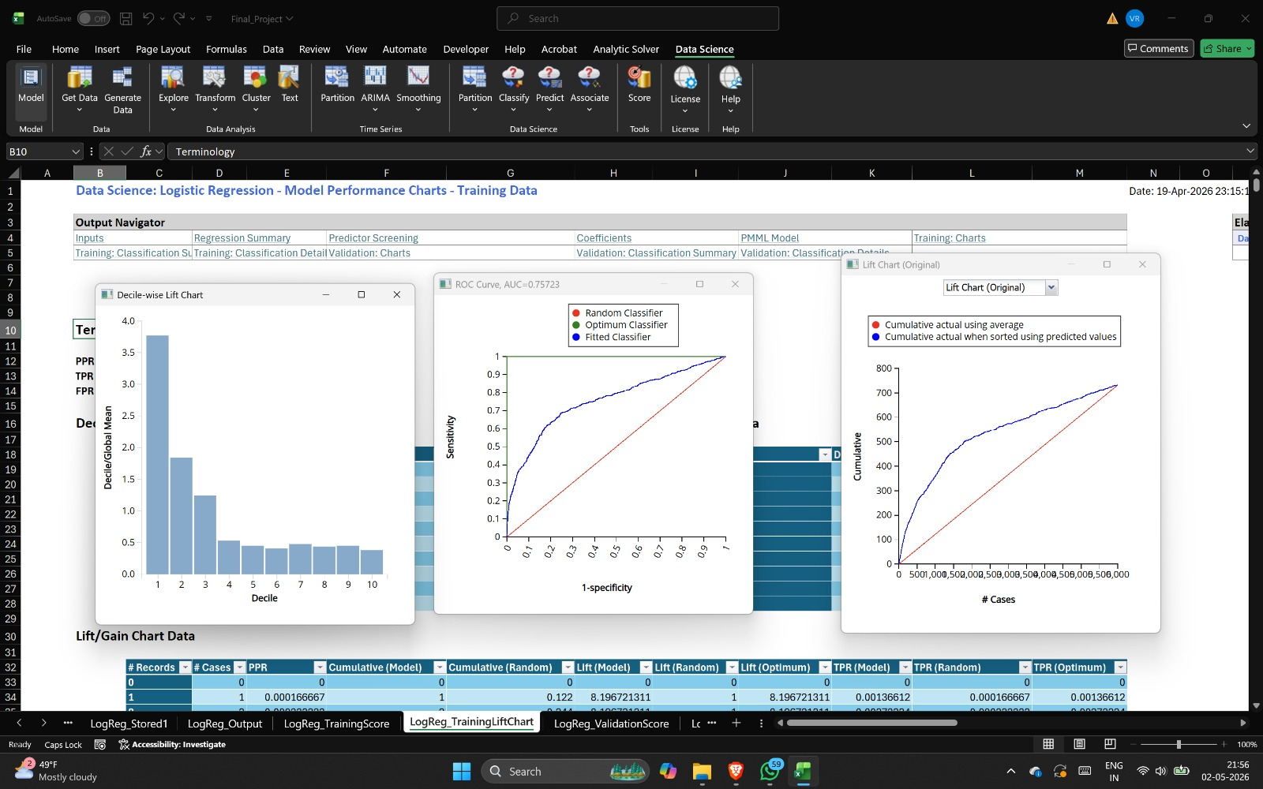
LOGISTIC REGRESSION
TRAINING & BUSINESS ANSWER
BUSINESS ANSWER
Strengths:
• Very high specificity (99%)
• Coefficients are explainable
• Stable across train/validation
Weakness:
• Misses 78% of subscribers
Example:
35-year-old, 300s call, positive previous outcome, low euribor3m → model predicts high subscription probability
Training (AUC=0.757)

Slide 8
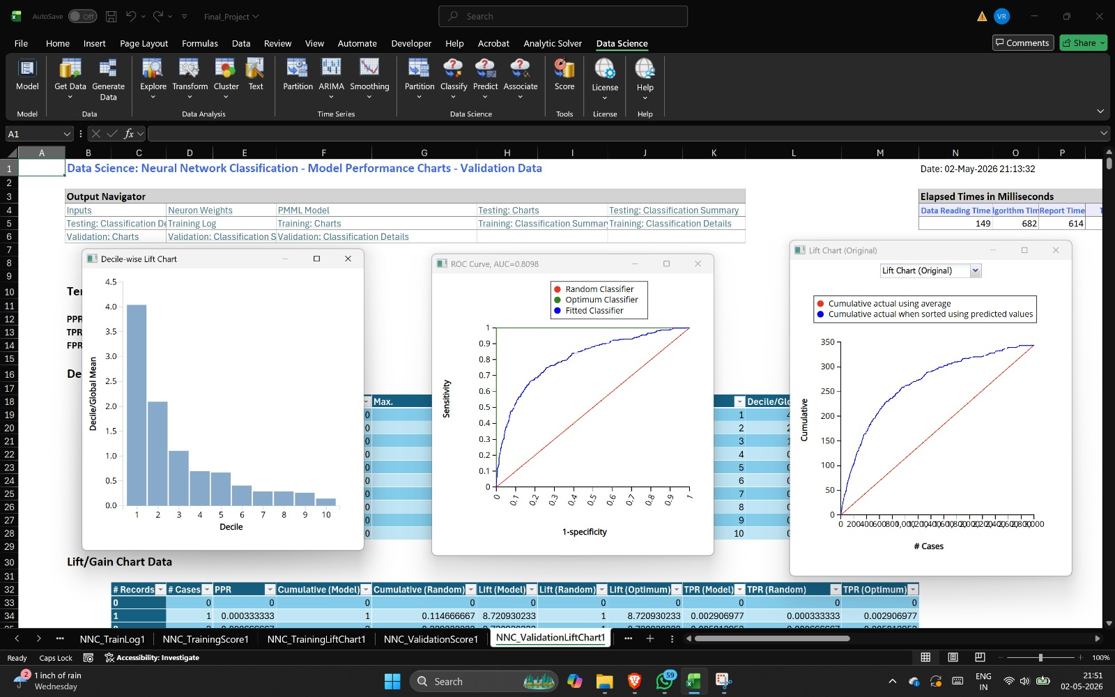
NEURAL
NETWORK
Why? Captures complex and non-linear customer patterns that Logistic Regression may miss.
Structure: 1 hidden layer with 5 neurons and sigmoid activation and learning rate 0.1.
Split: 5K training and 3K validation and 2K testing to check if the model works well on new data.
DATASET | ROC AUC
Training | 0.8135
Validation | 0.8098
Testing | 0.8270
METRIC | VALIDATION VALUE
Accuracy | ~88.5%
Error Rate | ~11.5%
Specificity | Very High
Sensitivity | Very Low at 0.5 cutoff
Validation: ROC (AUC=0.810), Decile Lift, Cumulative Lift

Slide 9
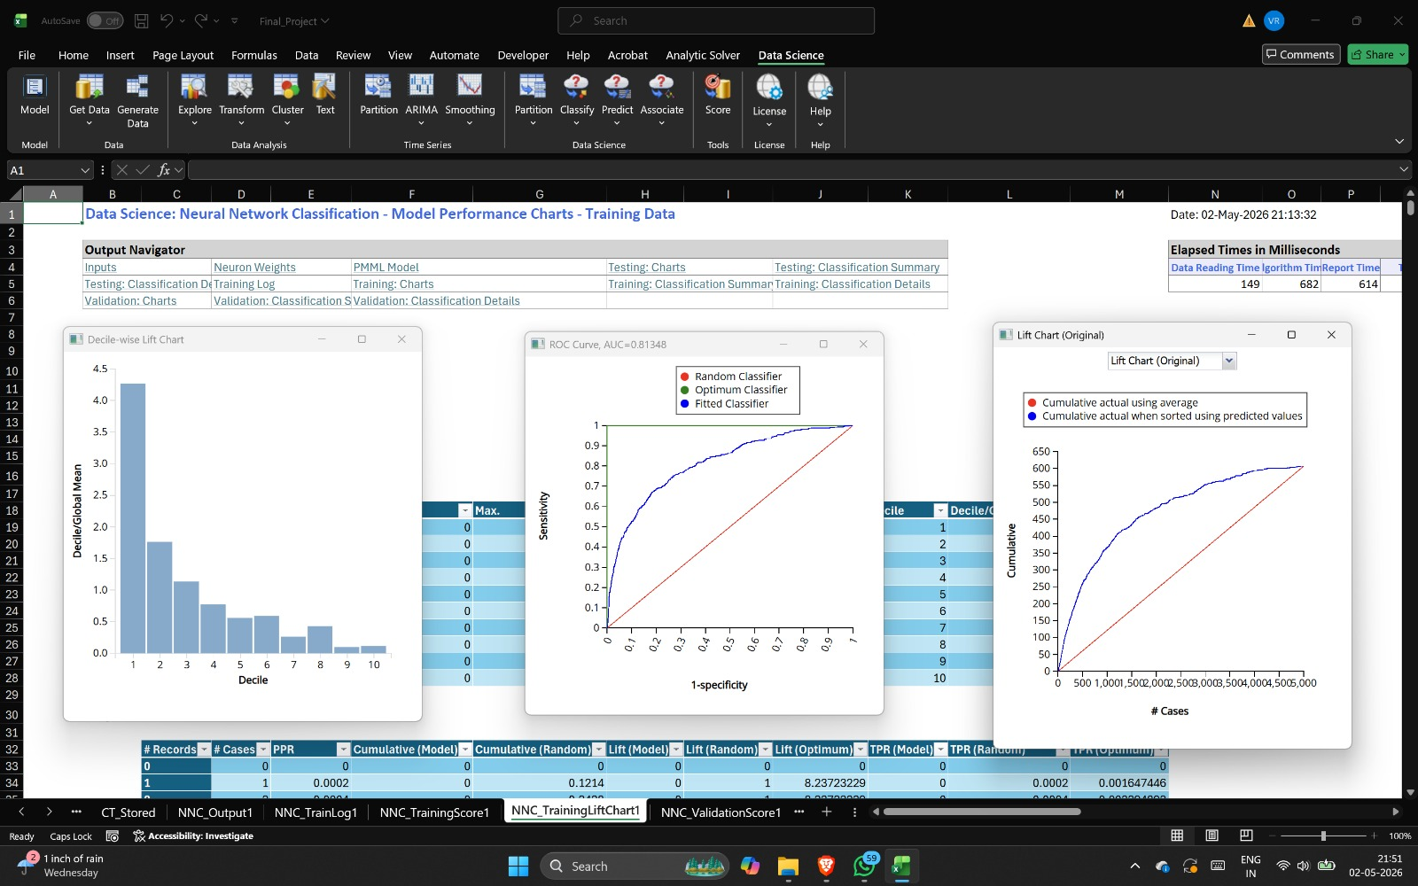
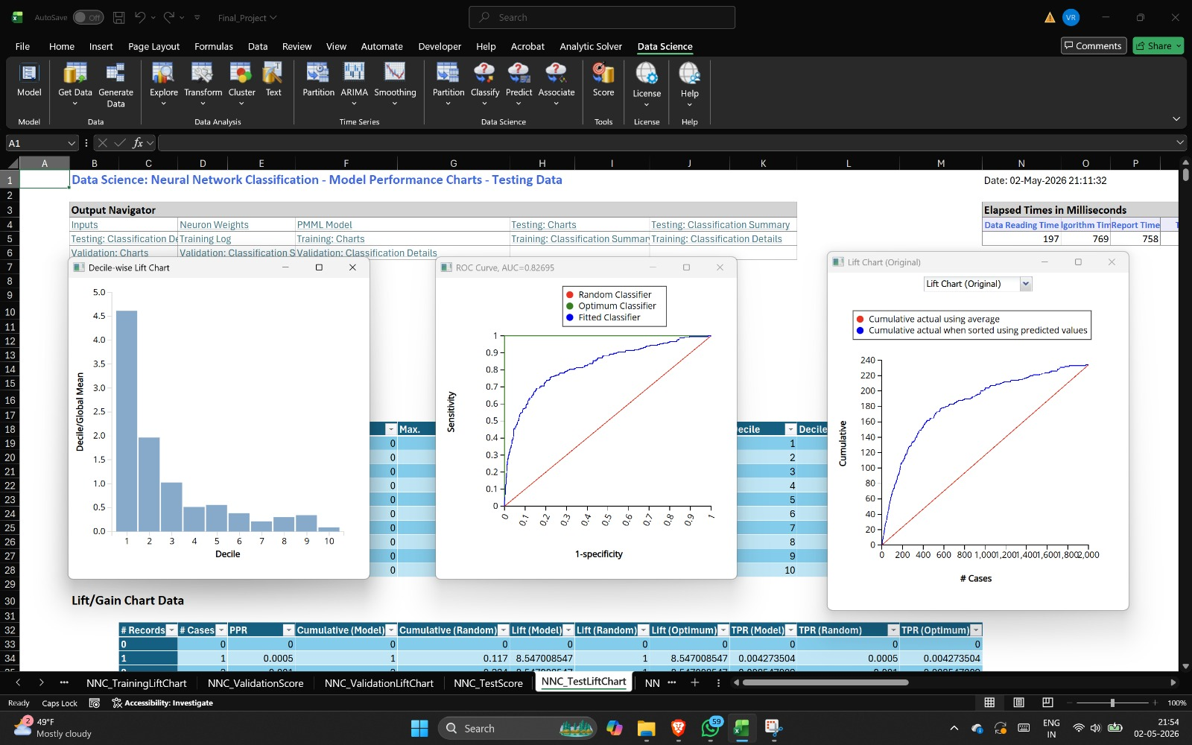
NEURAL NETWORK
TRAINING, TESTING & BUSINESS ANSWER
Training (AUC=0.813)
Testing (AUC=0.827)
Business: NN ranks customers better than logistic regression (AUC 0.81 vs 0.76). When sorted by predicted probability, real subscribers appear near the top. But it's a black box :- hard to explain WHY to management.

Slide 10
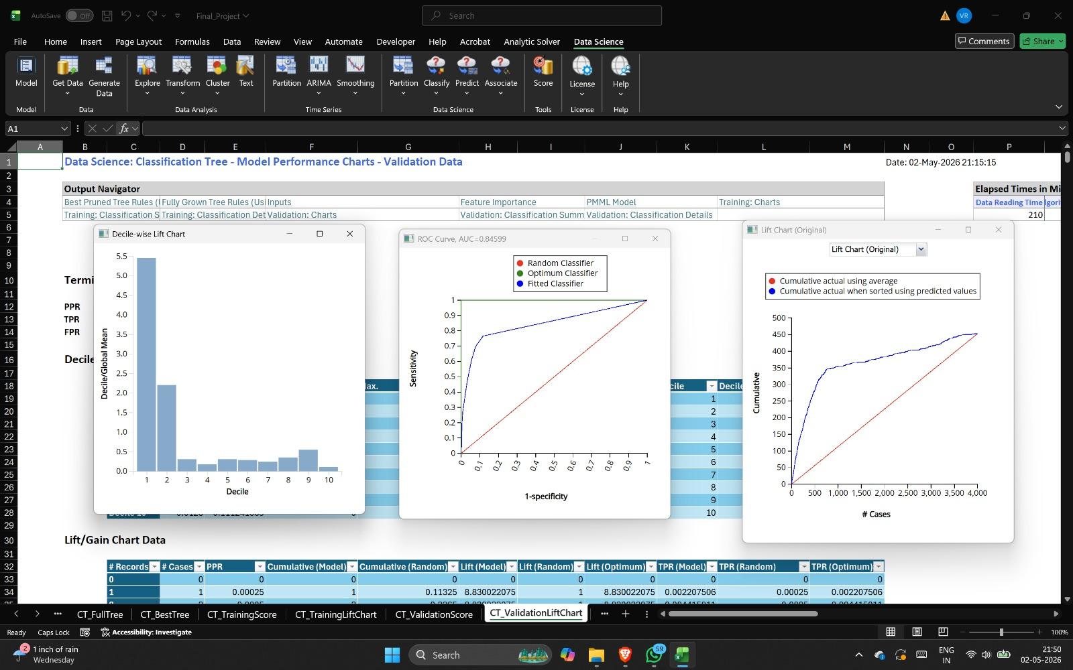
CLASSIFICATION
TREE
Why? Creates simple decision rules that are easy to explain and use in business.
Parameters: Tree depth was limited to 5 and each leaf needed at least 50 records to avoid overfitting.
Pruning: The best tree was selected using validation AUC so the model performs well on new data.
METRIC | TRAINING | VALIDATION
Accuracy | 90.82% | 91.18%
Specificity | 96.84% | 96.90%
Sensitivity | 67.40% | 66.36%
ROC AUC | 0.8506 | 0.8460
Sensitivity = 66% :- catches TWICE as many subscribers as logistic regression! Key drivers: nr.employed, duration, poutcome
Validation: ROC (AUC=0.846)

Slide 11
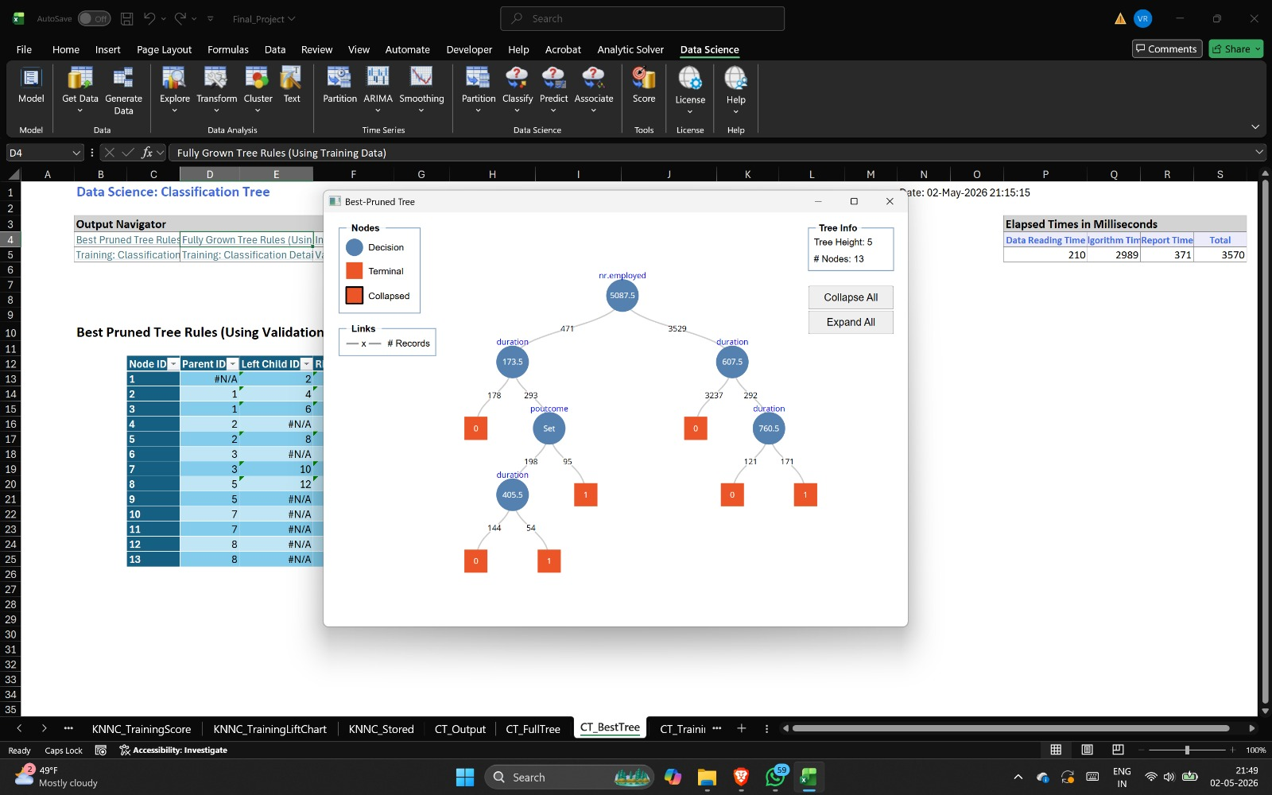
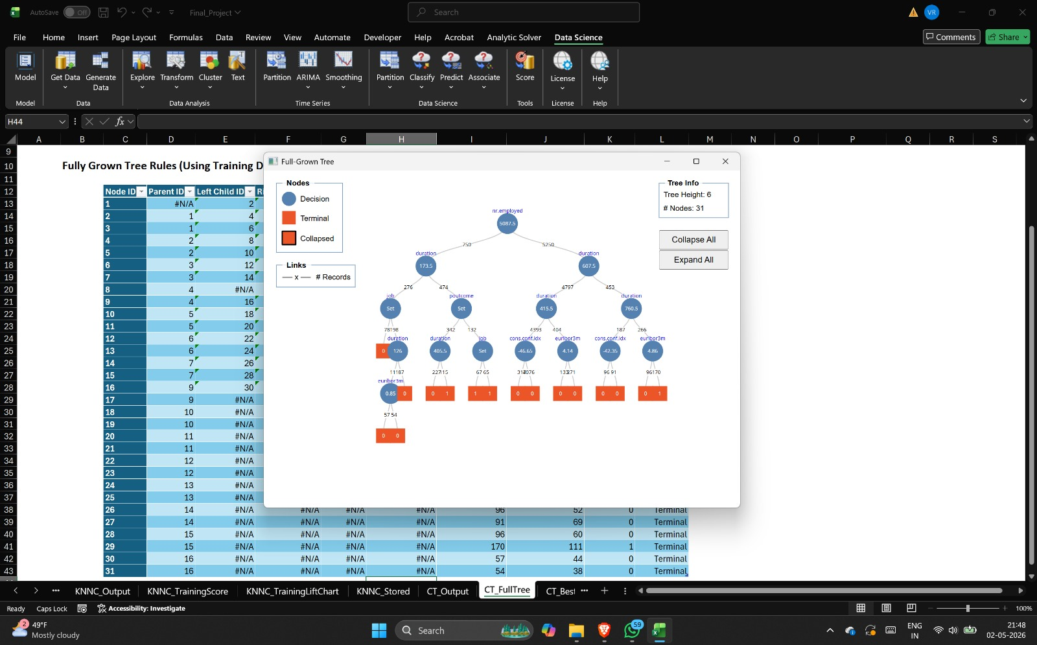
TREE RULES &
BUSINESS ANSWER
Best Pruned Tree (13 nodes)
Full-Grown Tree (31 nodes)
ACTIONABLE RULES
HYPOTHETICAL EXAMPLE
IF nr.employed ≤ 5087.5 AND duration > 173.5 AND poutcome = success → likely subscriber
IF nr.employed > 5087.5 AND duration > 607.5 → likely subscriber
Customer: 40y, 500 calls, previous success, nr.employed=5000 → Tree follows left branch → passes all conditions → Predicted: SUBSCRIBE

Slide 12
KNN
CLASSIFICATION
Why?
KNN predicts subscription by comparing a customer with the most similar past customers and using their outcomes to make the prediction.
Model Setup
METHOD
INPUTS
K-nearest neighbor classification for yes/no subscription prediction
Same cleaned customer, campaign, economic and previous-contact variables
PREPROCESSING
SELECTION
Missing values imputed and variables standardized because KNN uses distance
K value checked through validation; very small K can memorize training data

Slide 13
KNN RESULTS &
BUSINESS ANSWER
KNN was tested as an additional benchmark model, but the results showed overfitting instead of reliable business performance.
Observed Result
Business Answer
METRIC | KNN RESULT
Training ROC AUC | 1.00
Interpretation | Overfitting
Deployment Fit | Not suitable
• Good for comparing similar customers.
• But weak for explanation & management trust.
• Sensitive to scaling and noisy variables.
• Final decision: keep as benchmark, do not deploy
AUC = 1.00 on training means the model is likely memorizing the training data instead of learning a stable pattern.
TAKEAWAY: KNN helped us compare another modeling approach, but Classification Tree remains the best business-ready model.

Slide 14
MODEL
COMPARISON
KNN: AUC = 1.00 (training) → OVERFITTING
Not suitable for deployment
MODEL | VAL AUC | SENSITIVITY | INTERPRETABLE | BUSINESS FIT
Logistic Reg | 0.757 | 22% (low) | Very High | Moderate
Neural Net | 0.810 | Moderate* | Low | High
Class. Tree | 0.846 | 66% (high) | High | Very High
KNN | 1.00 (train) | Very High | Low | Low
*After cutoff tuning
BEST MODEL: Classification Tree is the best model because it has the highest validation AUC of 0.846 and better sensitivity of 66% while still giving clear business rules

Slide 15
RECOMMEND
ATIONS
DO NOW
DO NEXT
Deploy classification tree as primary model
Lower cutoff from 0.5 to catch more subscribers
Focus on top-lift deciles first
Target customers with:
• Longer call durations
• Positive previous outcomes
• Favorable economic conditions
Monitor model drift over time
Retrain periodically with new data
Add behavioral variables (clicks, emails)
Try ensemble methods:
• Random Forest
• Gradient Boosting / XGBoost
• Cost-sensitive classification

Slide 16
PROJECT
SUMMARY
LESSONS LEARNED
LIMITATIONS
Comparing models is essential, no single model wins on every metric
AUC is more reliable than accuracy for imbalanced data
Cut-off selection has huge business impact, 0.5 is rarely optimal
Interpretability matters for deployment trust
Class imbalance only ~11% subscribers
Duration is known only after the call
Limited feature diversity, no digital data
Economic changes may reduce model shelf life

Slide 17
THANK
YOU

