Slide 1
Game for Development
prakash_sellamuthu@yahoo.in

Slide 2
Introduction
Many games available but not supported for different platforms
This classic checker game (5-15) min
Microsoft,National instruments,miniclip have many platforms (Windows,PDA,mobiles)many interfaces(internet,bluetooth,wifi)

Slide 3
SWOT
Strength
  Many game support devices coming up & consumers will increase –Survey
  Game developers are around us,Develeopement kit,resource also accessible.
Weakness
  No Aritifical inteligence,machine learning and porting experience.
Opportunity
  Wide opportunity is predicted for implement and market.
Thread
  This is small application of the device ,Acceptance/usage by customer may not be satisfactory.
  Proto is available in market(Sheep andTiger,Tigers trouble),Claiming of loyalty after our product launch

Slide 4
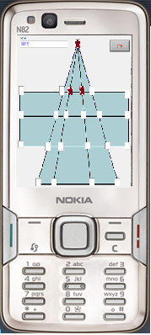
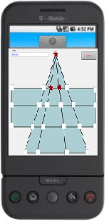
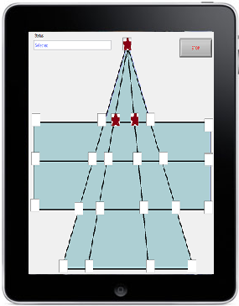
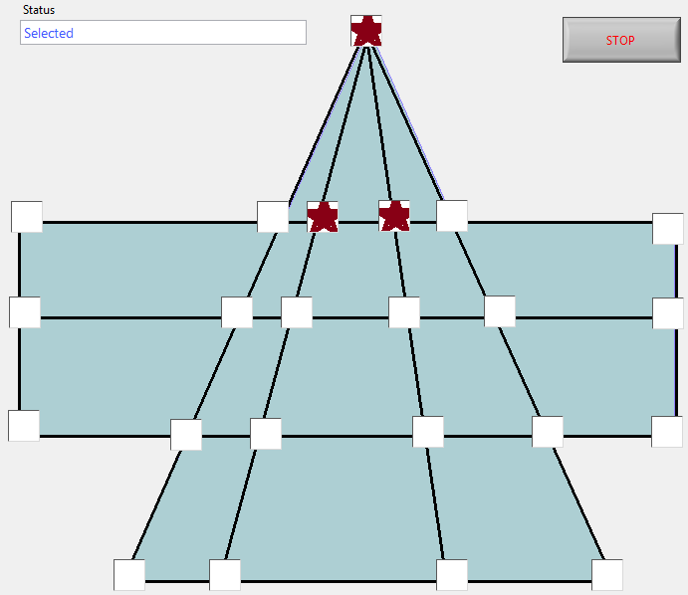
G

Slide 5
Game prototype
Two players on same PC
Two Player from two node development is under progress
Tool: National Instruments (LabVIEW2009)

Slide 6
Rules
Rules similar to checkers game movement
Player 1(3 coins)
  One location movement
  Cut the coin if it nearby location is empty
  Escape from the blocking movement
Player 2(15 coins)
  Place coins to block the 3 coins
  Move depends on the coin positions

Slide 7
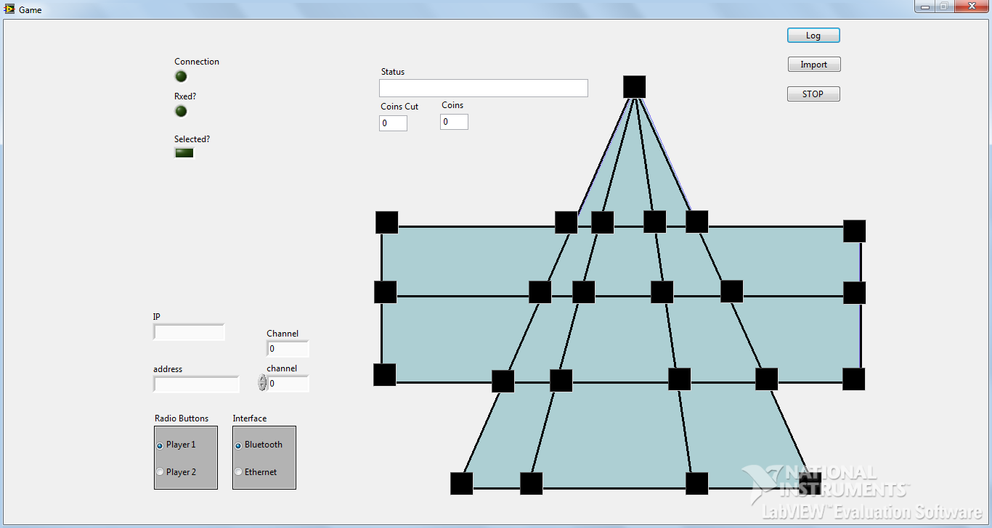
Prototype

Slide 8
Intelligence
Player 1
  Move the coins in grouped positions in multiple locations
  Push the coins to corners, Cut the coins
  Be in grouped and positioned manner
Player 2
  Separate the coins even sacrificing 1 or 2 coins

Slide 9
Issues
This prototype only works in windows XP with run time support, communication Drivers
Not licensed
Not tested completely, Not architectured as per regular games
Intelligence/machine learning is not added for CPU player, Needs support from game designers

Slide 10
Conclusion
This game can be designed/ported for different platforms
This game is incomplete
Continuous improvement on the User interface ,Game engines can be made .
http://youtu.be/DXfR6lCKbCg

Slide 11
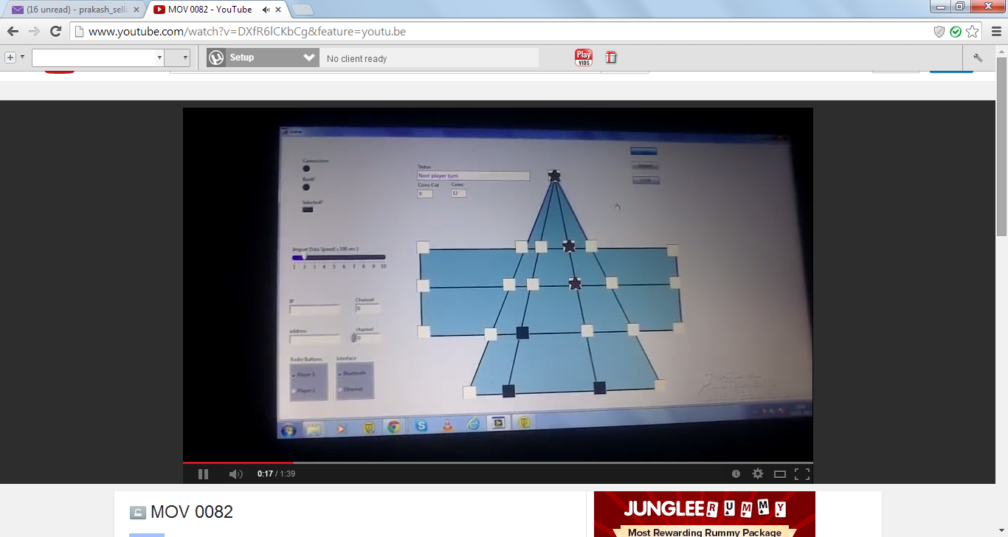

Slide 12


