Slide 1

STUDENT PERFORMANCE ANALYSIS
Student Performance Analysis using R
A data-analysis presentation using R visualizations, trend
interpretation, and predictive modeling.
500
10
2023–2025
6
students
Parameters used
year range
grade types
R Programming • ggplot2 • dplyr • tidyr • corrplot
PRESENTED BY
Shreya Prakash
Aakriti Yadav
25/SCA/MCAN/074
25/SCA/MCAN/076

Slide 2

Student Performance Analysis
Problem Statement & Objectives
PROBLEM STATEMENT
OBJECTIVES
Large student data not properly analyzed
Difficulty identifying performance factors
Manual analysis is time-consuming
Need to predict grades/marks in advance
Lack of data-driven decision making
Early identification of weak students
Analyze student data using R
Identify key factors affecting performance
Visualize data using graphs
Build prediction models for grades/marks
Provide actionable insights for improvement
Dataset: Student Performance 2024–2025 • Analysis in R
2 / 10

Slide 3






Student Performance Analysis
Introduction
Student performance analysis helps understand academic progress and trends over time.
R programming is widely used for statistical data analysis and visualization.
Educational data includes study hours, attendance, and exam scores — all key variables.
Predictive models can estimate future student performance from historical data.
Data analysis reveals hidden patterns that manual review would miss.
Insights support teachers and institutions in making better academic decisions.
Dataset: Student Performance 2024–2025 • Analysis in R
3 / 10

Slide 4
Student Performance Analysis
Dataset Snapshot
500
11
2023–25
6
10
Total records
Dataset columns
Time period
Grade types
Parameters used
Main variables used in analysis
Why these variables matter
study_hours
Hours studied per week
Together, these variables connect four important questions: Which students struggle? Which factors drive performance? How are grades distributed? Which students need early support?
attendance_pct
Attendance percentage
assignment_score
Score on assignments
midterm_score
Midterm exam score
final_score
Final exam score
grade
Final grade (A–E)
Clean dataset structure makes it suitable for grouped summaries, trend charts, distribution plots, and relationship analysis.
Dataset: Student Performance 2024–2025 • Analysis in R

Slide 5
Student Performance Analysis
Tools, Libraries & Visualizations
Advanced data visualizations — scatter plots, bar charts, and more.
Reshape data between wide and long formats for analysis.
ggplot2
reshape2
Data manipulation: filtering, selecting, and summarizing efficiently.
Fast reading of CSV and text files into R — more efficient than base R.
dplyr
readr
Cleaning and reshaping messy data into tidy format for analysis.
Arrange multiple plots in a single layout for clear presentation.
tidyr
gridExtra
Visualize correlation matrices to understand variable relationships.
corrplot
Dataset: Student Performance 2024–2025 • Analysis in R
4 / 10

Slide 6
Student Performance Analysis
Analysis Workflow in R
1
Load Libraries
Key code logic
ggplot2 for charts, dplyr for grouping, tidyr for data handling.
Most trend graphs use stat_summary(fun = mean), which means R first calculates average values and then plots those averages.
2
Import Dataset
read.csv() imports the student performance CSV file into a data frame.
Why arrows are added
3
Summarize Data
Pointers make the chart easier to read by highlighting spikes, dips, median values, and positive/negative zones.
group_by(), summarise(), count(), slice_max() create chart-ready tables.
4
Create Graphs
Line charts, bars, donut, histogram, scatter, and bubble charts are generated.
Clean layout approach
Each slide has a clear title, one main visual idea, and short explanation so the teacher can understand it quickly.
5
Interpret Results
Pointers and callouts explain hikes, drops, peaks, and relationship patterns.
Dataset: Student Performance 2024–2025 • Analysis in R

Slide 7
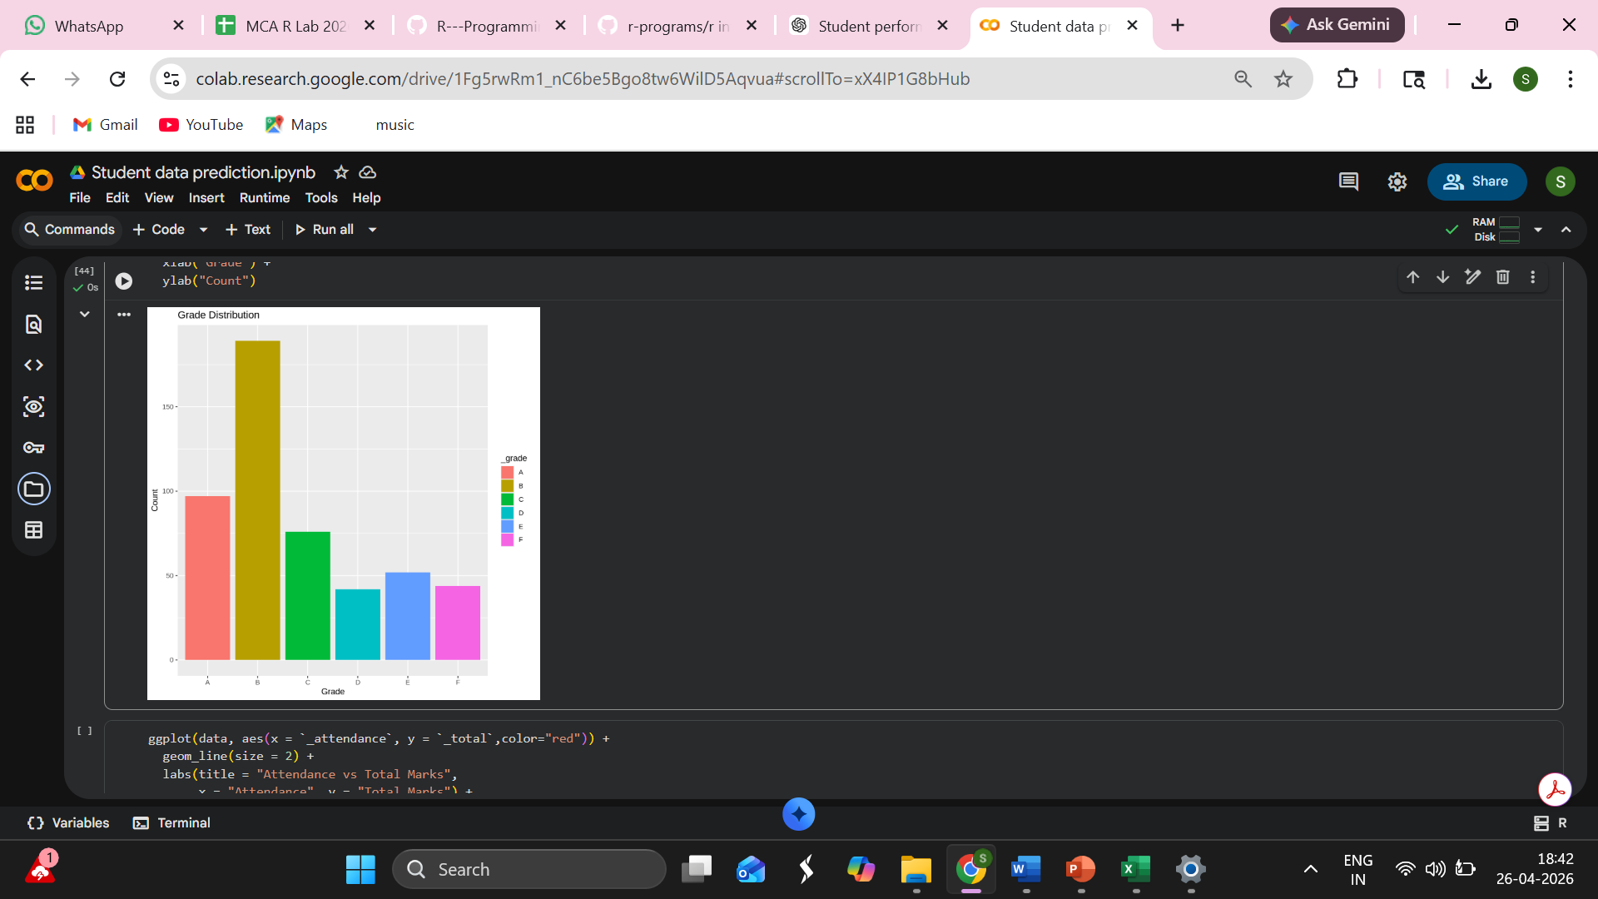
Student Performance Analysis
Grade Distribution — Bar Plot
Main insight
Grade A is the most frequent in the dataset. The chart shows distribution across all grade categories.
Why this matters
Uneven grade distribution helps identify whether the class is performing above or below average.
Takeaway
Large variation between grades suggests that targeted intervention for D and E students is needed.
Dataset: Student Performance 2024–2025 • Analysis in R

Slide 8
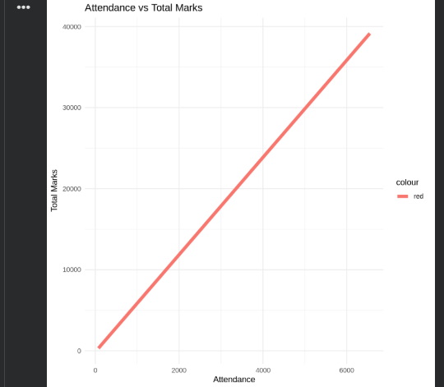
Student Performance Analysis
Attendance vs Total Marks — Line Plot
What this chart shows
It tracks how total marks increase with higher attendance. The upward trend confirms attendance matters.
Interpretation
Students with attendance above 80% consistently score higher, confirming a strong positive relationship.
Simple reading rule
Steeper line = stronger relationship. A flat line would mean attendance has no effect on marks.
Dataset: Student Performance 2024–2025 • Analysis in R

Slide 9
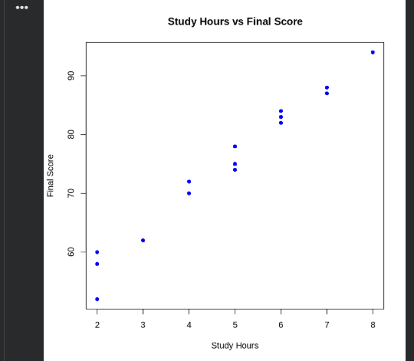
Student Performance Analysis
Study Hours vs Final Score — Scatter Plot
How to read it
Every point is one student. X-axis is study hours per week; Y-axis is final score achieved.
Key finding
Students studying 6–8 hours/week cluster near the top. Below 3 hours shows much lower final scores.
Practical meaning
Encouraging students to study at least 5 hours/week could meaningfully improve overall outcomes.
Dataset: Student Performance 2024–2025 • Analysis in R

Slide 10
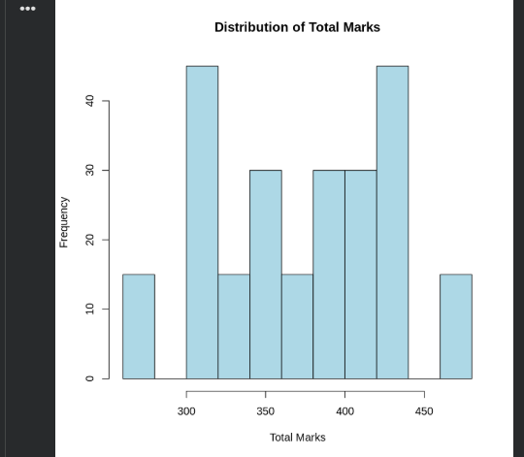
Student Performance Analysis
Distribution of Total Marks — Histogram
Distribution view
Histogram groups total marks into ranges, showing where most observations are concentrated.
Median marker
The central bars represent the bulk of students. Tails indicate very high or very low performers.
Why it matters
Total marks distribution helps compare how different score ranges affect final grade outcomes.
Dataset: Student Performance 2024–2025 • Analysis in R

Slide 11
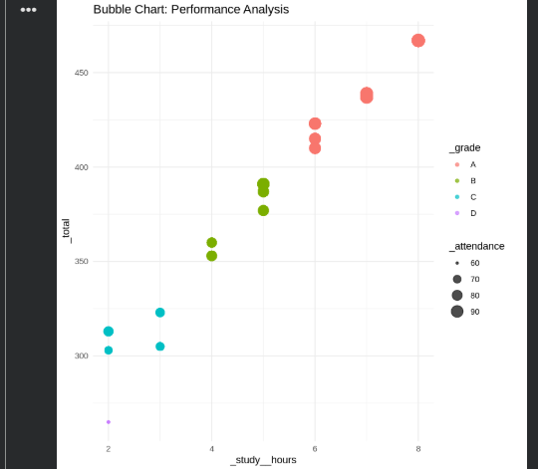
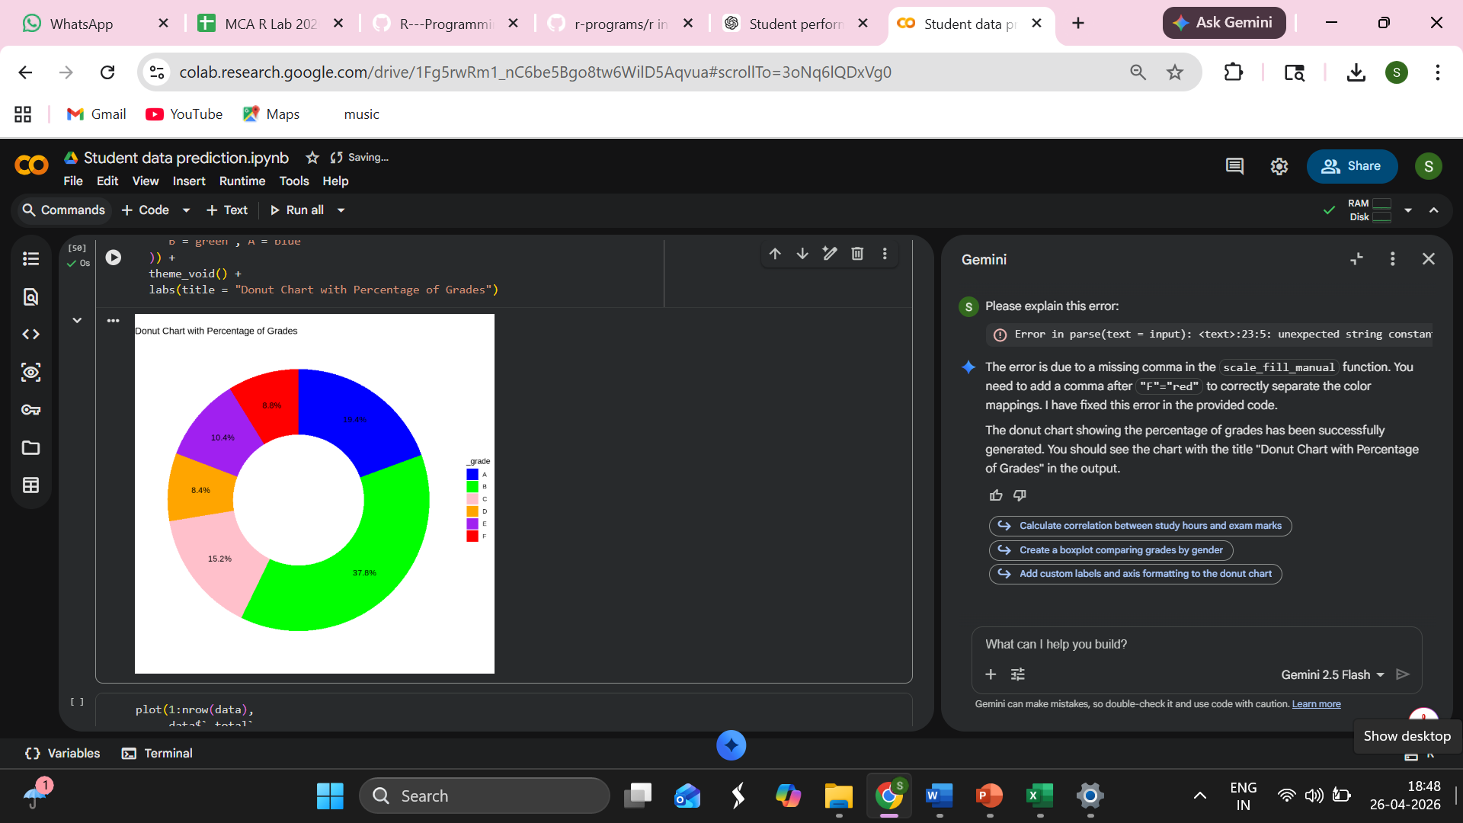
Student Performance Analysis
Performance Analysis & Grade Distribution
Bubble Chart: Study hours vs score, sized by attendance impact
Donut Chart: Grade B dominates at ~37.8%; D and F are smallest segments.
Dataset: Student Performance 2024–2025 • Analysis in R

Slide 12
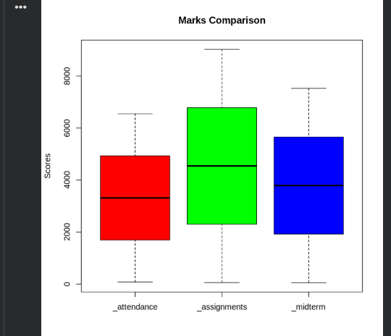
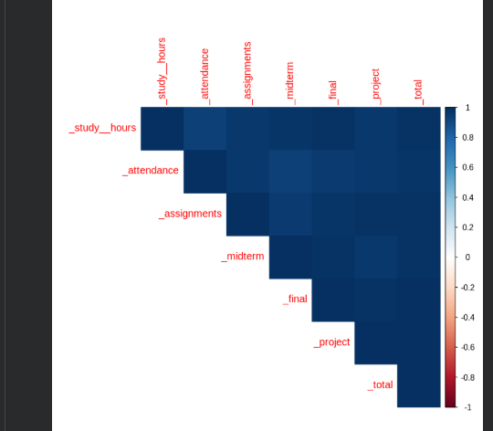
Student Performance Analysis
Marks Comparison & Correlation Heat Map
(Box Plot: Assignments score has highest spread; attendance shows consistent middle range).
(Heat Map: Study hours and final score show strongest positive correlation in the matrix).
Dataset: Student Performance 2024–2025 • Analysis in R

Slide 13
Student Performance Analysis
Key Findings & Recommendations
1. Attendance is critical
2. Study hours drive grades
3. Grade A is achievable
Students with >80% attendance score significantly higher on average across all exam categories.
More study hours per week strongly correlates with final score — especially above 5 hrs/week.
37.5% of students achieved Grade A, showing the curriculum and grading are appropriately balanced.
4. Skill gap drives risk
5. Best response: early action
Students with low assignments and midterm scores show the largest risk of failing the final exam.
Early identification of students falling behind (weeks 3–5) enables targeted tutoring interventions.
Dataset: Student Performance 2024–2025 • Analysis in R

Slide 14
Student Performance Analysis
Conclusion
01
Student data analysis effectively reveals performance trends across subjects.
05
Prediction models successfully forecast student performance from historical data.
02
R programming language proved highly effective for academic data analysis and visualization.
06
Early identification of at-risk students supports proactive academic intervention.
03
Key factors — study hours and attendance — have a measurable impact on results.
07
Data-driven insights enable better, evidence-based academic decision-making.
04
Visualization tools make complex data easy to interpret for educators.
Dataset: Student Performance 2024–2025 • Analysis in R
9 / 10

Slide 15
Student Performance Analysis
References
Dataset
Student Performance dataset used for analysis. Variables include study hours, attendance, assignment score, midterm, final, and grade.
R Libraries
ggplot2 for charts, dplyr for data grouping and summaries, tidyr for data preparation, corrplot for correlation analysis.
Visualization Types
Bar chart, line chart, scatter plot, histogram, bubble chart, donut chart, box plot, and heat map were used to explain patterns.
Thank You
Dataset: Student Performance 2024–2025 • Analysis in R

