Slide 1
CI/CD Pipeline with Jenkins - Condensed Overview
Streamlining software delivery through automation and integration
Notes:
---

Slide 2
Introduction and Learning Objectives
Notes:
---
This slide references information from the following file: https://dell-my.sharepoint.com/personal/prakash_hikkanagutti_dell_com/Documents/Microsoft%20Copilot%20Chat%20Files/Lesson_04_CI_CD_Pipeline_with_Jenkins.pdf
Learning Objectives

Slide 3

Learning Objectives
Understanding CI/CD Concepts
  Learn the fundamentals and importance of Continuous Integration and Continuous Delivery in software development.
Role of Jenkins Automation
  Discover how Jenkins automates CI/CD workflows to improve efficiency and reduce deployment risks.
Jenkins Architecture and Security
  Explore Jenkins’ architecture, features, user interface, and security settings for effective pipeline management.
Notes:
---
This slide references information from the following file: https://dell-my.sharepoint.com/personal/prakash_hikkanagutti_dell_com/Documents/Microsoft%20Copilot%20Chat%20Files/Lesson_04_CI_CD_Pipeline_with_Jenkins.pdf
The primary learning objectives of this presentation are to provide a clear understanding of Continuous Integration (CI) and Continuous Delivery/Deployment (CD) concepts, explain their significance in modern software development, and demonstrate how Jenkins serves as a powerful automation tool for implementing these practices. By the end of this session, you will be able to outline the fundamental principles of CI/CD pipelines, identify suitable tools for optimizing development workflows, and describe Jenkins' architecture, features, and benefits. Additionally, you will gain insights into Jenkins' user interface and security configurations, enabling effective management of pipelines and user permissions. These objectives aim to equip you with practical knowledge for streamlining software delivery processes, reducing risks, and improving efficiency through automation.

Slide 4
Understanding CI/CD Pipeline
Notes:
---
This slide references information from the following file: https://dell-my.sharepoint.com/personal/prakash_hikkanagutti_dell_com/Documents/Microsoft%20Copilot%20Chat%20Files/Lesson_04_CI_CD_Pipeline_with_Jenkins.pdf
What is CI/CD Pipeline?, Advantages of CI/CD

Slide 5

What is CI/CD Pipeline?
Continuous Integration
  Continuous Integration merges code changes frequently into a shared repository to detect integration issues early.
Continuous Delivery
  Continuous Delivery automates release processes to keep code deployment-ready at all times.
Continuous Deployment
  Continuous Deployment automatically pushes code changes to production without manual approvals.
Pipeline Stages
  The pipeline includes source control, build automation, testing, and deployment stages for smooth releases.
Notes:
---
This slide references information from the following file: https://dell-my.sharepoint.com/personal/prakash_hikkanagutti_dell_com/Documents/Microsoft%20Copilot%20Chat%20Files/Lesson_04_CI_CD_Pipeline_with_Jenkins.pdf
A CI/CD pipeline is an automated workflow that integrates various stages of software development, including building, testing, and deploying code changes. Continuous Integration focuses on merging code changes frequently into a shared repository, ensuring early detection of integration issues. Continuous Delivery extends this by automating the release process, making code deployment-ready at all times. Continuous Deployment takes it further by automatically pushing changes to production without manual approval. These practices collectively reduce deployment risks, accelerate delivery cycles, and enhance software quality. The pipeline typically includes stages such as source control, build automation, testing, and deployment, all orchestrated to ensure smooth and reliable software releases.

Slide 6
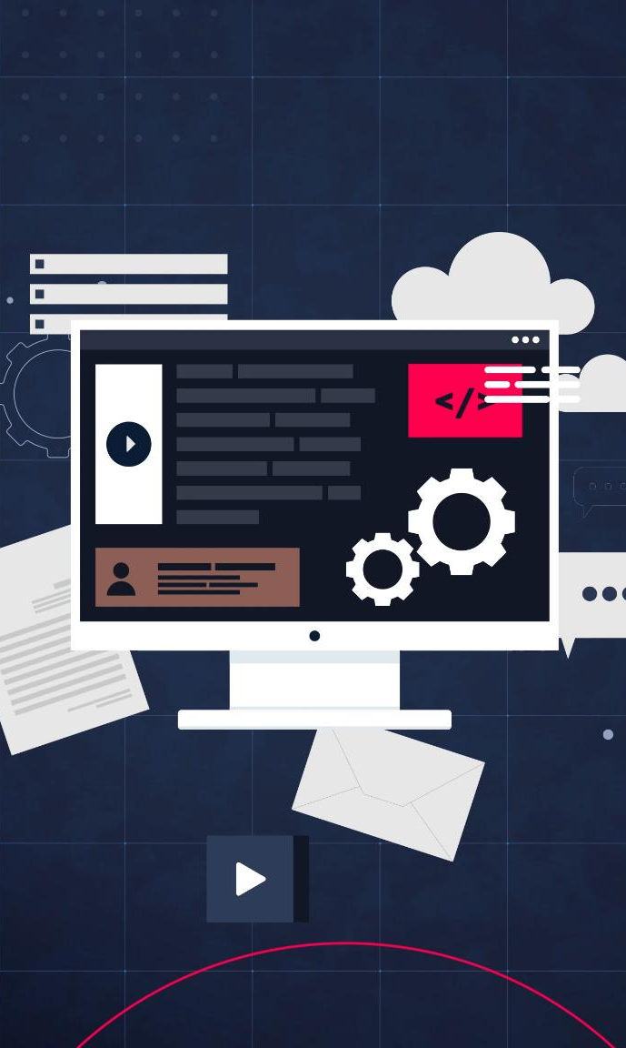
Advantages of CI/CD
Faster Software Delivery
  CI/CD automates repetitive tasks, enabling faster delivery of high-quality software with reduced manual effort.
Early Bug Detection
  Continuous Integration detects bugs early through automated testing, reducing issues in production.
Efficient Release Process
  Continuous Delivery ensures efficient, repeatable, and reliable release processes across environments.
Accelerated Feedback Loops
  Continuous Deployment accelerates feedback, allowing quick response to user needs and market changes.
Notes:
---
This slide references information from the following file: https://dell-my.sharepoint.com/personal/prakash_hikkanagutti_dell_com/Documents/Microsoft%20Copilot%20Chat%20Files/Lesson_04_CI_CD_Pipeline_with_Jenkins.pdf
Implementing CI/CD pipelines offers numerous benefits to development teams and organizations. It enables faster delivery of high-quality software by automating repetitive tasks and reducing manual intervention. Continuous Integration minimizes bugs by detecting issues early through automated testing, while Continuous Delivery ensures efficient and repeatable release processes. Continuous Deployment further accelerates feedback loops, allowing teams to respond quickly to user needs and market changes. These practices improve overall productivity, enhance code stability, and maximize return on investment by streamlining workflows and reducing operational overhead.

Slide 7
CI/CD Workflow and Key Elements
Notes:
---
This slide references information from the following file: https://dell-my.sharepoint.com/personal/prakash_hikkanagutti_dell_com/Documents/Microsoft%20Copilot%20Chat%20Files/Lesson_04_CI_CD_Pipeline_with_Jenkins.pdf
Workflow Stages, Key Elements of CI/CD Pipeline

Slide 8
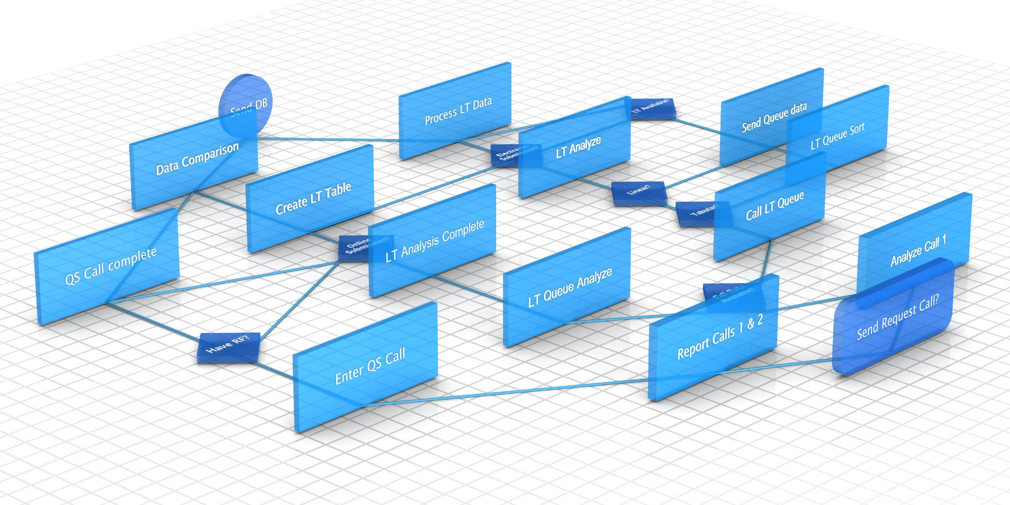
Workflow Stages
Source Code Management
  Source stage involves managing code in version control systems to maintain history and collaboration.
Build Process
  Build stage compiles code into deployable artifacts, ensuring readiness for testing and deployment.
Automated Testing
  Test stage runs automated tests to validate software functionality and performance before deployment.
Deployment Automation
  Deploy stage automates release of software to production or staging environments reliably and quickly.
Notes:
---
This slide references information from the following file: https://dell-my.sharepoint.com/personal/prakash_hikkanagutti_dell_com/Documents/Microsoft%20Copilot%20Chat%20Files/Lesson_04_CI_CD_Pipeline_with_Jenkins.pdf
The CI/CD workflow consists of several interconnected stages designed to automate the software delivery lifecycle. These stages include Source, where code is managed in version control systems; Build, which compiles the code into deployable artifacts; Test, where automated tests validate functionality and performance; and Deploy, which releases the application to staging or production environments. Each stage is supported by automation tools and scripts to ensure consistency and reliability. This structured approach reduces human error, accelerates delivery timelines, and provides visibility into the development process.

Slide 9

Key Elements of CI/CD Pipeline
Automated Builds and Testing
  Automated builds and self-testing code ensure quick feedback and maintain high code quality in the CI/CD pipeline.
Single Source Repository
  A single source repository centralizes code and build scripts, ensuring version control and traceability.
Frequent Commits and Integration
  Frequent code commits and automated testing reduce integration conflicts and maintain code integrity.
Monitoring and Reporting
  Comprehensive monitoring and reporting provide visibility to identify and resolve issues proactively.
Notes:
---
This slide references information from the following file: https://dell-my.sharepoint.com/personal/prakash_hikkanagutti_dell_com/Documents/Microsoft%20Copilot%20Chat%20Files/Lesson_04_CI_CD_Pipeline_with_Jenkins.pdf
A robust CI/CD pipeline incorporates essential elements such as automated builds, self-testing code, predictable deployments, and stable testing environments. It relies on a single source repository for all code and build scripts, ensuring version control and traceability. Frequent code commits and automated testing help maintain code integrity and reduce integration conflicts. Additionally, the pipeline emphasizes maximum visibility through monitoring and reporting, enabling teams to identify and resolve issues proactively. These elements collectively enhance the efficiency and reliability of software delivery.

Slide 10
Jenkins Overview and Features
Notes:
---
This slide references information from the following file: https://dell-my.sharepoint.com/personal/prakash_hikkanagutti_dell_com/Documents/Microsoft%20Copilot%20Chat%20Files/Lesson_04_CI_CD_Pipeline_with_Jenkins.pdf
Introduction to Jenkins, Features and Benefits of Jenkins

Slide 11

Introduction to Jenkins
Open-Source Automation Server
  Jenkins is a widely used open-source automation server that supports multiple operating systems.
CI/CD Pipeline Implementation
  It enables implementation of continuous integration and continuous delivery pipelines effectively.
Extensible Plugin Ecosystem
  Jenkins offers a rich plugin ecosystem allowing integration with various development tools and technologies.
Deployment Flexibility
  Jenkins can be deployed on-premises or in cloud environments to scale and customize projects.
Notes:
---
This slide references information from the following file: https://dell-my.sharepoint.com/personal/prakash_hikkanagutti_dell_com/Documents/Microsoft%20Copilot%20Chat%20Files/Lesson_04_CI_CD_Pipeline_with_Jenkins.pdf
Jenkins is an open-source automation server widely used for implementing CI/CD pipelines. Written in Java, it supports multiple operating systems, including Windows, macOS, and Unix-based platforms. Jenkins provides a flexible and extensible framework for automating tasks such as building, testing, deploying, and monitoring software changes. Its rich plugin ecosystem allows seamless integration with various tools and technologies, making it a preferred choice for DevOps teams. Jenkins can be deployed on-premises or in cloud environments, offering scalability and customization to meet diverse project requirements.

Slide 12

Features and Benefits of Jenkins
Pipeline as Code
  Pipeline as Code allows defining build workflows and automation scripts for flexible CI/CD processes.
Plugin Extensibility
  Jenkins supports extensibility through numerous plugins to integrate with popular tools and services.
Distributed Build Architecture
  Distributed build architecture enables scalability by running builds on multiple agent machines.
Benefits and Usability
  Jenkins enhances cost-effectiveness, issue detection, scalability, integration, and user-friendly operation.
Notes:
---
This slide references information from the following file: https://dell-my.sharepoint.com/personal/prakash_hikkanagutti_dell_com/Documents/Microsoft%20Copilot%20Chat%20Files/Lesson_04_CI_CD_Pipeline_with_Jenkins.pdf
Jenkins offers a wide range of features that make it an indispensable tool for CI/CD automation. Key features include Pipeline as Code, which enables defining build workflows using scripts; extensibility through plugins; distributed build architecture for scalability; and robust security configurations. Jenkins also provides notifications, reporting, and integration capabilities with popular tools like Git, Maven, and Docker. The benefits of using Jenkins include cost-effectiveness, early detection of issues, increased scalability, and limitless integration possibilities. Its user-friendly interface and active community support further enhance its usability and adoption.

Slide 13
Jenkins Architecture and UI
Notes:
---
This slide references information from the following file: https://dell-my.sharepoint.com/personal/prakash_hikkanagutti_dell_com/Documents/Microsoft%20Copilot%20Chat%20Files/Lesson_04_CI_CD_Pipeline_with_Jenkins.pdf
Architecture, Exploring Jenkins UI

Slide 14
Architecture
Master Node Role
The master node schedules jobs, dispatches builds, and monitors execution to orchestrate distributed builds.
Slave Nodes Function
Slave nodes perform the actual build operations, executing tasks assigned by the master node.
Communication and Scalability
Master and slave nodes communicate over TCP/IP, enabling scalable and efficient resource usage.
Notes:
---
This slide references information from the following file: https://dell-my.sharepoint.com/personal/prakash_hikkanagutti_dell_com/Documents/Microsoft%20Copilot%20Chat%20Files/Lesson_04_CI_CD_Pipeline_with_Jenkins.pdf
Jenkins follows a master-slave architecture to manage distributed builds efficiently. The master node orchestrates tasks such as scheduling jobs, dispatching builds to slave nodes, and monitoring their execution. Slave nodes, also known as agents, perform the actual build operations. Communication between master and slaves occurs over TCP/IP, ensuring scalability and resource optimization. This architecture allows Jenkins to handle multiple builds concurrently, improving performance and reducing bottlenecks in large-scale projects.

Slide 15

Exploring Jenkins UI
Dashboard Overview
  The Dashboard summarizes project statuses, providing a quick overview for users and administrators.
Build History Tracking
  Build History enables tracking of executed jobs, helping users monitor build outcomes over time.
Global Configuration
  Manage Jenkins allows setting global configurations, security options, and plugin management.
User and Resource Insights
  Features like People, Build Queue, and Executor Status provide insights into user activity and resource usage.
Notes:
---
This slide references information from the following file: https://dell-my.sharepoint.com/personal/prakash_hikkanagutti_dell_com/Documents/Microsoft%20Copilot%20Chat%20Files/Lesson_04_CI_CD_Pipeline_with_Jenkins.pdf
The Jenkins user interface provides intuitive navigation and management capabilities for administrators and developers. Key components include the Dashboard, which summarizes project statuses; Build History for tracking executed jobs; and Manage Jenkins for configuring global settings and security. Additional features such as People, Build Queue, and Executor Status offer insights into user activities and resource utilization. The UI also supports plugin management, system configuration, and troubleshooting tools, enabling efficient administration of the Jenkins environment.

Slide 16
Key Takeaways
Notes:
---
This slide references information from the following file: https://dell-my.sharepoint.com/personal/prakash_hikkanagutti_dell_com/Documents/Microsoft%20Copilot%20Chat%20Files/Lesson_04_CI_CD_Pipeline_with_Jenkins.pdf
Summary of Concepts

Slide 17
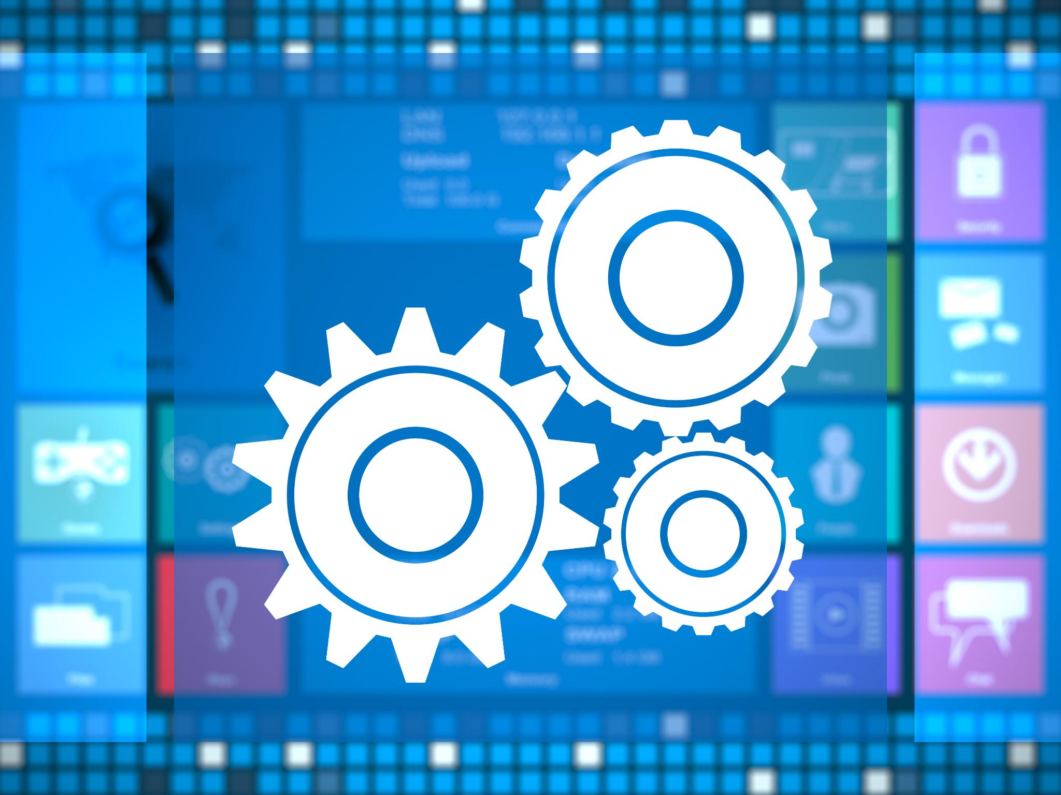
Summary of Concepts
Importance of CI/CD Practices
  CI/CD enables faster software delivery with improved quality and reduced risks through automation.
Role of Jenkins Tool
  Jenkins offers flexibility, scalability, and integration to implement CI/CD practices effectively.
Understanding CI/CD Workflow
  Knowing the workflow and Jenkins architecture helps teams streamline development and delivery.
Optimizing Collaboration
  Jenkins features enhance resource management and collaboration between development and operations teams.
Notes:
---
This slide references information from the following file: https://dell-my.sharepoint.com/personal/prakash_hikkanagutti_dell_com/Documents/Microsoft%20Copilot%20Chat%20Files/Lesson_04_CI_CD_Pipeline_with_Jenkins.pdf
CI/CD practices are essential for modern software development, enabling faster delivery, improved quality, and reduced risks through automation. Jenkins serves as a powerful tool for implementing these practices, offering flexibility, scalability, and extensive integration capabilities. Understanding the CI/CD workflow, its key elements, and Jenkins' architecture equips teams to streamline development processes and achieve reliable software delivery. By leveraging Jenkins' features and user interface, organizations can optimize resource management and enhance collaboration across development and operations teams.

