Slide 1
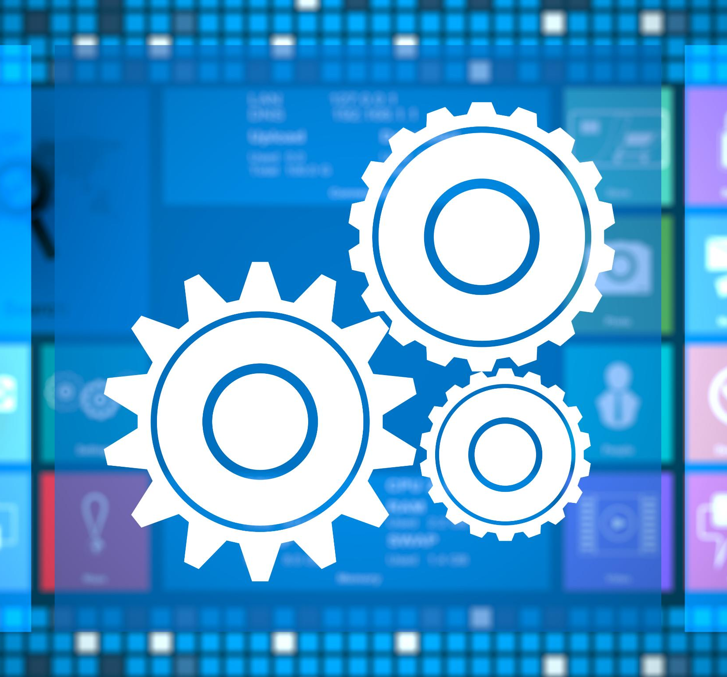
Jenkins Build Tools and Build Triggers
Automating software builds with efficient triggers
Notes:
---

Slide 2
Learning Objectives
Notes:
Goals of the Lesson

Slide 3

Goals of the Lesson
Jenkins and Build Tools
  Understand how Jenkins integrates with build tools like Maven to automate software development processes effectively.
Unit Testing Automation
  Learn concepts of unit testing and Jenkins automation for test execution and reporting to enhance code quality.
Artifact and Fingerprint Management
  Explore artifacts and fingerprints usage for tracking changes and maintaining build integrity in CI/CD pipelines.
Webhook Configuration
  Configure webhook integration in Jenkins to trigger builds in real-time from external systems, improving workflow efficiency.
Notes:
This section focuses on the primary objectives of understanding Jenkins build tools and triggers. Learners will explore how Jenkins integrates with various build tools to automate processes, ensuring efficiency and consistency in software development. The lesson emphasizes using Maven for Java projects, which simplifies compilation, testing, and packaging tasks. Additionally, learners will gain insights into unit testing concepts and how Jenkins can automate test execution and reporting, improving code quality. Another key objective is understanding artifacts and fingerprints, which are essential for tracking changes, maintaining build integrity, and facilitating rollbacks. Finally, configuring webhook integration in Jenkins is highlighted to enable real-time triggering of builds from external systems, streamlining CI/CD workflows and reducing manual intervention.

Slide 4
Build Tools Overview
Notes:
Popular Build Tools and Their Role

Slide 5

Popular Build Tools and Their Role
Role of Build Tools
  Build tools automate source code conversion to deployable formats, improving development efficiency and consistency.
Apache Ant Features
  Ant uses XML configuration for managing tasks like compiling and packaging Java applications.
Maven Project Management
  Maven simplifies project management with POM, handling dependencies and automating builds.
Gradle and Travis CI Advantages
  Gradle offers flexible Groovy-based scripting for complex builds; Travis CI provides cloud-based continuous integration.
Notes:
Build tools are essential for automating the conversion of source code into deployable formats, enhancing the software development lifecycle. Jenkins supports integration with widely used tools such as Apache Ant, Maven, Gradle, and Travis CI. Ant is a Java-based tool that uses XML configuration to manage tasks like compiling and packaging. Maven simplifies project management through its Project Object Model (POM), handling dependencies and automating builds. Gradle offers flexibility and speed, using Groovy-based scripts for defining tasks, making it suitable for complex projects. Travis CI provides a cloud-based solution for continuous integration, particularly popular for GitHub projects. These tools collectively enable developers to automate repetitive tasks, maintain consistency across environments, and improve collaboration by centralizing build management.

Slide 6
Maven Build Tool
Notes:
Features and Integration with Jenkins

Slide 7

Features and Integration with Jenkins
Maven Build Automation
  Maven automates Java project builds with consistent structure and manages compilation, testing, and packaging tasks effectively.
Dependency Management
  Maven efficiently handles dependencies by downloading libraries automatically and ensuring compatibility without manual intervention.
Extensibility with Plugins
  Developers can extend Maven functionality by creating custom plugins tailored to project-specific needs and workflows.
Integration with Jenkins
  Jenkins integration automates Maven builds and deployments, enhancing CI/CD pipelines and improving software delivery cycles.
Notes:
Maven is a powerful build automation tool primarily used for Java projects. It simplifies the build process by providing a consistent project structure and automating tasks such as compilation, testing, and packaging. Maven manages dependencies efficiently, downloading required libraries and ensuring compatibility, which eliminates manual intervention. It also generates reports and documentation, offering insights into project health and progress. Maven’s extensibility allows developers to create custom plugins tailored to specific needs. Integration with Jenkins enhances CI/CD pipelines by enabling automated builds and deployments. Jenkins can invoke Maven goals to compile code, run tests, and package applications, ensuring streamlined workflows and reducing errors. This integration is crucial for maintaining high-quality software and accelerating delivery cycles.

Slide 8
Build Automation Using Jenkins
Notes:
Tasks and Benefits

Slide 9
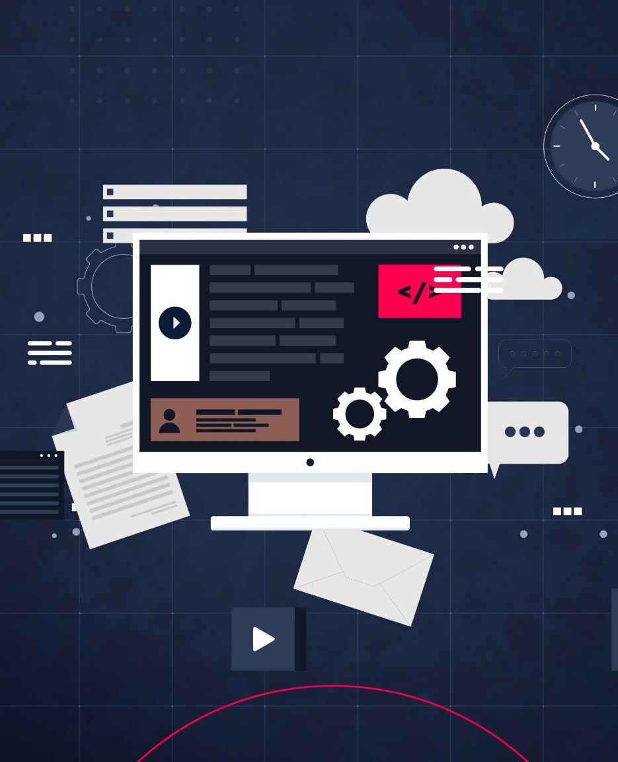
Tasks and Benefits
Automated Build Tasks
  Jenkins automates retrieving code, compiling, testing, and packaging to streamline the build process and reduce errors.
Improved Development Efficiency
  Automation frees developers from repetitive tasks, speeds up development cycles, and ensures consistent builds across environments.
Enhanced Collaboration and Visibility
  Jenkins serves as a central hub providing visibility into build status and history, improving team collaboration.
Notes:
Jenkins automates several critical tasks in the build process, including retrieving code from version control systems, compiling source code, running unit tests, and packaging the final application into deployable formats such as JAR or WAR files. This automation reduces manual effort, minimizes errors, and ensures consistency across environments. Benefits of using Jenkins for build automation include freeing developers from repetitive tasks, improving build quality through automated testing, and accelerating development cycles with parallel execution. Jenkins also enhances collaboration by serving as a central hub for build management, providing visibility into build status and history. These advantages make Jenkins an indispensable tool for modern software development practices focused on continuous integration and delivery.

Slide 10
Unit Testing and Reports
Notes:
Configuration and Reporting in Jenkins

Slide 11
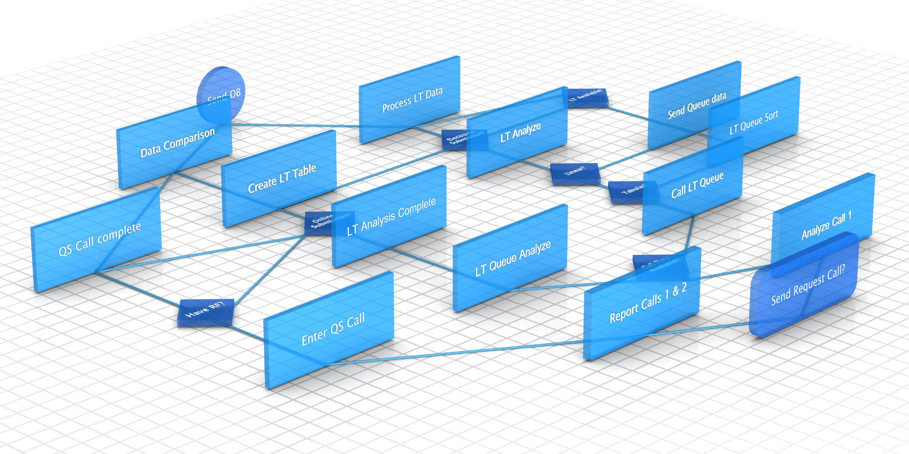
Configuration and Reporting in Jenkins
Plugin Integration for Testing
  Jenkins integrates plugins like JUnit and NUnit to automate unit test execution during software builds.
Consistent Test Execution
  Configured build steps in Jenkins ensure tests run consistently across different environments during builds.
Detailed Test Reporting
  Jenkins generates detailed reports with pass/fail status and error details to help teams identify and fix issues early.
Supporting Continuous Integration
  Automated testing and reporting in Jenkins provide immediate feedback to support continuous integration workflows and improve collaboration.
Notes:
Unit testing is a critical aspect of software quality assurance, and Jenkins simplifies this process through plugin integration. Developers can install plugins for popular frameworks such as JUnit for Java or NUnit for .NET, enabling automated test execution during builds. Jenkins allows configuration of build steps to invoke test scripts, ensuring tests run consistently across environments. After execution, Jenkins generates detailed reports summarizing test outcomes, including pass/fail status and error details. These reports help teams identify issues early, track code quality trends, and improve collaboration by sharing results. Automated testing and reporting in Jenkins not only enhance transparency but also support continuous integration by providing immediate feedback on code changes.

Slide 12
Artifacts and Fingerprints
Notes:
Importance in CI/CD Pipelines

Slide 13

Importance in CI/CD Pipelines
Role of Artifacts
  Artifacts include compiled code, test reports, and logs essential for deployment and rollback.
Fingerprinting for Traceability
  Jenkins assigns unique fingerprints to artifacts to track their origin and dependencies.
Efficiency in CI/CD
  Fingerprints enable artifact reuse in downstream jobs, improving efficiency and reducing build times.
Robust Pipeline Management
  Clear artifact versioning supports quick adaptation and recovery from failures in CI/CD pipelines.
Notes:
Artifacts are files generated during the build process, such as compiled code, test reports, logs, and deployment packages. They are essential for deployment, testing, and rollback scenarios. Jenkins assigns fingerprints to artifacts, which are unique identifiers that enable traceability and dependency management. Fingerprints help track artifact origins, such as the build or commit that produced them, ensuring accountability and simplifying debugging. They also allow reuse of existing artifacts in downstream jobs, reducing build times and improving efficiency. By maintaining a clear record of artifact versions and their relationships, Jenkins supports robust CI/CD pipelines that can quickly adapt to changes and recover from failures.

Slide 14
Upstream and Downstream Jobs
Notes:
Job Chaining for Automation

Slide 15

Job Chaining for Automation
Upstream and Downstream Jobs
  Upstream jobs trigger before the main job, and downstream jobs run after, enabling sequential workflow execution.
Trigger Conditions
  Job triggers depend on build success, failure, or custom parameters defined in pipeline scripts.
Benefits of Job Chaining
  Job chaining reduces manual intervention and ensures reliable execution of dependent tasks in CI/CD pipelines.
Notes:
Jenkins enables job chaining through upstream and downstream configurations, allowing multiple jobs to execute in sequence or based on specific conditions. An upstream job triggers before the main job, while a downstream job runs after the main job completes. Trigger conditions can include build success, failure, or custom parameters defined through pipeline scripts. This setup is useful for complex workflows where tasks such as building, testing, and deployment need to occur in a controlled order. Job chaining enhances automation, reduces manual intervention, and ensures that dependent processes execute reliably, contributing to efficient CI/CD pipelines.

Slide 16
Build Triggers
Notes:
Options and Configurations

Slide 17
Options and Configurations
Trigger Type | Mechanism | Use Case
Poll SCM | Checks repository for changes | Projects with infrequent commits
Build Periodically | Runs on scheduled intervals | Regular maintenance builds
Webhooks | Receives real-time notifications | Immediate feedback on code changes
Notes:
Jenkins offers multiple build trigger options to automate job execution. Build Periodically uses cron expressions to schedule jobs at fixed intervals, ensuring regular builds and early detection of issues. Poll SCM checks version control systems for changes and triggers builds when new commits are detected, supporting continuous integration. Webhooks provide real-time notifications from external systems, such as GitHub, to initiate builds immediately after code changes, reducing latency and improving feedback loops. Each method serves different use cases: periodic builds for maintenance, polling for frequent changes, and webhooks for instant integration. Configuring these triggers effectively ensures smooth and efficient CI/CD workflows.

Slide 18
Key Takeaways
Notes:
Summary of Concepts

Slide 19

Summary of Concepts
Build Tools Integration
  Jenkins integrates with various build tools, automating compilation, testing, and deployment efficiently.
Plugin Extensions
  Plugins extend Jenkins capabilities for unit testing and reporting, enhancing CI/CD workflows.
Artifact Traceability
  Artifacts and fingerprints provide traceability and support reliable dependency management in CI/CD pipelines.
Job Automation and Triggers
  Job chaining and build triggers like Poll SCM and Webhooks automate workflows and streamline execution.
Notes:
Jenkins integrates seamlessly with multiple build tools, enabling automation of compilation, testing, and deployment processes. Maven stands out as a robust solution for managing Java projects, while plugins extend Jenkins’ capabilities for unit testing and reporting. Artifacts and fingerprints ensure traceability and efficient dependency management, supporting reliable CI/CD pipelines. Job chaining through upstream and downstream configurations enhances workflow automation, and build triggers like Poll SCM, Build Periodically, and Webhooks streamline job execution. Collectively, these features make Jenkins a powerful platform for continuous integration and delivery, improving software quality and accelerating development cycles.

