Slide 1
Introduction to DevOps
Understanding collaboration between development and operations teams
Notes:
---

Slide 2
Introduction to DevOps
Notes:
---
This slide references information from the following file: https://dell-my.sharepoint.com/personal/prakash_hikkanagutti_dell_com/Documents/Microsoft%20Copilot%20Chat%20Files/Lesson_01_Introduction_to_DevOps.pdf
What is DevOps?, Benefits of DevOps

Slide 3

What is DevOps?
DevOps Definition
  DevOps bridges software development and IT operations to improve collaboration and delivery speed.
Core Practices
  Includes continuous integration, continuous delivery, infrastructure as code, and automated testing.
Goals and Benefits
  Shortens development lifecycle while maintaining quality, security, and enhancing customer satisfaction.
Cultural Mindset
  Promotes shared responsibility, collaboration, agility, and adaptability across all stakeholders.
Notes:
---
This slide references information from the following file: https://dell-my.sharepoint.com/personal/prakash_hikkanagutti_dell_com/Documents/Microsoft%20Copilot%20Chat%20Files/Lesson_01_Introduction_to_DevOps.pdf
DevOps is a cultural and technical movement that bridges the gap between software development and IT operations. It emphasizes collaboration, automation, and continuous improvement to deliver high-quality software faster and more reliably. The primary goal of DevOps is to shorten the development lifecycle while maintaining high standards of quality and security. By integrating development and operations teams, organizations can eliminate silos, improve communication, and streamline workflows. DevOps practices include continuous integration (CI), continuous delivery (CD), infrastructure as code (IaC), and automated testing. These practices enable teams to respond quickly to changes, reduce time-to-market, and enhance customer satisfaction. Unlike traditional approaches that rely on rigid phases and manual processes, DevOps promotes agility and adaptability, ensuring that software evolves in alignment with business needs and user feedback. This mindset is not limited to tools but extends to fostering a culture of shared responsibility and collaboration across all stakeholders.

Slide 4

Benefits of DevOps
Faster Release Speed
  DevOps enables faster software releases through automation and streamlined workflows, reducing time-to-market.
Improved Efficiency
  Integration of processes and tools in DevOps reduces manual work and minimizes errors for better efficiency.
Enhanced Reliability
  Consistent deployments and strong infrastructure management in DevOps reduce downtime and increase system stability.
Agility and Adaptability
  DevOps fosters agility, enabling quick response to changes and continuous improvement based on feedback.
Notes:
---
This slide references information from the following file: https://dell-my.sharepoint.com/personal/prakash_hikkanagutti_dell_com/Documents/Microsoft%20Copilot%20Chat%20Files/Lesson_01_Introduction_to_DevOps.pdf
DevOps offers numerous benefits that transform the way organizations build and deliver software. First, it significantly improves speed by enabling faster releases through automation and streamlined workflows. This reduction in time-to-market is critical for businesses operating in competitive environments. Second, DevOps enhances efficiency by integrating processes and tools, reducing manual interventions, and minimizing errors. Third, it ensures reliability by promoting consistent deployments and robust infrastructure management, which reduces downtime and improves system stability. Additionally, DevOps fosters agility, allowing teams to respond proactively to changing requirements and market conditions. Continuous feedback loops and iterative improvements lead to higher quality products, as issues are detected and resolved early in the development cycle. Adaptability is another key advantage, as DevOps practices enable real-time responses to operational challenges. Overall, DevOps creates a culture of collaboration and accountability, resulting in improved customer satisfaction and business outcomes.

Slide 5
DevOps vs Traditional Approach
Notes:
---
This slide references information from the following file: https://dell-my.sharepoint.com/personal/prakash_hikkanagutti_dell_com/Documents/Microsoft%20Copilot%20Chat%20Files/Lesson_01_Introduction_to_DevOps.pdf
Comparison of Approaches

Slide 6
Comparison of Approaches
Aspect | Traditional Approach | DevOps
Focus | Infrastructure only | Infrastructure and application
Speed | Slow recovery and releases | Fast recovery and releases
Development Model | Linear | Continuous integration and deployment
Teamwork | Siloed functions | Collaborative approach
Notes:
---
This slide references information from the following file: https://dell-my.sharepoint.com/personal/prakash_hikkanagutti_dell_com/Documents/Microsoft%20Copilot%20Chat%20Files/Lesson_01_Introduction_to_DevOps.pdf
The traditional software development approach, often represented by the waterfall model, follows a linear sequence of phases: requirements, design, implementation, testing, deployment, and maintenance. This rigid structure makes it difficult to accommodate changes, leading to delays and increased costs. Feedback loops are limited, and customer involvement typically occurs late in the process, which can compromise product relevance and quality. In contrast, DevOps adopts an iterative and collaborative model that integrates development and operations throughout the software lifecycle. It emphasizes continuous integration and continuous delivery (CI/CD), enabling frequent and reliable releases. Automation plays a central role in DevOps, reducing manual tasks and improving consistency. Teamwork is another differentiator: while traditional methods often isolate teams by function, DevOps encourages cross-functional collaboration, breaking down silos and fostering shared responsibility. This approach not only accelerates delivery but also enhances adaptability, quality, and customer satisfaction.

Slide 7
DevOps Lifecycle and Tools
Notes:
---
This slide references information from the following file: https://dell-my.sharepoint.com/personal/prakash_hikkanagutti_dell_com/Documents/Microsoft%20Copilot%20Chat%20Files/Lesson_01_Introduction_to_DevOps.pdf
DevOps Lifecycle, Essential DevOps Tools

Slide 8
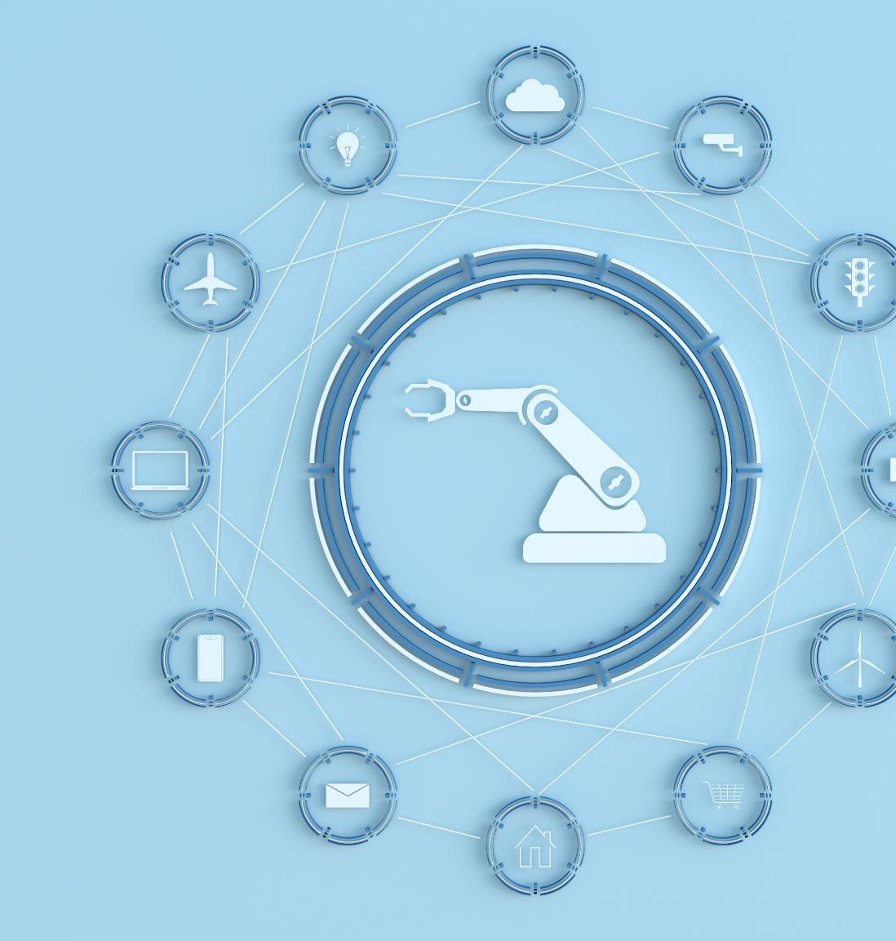
DevOps Lifecycle
Seven Key Phases
  DevOps lifecycle includes Plan, Code, Build, Test, Deploy, Operate, and Monitor phases working iteratively.
Automation and Integration
  Automation ensures seamless integration and faster delivery without compromising software quality.
Continuous Monitoring
  Real-time monitoring provides insights for proactive issue resolution and continuous improvement.
Notes:
---
This slide references information from the following file: https://dell-my.sharepoint.com/personal/prakash_hikkanagutti_dell_com/Documents/Microsoft%20Copilot%20Chat%20Files/Lesson_01_Introduction_to_DevOps.pdf
The DevOps lifecycle is a continuous and iterative process designed to deliver software efficiently and reliably. It consists of seven key phases: Plan, Code, Build, Test, Deploy, Operate, and Monitor. Planning involves defining project goals, requirements, and timelines. Coding focuses on writing and managing source code using version control systems. Building automates the compilation and packaging of code into executable artifacts. Testing includes automated and manual validation to ensure functionality and quality. Deployment automates the release of software to production environments, while operation ensures system stability and performance. Monitoring provides real-time insights into application behavior, enabling proactive issue resolution and continuous improvement. These phases are interconnected, creating a feedback loop that drives agility and responsiveness. Automation and collaboration underpin the entire lifecycle, ensuring that changes are integrated seamlessly and delivered quickly without compromising quality.

Slide 9
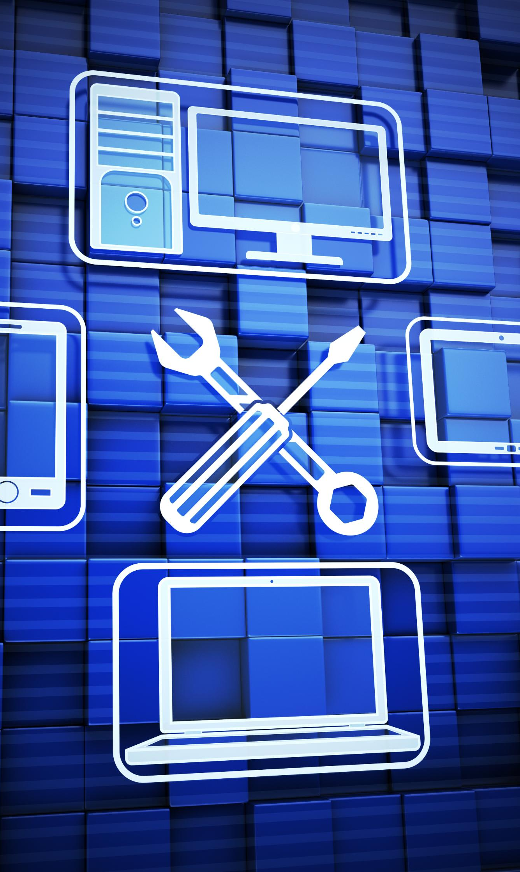
Essential DevOps Tools
Source Code Management
  Tools like Git enable version control and collaborative coding for efficient software development.
Build Automation and CI/CD
  Build tools and Jenkins automate compiling, testing, and deployment for continuous integration and delivery.
Testing and Quality Assurance
  Testing tools like Selenium ensure software quality through automated validation and error detection.
Infrastructure and Monitoring
  Configuration management and monitoring tools automate infrastructure and provide system health visibility.
Notes:
---
This slide references information from the following file: https://dell-my.sharepoint.com/personal/prakash_hikkanagutti_dell_com/Documents/Microsoft%20Copilot%20Chat%20Files/Lesson_01_Introduction_to_DevOps.pdf
DevOps relies on a diverse set of tools to implement its practices effectively. For source code management (SCM), tools like Git and GitHub enable version control and collaborative coding. Build automation tools such as Maven and Gradle streamline the process of compiling and packaging applications. Continuous integration and delivery (CI/CD) pipelines are powered by tools like Jenkins, which automate building, testing, and deployment. Testing tools such as Selenium, JUnit, and TestNG ensure software quality through automated validation. Configuration management and deployment tools, including Ansible, Chef, Puppet, and Terraform, facilitate infrastructure automation and consistency across environments. Monitoring tools like Nagios, Grafana, and Prometheus provide visibility into system performance and health, enabling proactive issue detection. Containerization tools such as Docker and Kubernetes allow applications to run reliably across different environments by packaging them with their dependencies. Together, these tools create a robust ecosystem that supports the principles of speed, reliability, and scalability in DevOps.

Slide 10
DevSecOps and Key Takeaways
Notes:
---
This slide references information from the following file: https://dell-my.sharepoint.com/personal/prakash_hikkanagutti_dell_com/Documents/Microsoft%20Copilot%20Chat%20Files/Lesson_01_Introduction_to_DevOps.pdf
Introduction to DevSecOps, Key Takeaways

Slide 11
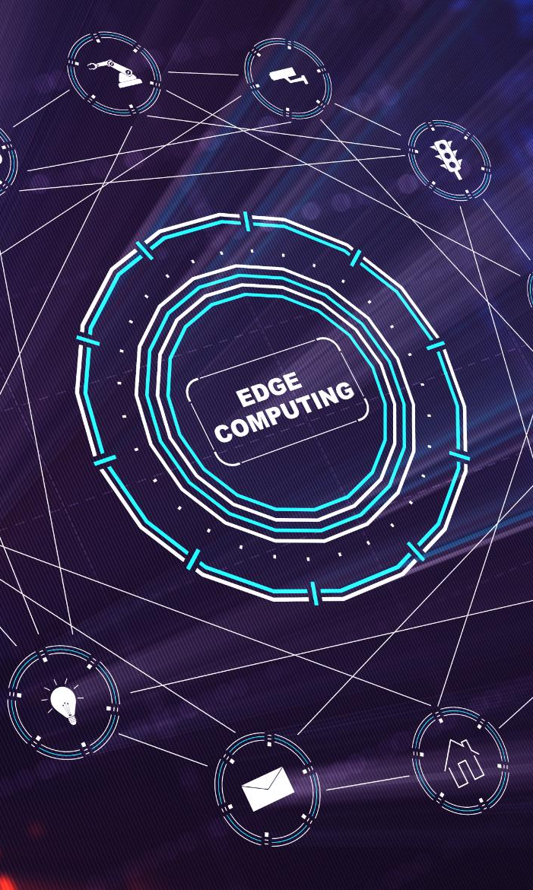
Introduction to DevSecOps
Integrated Security in Development
  DevSecOps embeds security in every stage of software development to identify vulnerabilities early and reduce risks.
Automated Security Practices
  Automation tools like security testing and vulnerability scanning enhance continuous security enforcement in CI/CD pipelines.
Collaborative Culture
  DevSecOps fosters shared responsibility among development, operations, and security teams for delivering secure software efficiently.
Benefits of DevSecOps
  Adopting DevSecOps accelerates delivery while maintaining compliance, security, and resilience against cyber threats.
Notes:
---
This slide references information from the following file: https://dell-my.sharepoint.com/personal/prakash_hikkanagutti_dell_com/Documents/Microsoft%20Copilot%20Chat%20Files/Lesson_01_Introduction_to_DevOps.pdf
DevSecOps extends the principles of DevOps by integrating security practices throughout the software development lifecycle. Instead of treating security as a separate phase, DevSecOps embeds it into every stage, from planning to deployment. This approach ensures that vulnerabilities are identified and addressed early, reducing risks and improving compliance. Key practices include automated security testing, vulnerability scanning, and policy enforcement within CI/CD pipelines. DevSecOps promotes a culture of shared responsibility, where development, operations, and security teams collaborate to deliver secure software quickly and efficiently. By adopting DevSecOps, organizations can achieve faster delivery without compromising security, maintain regulatory compliance, and enhance overall resilience against cyber threats.

Slide 12
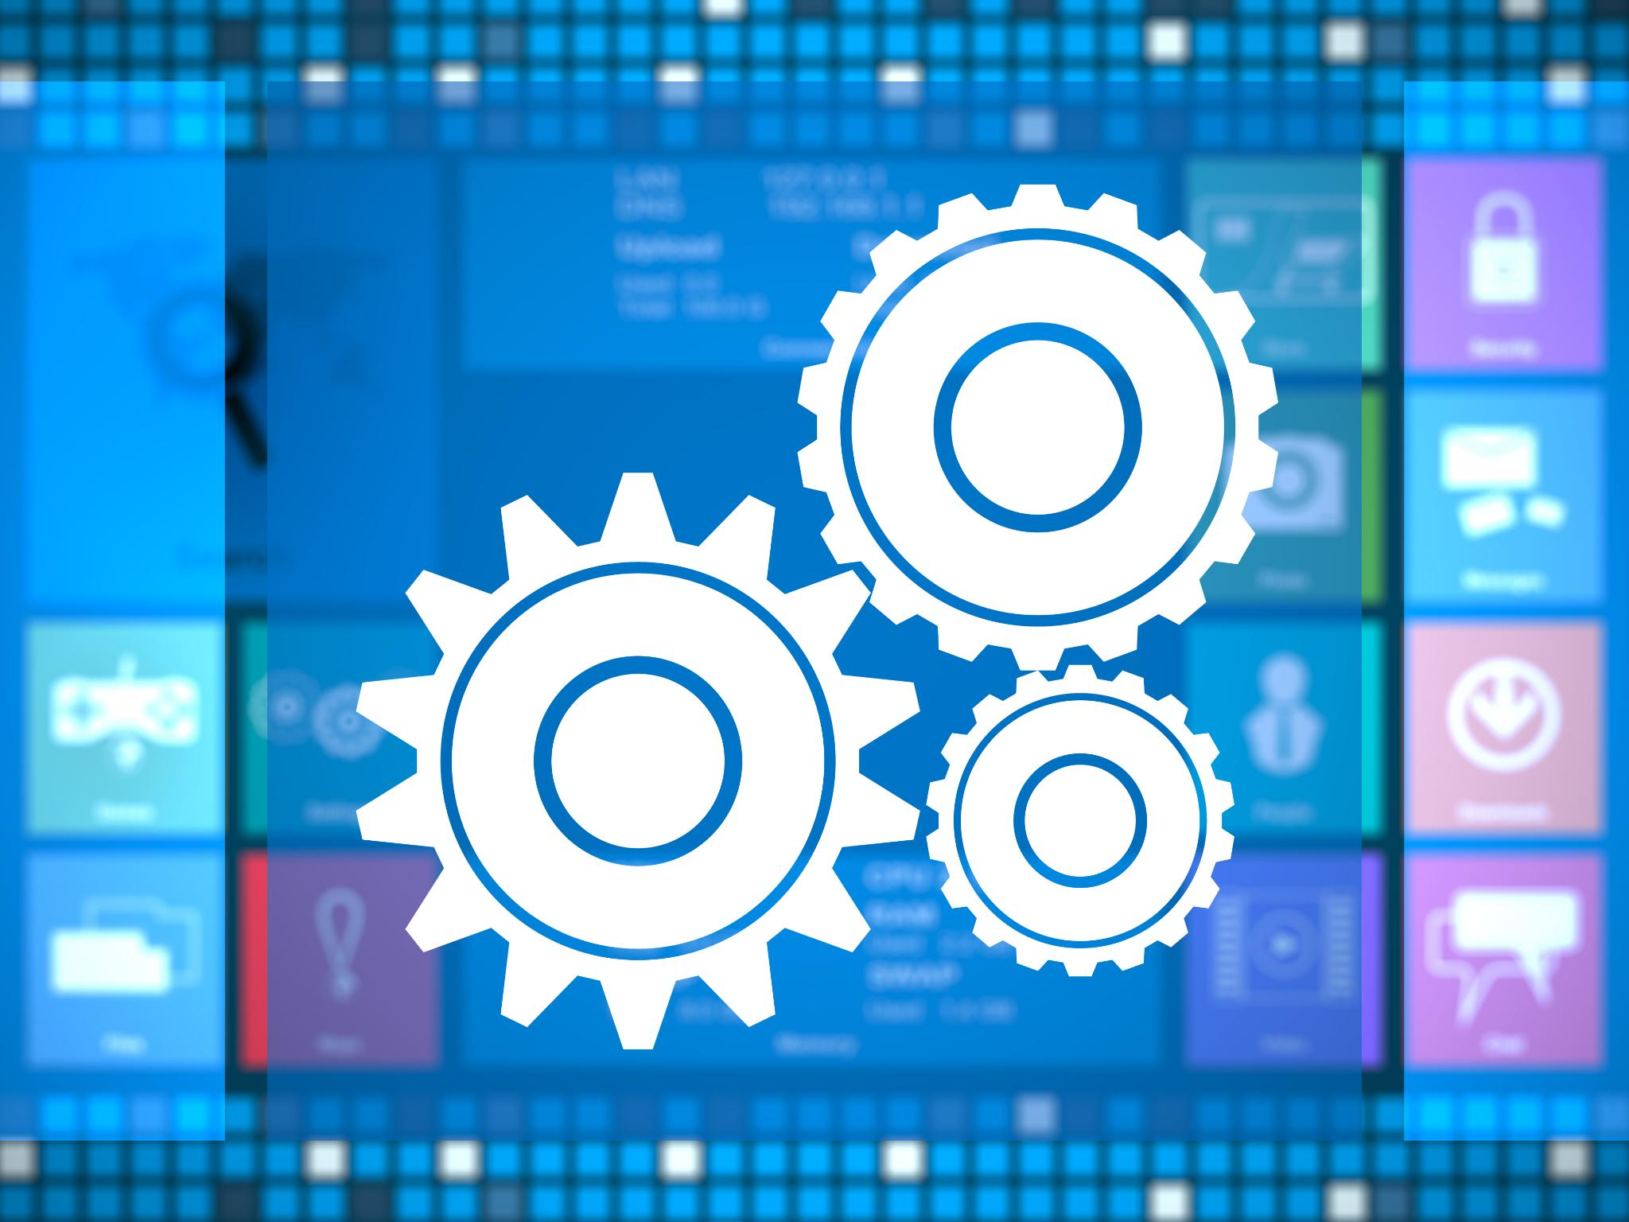
Key Takeaways
DevOps Benefits
  DevOps fosters collaboration and automation, reducing time-to-market and enhancing software quality and adaptability.
Agile and DevOps Integration
  Agile and DevOps complement each other by combining iterative development with streamlined delivery processes.
DevOps Lifecycle
  The DevOps lifecycle integrates planning, coding, building, testing, deploying, operating, and monitoring with automation and feedback loops.
DevSecOps Importance
  DevSecOps embeds security into every phase, ensuring fast and safe software delivery.
Notes:
---
This slide references information from the following file: https://dell-my.sharepoint.com/personal/prakash_hikkanagutti_dell_com/Documents/Microsoft%20Copilot%20Chat%20Files/Lesson_01_Introduction_to_DevOps.pdf
DevOps revolutionizes software development by fostering collaboration, automation, and continuous improvement. It reduces time-to-market, enhances quality, and improves adaptability. Agile and DevOps complement each other, combining iterative development with streamlined delivery processes. The DevOps lifecycle integrates planning, coding, building, testing, deploying, operating, and monitoring into a cohesive workflow supported by automation and feedback loops. DevSecOps builds on this foundation by embedding security into every phase, ensuring that speed does not come at the expense of safety. Organizations adopting these practices can achieve faster, more reliable, and secure software delivery, ultimately driving innovation and customer satisfaction.

