Slide 1

Basics of Version Control System with Git
Understanding fundamental tools for code management
Notes:
---

Slide 2
Introduction and Learning Objectives
Notes:
Learning Objectives

Slide 3

Learning Objectives
Version Control Fundamentals
  Learn the basics of version control systems and Git to track and manage code changes effectively.
Repository Management
  Create, clone, and manage GitHub repositories to organize and share project code efficiently.
Branching and Merging
  Master branching strategies and resolve merge conflicts to enable parallel development workflows.
Collaboration and Synchronization
  Use Git commands like push and pull for synchronizing local and remote repositories, supporting team collaboration.
Notes:
By the end of this lesson, learners will understand the fundamentals of version control systems and Git. They will be able to create and clone GitHub repositories, manage branches, and resolve merge conflicts. Additionally, learners will gain proficiency in using Git commands such as git push and git pull to synchronize local and remote repositories. The objectives also include understanding repository management, branching strategies, and collaboration techniques essential for modern software development workflows. These skills are critical for maintaining code integrity, enabling team collaboration, and supporting continuous integration and deployment practices in DevOps environments.

Slide 4
Overview of Version Control Systems
Notes:
Source Code Management and Benefits, VCS vs SCM

Slide 5

Source Code Management and Benefits
Track Code Changes
  SCM systems maintain a centralized history of source code changes over time for accurate tracking and auditing.
Collaborative Coding
  SCM enables multiple developers to work together on the same project without code conflicts or data loss.
Backup and Recovery
  SCM ensures secure code backup and easy retrieval of previous versions, minimizing risk of data loss.
Streamlined Workflow
  SCM systems automate release notes and improve workflow efficiency in large-scale development projects.
Notes:
Source Code Management (SCM) systems track modifications to source code over time, providing a centralized history of changes. SCM enables collaborative coding, version history tracking, and automated release note generation. It ensures code backup and easy retrieval of previous versions, reducing risks of data loss. SCM systems also streamline workflows by allowing multiple developers to work on the same project without conflicts. These benefits make SCM indispensable for large-scale projects where maintaining code quality and consistency is paramount.

Slide 6
VCS vs SCM
Aspect | VCS | SCM
Focus | Manage file versions | Manage versions and collaboration
Purpose | Track changes in files | Track changes and facilitate teamwork
Examples | Git, SVN | GitHub, GitLab
Notes:
Version Control Systems (VCS) focus on managing file versions, while SCM encompasses broader collaboration and lifecycle management. VCS tracks changes in files and supports rollback, whereas SCM integrates version control with team collaboration across development phases. Common VCS tools include Git, SVN, and Mercurial, while SCM platforms like GitHub, GitLab, and Bitbucket provide additional features such as issue tracking and CI/CD integration.

Slide 7
Git Basics and Features
Notes:
What is Git and Why Use It?, Key Features of Git

Slide 8

What is Git and Why Use It?
Distributed Version Control
  Git is a distributed system where every developer has a full repository copy ensuring robustness and data safety.
Simultaneous Collaboration
  Git allows multiple developers to work on the same project simultaneously without conflicts.
Branching and Merging
  Supports branching and merging which enables parallel development and easy experimentation.
Wide Industry Adoption
  Git is widely used by major companies for its scalability, security, and efficiency.
Notes:
Git is an open-source distributed version control system designed to track changes in source code during software development. It allows multiple developers to work simultaneously on the same project without conflicts. Git supports branching and merging, enabling parallel development and experimentation. Its distributed nature ensures robustness, as every developer has a complete copy of the repository. Git is widely adopted by major companies like Google and Microsoft due to its scalability, security, and efficiency.

Slide 9

Key Features of Git
Version Tracking and Security
  Git provides secure and reliable version tracking enabling developers to manage history and changes efficiently.
Branching and Staging Area
  Git supports non-linear development through branching and offers a staging area to prepare commits effectively.
Distributed and Scalable
  Git’s distributed design and scalability support collaborative workflows across diverse teams and projects.
Commit Management and Versioning
  Developers can revert changes, annotate commits, and manage tags for efficient version control.
Notes:
Git offers secure version tracking, non-linear development through branching, and a staging area for commits. It is open-source, scalable, and supports distributed workflows. Developers can revert changes, annotate commits, and manage tags for versioning. These features make Git ideal for collaborative projects and continuous integration pipelines.

Slide 10
Git vs GitHub
Notes:
Differences Between Git and GitHub

Slide 11
Differences Between Git and GitHub
Git Overview
Git is a local version control system that manages code changes via command-line interface.
GitHub Features
GitHub is a cloud-based platform offering graphical interface, user management, and collaboration tools.
Collaboration Benefits
GitHub enables remote repository hosting, pull requests, and access control for distributed teams.
Notes:
Git is a version control system installed locally, while GitHub is a cloud-based hosting service for Git repositories. Git operates via command-line interface and manages local changes, whereas GitHub provides a graphical interface, user management, and collaboration tools. GitHub enables remote repository hosting, pull requests, and access control, making it essential for distributed teams.

Slide 12
Git Workflow and Commands
Notes:
Push and Pull Operations, Basic Git Commands

Slide 13

Push and Pull Operations
Git Push Operation
  Push uploads committed local changes to a remote repository to synchronize codebases.
Git Pull Operation
  Pull fetches updates from the remote repository and merges them into the local branch.
Importance in Collaboration
  Using push and pull correctly helps maintain synchronization and avoid conflicts in teams.
Notes:
The Git workflow involves staging changes with git add, committing them with git commit, and synchronizing with remote repositories using git push and git pull. Push uploads local changes to a remote repository, while pull fetches and merges updates from the remote repository into the local branch. Understanding these operations is crucial for maintaining synchronization and avoiding conflicts in collaborative environments.

Slide 14
Basic Git Commands
Operation | Command
Initialize repository | git init
Clone repository | git clone [URL]
Stage changes | git add [file]
Commit changes | git commit -m 'message'
Push changes | git push
Pull changes | git pull

Slide 15
Branching and Merging
Notes:
Branching Strategies, Merging and Conflict Resolution

Slide 16

Branching Strategies
Purpose of Branching
  Branching creates isolated environments for features, bug fixes, and experiments without affecting stable code.
Common Branch Types
  Main, develop, feature, release, and hotfix are commonly used branches in Git to organize development.
Branching Models
  Branching models like Git Flow provide structured conventions to manage branches effectively and ensure smooth workflow.
Notes:
Branching in Git allows developers to create isolated environments for feature development, bug fixes, and experimentation. Common branches include main, develop, feature, release, and hotfix. This strategy ensures parallel development without impacting the stable codebase. Branching models like Git Flow define conventions for managing these branches effectively.

Slide 17

Merging and Conflict Resolution
Branch Changes Integration
  Merging combines code changes from different branches to unify updates and features seamlessly.
Conflict Detection
  Conflicts arise when overlapping edits occur in the same file, requiring manual intervention to resolve.
Manual Conflict Resolution
  Developers manually edit conflicting files, remove conflict markers, and commit the resolved code.
Maintaining Code Integrity
  Effective merging practices ensure stable codebases and smooth collaboration among developers.
Notes:
Merging integrates changes from one branch into another, typically using git merge. Conflicts occur when changes overlap in the same file, requiring manual resolution. Developers must edit conflicting files, remove conflict markers, and commit the resolved changes. Effective merging practices maintain code integrity and prevent disruptions in collaborative workflows.

Slide 18
Best Practices and Key Takeaways
Notes:
Best Practices for Version Control, Key Takeaways

Slide 19
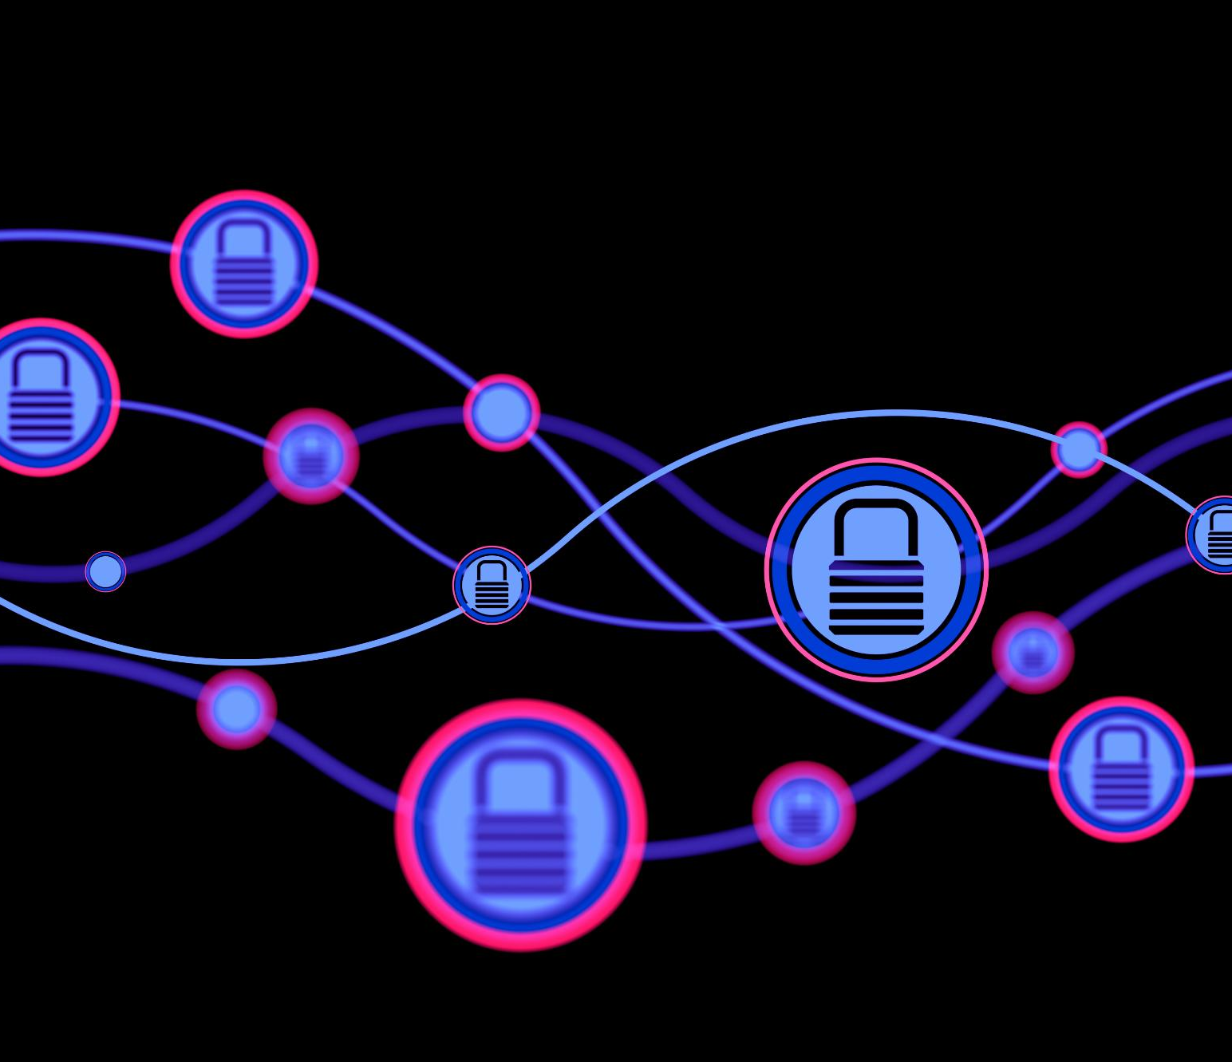
Best Practices for Version Control
Frequent Commits and Branching
  Commit changes often with clear messages and use branches to develop new features separately.
Synchronization with Remote Repositories
  Regularly sync local changes with remote repositories to keep codebases consistent and up to date.
Security and Backup Strategies
  Implement access controls and backup plans to safeguard code and ensure disaster recovery.
Monitoring and Compliance
  Monitor version control activities to maintain code integrity and adhere to compliance standards.
Notes:
Commit changes frequently with descriptive messages, use branches for feature development, and regularly synchronize with remote repositories. Implement access control and backup strategies to ensure security and disaster recovery. Monitor version control activities to maintain code integrity and compliance. These practices enhance collaboration and reduce risks in software development.

Slide 20

Key Takeaways
Importance of Version Control
  Version control systems track changes, support collaboration, and help maintain high code quality in projects.
Git Features
  Git offers distributed version control with features like branching, merging, and staging for efficient code management.
Role of GitHub
  GitHub provides remote hosting and tools that enhance collaboration on Git-based projects.
Best Practices
  Mastering Git workflows and best practices ensures efficient and reliable software development processes.
Notes:
Version control systems are essential for tracking changes, enabling collaboration, and maintaining code quality. Git, as a distributed VCS, offers powerful features like branching, merging, and staging. GitHub complements Git by providing remote hosting and collaboration tools. Mastering Git workflows and best practices ensures efficient and reliable software development.

