Slide 1

Jenkins Pipeline: Concepts and Implementation
Understanding automation for continuous integration delivery
Notes:
---

Slide 2
Introduction to Jenkins Pipeline
Notes:
Learning Objectives, Overview of Jenkins Pipeline

Slide 3

Learning Objectives
Utilize Jenkins Pipelines
  Learners will understand how to use Jenkins pipelines to automate builds and streamline software releases effectively.
Scripted vs Declarative Pipelines
  Identify similarities and differences between scripted and declarative Jenkins pipelines to optimize CI/CD workflows.
Jenkins Authentication Options
  Outline authentication methods in Jenkins for secure access control and user management in pipeline execution.
Notes:
By the end of this lesson, learners will understand how to utilize Jenkins pipelines to enhance software development and deployment workflows, achieving faster, automated builds and streamlined releases. They will be able to identify similarities and differences between scripted and declarative Jenkins pipelines for optimizing CI/CD processes. Additionally, learners will outline authentication options in Jenkins for secure access control and user management, ensuring robust security practices in pipeline execution.

Slide 4

Overview of Jenkins Pipeline
Pipeline as Code
  Jenkins Pipeline enables defining continuous delivery workflows as code inside a Jenkinsfile for automation and version control.
Workflow Automation
  It automates tasks like testing, merging, packaging, shipping, and deploying software efficiently.
Structured CI/CD Stages
  Typical stages include code checkout, build, unit tests, security scans, and deployment ensuring comprehensive delivery.
Notes:
Jenkins Pipeline is a suite of plugins that enables defining and automating continuous delivery workflows as code within a Jenkinsfile. It orchestrates tasks such as testing, merging, packaging, shipping, and deploying code. Pipelines provide a structured approach to CI/CD, allowing developers to manage complex workflows efficiently. The pipeline stages typically include code checkout, build, unit testing, security scans, and deployment, ensuring a comprehensive and automated delivery process.

Slide 5
Pipeline Stages and Benefits
Notes:
Key Stages of Jenkins Pipeline, Benefits of Using Jenkins Pipeline

Slide 6
Key Stages of Jenkins Pipeline
Code Checkout
Retrieving the latest code from version control ensures all updates are included before building.
Build Stage
Compiling source code to create executable artifacts is essential for software deployment.
Unit Testing
Running unit tests validates individual components to ensure they function correctly.
Security Scanning
Performing security scans helps identify vulnerabilities to maintain application safety.
Deployment
Deploying the code to production or staging environments completes the CI/CD cycle.
Notes:
The Jenkins pipeline consists of several stages that facilitate seamless CI/CD automation. These include: (1) Checkout code from version control to ensure the latest updates are retrieved; (2) Build the code to compile and create executable artifacts; (3) Run unit tests to validate individual components; (4) Perform security scans to identify vulnerabilities; and (5) Deploy the code to production or staging environments. Each stage is critical for maintaining code quality and ensuring reliable deployments.

Slide 7

Benefits of Using Jenkins Pipeline
Automation Efficiency
  Automation minimizes manual tasks, increasing efficiency and reducing errors in software delivery.
Enhanced Visibility
  Pipelines provide clear progress tracking, improving transparency and team collaboration.
Consistent Repeatability
  Repeatable pipelines ensure consistent results across different environments, reducing discrepancies.
Version Control Benefits
  Pipeline definitions under version control facilitate change tracking and easy rollback when needed.
Notes:
Jenkins pipelines offer multiple advantages: Automation reduces manual intervention, making the delivery process efficient and error-free. Visibility into build and deployment progress enhances transparency and collaboration among teams. Repeatability ensures consistent results across environments, reducing discrepancies. Version control of pipeline definitions allows easy tracking of changes and rollback when necessary. These benefits collectively improve software quality and accelerate delivery timelines.

Slide 8
Pipeline Types and Syntax
Notes:
Freestyle vs Jenkins Pipeline, Scripted vs Declarative Pipelines

Slide 9
Freestyle vs Jenkins Pipeline
Feature | Freestyle Project | Jenkins Pipeline
Configuration | GUI-based setup | Code-based using DSL
Flexibility | Limited | Highly flexible
Reusability | Low | High
Complexity | Simple builds | Complex workflows
Learning Curve | Easy | Requires scripting
Notes:
Freestyle projects in Jenkins are configured through a graphical interface and are suitable for simple builds. They offer limited flexibility and reusability. In contrast, Jenkins pipelines are defined using code, providing high flexibility and enabling complex workflows. Pipelines support custom logic, integration with various tools, and reuse across multiple jobs. While freestyle jobs are easier to learn, pipelines require scripting knowledge but deliver greater scalability and maintainability.

Slide 10
Scripted vs Declarative Pipelines
Feature | Scripted Syntax | Declarative Syntax
Approach | Traditional | Modern
Syntax | Imperative | Declarative
Integration | No Blue Ocean support | Supports Blue Ocean
Error Handling | Manual | Automatic
Structure | Less structured | Highly structured
Notes:
Jenkins supports two pipeline syntaxes: Scripted and Declarative. Scripted pipelines use Groovy DSL and provide complete control over pipeline execution, making them suitable for complex scenarios. They lack formal structure and require manual error handling. Declarative pipelines, on the other hand, offer a predefined structure, simplified syntax, and integration with Blue Ocean GUI. They include automatic error handling and are easier to maintain, making them ideal for most modern CI/CD workflows.

Slide 11
Advanced Pipeline Features
Notes:
Jenkinsfile and Pipeline Variables, Multibranch Pipeline and Docker Integration

Slide 12

Jenkinsfile and Pipeline Variables
Jenkinsfile Structure
  A Jenkinsfile defines pipeline components like pipeline block, agent directive, and stages section in source control.
Configuration Approaches
  Supports direct scripting and referencing external scripts from Git repositories for pipeline configuration.
Pipeline Variables Usage
  Pipeline variables allow dynamic values, environment-specific settings, and secure credentials management.
Notes:
A Jenkinsfile is a text file that contains the definition of a Jenkins pipeline and is stored in source control. It includes components such as the pipeline block, agent directive, and stages section. Jenkinsfile supports two configuration approaches: direct scripting and referencing external scripts from a Git repository. Additionally, pipeline variables enhance flexibility by allowing dynamic values, environment-specific configurations, and secure handling of sensitive data using credentials plugins.

Slide 13
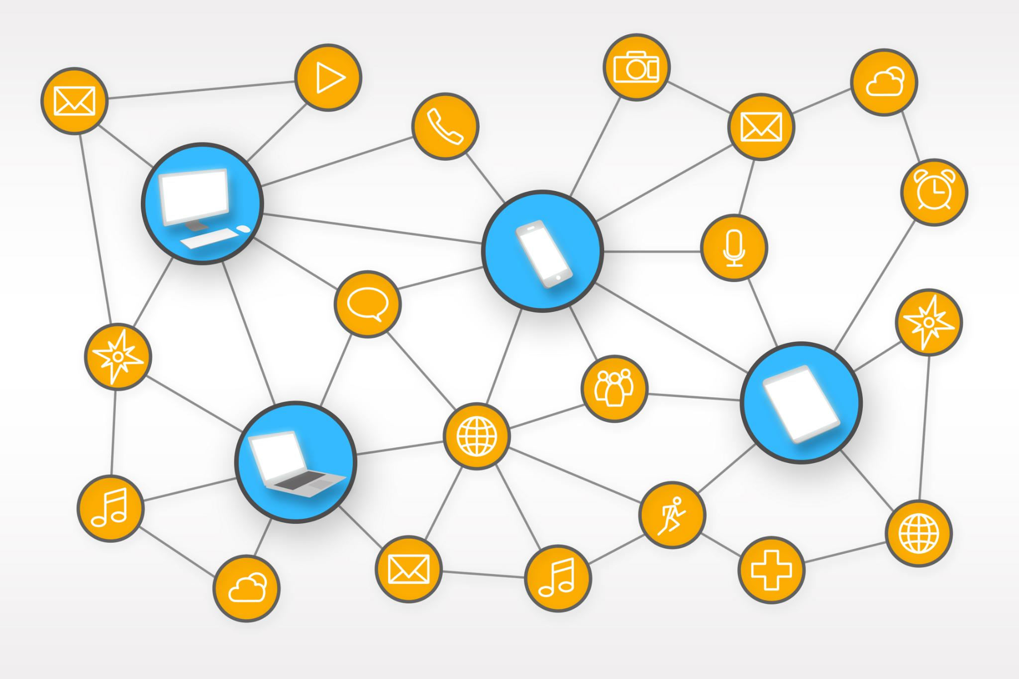
Multibranch Pipeline and Docker Integration
Multibranch Pipelines
  Automatically creates pipelines for each repository branch to support parallel development and custom configurations.
Docker Integration
  Runs builds and tests inside Docker containers, ensuring consistent and portable environments.
Docker Plugin Features
  Enables building images, deploying containers, and pushing images to registries, enhancing CI/CD workflows.
Notes:
Multibranch pipelines automatically create a pipeline for each branch in a repository, enabling concurrent development and environment-specific configurations. Docker integration in Jenkins pipelines allows builds and tests to run inside containers, ensuring consistency and portability. The Docker plugin facilitates building images, deploying containers, and pushing images to registries, streamlining CI/CD workflows for containerized applications.

Slide 14
Security and Administration
Notes:
Authentication and Authorization, Backup and Maintenance

Slide 15
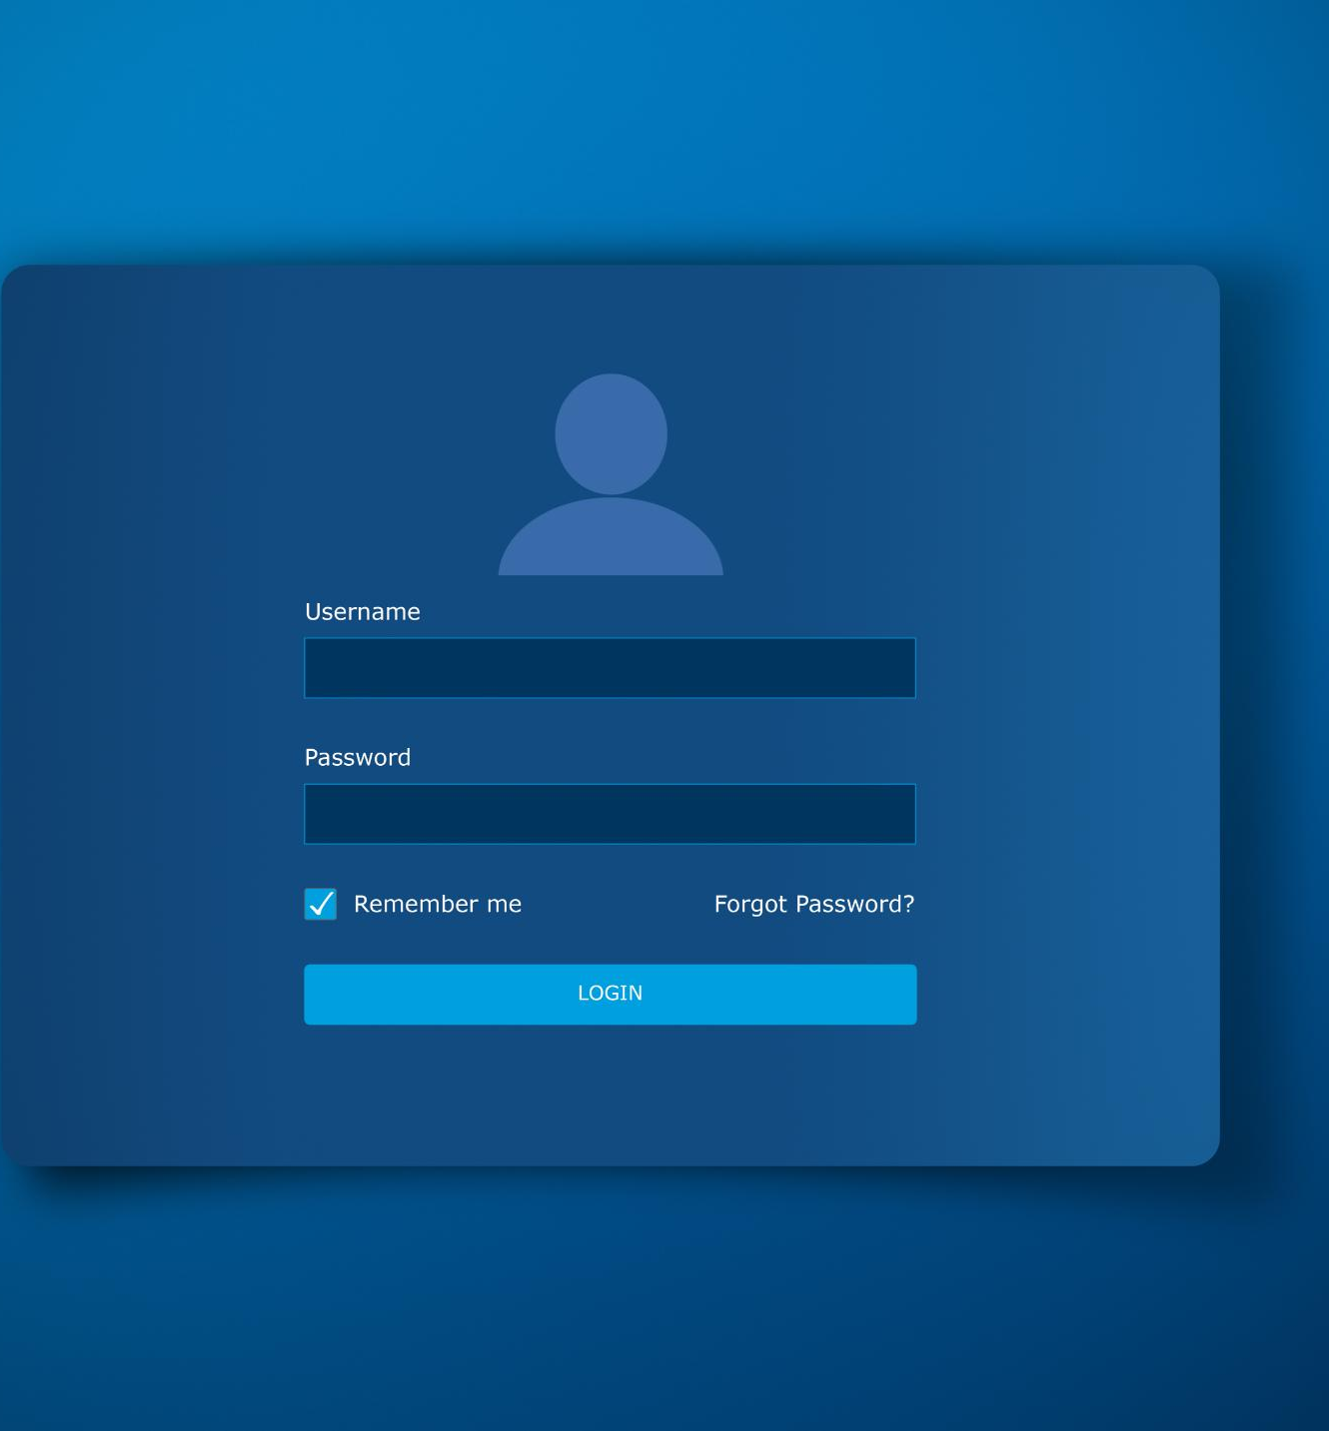
Authentication and Authorization
Authentication Controls
  Authentication verifies user identity to ensure only authorized users access Jenkins.
Authorization Management
  Authorization defines user roles and permissions to control access to Jenkins resources.
Role-Based Plugins
  Plugins like Role-based Authorization Strategy provide granular access control for securing jobs and data.
Notes:
Jenkins provides robust security features through Global Security Configuration, enabling authentication and authorization controls. Authentication ensures only verified users can access Jenkins, while authorization defines user roles and permissions. Plugins like Role-based Authorization Strategy allow granular control over access, safeguarding critical jobs and sensitive data. These measures are essential for maintaining a secure CI/CD environment.

Slide 16

Backup and Maintenance
Importance of Regular Backups
  Regular backups protect Jenkins configurations and job data from loss and enable quick recovery.
Backup Plugins Usage
  Plugins like Thin Backup and Backup and Restore allow scheduled and manual data backups for Jenkins.
Monitoring with Logging Plugins
  Logging and build metrics plugins help monitor Jenkins performance and troubleshoot issues effectively.
Ensuring System Reliability
  Backup and maintenance practices ensure system stability and quick recovery from potential failures.
Notes:
Regular backups and maintenance are crucial for Jenkins administration. Plugins such as Thin Backup and Backup and Restore facilitate scheduled and manual backups of Jenkins configurations and job data. Logging and build metrics plugins help monitor performance and troubleshoot issues effectively. These practices ensure system reliability and quick recovery in case of failures.

Slide 17
Key Takeaways
Notes:
Summary of Jenkins Pipeline Concepts

Slide 18

Summary of Jenkins Pipeline Concepts
Pipeline Syntax Types
  Jenkins pipelines support both scripted and declarative syntax styles, offering flexibility in defining workflows.
Tool Integration
  Pipelines seamlessly integrate with tools like Docker, enabling containerized build and deployment processes.
Advanced Pipeline Features
  Multibranch pipelines allow managing multiple branches, improving automation and workflow scalability.
Security and Management
  Security settings, Jenkinsfile management, and plugin use enhance pipeline reliability and secure software delivery.
Notes:
Jenkins pipelines provide a powerful mechanism for automating CI/CD workflows. They support both scripted and declarative syntaxes, integrate with tools like Docker, and enable advanced features such as multibranch pipelines. Security configurations, Jenkinsfile management, and plugin integrations further enhance flexibility and reliability. By leveraging these capabilities, teams can achieve faster, consistent, and secure software delivery.

