Slide 1
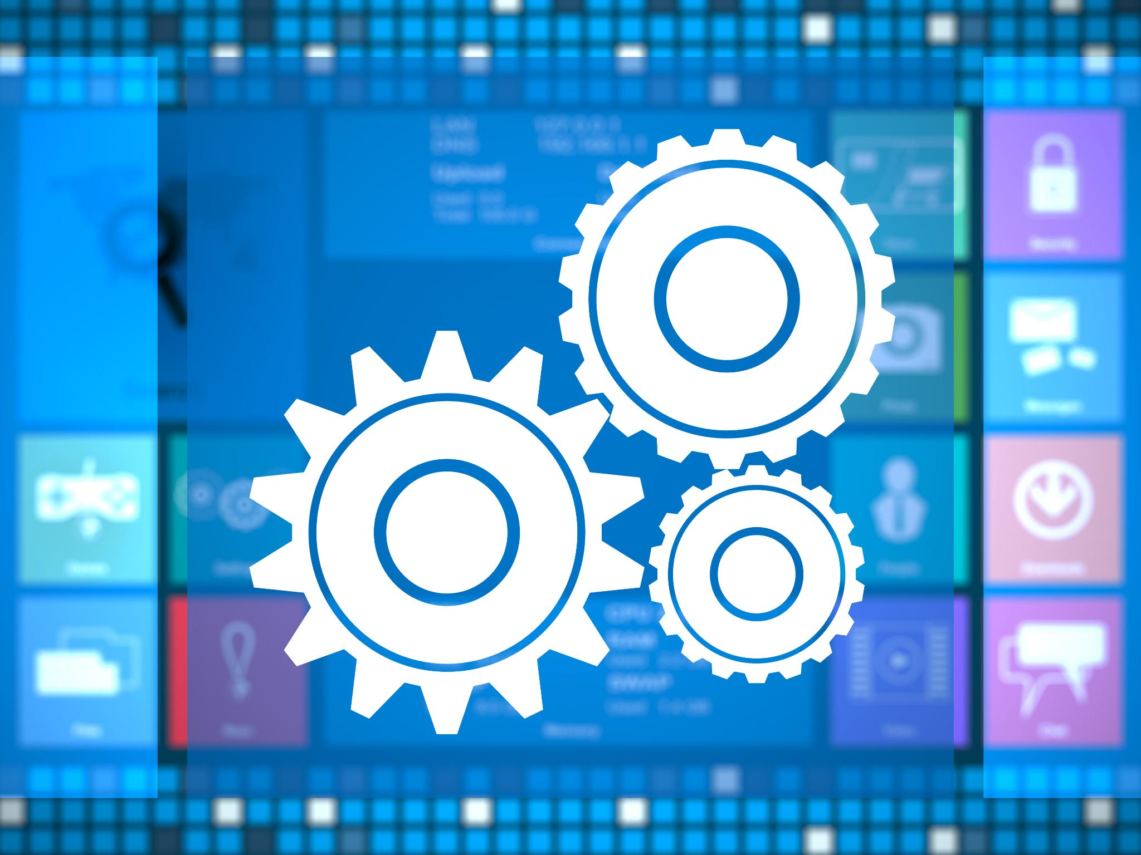
Jenkins Job and Plugins
Enhancing automation through customizable workflows
Notes:
---

Slide 2
Learning Objectives
Notes:
Goals of the Lesson

Slide 3
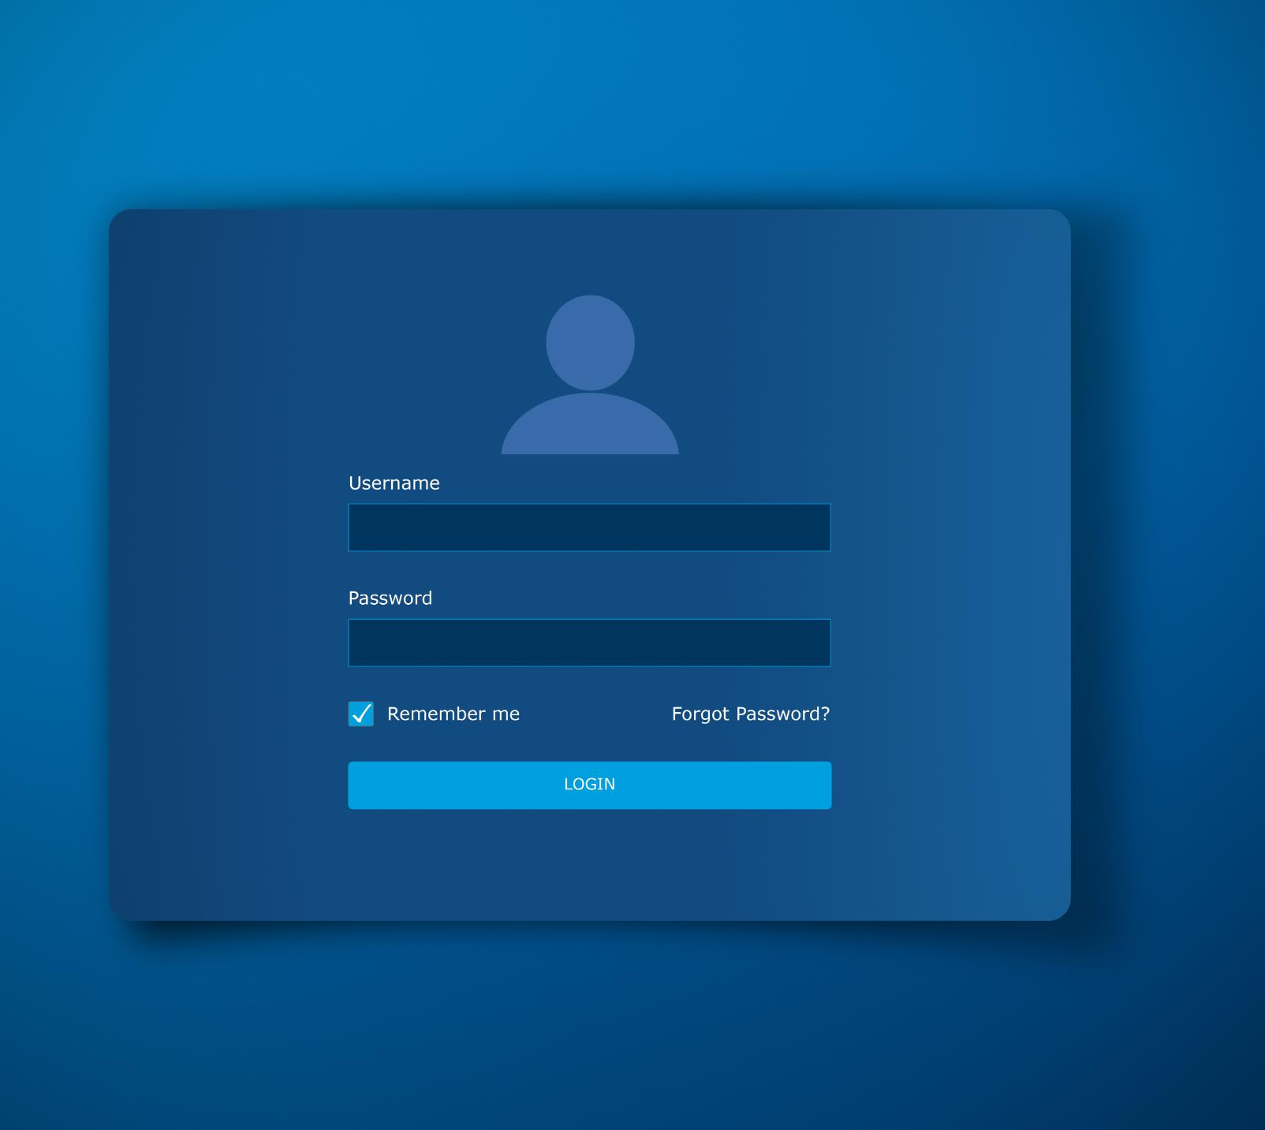
Goals of the Lesson
Jenkins Job Configuration
  Learn to configure Jenkins jobs to automate build, test, and deployment stages effectively.
Plugin Usage and Integration
  Understand how to use Jenkins plugins to automate tasks and integrate with other development tools.
Jenkins Architecture Overview
  Outline key architectural components for scalable and robust CI/CD automation with Jenkins.
Freestyle Job Sections
  Identify and use Jenkins freestyle job sections to streamline CI/CD practices effectively.
Notes:
By the end of this lesson, learners should be able to configure Jenkins jobs effectively to automate building, testing, and deploying applications at various stages of development. They will understand how to employ Jenkins plugins for automating tasks and integrating with other tools in the software development pipeline. Additionally, learners will outline key architectural components within Jenkins for robust and scalable CI/CD automation. Finally, they will identify and utilize Jenkins freestyle job sections efficiently to implement CI/CD practices and streamline software development processes. These objectives ensure that participants gain practical knowledge of Jenkins job configuration, plugin management, and integration strategies essential for modern DevOps workflows.

Slide 4
Jenkins Job Configuration
Notes:
Introduction and Types of Jenkins Jobs

Slide 5

Introduction and Types of Jenkins Jobs
Jenkins Job Overview
  Jenkins jobs automate software building and deployment using predefined tasks and triggers.
Freestyle and Maven Jobs
  Freestyle jobs provide flexible general-purpose builds; Maven jobs handle projects using Maven and POM files.
External and Multi-configuration Jobs
  External jobs monitor non-interactive processes; multi-configuration jobs test across environments and settings.
Notes:
A Jenkins job is a predefined set of instructions or tasks within Jenkins that automates software processes such as building and deploying applications. Jobs ensure consistent execution based on configured triggers and parameters. Jenkins supports multiple job types, including Freestyle projects, Maven projects, External jobs, and Multi-configuration jobs. Freestyle jobs offer maximum flexibility and are suitable for general-purpose builds, while Maven jobs simplify builds for projects using the Maven build tool by interpreting POM files. External jobs monitor non-interactive processes like Cron jobs, enabling integration with external systems. Multi-configuration jobs, also known as matrix jobs, allow testing across different environments and configurations, making them ideal for complex testing scenarios.

Slide 6
Job Import Plugin
Notes:
Purpose and Workflow

Slide 7
Purpose and Workflow
Job Import Purpose
The plugin eliminates manual job recreation, saving time and reducing configuration errors during migration.
Migration Workflow
Install plugin on source and target, configure credentials, fetch jobs, and select jobs to import.
Benefits of Plugin
Ensures consistency, reduces errors, and streamlines environment setup during upgrades or disaster recovery.
Notes:
The Job Import Plugin in Jenkins is a valuable tool that simplifies the migration of jobs from one Jenkins server to another. Its primary purpose is to eliminate the need for manually recreating complex job configurations, saving time and reducing errors. The workflow involves installing the plugin on both source and target servers, configuring access credentials, fetching the list of jobs from the source server, and selecting which jobs to import. This process ensures identical job configurations across environments, promoting consistency in CI/CD pipelines. Benefits include efficient migration during upgrades or disaster recovery, error reduction, and streamlined setup of new environments.

Slide 8
Jenkins Plugins
Notes:
Types and Management

Slide 9

Types and Management
Jenkins Plugin Types
  Plugins include Build Steps, Build Wrappers, SCM, Notifiers, Pipeline, and UI enhancements, extending Jenkins functionality.
Importance of Plugin Management
  Managing plugins effectively is essential for stable and secure CI/CD pipelines in Jenkins.
Key Management Tasks
  Installing, updating, uninstalling plugins, and configuring settings tailor Jenkins to project needs.
Notes:
Jenkins plugins extend the core functionality of Jenkins by integrating with tools such as Git, Maven, and Docker, enhancing automation capabilities. Plugins are categorized into types like Build Steps, Build Wrappers, SCM (Source Code Management), Notifiers, Pipeline, and UI enhancements. Effective plugin management is crucial for maintaining a stable CI/CD pipeline. Key tasks include installing new plugins to add functionality, updating existing plugins for compatibility and security, uninstalling unused plugins to reduce conflicts, and configuring plugin settings to tailor behavior to project needs. Proper management ensures Jenkins remains secure, efficient, and adaptable to evolving requirements.

Slide 10
Freestyle Job Sections
Notes:
Core Components and Configuration

Slide 11

Core Components and Configuration
User-Friendly Job Setup
  Freestyle jobs offer an intuitive interface for build configuration without fixed pipeline constraints.
Dynamic Build Parameters
  Parameters like Boolean, Choice, File, and Credentials enable flexible input during job execution.
Version Control Integration
  SCM integration with systems such as Git or SVN automates source code retrieval for builds.
Automation and Post-Build Tasks
  Build triggers automate job execution; post-build actions manage tasks like artifact archiving and notifications.
Notes:
Freestyle jobs in Jenkins provide a user-friendly interface for configuring builds without predefined pipeline structures. Key sections include General, Build Parameters, SCM, Build Triggers, Build Steps, and Post-build Actions. The General section defines job name, description, and build retention policies. Build Parameters allow dynamic input values such as Boolean, Choice, File, and Credentials. SCM integrates version control systems like Git or SVN, enabling automated code retrieval. Build Triggers automate job execution based on events like Git webhooks or scheduled intervals. Build Steps execute tasks such as compiling code or running scripts, while Post-build Actions handle tasks like archiving artifacts or sending notifications. These sections collectively enable flexible and comprehensive job configuration.

Slide 12
Notifications in Jenkins
Notes:
Email and Slack Integration

Slide 13

Email and Slack Integration
Email Notifications in Jenkins
  The Email plugin enables customized notifications for build events, supporting multiple recipients and dynamic content.
Extended Email Features
  The Extended Email Notification plugin allows advanced customization and logging for detailed build event communication.
Slack Real-Time Alerts
  Slack integration delivers real-time notifications in team channels, enhancing collaboration and quick responses.
Configuration and Benefits
  Setting up SMTP for email and specifying Slack channels ensures timely communication and better CI/CD visibility.
Notes:
Jenkins supports notifications to keep stakeholders informed about build statuses. The Email plugin allows customized notifications for build events like successes and failures, supporting dynamic content and multiple recipients. The Extended Email Notification plugin (Email-ext) enhances these capabilities by enabling advanced customization and logging. Slack integration provides real-time notifications within team communication channels, improving collaboration and response times. Configuring these plugins involves setting up SMTP for email or specifying Slack channels and triggers for notifications. Effective use of notifications ensures timely communication, faster issue resolution, and improved visibility into CI/CD processes.

Slide 14
Key Takeaways
Notes:
Summary of Concepts

Slide 15
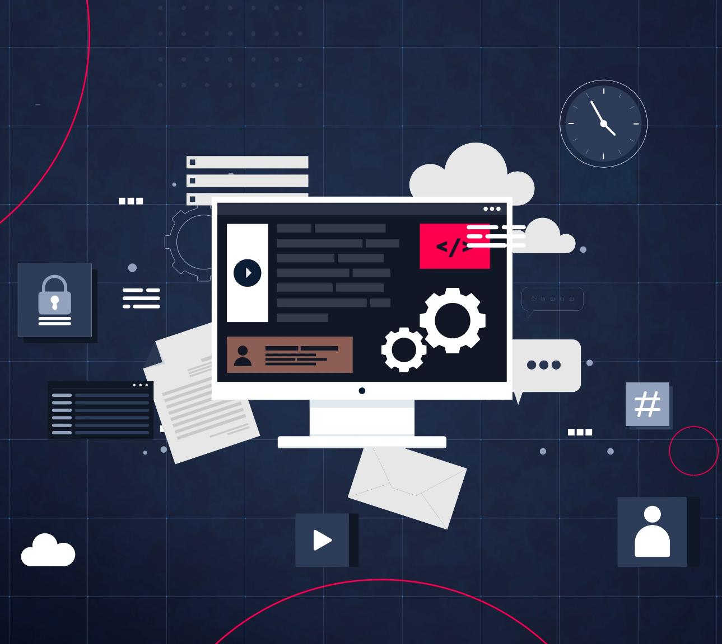
Summary of Concepts
Jenkins Jobs Flexibility
  Freestyle jobs provide versatile options to configure builds tailored to project needs.
Plugins Extend Capabilities
  Plugins enable Jenkins to integrate with various tools, enhancing functionality and automation.
Effective Plugin Management
  Managing plugins ensures security, compatibility, and smooth operation of automation workflows.
Notifications and Collaboration
  Email and Slack notifications improve team communication and collaboration during builds.
Notes:
Jenkins jobs and plugins form the backbone of automated CI/CD workflows. Freestyle jobs offer flexibility for configuring builds, while plugins extend Jenkins capabilities to integrate with diverse tools and technologies. Effective plugin management ensures security, compatibility, and efficiency. Notifications via email and Slack enhance communication and collaboration. Understanding job sections like SCM, Build Triggers, and Post-build Actions is essential for creating robust automation pipelines. By mastering these concepts, teams can streamline software delivery, reduce manual effort, and maintain high-quality releases.

