Slide 1

Proposal from Rao’s Infosoft Join Pvt Ltd
Ver3.14. Apirl 2024

Slide 2










Our Capabilities
We specialize in the marketing trending tools and technologies
Systems Virtualization
Citrix Implementation Desktop as a Service (DaaS)
Workspace Optimization VMware, ESXi, Redhat
Django/ReactJS Web Development
Serverless Apps
Event-Driven
Architecture with Kafka, Message Queues, and WebSockets
API Design and Development
❖ Systems Integration
❖ Product Lifecycle
Management
❖ Mobile App Development
Assessment & Strategy
CI/CD Pipelines Infrastructure as Code (IaC) Monitoring & Logging Containerization & Orchestration
DevSecOps Toolchain Integration
Server Environment Optimization
Automated Patch Deployment
Scheduled System Maintenance
License Compliance Management
Endpoint Security Enforcement
Real-Time Health
Diagnostics
24/7 System Monitoring
Onperm VMWare , RHEL
Infrastructure-as-a-Service (IaaS)
Information Security Compliance
Management
On perm Infrastructure Orchestration
On perm Infrastructure Automation

Slide 3
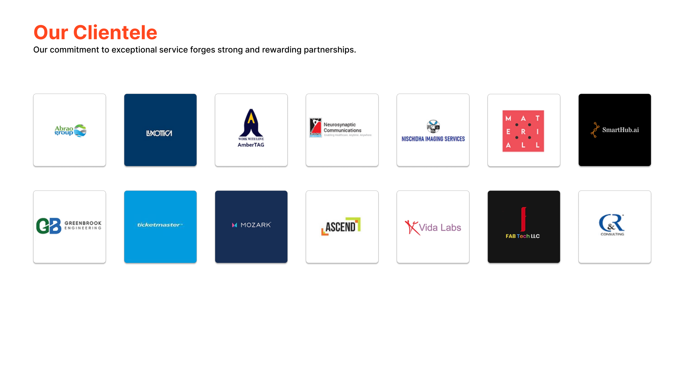
Our Clientele
Our commitment to exceptional service forges strong and rewarding partnerships.

Slide 4
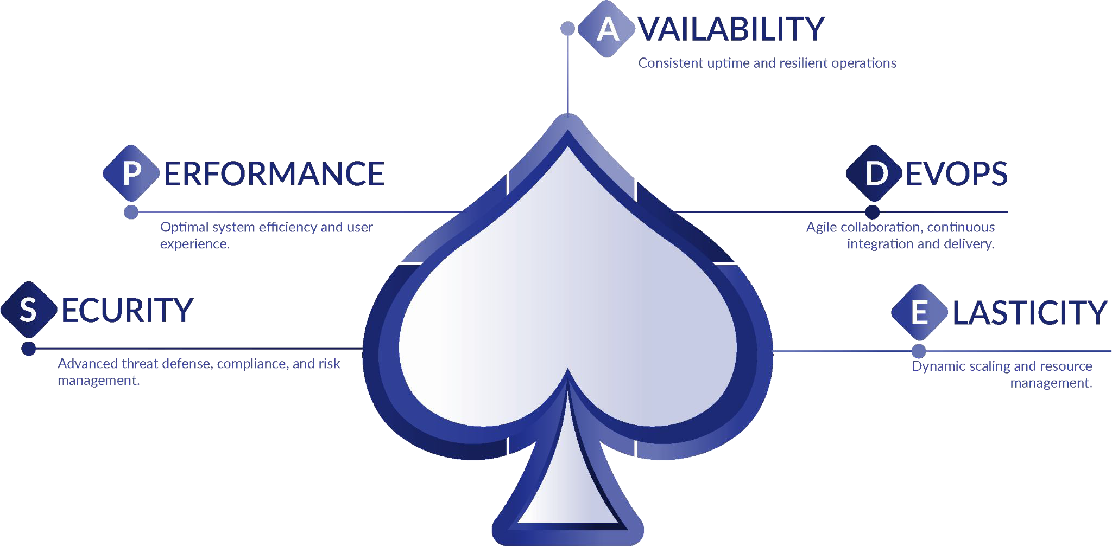
SPADE™ - The Diﬀerence
Our Five-Spoke Engineering Approach to elevate your IT Strategy

Slide 5
Cloud

Slide 6
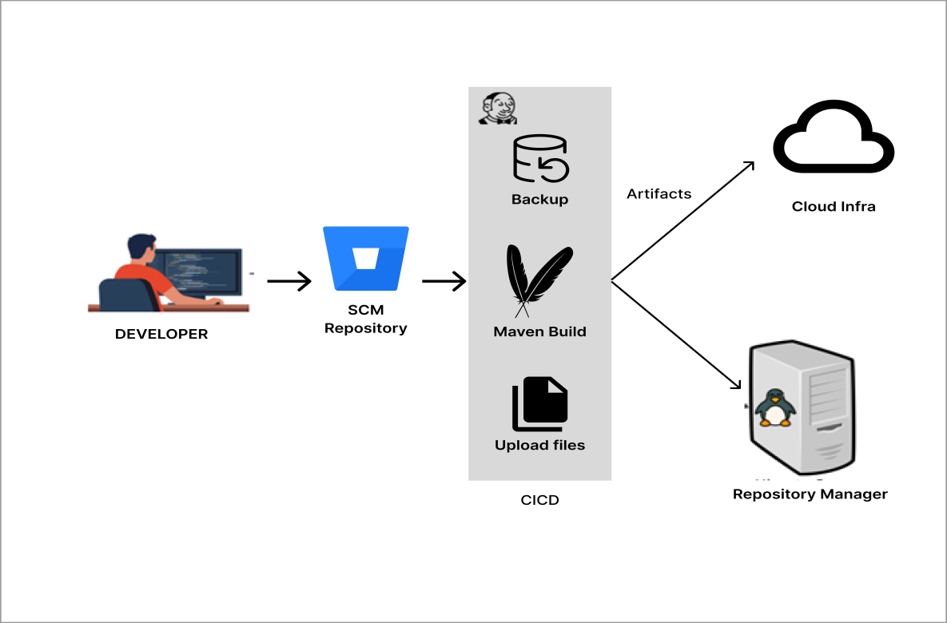
CI/CD Deployment On-Cloud
""Experience seamless automation with our project! Watch as developers commit their code to SCM repository , triggering CI/CD pipeline. Witness CI/CD tool meticulously checking out code, building it with Build Tools, and even taking backups before deploying artifacts to application server. This pipeline effortlessly deploys applications to your AWS/Azure. And that's not all - Jenkins also identifies and deploys newly added and updated schema files to their respective folders to cloud server. Likewise, Streamline your development process with our comprehensive solution."

Slide 7
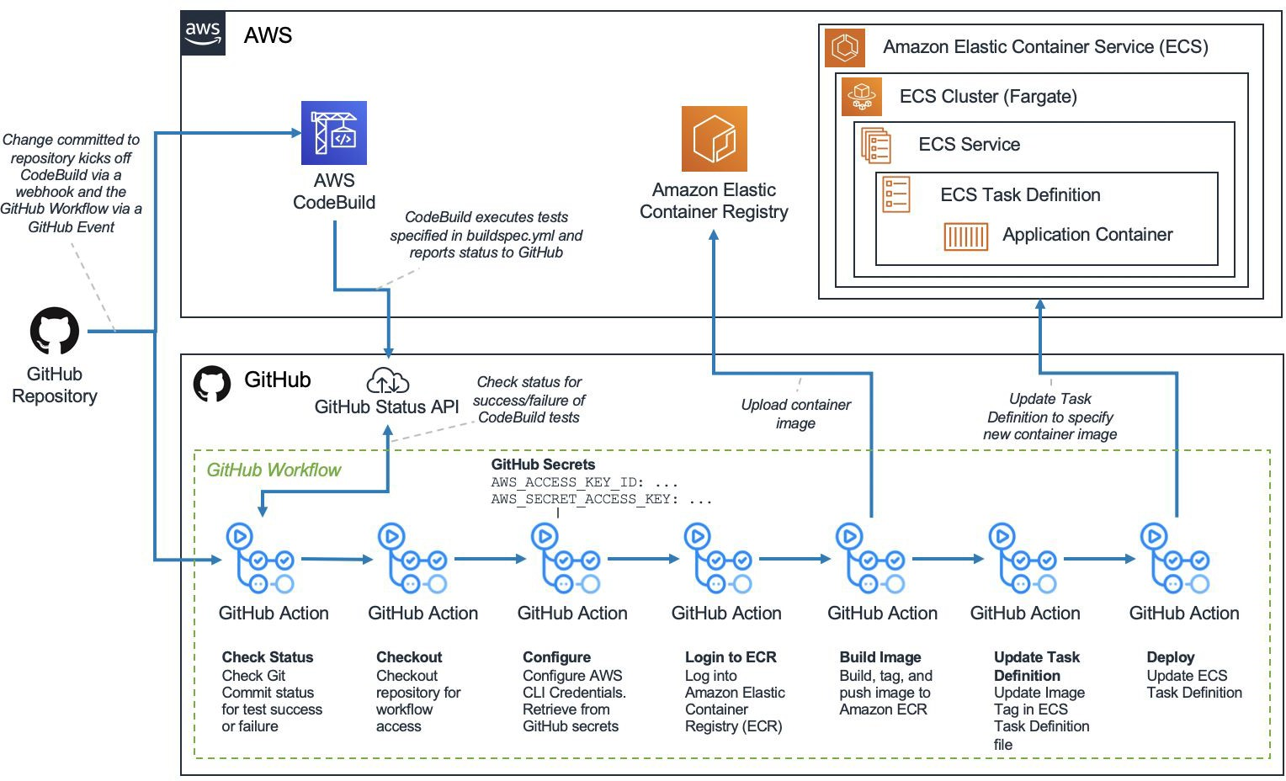










DevOps Processes
Ship Code Faster
CI/CD on AWS with GitHub
Code hosted on GitHub
Unit tests ensure code quality
GitHub CI/CD triggers builds on code push
Docker images built and pushed to ECR
Deployed on ECS Fargate QA
QA environment for Selenium tests
Successful QA merges code to master
Master branch triggers production image
Deployed on ECS Fargate Prod with autoscaling
Streamlined process for rapid market delivery
Our Tools

Slide 8
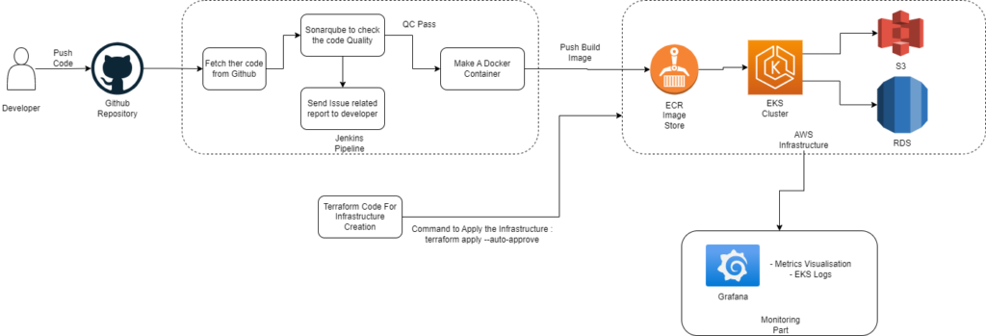
Seamless Deployment using DevSecOps - US Based Client
"This project exemplifies DevSecOps by automating the deployment of a Java Application via Jenkins CI/CD Pipeline. The pipeline conducts thorough bug and vulnerability checks, dockerizes images, and pushes them to AWS ECR. Deployed containers on EKS utilize AWS RDS and S3 buckets for data management. Infrastructure creation in AWS is orchestrated using Terraform. Additionally, Grafana is configured to monitor the EKS cluster, ensuring robust performance and security throughout."

Slide 9
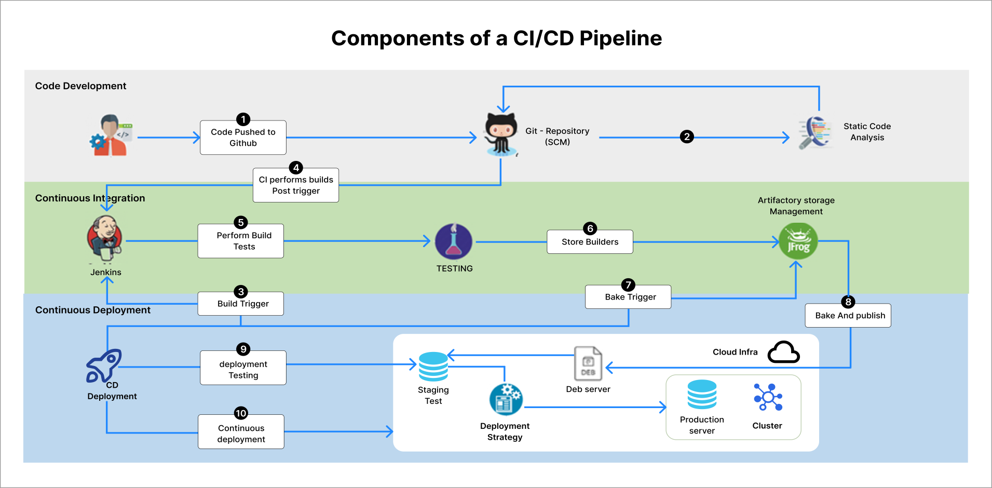
CICD Deployment On-Cloud

Slide 10
On-Prem

Slide 11

CI/CD Deployment On-Prem – Telecom Client US
one click build and deployment
""Experience seamless automation with our project! Watch as developers commit their code to SCM repository , triggering CI/CD pipeline. Witness CI/CD tool meticulously checking out code, building it with Build Tools, and even taking backups before deploying artifacts to application server. This pipeline effortlessly deploys applications to your on-prem Linux server. And that's not all - Jenkins also identifies and deploys newly added and updated schema files to their respective folders to on-prem server. Likewise, Streamline your development process with our comprehensive solution."

Slide 12

CICD Deployment On-Prem - T-Mobile, US
one click build and deployment

Slide 13
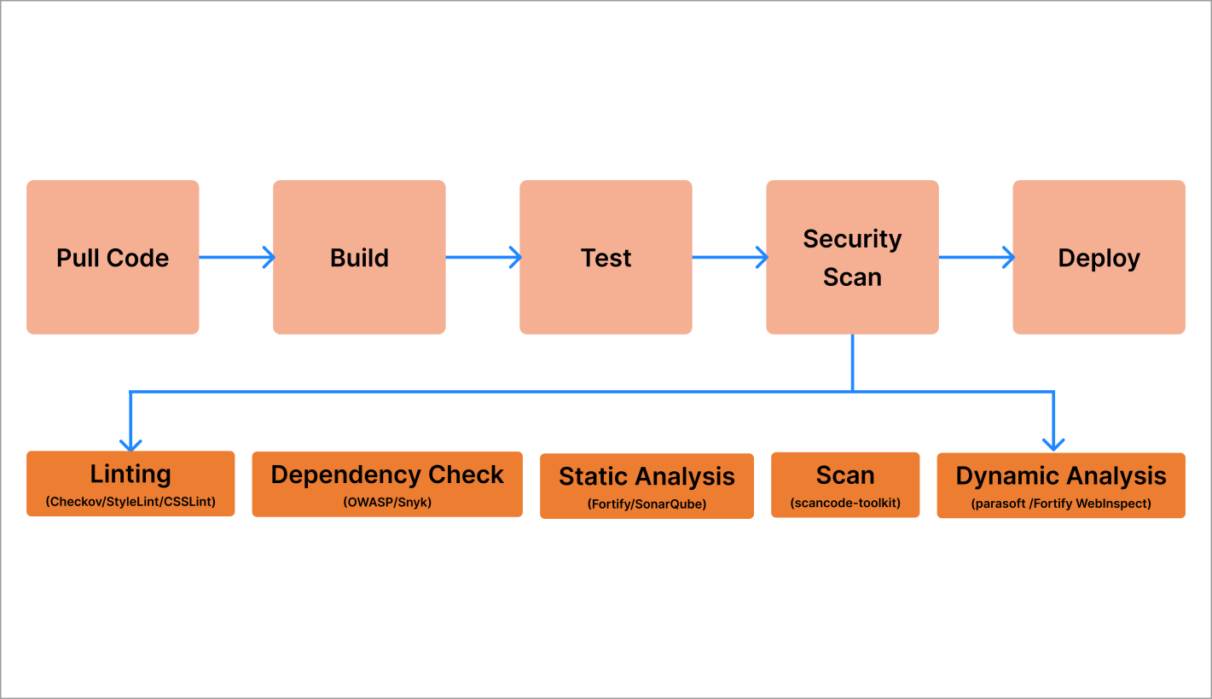
Seamless Deployment using DevSecOps - US Based Client
integrated code scans
"This project exemplifies DevSecOps by automating the deployment of any Application via CI/CD Pipeline. The pipeline conducts thorough bug and vulnerability checks, creates deployable artifacts, and pushes them to on Prem server.

Slide 14
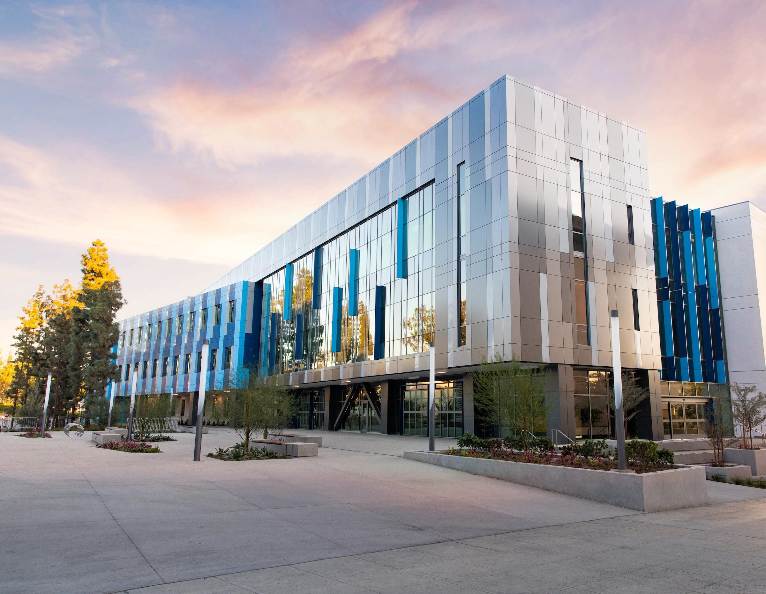

Contact Us
ADDRESS
EMAIL
Murdeswar Arcade, 1140, Marenahalli Rd, Putlanpalya, Jayanagara 9th Block, Jayanagar, Bengaluru, Karnataka 560069
suthindran.rao@infosoftjoin.in
PHONE
+91 98808 39078

