Slide 1

Proposal from Rao’s Infosoft Join Pvt Ltd
Ver3.14. Apirl 2024

Slide 2










Our Capabilities
We specialize in the marketing trending tools and technologies
Systems Virtualization
Citrix Implementation Desktop as a Service (DaaS)
Workspace Optimization VMware, ESXi, Redhat
Django/ReactJS Web Development
Serverless Apps
Event-Driven
Architecture with Kafka, Message Queues, and WebSockets
API Design and Development
❖ Systems Integration
❖ Product Lifecycle
Management
❖ Mobile App Development
Assessment & Strategy
CI/CD Pipelines Infrastructure as Code (IaC) Monitoring & Logging Containerization & Orchestration
DevSecOps Toolchain Integration
Server Environment Optimization
Automated Patch Deployment
Scheduled System Maintenance
License Compliance Management
Endpoint Security Enforcement
Real-Time Health
Diagnostics
24/7 System Monitoring
Onperm VMWare , RHEL
Infrastructure-as-a-Service (IaaS)
Information Security Compliance
Management
On perm Infrastructure Orchestration
On perm Infrastructure Automation

Slide 3
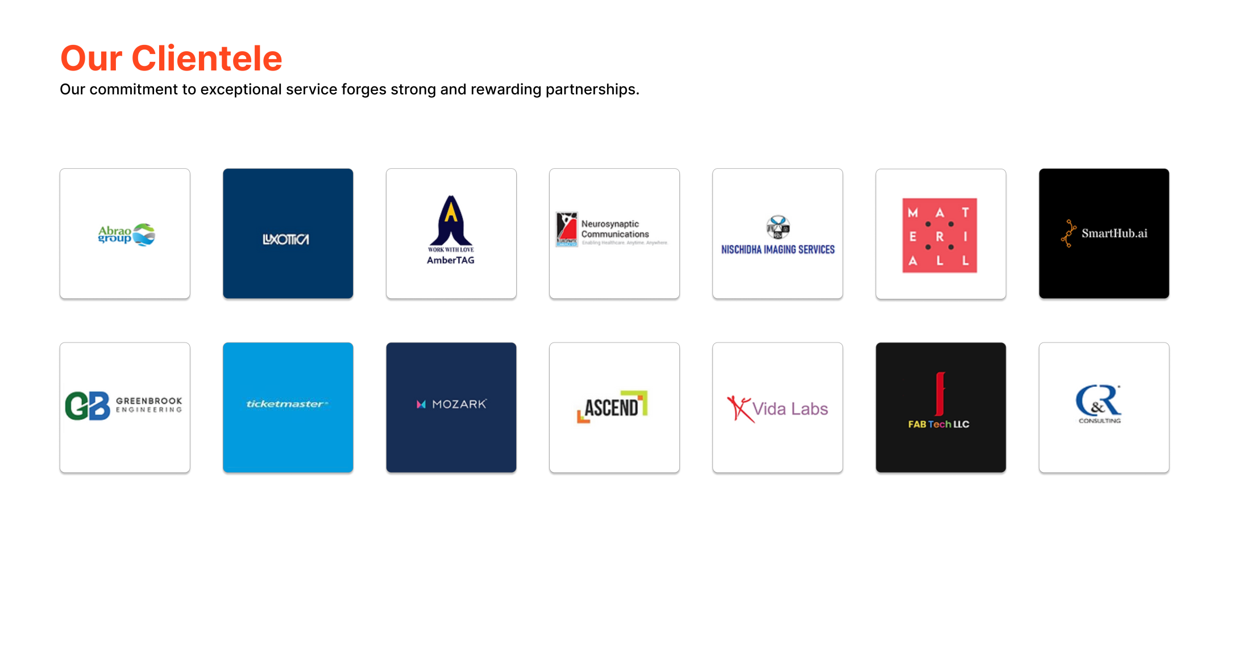
Our Clientele
Our commitment to exceptional service forges strong and rewarding partnerships.

Slide 4
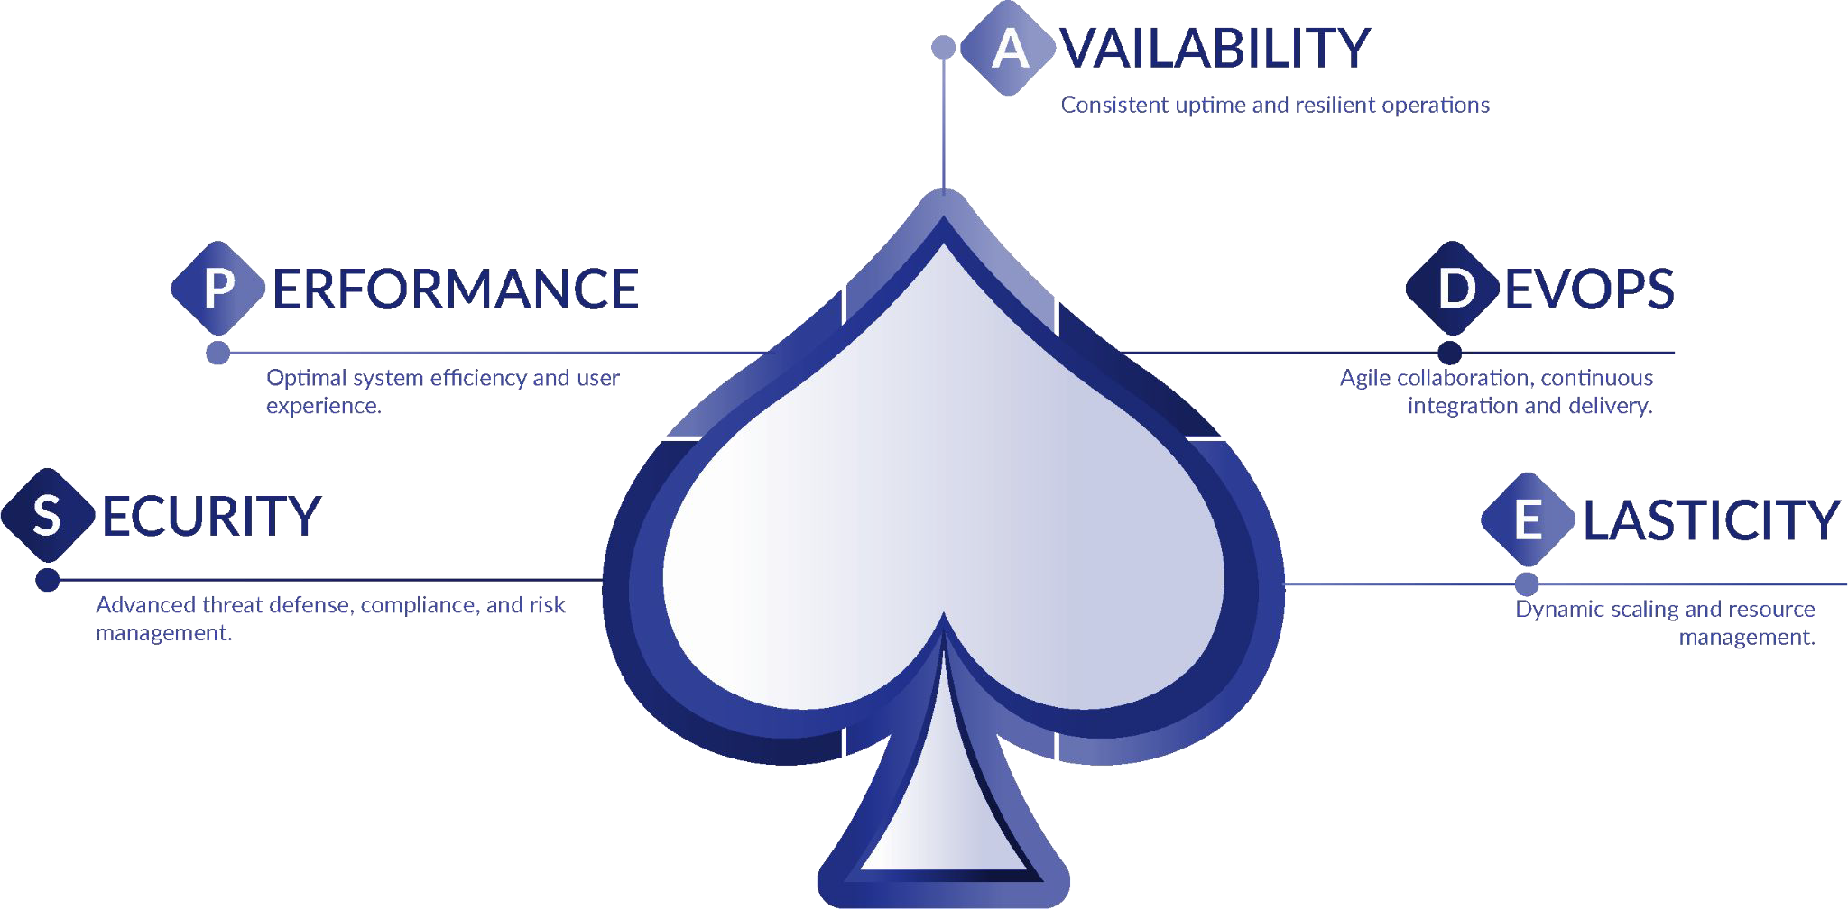
SPADE™ - The Diﬀerence
Our Five-Spoke Engineering Approach to elevate your IT Strategy

Slide 5
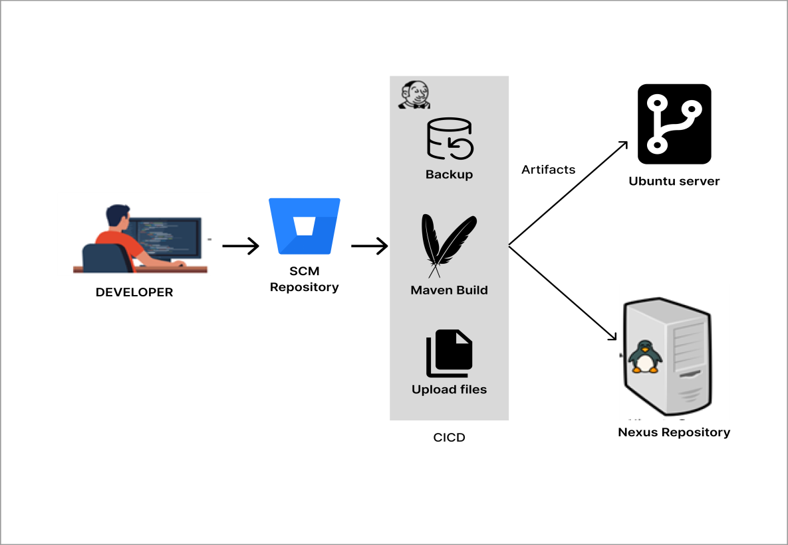
CI/CD Deployment On-Prem – Telecom Client US
one click build and deployment
""Experience seamless automation with our project! Watch as developers commit their code to SCM repository , triggering CI/CD pipeline. Witness CI/CD tool meticulously checking out code, building it with Build Tools, and even taking backups before deploying artifacts to application server. This pipeline effortlessly deploys applications to your on-prem Linux server. And that's not all - Jenkins also identifies and deploys newly added and updated schema files to their respective folders to on-prem server. Likewise, Streamline your development process with our comprehensive solution."

Slide 6
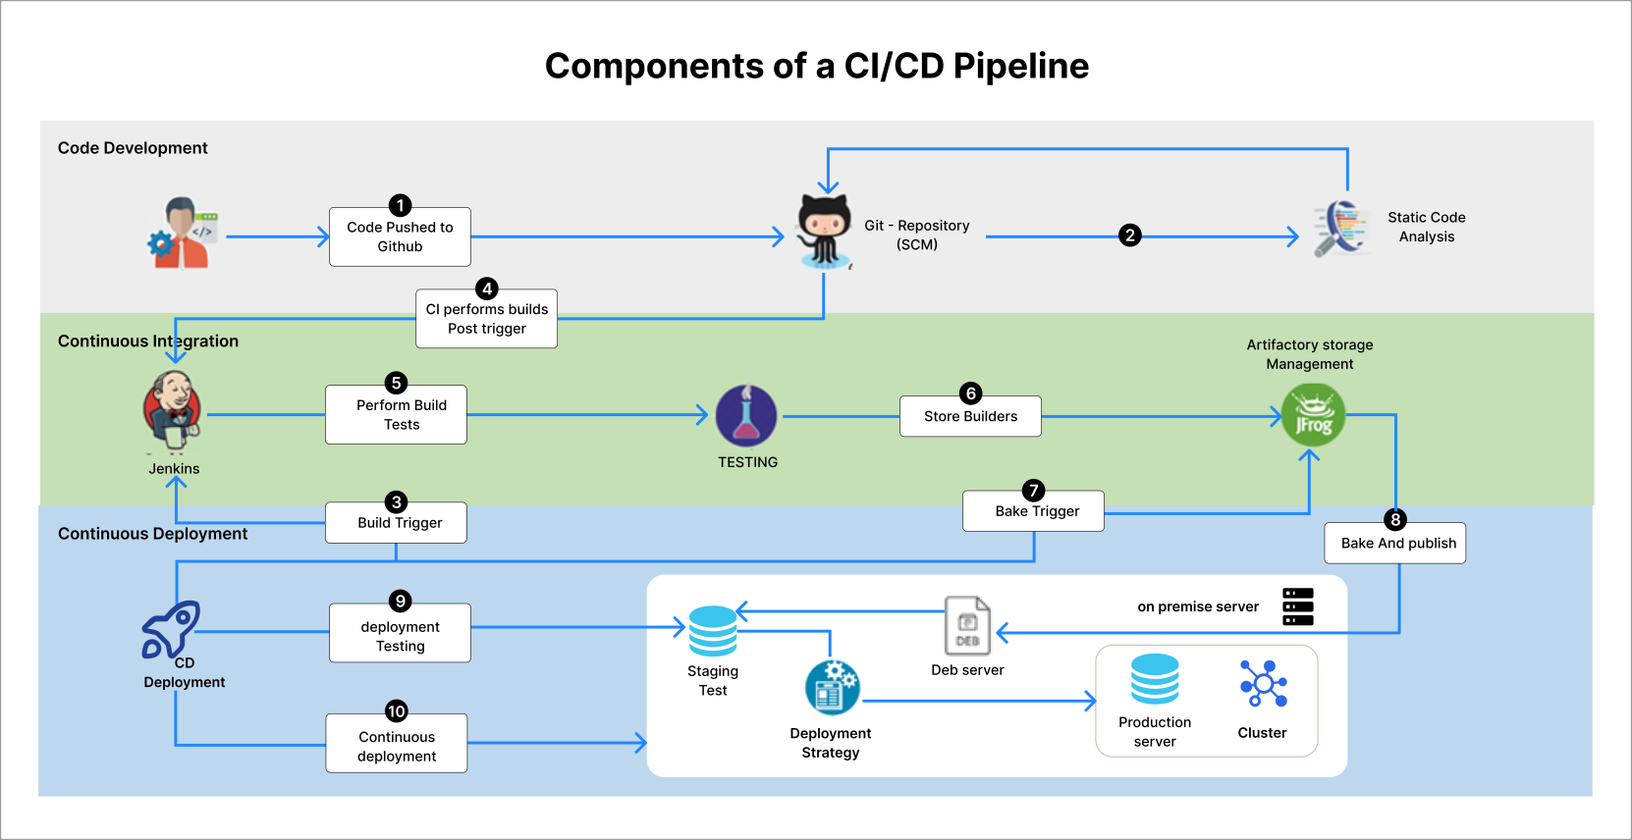
CICD Deployment On-Prem - T-Mobile, US
one click build and deployment

Slide 7
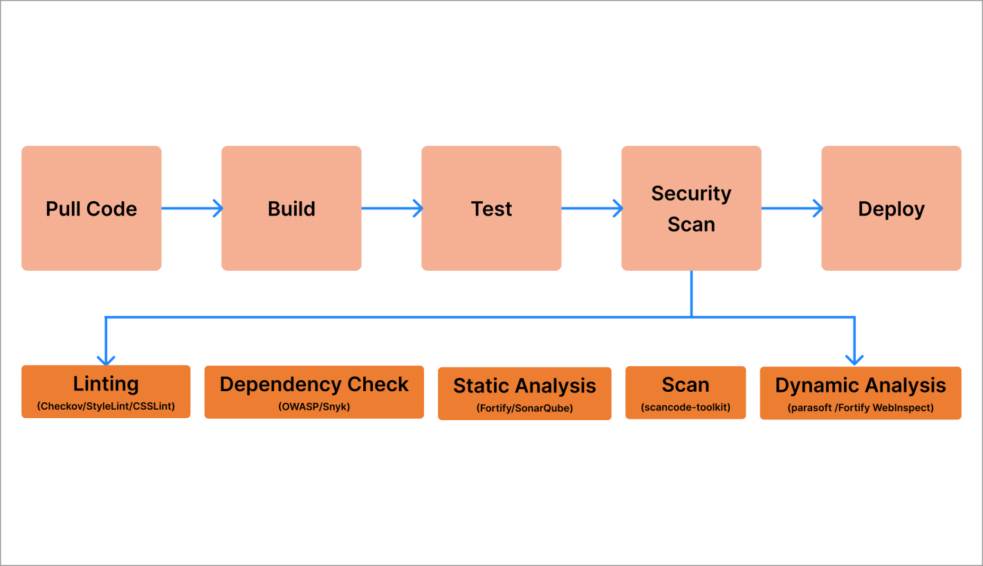
Seamless Deployment using DevSecOps - US Based Client
integrated code scans
"This project exemplifies DevSecOps by automating the deployment of any Application via CI/CD Pipeline. The pipeline conducts thorough bug and vulnerability checks, creates deployable artifacts, and pushes them to on Prem server.

Slide 8
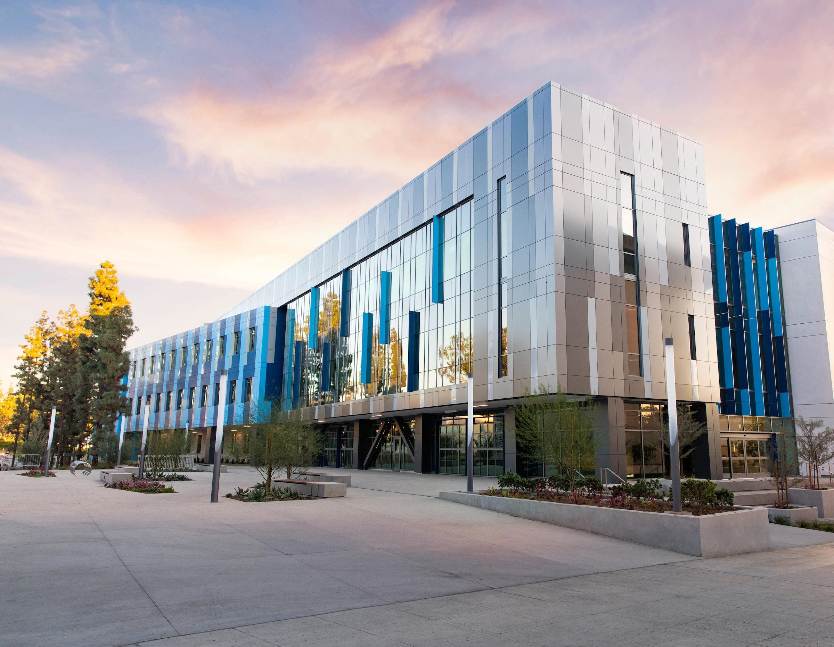

Contact Us
ADDRESS
EMAIL
Murdeswar Arcade, 1140, Marenahalli Rd, Putlanpalya, Jayanagara 9th Block, Jayanagar, Bengaluru, Karnataka 560069
suthindran.rao@infosoftjoin.in
PHONE
+91 98808 39078

