Slide 1
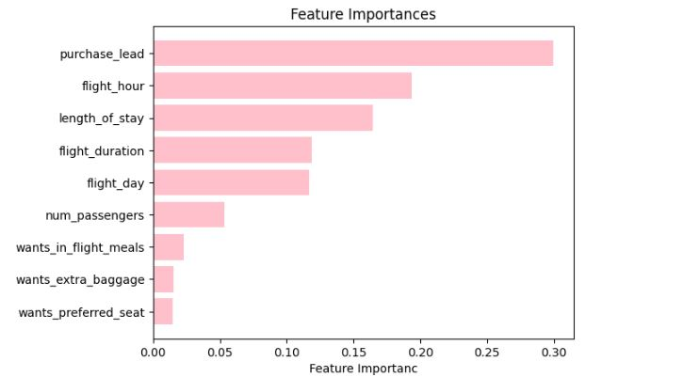
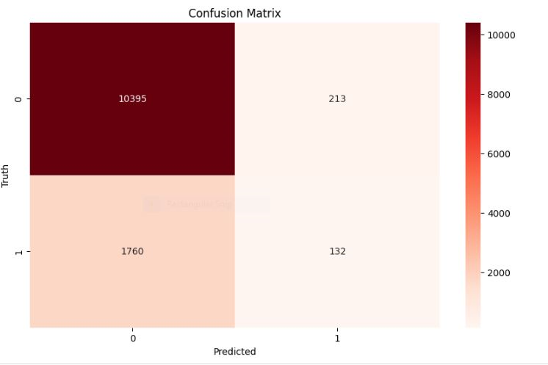

After analyzing and modeling the customers bookings data, we conclude
99.2% accuracy on the given dataset.
Purchase lead, flight hour and length of stay has the top most contributors for the model decision making process.
The model predictions deviate from the true values by approx. 0.16 degree.
The model correctly classify roughly 84.126% of the data points in the dataset.

