Slide 1
Football Players Stats in Top 5 Leagues 23/24
Dashboard Link:
https://public.tableau.com/views/footballplayersanalysis_17303300164130/PerformanceAnaysis?:language=en-GB&publish=yes&:sid=&:redirect=auth&:display_count=n&:origin=viz_share_link

Slide 2
Introduction
Objective:
Analyze key player metrics across Europe’s top 5 leagues:
Premier League
La Liga
Serie A
Bundesliga
Ligue 1
Provide insights into player performance trends across multiple dimensions (e.g., goals, assists, playing time, expected metrics).
Data Sources: Dataset includes in-depth player stats from the 23/24 season.
Dashboard Purpose:
Facilitate easy exploration of player performance metrics.
Help users identify trends based on player age, playing time, and expected vs. actual performance.

Slide 3
Dataset Overview
Player Information: Name, nationality, position, and age.
Playing Time Metrics: Matches played, minutes played, 90s played.
Performance Metrics:
Goals (Gls), Assists (Ast), G+A (Goals + Assists)
Goals excluding penalties (G-PK) & penalty goals (PK, PKatt)
Expected Metrics:
Expected Goals (xG), Expected Assists (xAG), Non-penalty Expected Goals (npxG)
Disciplinary Records: Yellow and Red Cards (CrdY, CrdR)
Progressive Play Metrics: Progressive Carries (PrgC), Passes (PrgP), and Runs (PrgR)

Slide 4
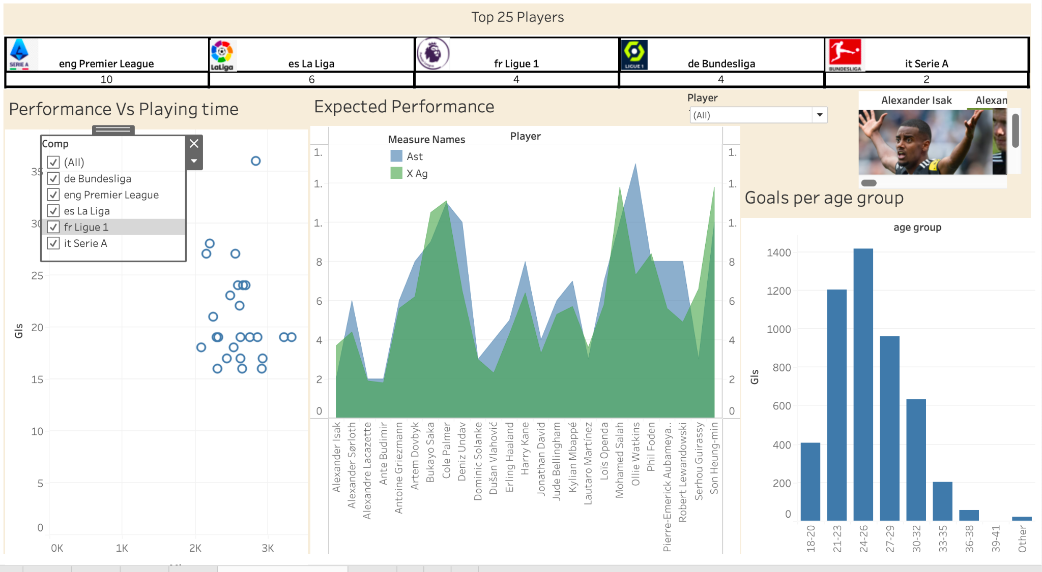
Dashboard

Slide 5
Performance vs PlayerTime
Purpose: Visualize the relationship between total minutes played and goals scored.
Interactive Filters:
Users can filter by competition (league) and position (e.g., DF, MF, FW).
Insights:
Identify outliers, such as players with high goal counts despite fewer minutes.

Slide 6
Expected vs Actual Performance (Area Chart)
Purpose: Compare actual assists (Ast) and expected assists (xAG) for top 25 players.
Visual Elements: Dual-colored area chart with interactive player filters.
Insights:
Assess how well players meet or exceed their expected performance metrics.

Slide 7
Goals by Age Group (Bar Chart)
Purpose: Highlight the distribution of goals across different age groups.
Key Insight:
Players aged 24-29 contribute the highest number of goals.
Useful for talent scouting and understanding peak performance windows.

Slide 8
Insights & Takeaways
Goals vs Playing Time: Players with limited minutes still make significant contributions.
Peak Age Group: Majority of goals are scored by players aged 24-29.
Expected vs Actual Performance: Some players exceed expectations, while others underperform.

