Slide 1
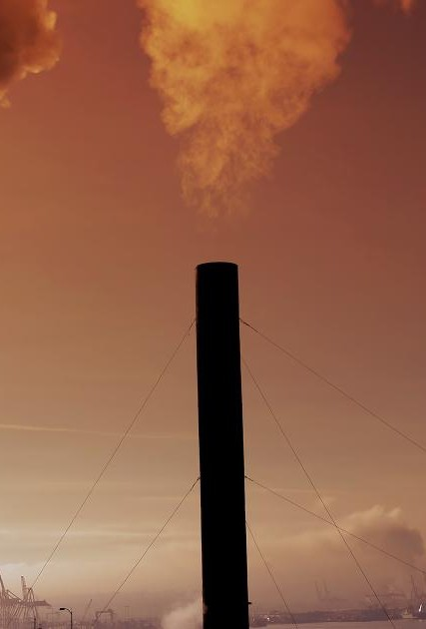


AIR QUALITY INDEX
Nature Presentation
(AQI) PREDICTION
xt
Using Machine Learning on Indian Environmental Data
Presented by Mohd Saif Mohd Fahim Pawan Kumar
www.aqifinder.com

Slide 2
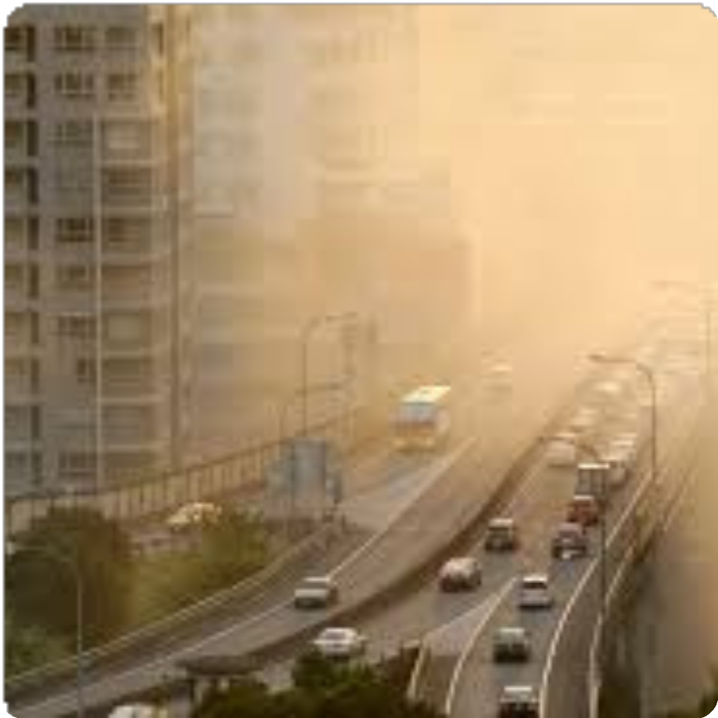
Introduction
Air Quality Index (AQI)
A standardized metric to report daily air quality status.
Importance
Vital for public health, environmental policies, and awareness.
Project Objective
Predict AQI using pollution data from Indian cities.
Goal
Enhance accuracy and reliability of AQI forecasting.

Slide 3

Dataset Overview
Data Source & Location
Source: Kaggle, Air Quality Data in India Combined 5 CSV datasets containing: City-wise air quality measurements
Pollutants: PM2.5, PM10, NO, NO2, NOx, CO, SO2, O3,
Benzene, Toluene, Xylene Target: AQI (Air Quality Index)
Includes extensive spatial coverage from urban to rural areas.

Slide 4
Methodology
1
Data Cleaning
Handled missing values and removed outliers carefully.
2
Feature Engineering
Created new features to improve model inputs.
3
Model Selection
Tested XGBoost, Random Forest, and LSTM algorithms.
4
Training & Validation
Used an 80/20 split for training and validation datasets.
5
Evaluation Metric
Root Mean Squared Error (RMSE) for accurate comparison.
6
Experiment Tracking
Utilized MLflow for model management and tracking.

Slide 5
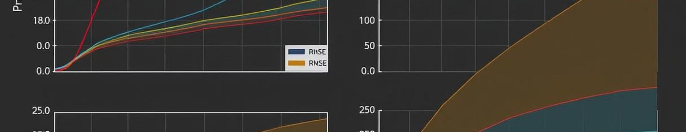
Model Training and Evaluation
XGBoost
Lowest RMSE of 25.7, best predictive accuracy.
LSTM
RMSE of 31.5; needs more data for improvement.
Random Forest
RMSE of 28.1, strong baseline performance.
Feature Importance
PM2.5 and PM10 are the most impactful variables.

Slide 6

RESULTS AND VISUALIZATION
Actual vs Predicted AQI plotted for multiple cities.
Time series charts display trends over time clearly.
Model RMSE
XGBoost 25.7
Random Forest 28.1
LSTM 31.5
Statistical testing confirms significance of results.

Slide 7

Challenges and Solutions
Data Ǫuality
Missing data and sensor noise addressed by imputation and outlier removal.
Model Complexity
Mitigated overfitting using regularization and reduced dimensions.
Interpretability
Analyzed feature importance and SHAP values for transparency.

Slide 8





Conclusion and Future Work
Limitations
Data gaps and limited spatial coverage remain challenges.
Summary
Accurate AQI predictions are achievable with ML methods.
2
1
Future Work
Integrate weather data and satellite imagery for enhancement.
3
Deployment
Plan to build a web application for
public access.
5
Potential Impact
Enable real-time forecasting and public alert systems.
4

Slide 9
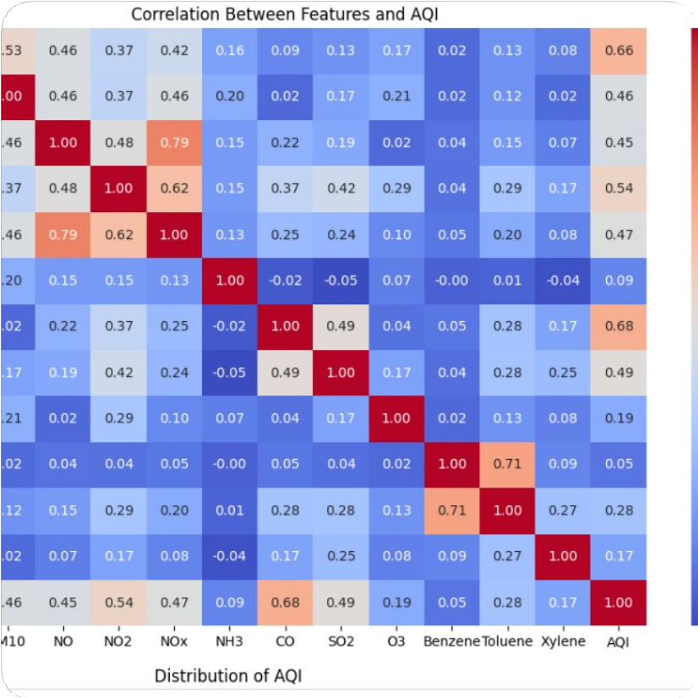
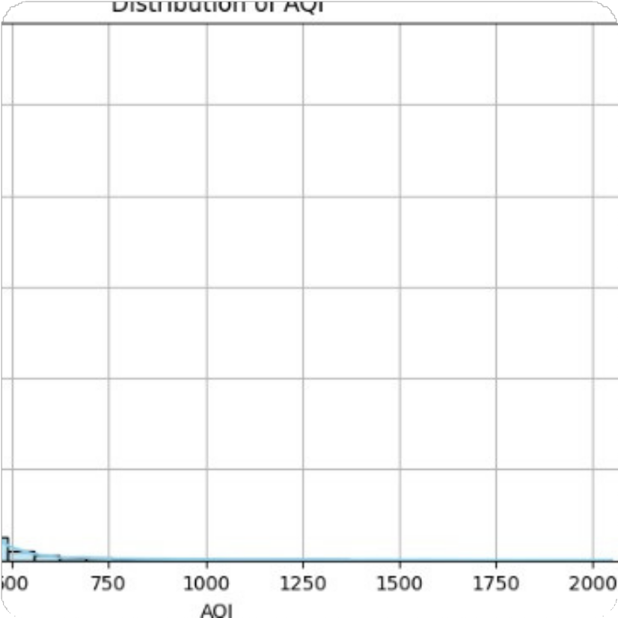
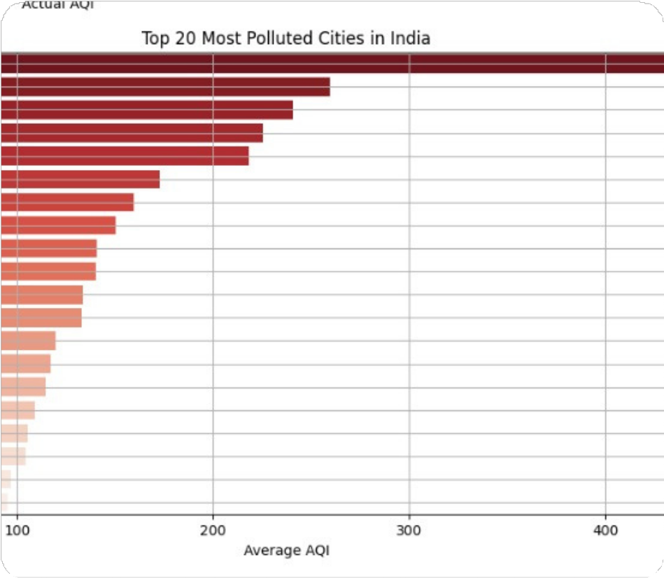
Output/Result & References.
top 20 Polluted city

